Slide 1

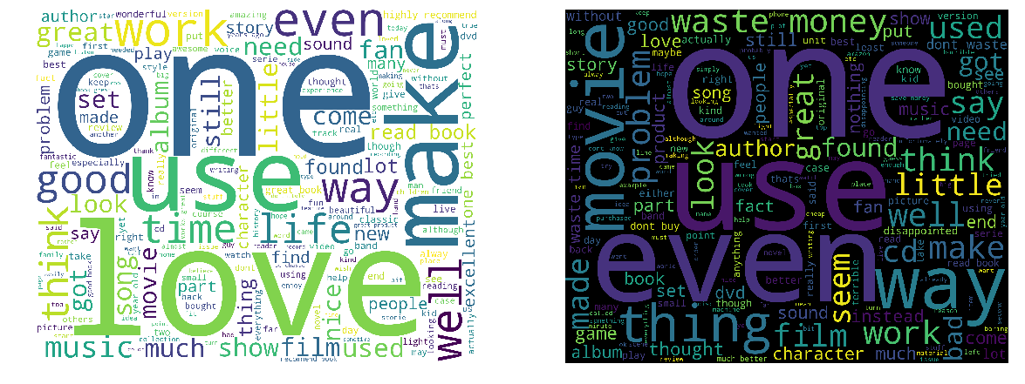
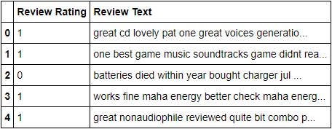
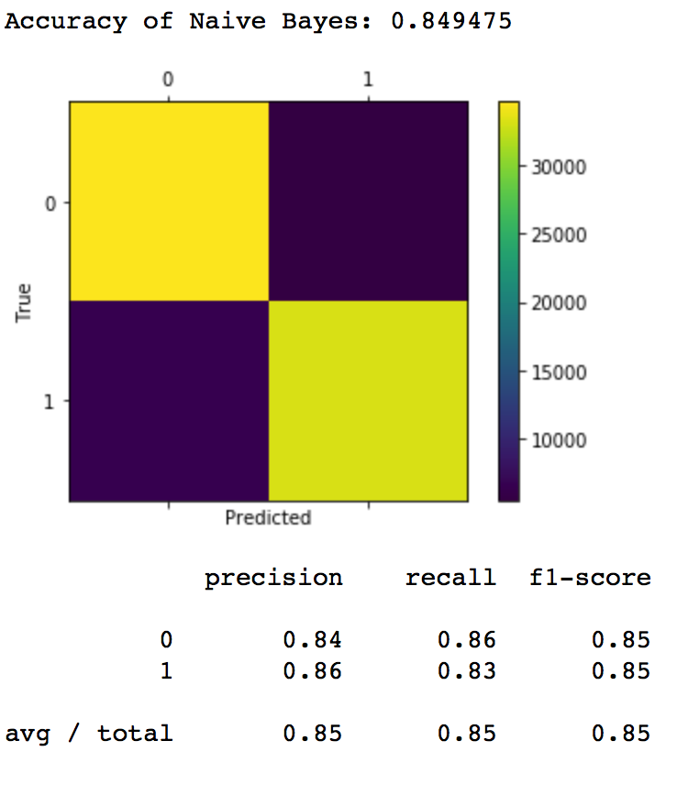
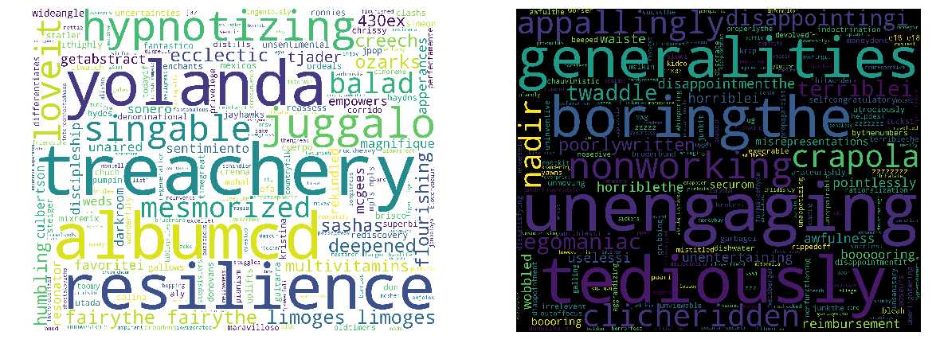
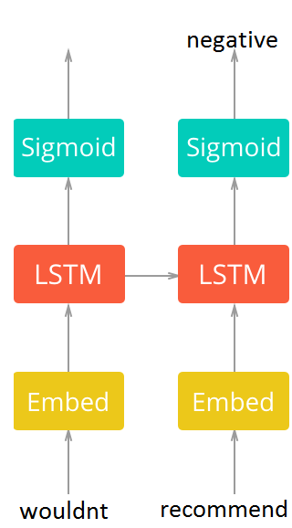
Amazon Review Classifier
Ezgi Tekdemir, Akın İlerle, Ozan Kınasakal Advisor: Ali Taylan Cemgil
Abstract
Preprocessing the Data
Results
In this NLP project, we are trying to classify reviews on Amazon as positive or negative. The dataset consists of English comments and the corresponding ratings. We used Naive Bayes and LSTM as models in order to train the program. At the end, we tested these two models and compared their accuracies.
1 and 2 star ratings = Negative reviews (labeled as 0)
4 and 5 star ratings = Positive reviews (labeled as 1)
3 star ratings = not taken into account
Stopwords and punctuations are eliminated.
All the words are turned into lowercase.
Naive Bayes
Accuracy: 0.8494
LSTM
Accuracy: 0.8009
Figure 3. Head pf the dataframe consisting of ratings and reprocessed comments
Naive Bayes
Figure 1. Words that are most associated with positive and negative reviews
We first calculate the possibility of a word in the train data. Then, we calculate possibility of the word in both positive and negative reviews.
We find the possibility of a sentence being positive by multiplying the word positive possibilities, and same for the negative possibility.
If positive possibility is more than the negative possibility, we classify the sentence as being positive.
If the frequency of a word is less than 100, we do not include it in our analysis so that we get rid of typos.
Figure 4. Confusion Matrix for Naive Bayes
LSTM
Figure 2. Unique words that are most associated with negative and positive reviews
This NN considers order of networks and remembers the previous input.
We used keras to implement LSTM.
We limited the size of training data to 10000 since the training process was very slow.
Fixed length reviews encoded as integers, pad short ones with zeroes.
Pick the last prediction as output
Discussion and Conclusions
Introduction
LSTM would be more successful if we could process data more than 10K.
There are some Spanish sentences in the dataset, however, they are eliminated in feature selection.
The analysis would be better in Naive Bayes if we used a stemmer for inflectional (not derivational) affices. Here, we counted «watch» and «watched» as different words. However, it would take a lot of time on 400K data, so we decided not to.
We definitely need a GPU for large datasets, although 400K is not even that large.
If you work in e-commerce business which promotes thousands of products, or sell a product which has thousands of comments under it in social media, it might be hard to keep track of whether the customers like the product or not. For this binary classification problem, we train our models with 320K Amazon product reviews and test them with 80K. This way, it will be possible to classify a new review as positive and negative automatically.
References
Our dataset: https://www.kaggle.com/bittlingmayer/AmazonReviews
LSTM: https://www.kaggle.com/ngyptr/lstm-sentiment-analysis-keras
Naive Bayes: https://medium.com/@theflyingmantis/text-classification-in-nlp-naive-bayes-a606bf419f8c

