Slide 1


Just Speak It
Turn your own words into English you can speak.
Final Project · Mobile App
Expo · Supabase · OpenAI
Notes:
Just Speak It is a mobile app for practicing the English you personally want to say. Instead of starting with textbook sentences, the learner starts with a real thought from their own day. The app turns that thought into short English cards that can be reviewed again later.
[Sources]
- README.md
- docs/design/app-icon/app-icon-speak-card-v3.png

Slide 2

PROBLEM
02
Textbook English is not always what you want to say
Learners can memorize useful sentences and still struggle to express their own day, opinions, and experiences.
WHAT I STUDY
WHAT I WANT TO SAY
HOW I KEEP PRACTICING
Prepared examples
My real thoughts
A repeatable habit
Useful, but not always personal
My day, opinions, and experiences
Bring each phrase back when it is due
Notes:
The problem is not that learning material has no value. The problem is the gap between prepared examples and the learner’s own life. Creating personal examples takes time, translating them is difficult, and a sentence is easy to forget after using it once. Just Speak It is designed around closing that gap.
[Sources]
- README.md
- docs/redesign-proposal.md

Slide 3

PROMISE
03
Speak first. Practice what matters to you.
USER STORY
Create material without writing English first
As an English learner, I want to speak or write about my day in Japanese, so I can practice English based on what I actually want to say.
Review it again when it is due
Keep the original thought as a personal note
Notes:
This is the main user story behind the product. The user should not need to prepare English before using it. Speaking or writing in Japanese is enough. The result must remain useful after generation, so the same input becomes both a personal note and material for repeated speaking practice.
[Sources]
- README.md
- docs/redesign-proposal.md

Slide 4
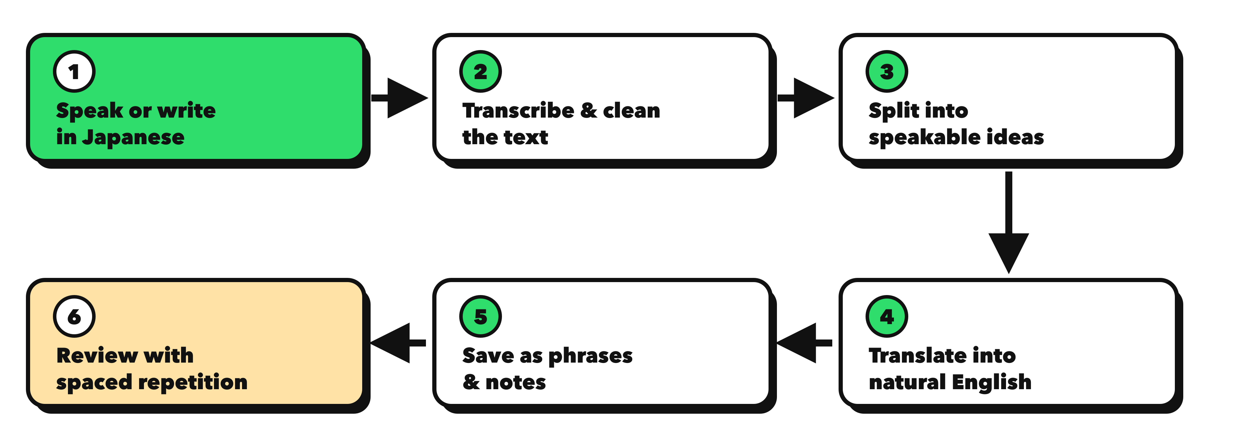
HOW IT WORKS
04
One Japanese thought becomes a reusable speaking exercise
今日は授業のあと、友達とカフェで新しいプロジェクトについて話した。
I went to a café with a friend after class.
We talked about a new project.
Notes:
This is the complete product loop. Voice input is transcribed and cleaned, then divided into ideas that are short enough to practice speaking. Each idea is translated, saved as a phrase, and scheduled for later review. Text input follows the same path but allows the learner to confirm the Japanese split before translation.
[Sources]
- README.md
- features/capture/capture-screen.tsx
- docs/redesign-proposal.md

Slide 5
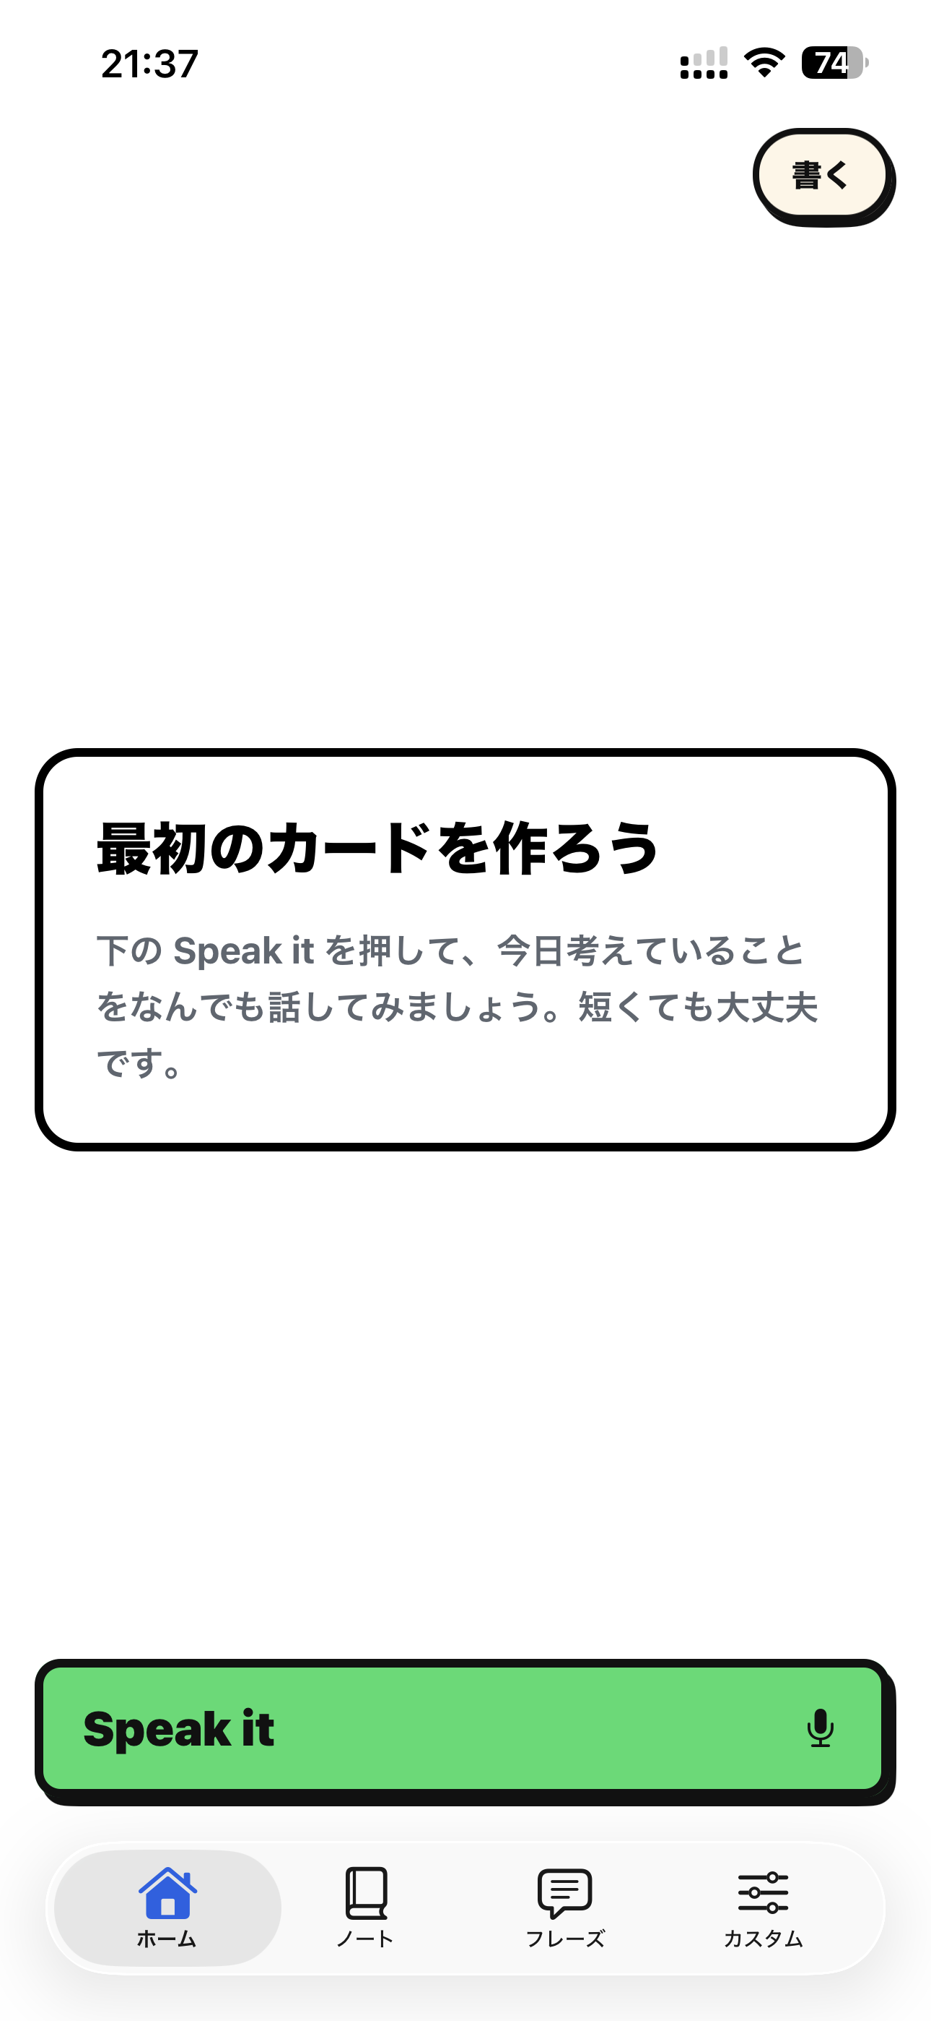
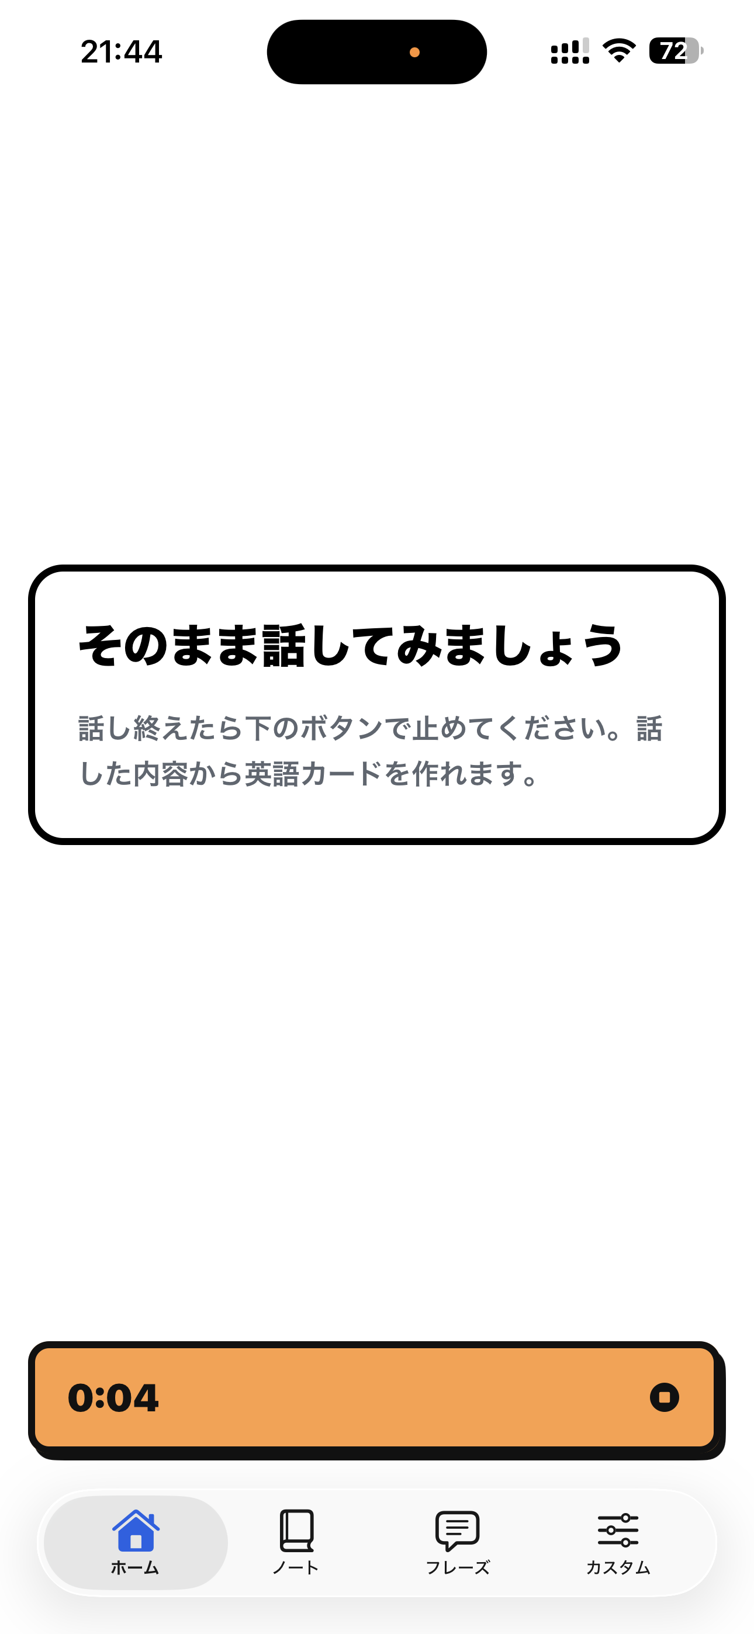
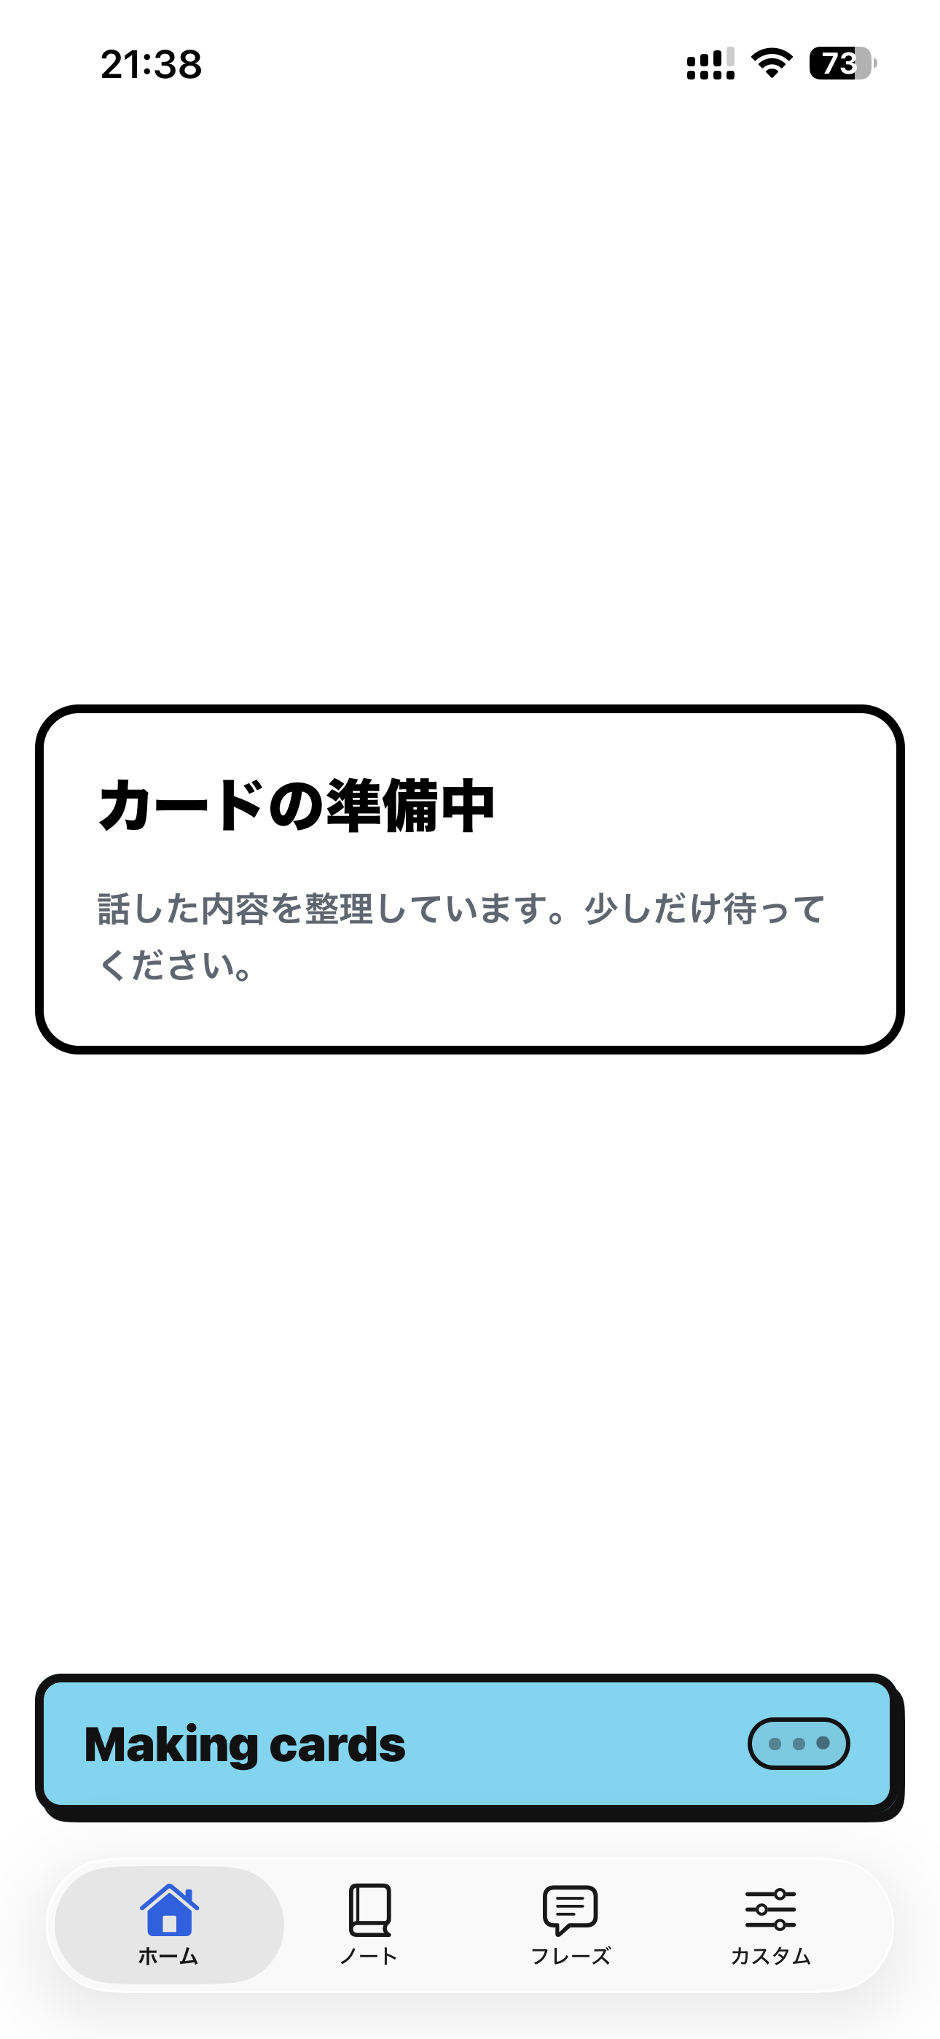
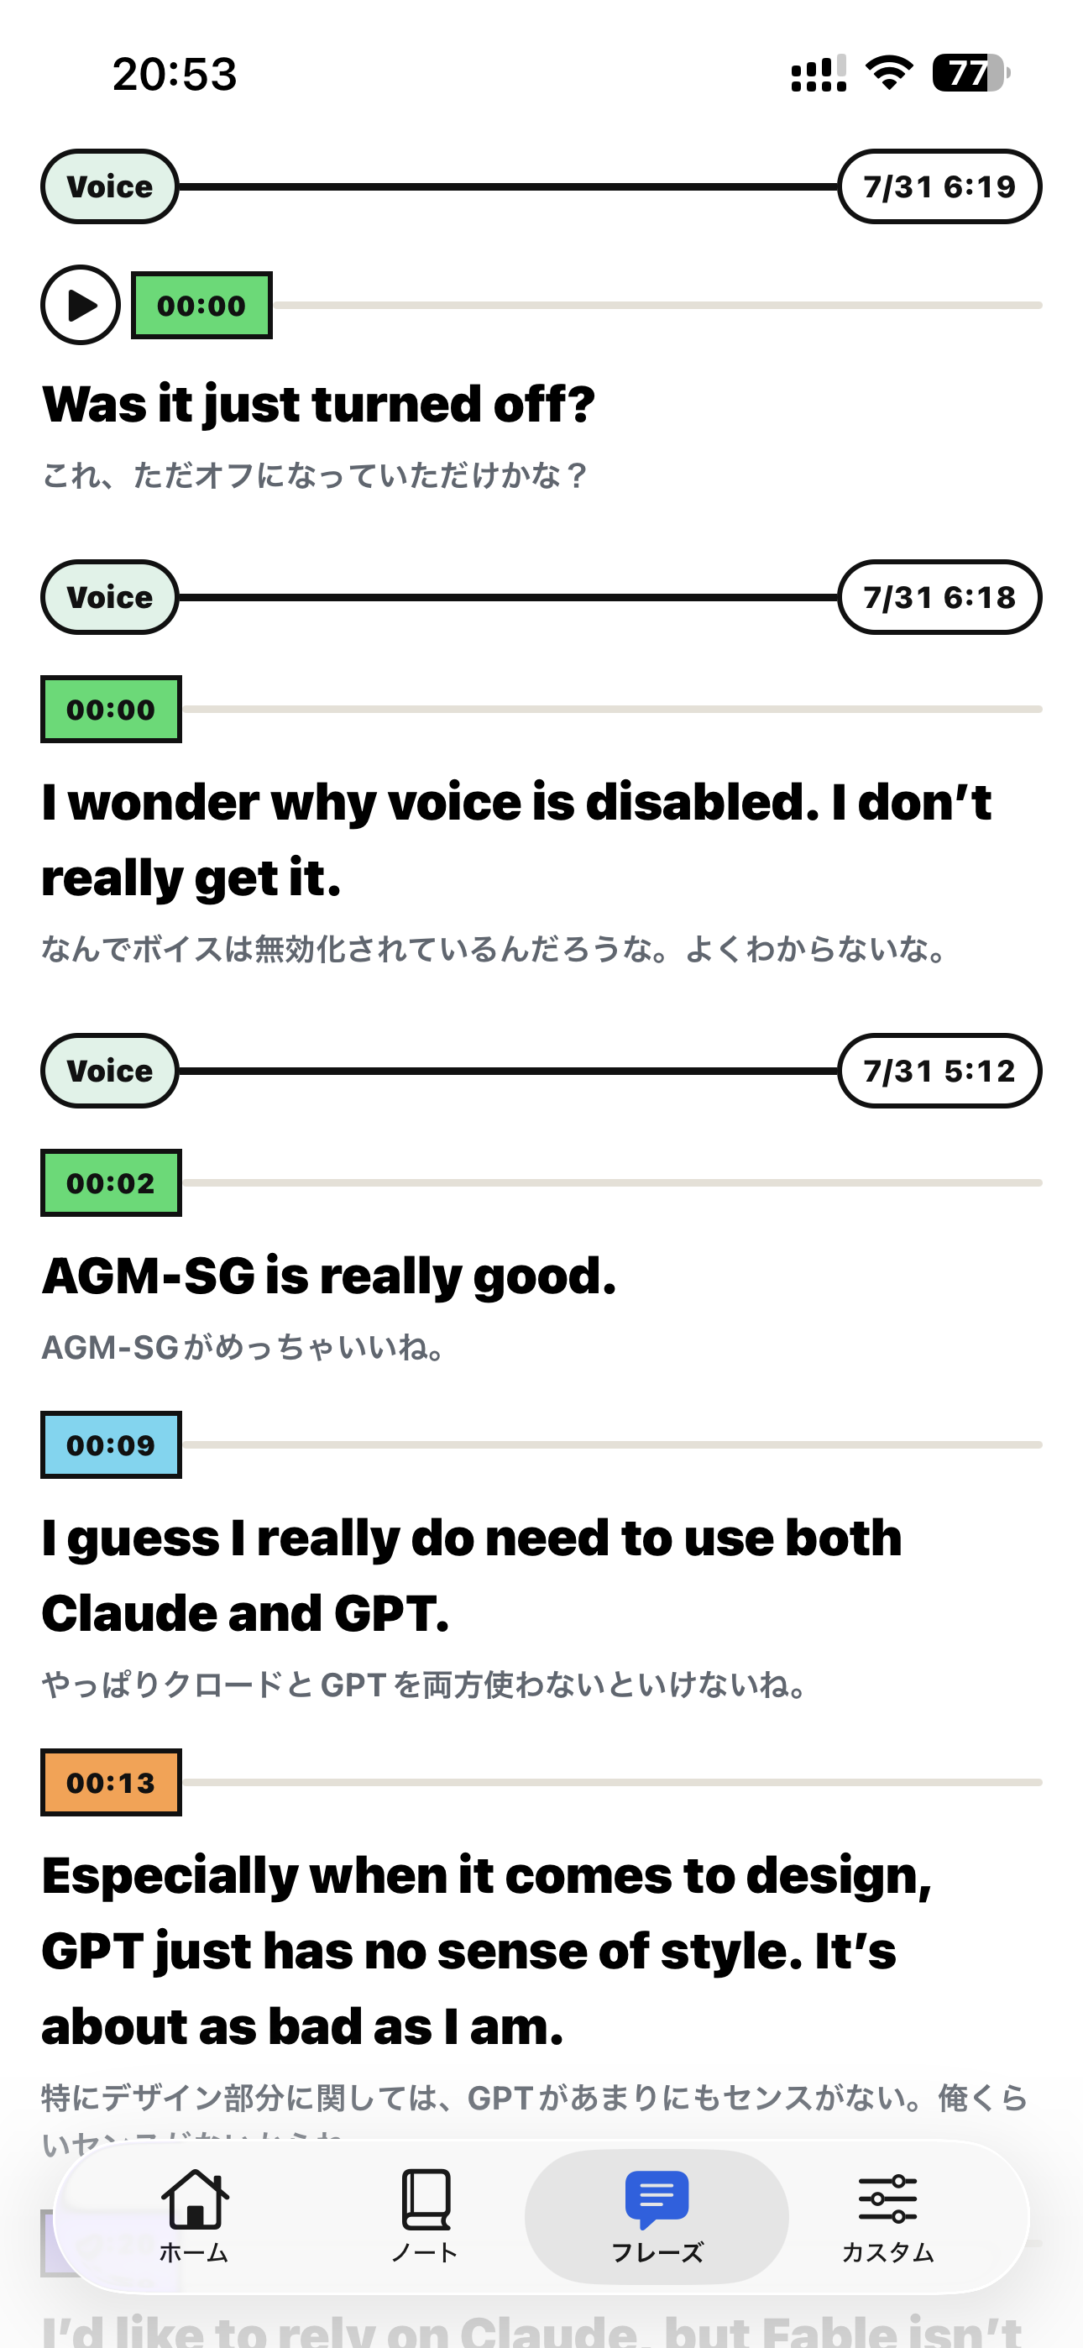
IN THE APP
05
The main flow stays focused from capture to cards
CAPTURE
GENERATE
PRACTICE
Notes:
The home screen keeps the main journey in one place. In the voice path, the learner starts speaking, then the app transcribes the recording and generates cards automatically. Text input uses the same learning loop but adds a confirmation step before translation. The demo follows the voice path shown here.
[Sources]
- features/capture/capture-screen.tsx
- features/capture/draft-card-list.tsx

Slide 6
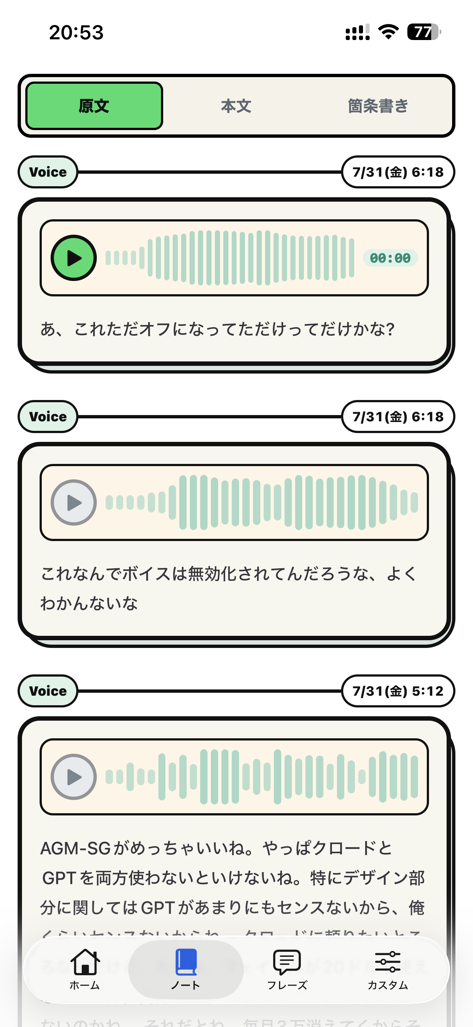
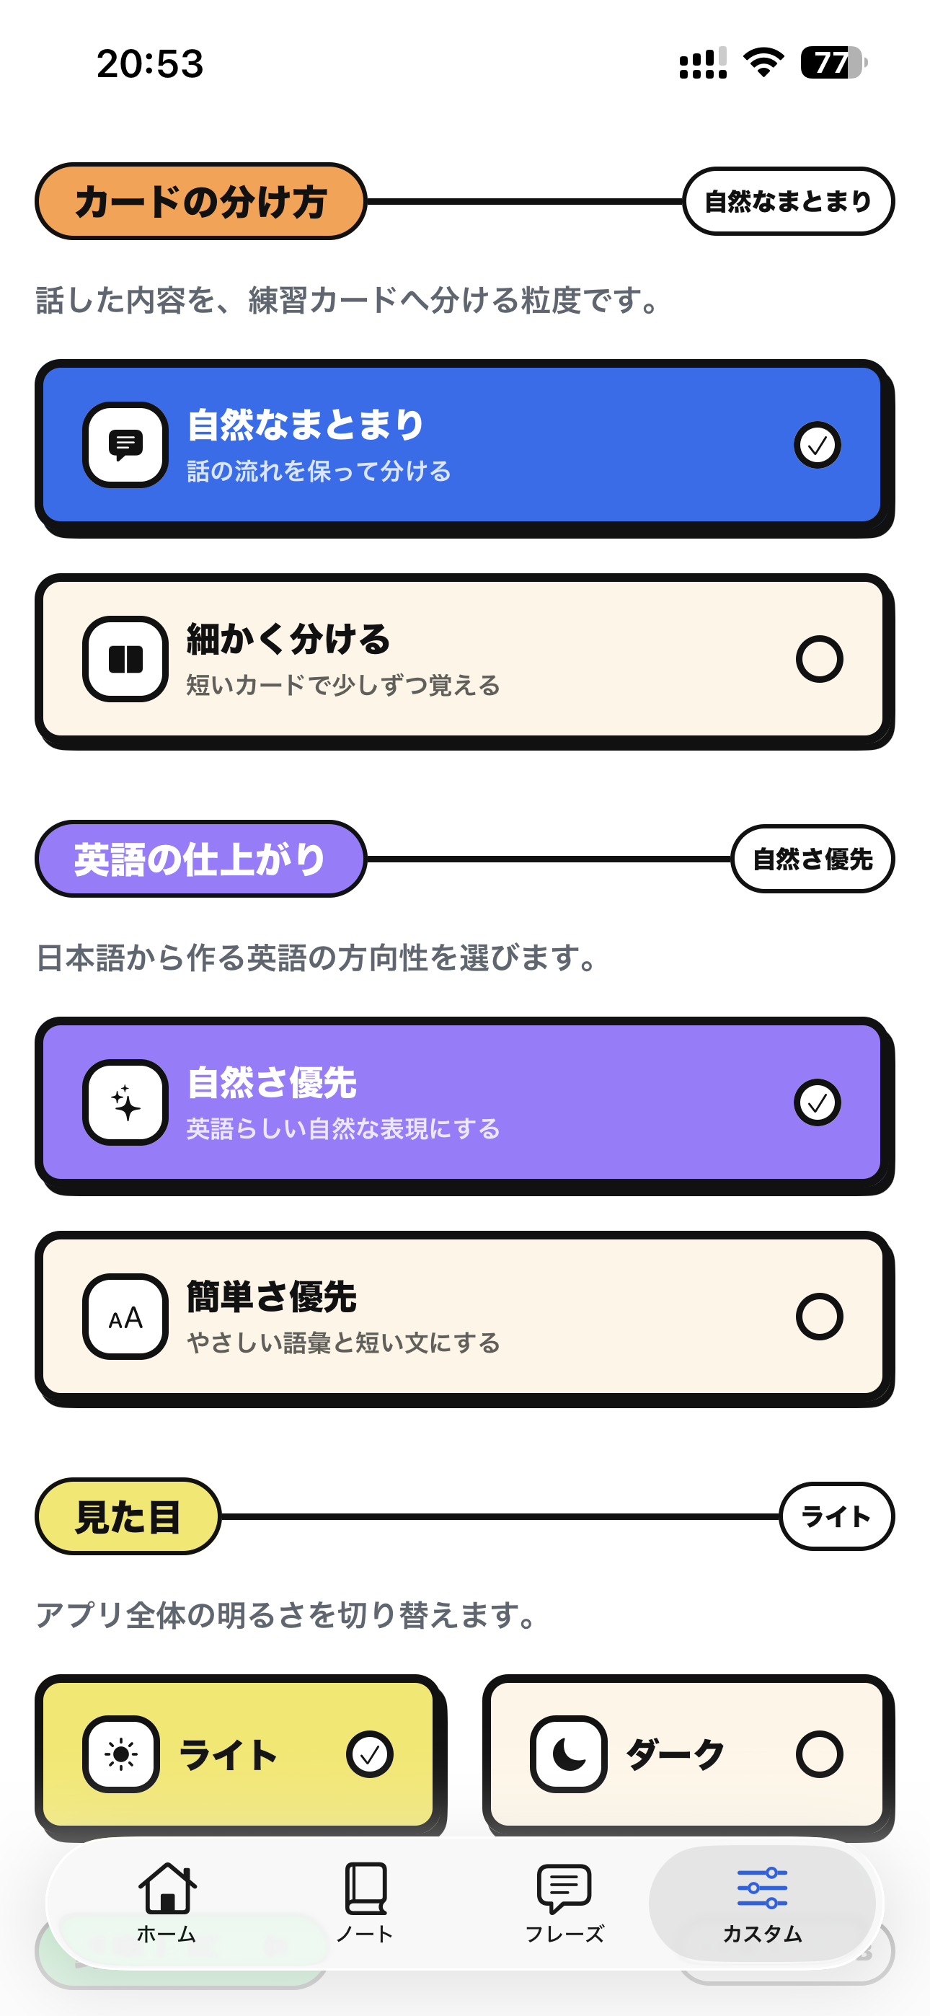
SURFACES
06
Capture, remember, practice, and customize
HOME
Speak, write, and review due cards
NOTES
Revisit the original entry and audio
PHRASES
Browse saved Japanese–English cards
CUSTOM
Choose how cards are made and stored
NOTES
PHRASES
CUSTOM
Notes:
The product has four tabs, but they are not separate experiences. Home creates and reviews material. Notes preserves the original entry and, when enabled, its local recording. Phrases provides a browsable library of generated cards. Custom lets the learner choose card size, translation style, theme, and whether recordings remain on the device.
[Sources]
- app/(tabs)/_layout.tsx
- features/diary/diary-screen.tsx
- features/cards/cards-screen.tsx
- features/settings/settings-screen.tsx

Slide 7
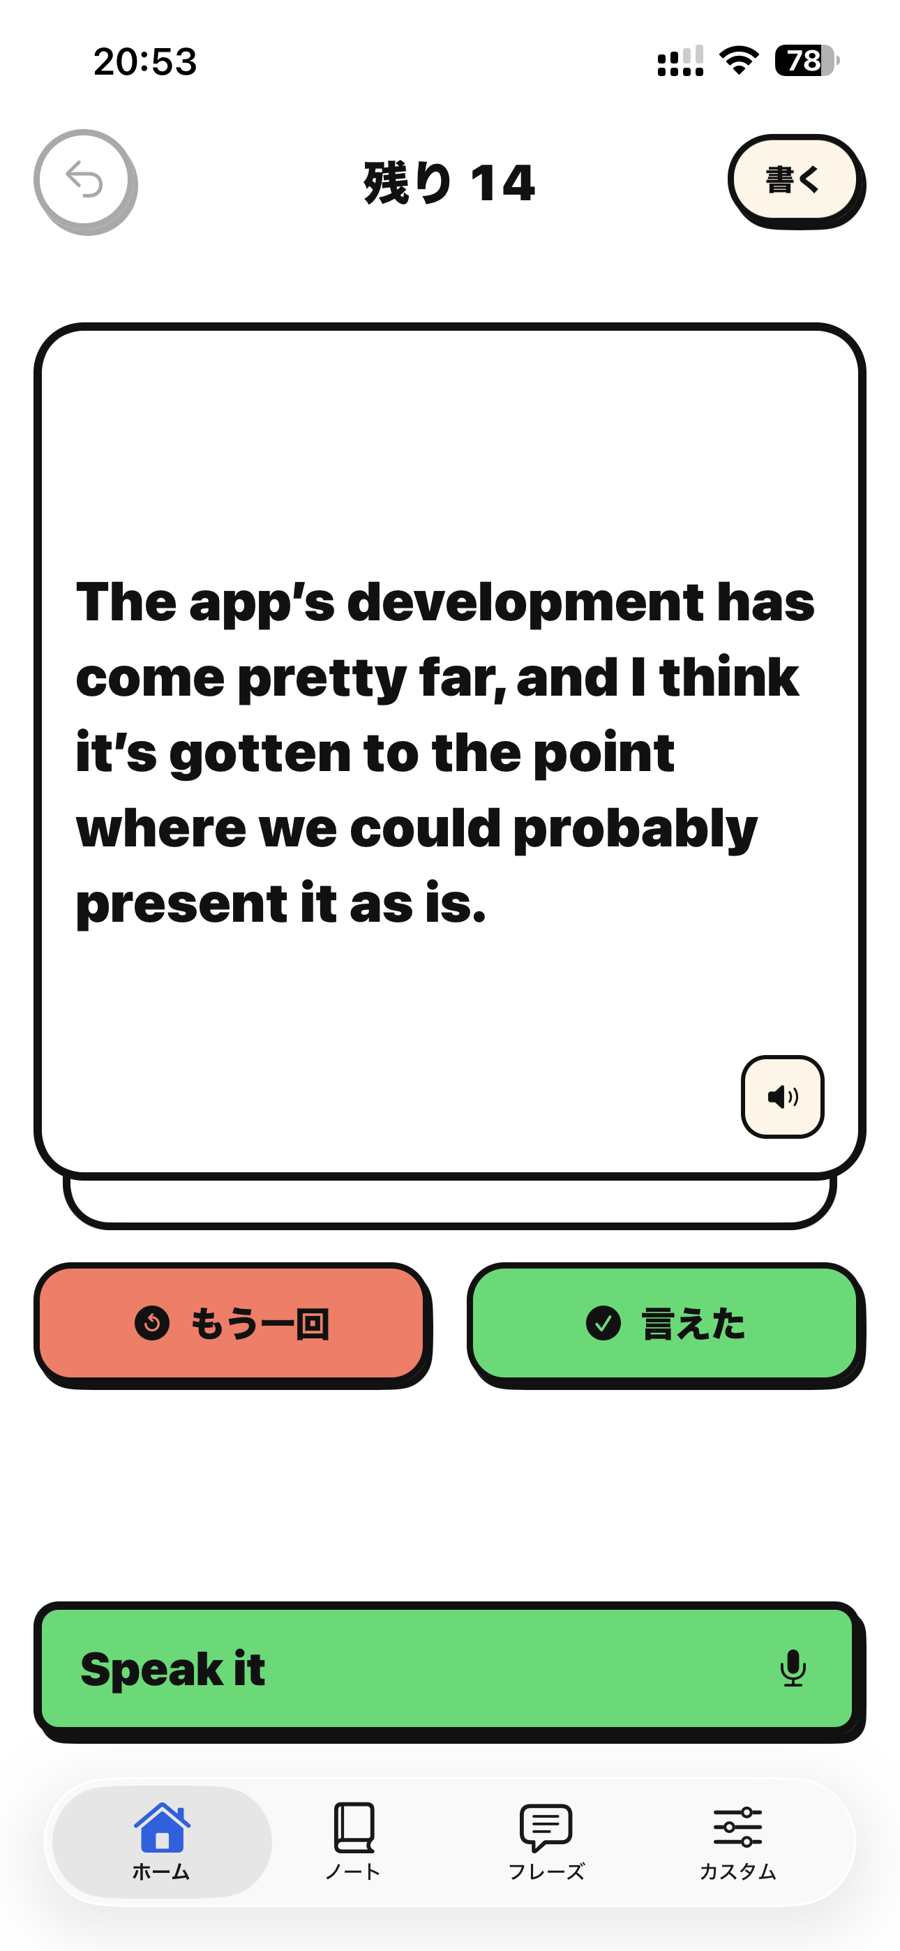
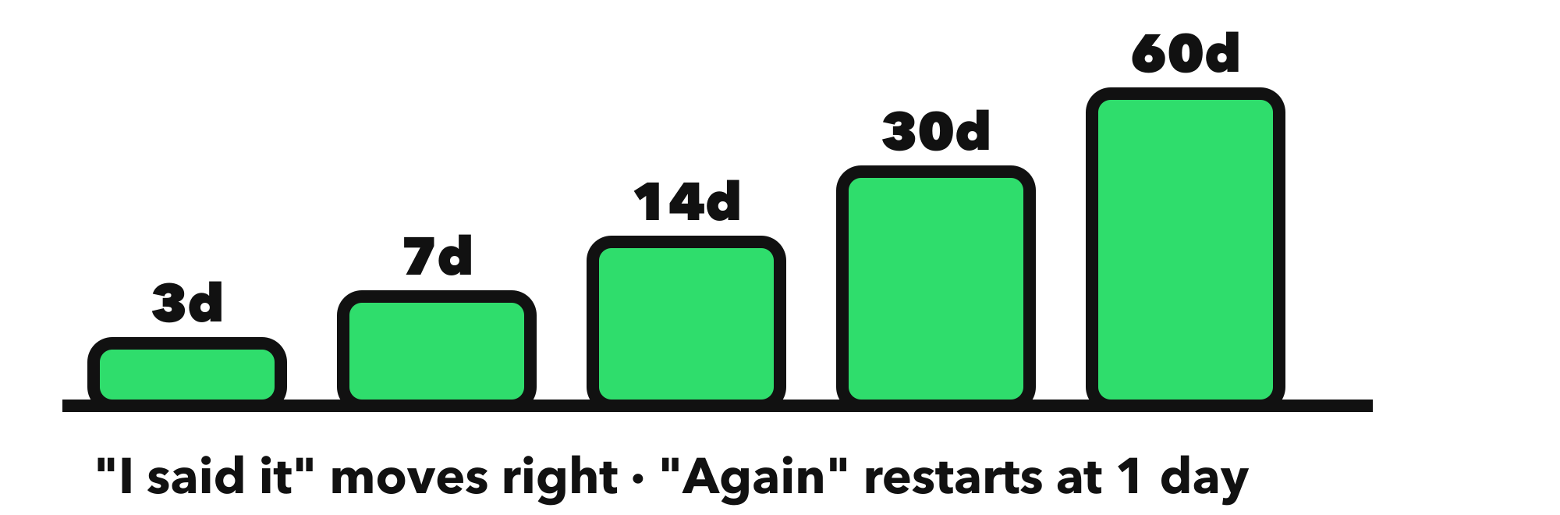
LEARNING LOOP
07
Two decisions keep practice fast and repeatable
AGAIN
Returns the phrase sooner
I SAID IT
Increases the review interval
UNDO
Protects against accidental taps
OFFLINE
Queued locally, synced reliably
Notes:
Review uses only two decisions. If the learner cannot say the phrase, “Again” brings it back sooner. If they can say it, the interval grows. This keeps the interaction fast enough for daily practice. Undo handles accidental decisions, while a local outbox keeps pending review events safe until synchronization succeeds.
[Sources]
- features/review/slack-flashcard-lab.tsx
- features/review/review-deck.tsx
- shared/api/review-outbox.ts
- packages/core/src/srs.ts

Slide 8
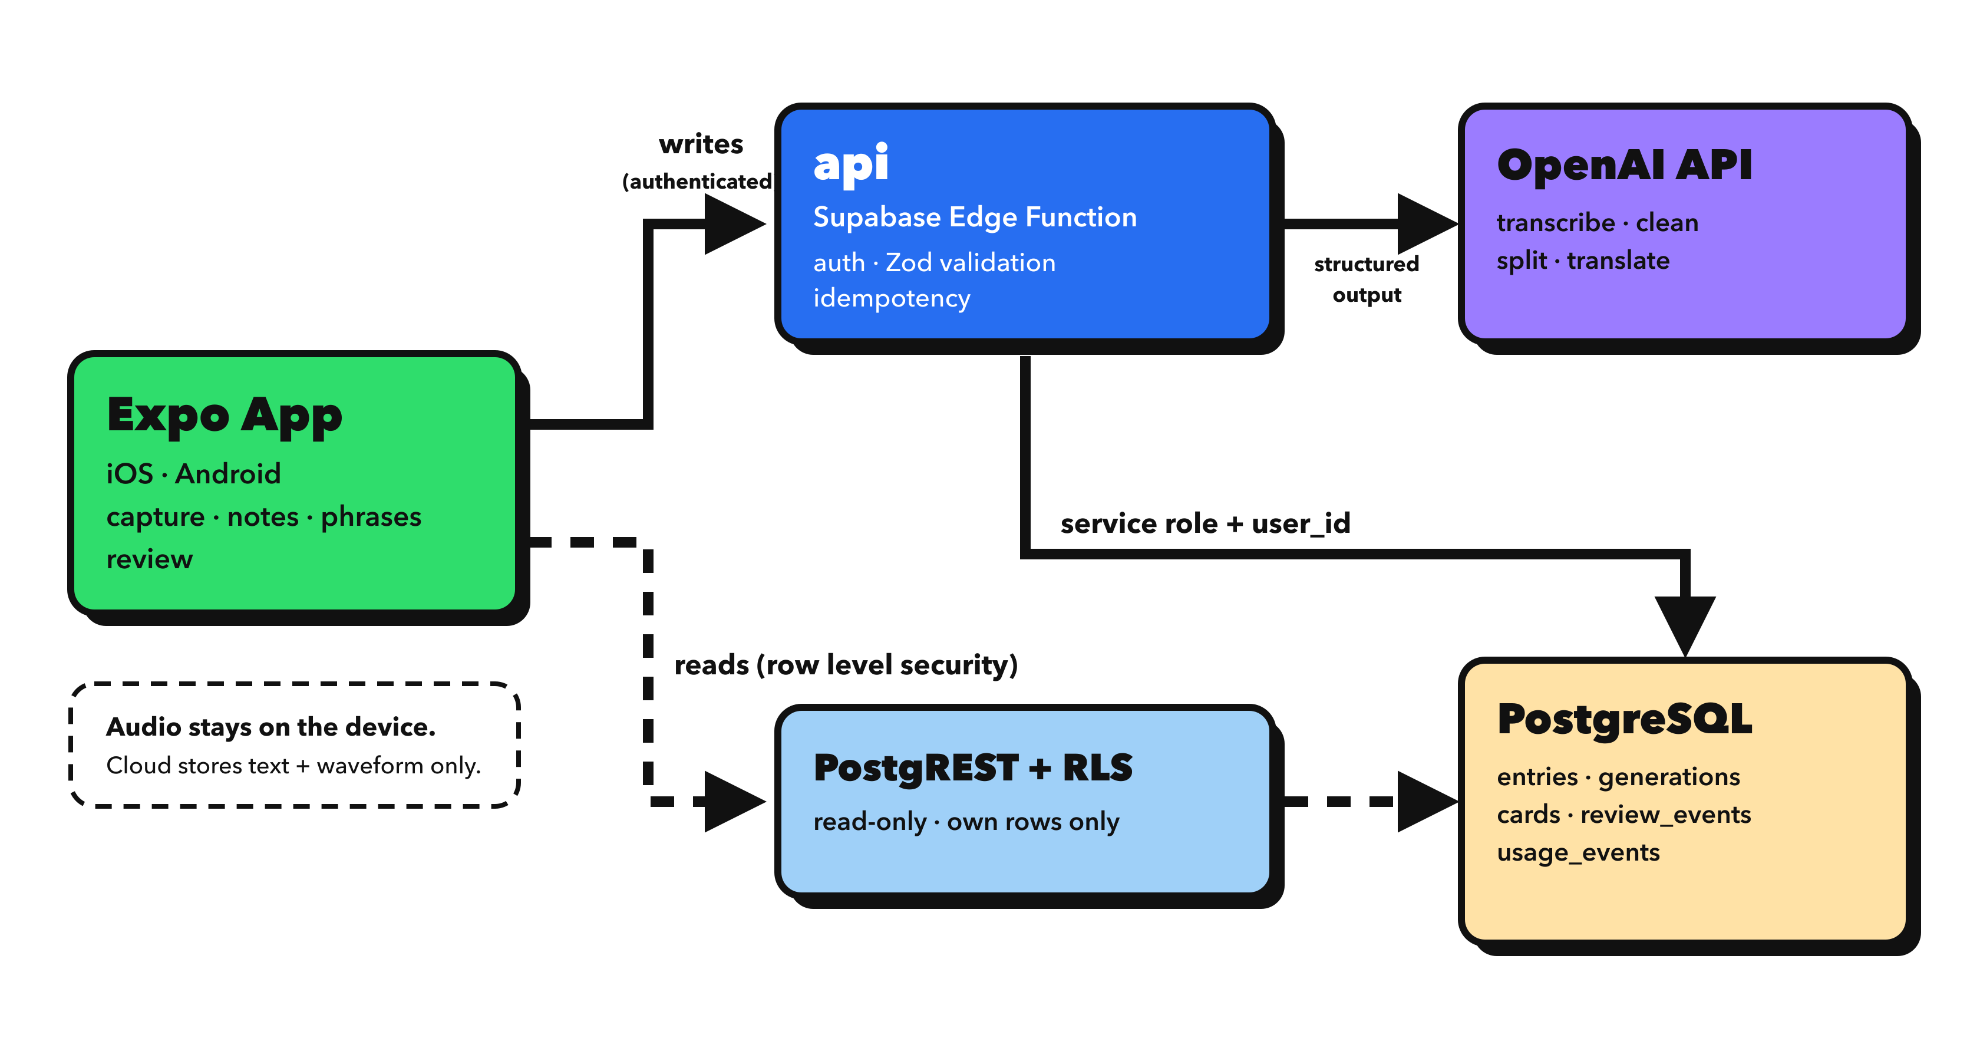
SYSTEM
08
AI transforms the content without becoming the product
Notes:
The mobile app does not call the model as an unstructured shortcut. An authenticated Supabase Edge Function validates the request, coordinates the OpenAI operations, and stores structured results. The database keeps entries, generations, cards, review events, and usage events. The original audio is never persisted in cloud storage; an optional copy can remain on the learner’s device.
[Sources]
- docs/architecture/just-speak-it-low-level-overview.png
- docs/architecture/README.md
- supabase/functions/api/index.ts
- supabase/migrations/20260731043000_rebuild_schema_v3.sql

Slide 9
ENGINEERING
09
Designed to recover, stay consistent, and protect data
STATE MACHINE
ZOD CONTRACTS
TANSTACK QUERY
Keeps capture and generation states predictable
Keeps the app and API in agreement
Keeps server state consistent across screens
IDEMPOTENCY
LOCAL OUTBOX
RLS
Prevents duplicate AI work after retries
Makes review and undo survive temporary failures
Restricts every user to their own data
Notes:
These choices are technical, but their purpose is user-facing. The capture state machine prevents contradictory screens. Shared Zod contracts keep the app and backend aligned. Idempotency prevents duplicate generations if a request is retried. Review events and the local outbox make the two-button review flow reliable. Row Level Security restricts reads to the current user, while every write passes through the authenticated API.
[Sources]
- features/capture/capture-state.ts
- packages/contract/src/index.ts
- shared/api/client.ts
- shared/api/review-outbox.ts
- supabase/functions/api/index.ts
- supabase/migrations/20260731043000_rebuild_schema_v3.sql

Slide 10

LIVE DEMO
Now, one thought becomes something I can practice
1
Speak a short Japanese thought
2
Watch it become English cards
3
Open a card and review it
Your life becomes your English practice.
Notes:
I will now demonstrate one complete user flow. I will speak a short thought in Japanese, show how the app turns it into English cards, and then practice one of those cards. This is the core promise of Just Speak It: your own life becomes the material for your English practice.
[Sources]
- README.md
- features/capture/capture-screen.tsx
- features/review/review-deck.tsx

Slide 11
APPENDIX · IF THE DEMO FIGHTS BACK
A1
1 Speak
2 Transcribe
3 Generate
4 Cards
5 Review
Notes:
This appendix preserves the complete voice journey as static evidence. It can support questions about the flow or provide a visual reference if the live demo environment becomes unavailable. Text input follows the same learning loop with an additional split-confirmation step before generation.
[Sources]
- features/capture/capture-screen.tsx
- features/capture/draft-card-list.tsx
- features/cards/cards-screen.tsx
- features/review/review-deck.tsx

Slide 12
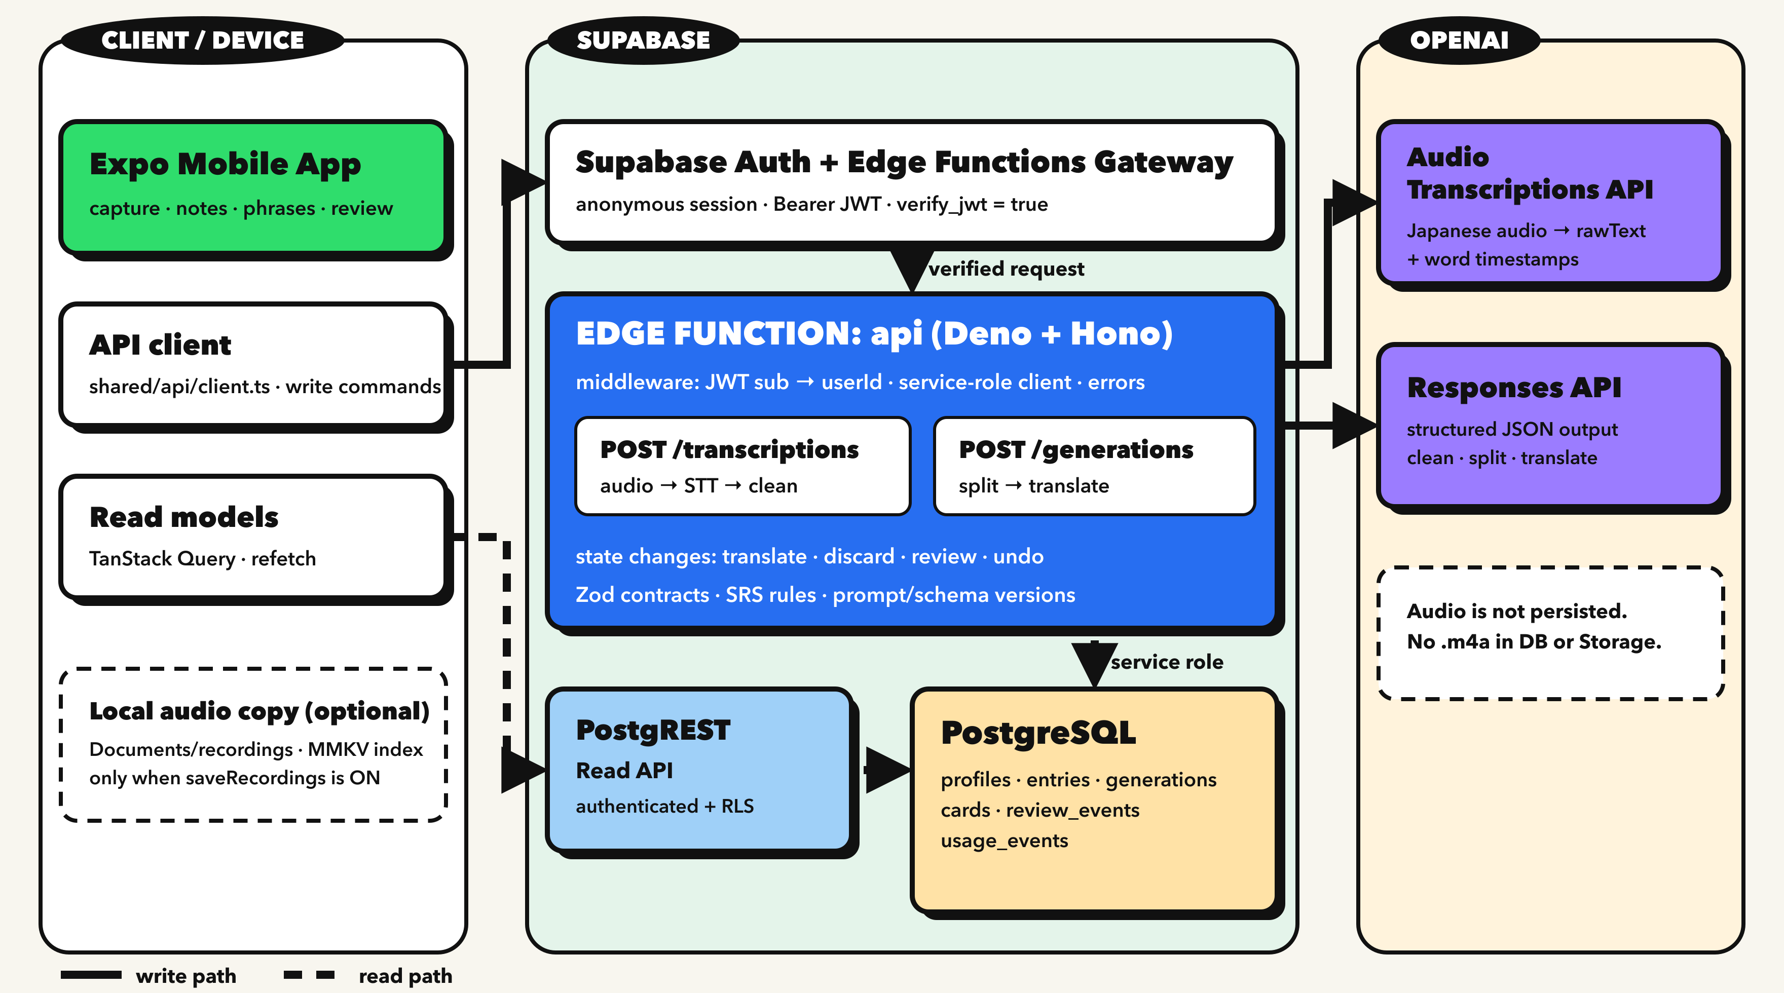
APPENDIX · SYSTEM DETAIL
A2
Notes:
This detailed architecture view shows the two main paths. Authenticated writes and all AI work go through the single Edge Function. Read models use PostgREST with Row Level Security. Optional audio copies stay on the device, while cloud storage contains structured text and learning state.
[Sources]
- docs/architecture/just-speak-it-low-level-overview.png
- docs/architecture/README.md

