Slide 1
Digital Portfolio
STUDENT NAME: EZILANANDAN A
REGISTER NO AND NMID:24524u48011 AND 697DEFC7CC6AEBEB3BE4744A9731BA5B
DEPARTMENT: B.Sc.,(Data Science)
COLLEGE: KARAN ARTS AND SCIENCE COLLEGE/ Thiruvalluvar University

Slide 2
Digital Portfolio
A responsive personal website built using HTML, CSS, and Bootstrap. Showcases skills, services, and achievements in a clean layout. Acts as a digital CV for recruiters and clients.

Slide 3


AGENDA
Problem Statement
Project Overview
End Users
Tools and Technologies
Portfolio design and Layout
Features and Functionality
Results and Screenshots
Conclusion
Github link
3/21/2024 Annual Review

Slide 4

PROBLEM STATEMENT
►Need for a personal website
►Showcase skills & services
►Easy way for recruiters/clients to know me

Slide 5

PROJECT OVERVIEW
► Responsive portfolio website
► Built using HTML, CSS, Bootstrap
► Sections : Home, About, Skills, Services, Work, Contact

Slide 6

WHO ARE THE END USERS?
► Recruiters
► Clients
► Peers / Network
► Personal Branding

Slide 7

TOOLS AND TECHNIQUES
► HTML5
► CSS3
► Bootstrap
► JavaScript

Slide 8
POTFOLIO DESIGN AND LAYOUT
► Navbar & Hero – Profile and quick links
► Sections – About, Skills, Services, Workdone
► Footer – Contact & social links
8

Slide 9
FEATURES AND FUNCTIONALITY
► Responsive design for all devices
► Showcase skills, services, and work
► Easy navigation with contact details

Slide 10

RESULT AND SCREENSHORTS
Created a responsive portfolio website
Showcases skills, services, and achievements
Acts as a digital CV for career growth
3/21/2024 Annual Review
10

Slide 11
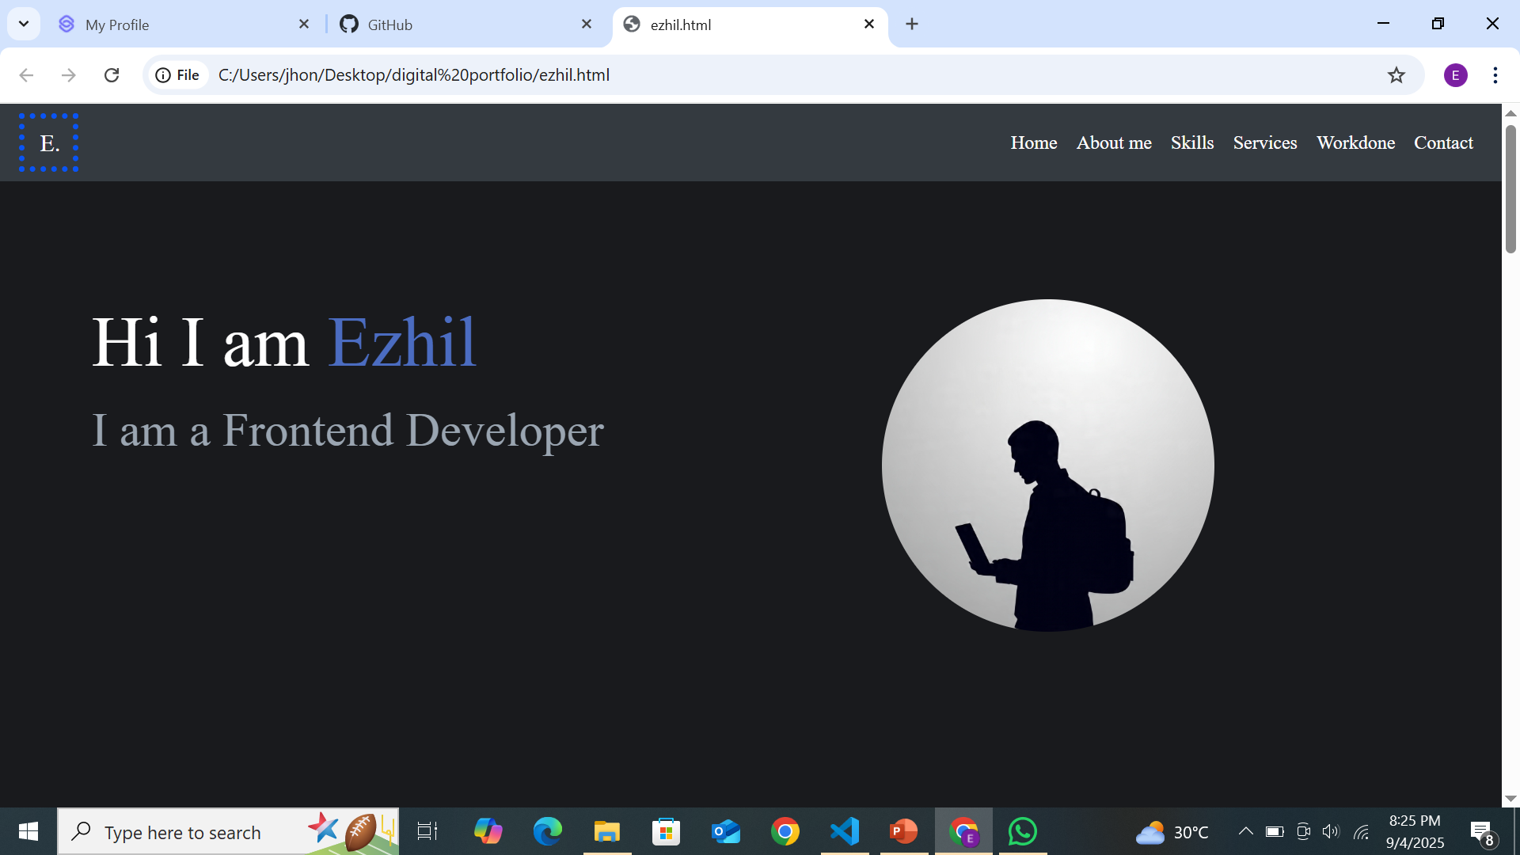

Slide 12
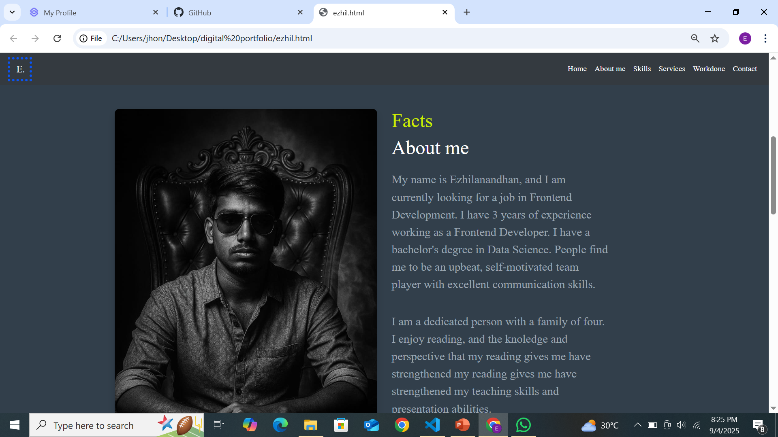

Slide 13
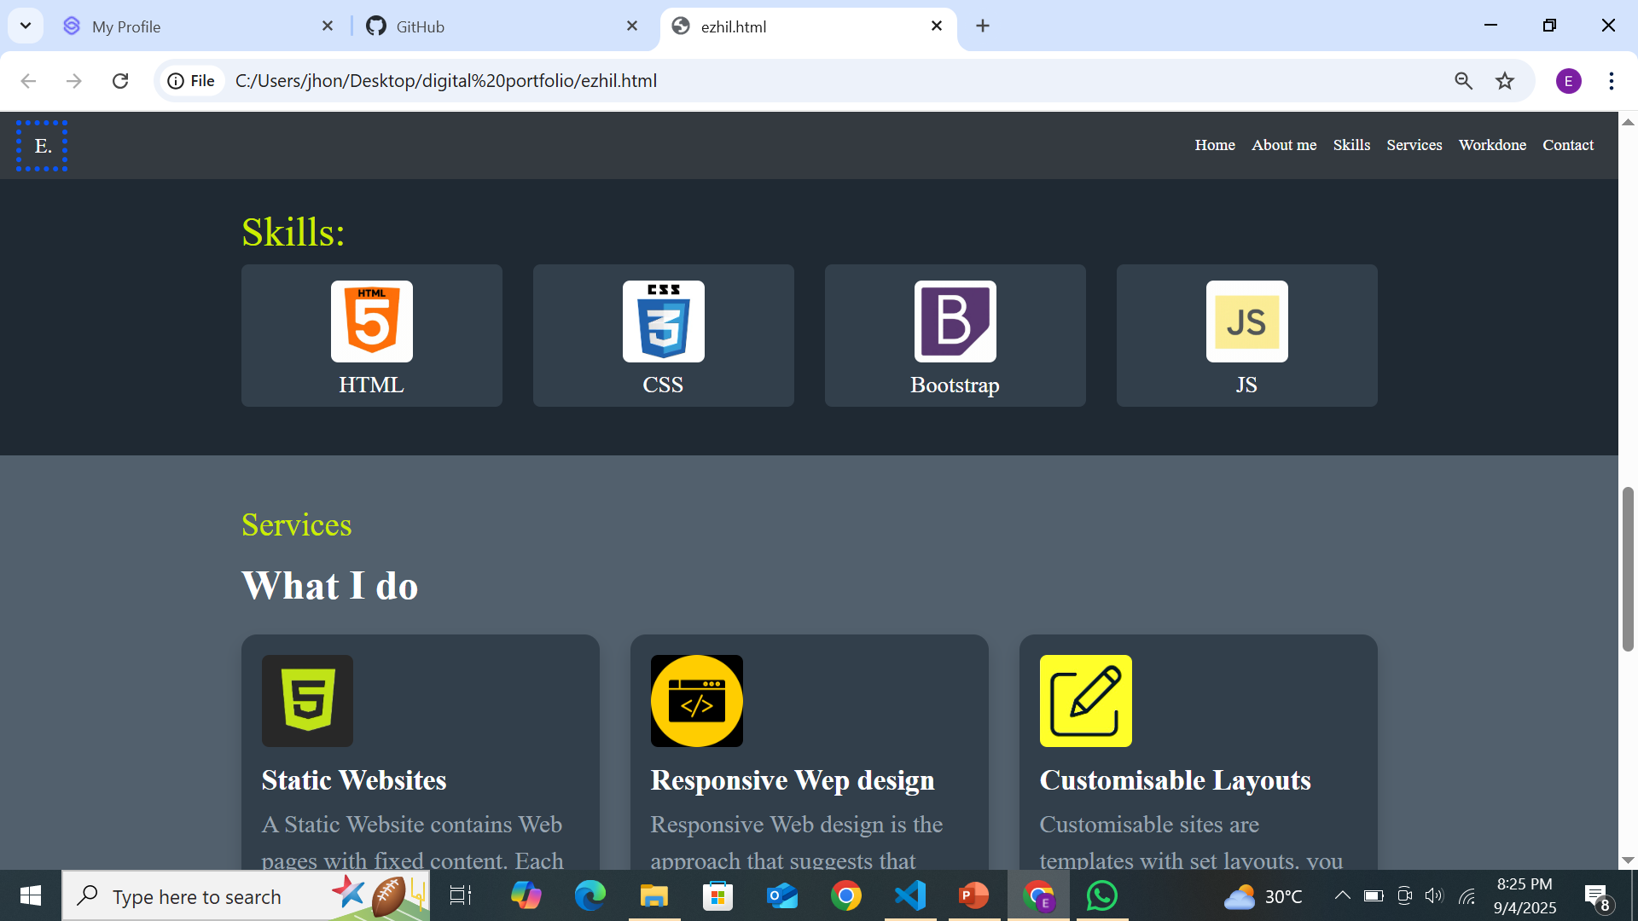

Slide 14
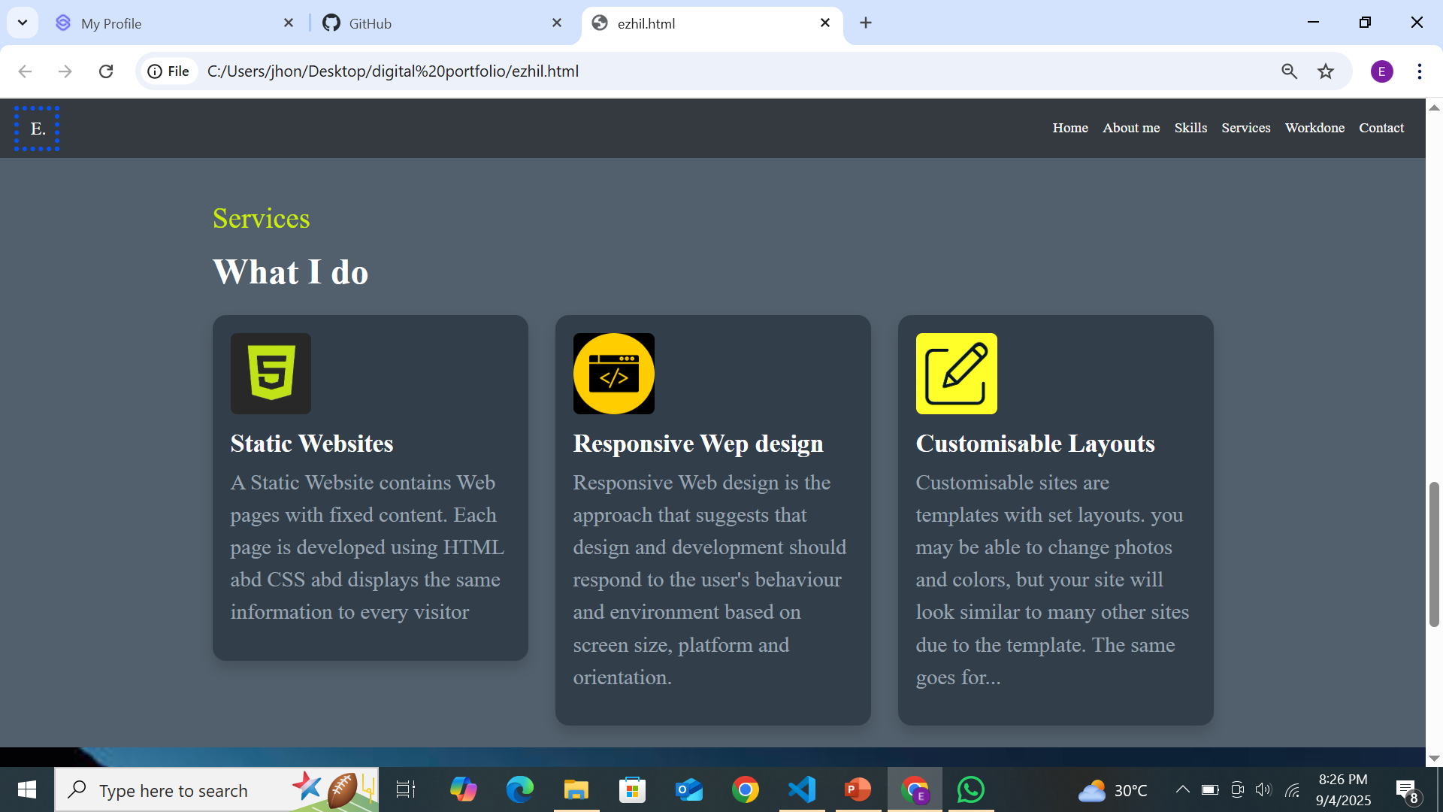

Slide 15
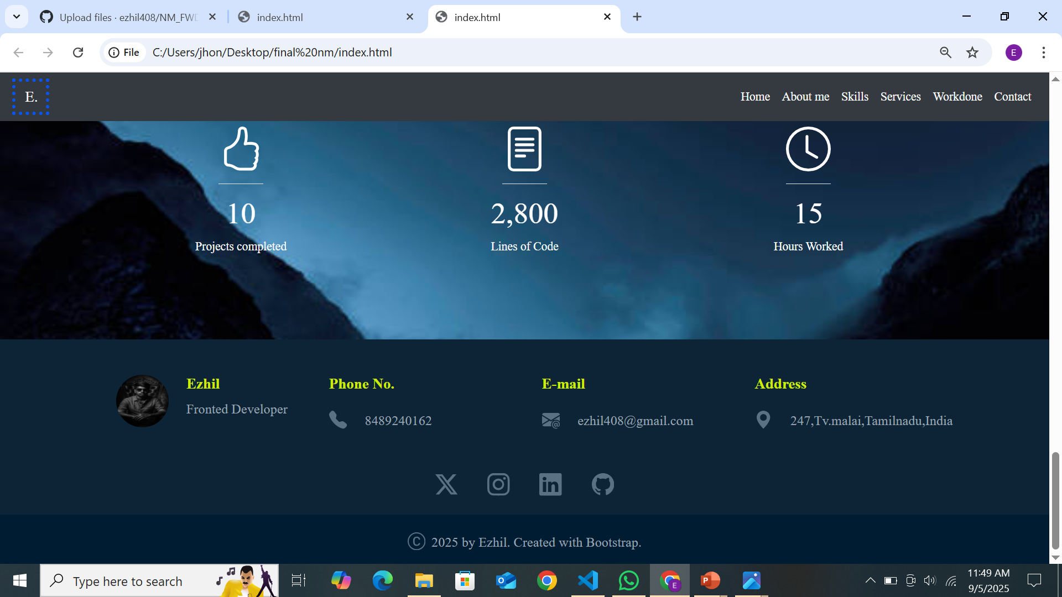

Slide 16
CONCLUSION
► Portfolio website built using Bootstrap & CSS
► Showcases my skills, services, and achievements
► Helps in career growth and client reach
16

Slide 17
GITHUB LINK
https://github.com/ezhil408

