Slide 1

WEBSITE + MOBILE APP
A clearer path
to your firm.
Help people discover, consult and stay connected.
A connected website and workspace experience for your firm.
01

Slide 2
THE OPPORTUNITY
Be useful before the first consultation.
Connect the moments that turn a question into a lasting client relationship.
01
02
03
04
Discover
Decide
Consult
Continue
A relevant guide
in Tamil or English.
A direct booking route
or optional assistant.
A confirmed appointment
and useful preparation.
Documents, updates
and the next step.
02

Slide 3
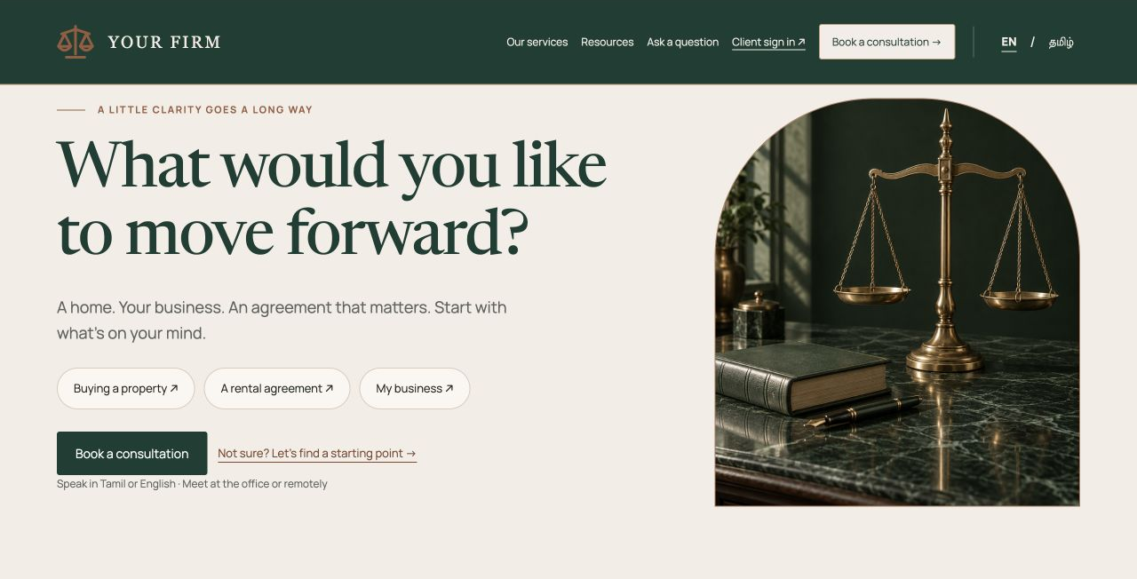
WEBSITE EXPERIENCE
A confident first impression.
Ready to speak?
Book directly without needing chat or an app download.
Still exploring?
Read a guide, explore services or ask for help choosing.
03

Slide 4
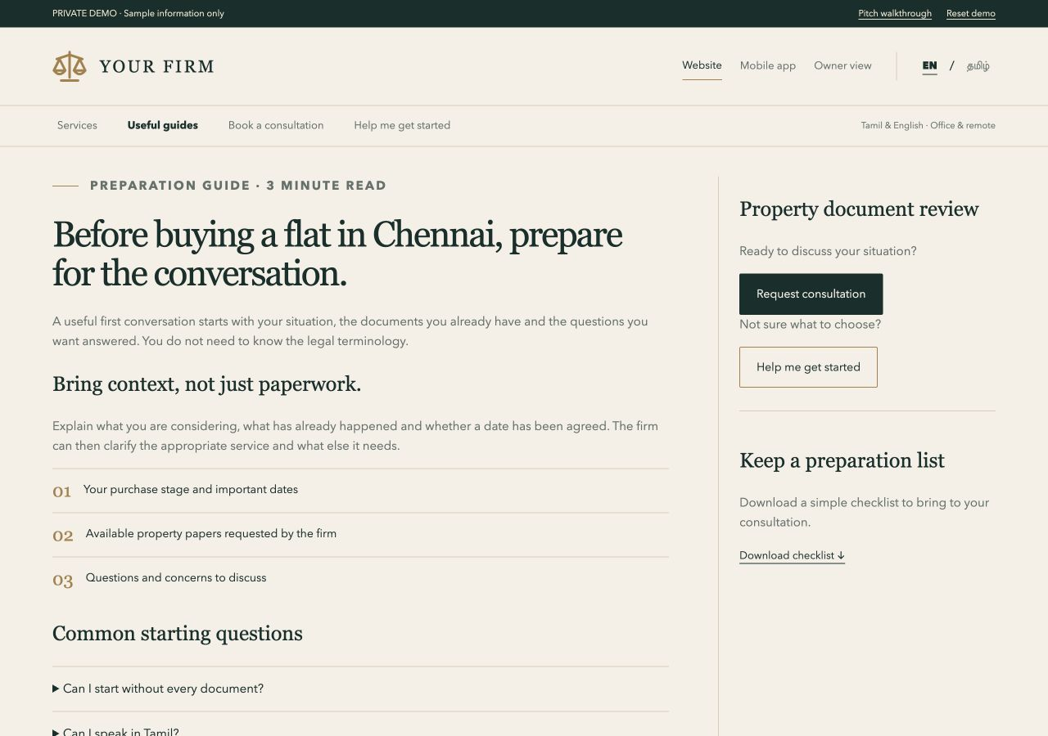
DISCOVERY
Answer the questions people already ask.
Start with a focused topic.
Property preparation → related service → checklist → consultation.
Tamil + English articles
Short social explainers
Search visibility tracking
04

Slide 5
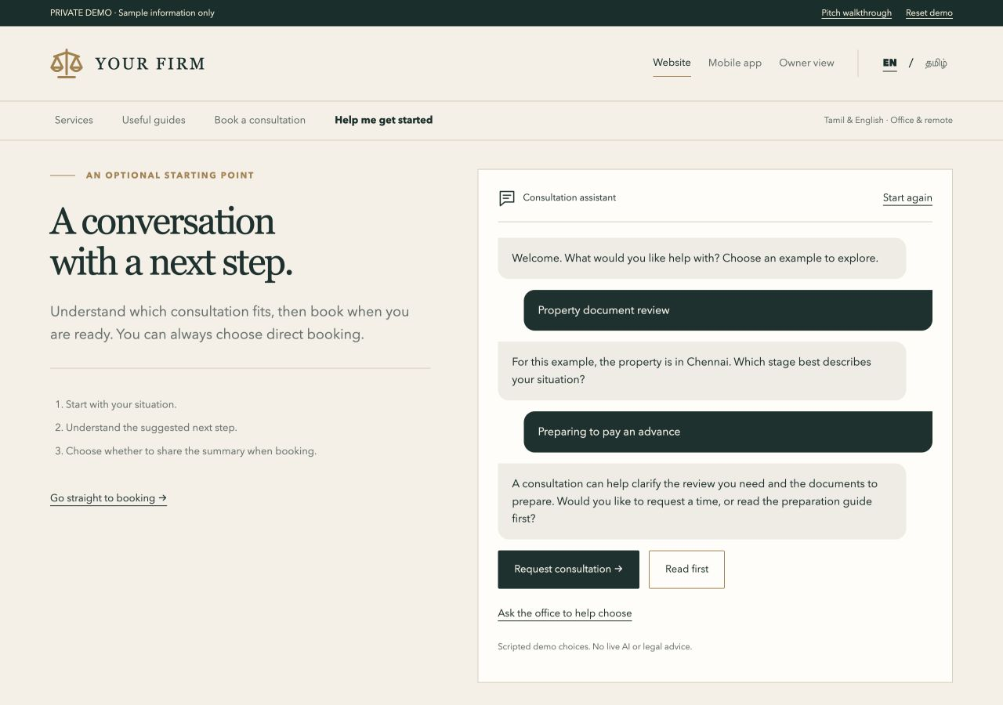
OPTIONAL CONSULTATION ASSISTANT
Help an unsure visitor become ready to book.
Understand the situation.
Ask a few relevant questions, explain the next step and suggest a suitable consultation.
Carry the summary forward only with the visitor’s agreement.
05

Slide 6
ONE CONNECTED APPOINTMENT
Make every handover clear.
One consultation record connects the client, lawyer and office.
1
→
2
→
3
→
4
Request
Review
Confirm
Follow through
Client chooses service,
format, language and time.
Office confirms scope,
assignment and fee.
Client tries mock checkout;
appointment is confirmed.
Review documents,
share advice and follow up.
The payment sequence and service terms remain subject to the firm’s approval.
06

Slide 7
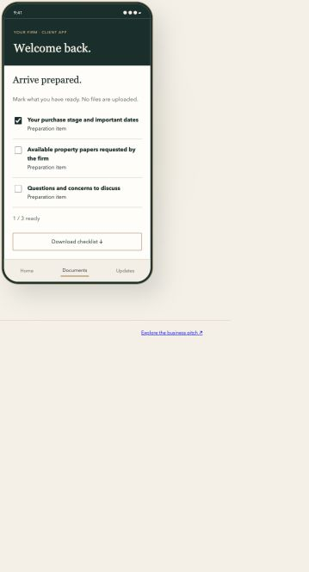
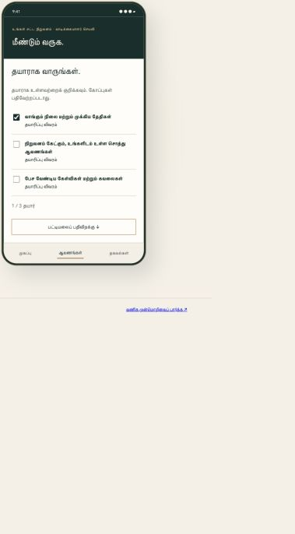
BILINGUAL MOBILE EXPERIENCE
Your firm. In their pocket.
The website welcomes new visitors.
The app supports the ongoing relationship.
Demo OTP and profile editing
Mock checkout and booking alerts
Documents and time changes
Shared summaries and follow-up
07

Slide 8
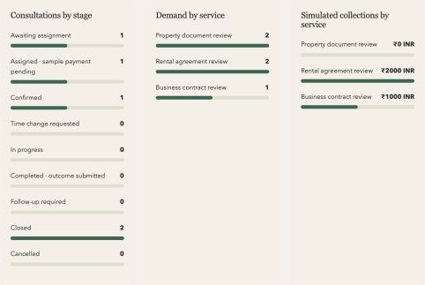
OWNER INSIGHT
Manage the team. Understand the work.
Client accounts
Add and edit contact details; retain consultation history.
Lawyers & performance
Manage photos and specializations; view activity, demand and sample collections.
Charts reflect sample records. Real reporting needs connected firm data.
08

Slide 9
SERVICE OPPORTUNITIES
Add services around the firm’s strengths.
Choose a small set the team can deliver well.
Property support
Remote / NRI clients
Small-business support
Document review and registration assistance.
Consultations and progress updates for Tamil Nadu matters.
Contracts, employment documents and continuing advice.
Potential: clearly scoped paid engagements.
Potential: reach beyond the local area.
Potential: recurring client relationships.
09

Slide 10
WHAT TO TAKE FORWARD
A focused next step.
Agree which additions would help most alongside the existing build.
01
Choose the first customer journey.
Property is the example; confirm the firm’s strongest service.
02
Compare with the current scope.
Keep what is already planned and identify useful additions.
03
Agree the service experience.
Confirm languages, booking steps, fees and office responsibilities.
10

