Slide 1
SERVICE EXPERIENCE & DELIVERY SCOPE
Your firm.
One connected service.
CLIENT
From the first question to the final follow-up.
LAWYER
A website and one role-based app for clients, lawyers and the firm.
FIRM
Explore the interactive experience →
YOUR FIRM
01
Notes:
Prepared for Suganthan. Scope reference: Online lawyer consultation mobile App development Proposal V0.3, issued 16 September 2026, functional pages 8–13. Later direction consolidates mobile roles into one app and adds a website. This presentation is not a cost or delivery-date commitment.

Slide 2
THE SERVICE MODEL
Three roles. One continuous relationship.
The website starts the relationship. The workspaces carry it forward.
01
02
03
Clients
Lawyers
The firm
Choose a service, arrange a consultation, prepare documents and understand the next step.
Manage availability, prepare for appointments, record outcomes and follow through.
Coordinate people, assignments, payments and service quality from one operating view.
Product scope: website + Android/iOS app + firm administration. Current release: an interactive browser demonstration.
YOUR FIRM
02

Slide 3
THE OPERATING JOURNEY
A clear owner at every handover.
One consultation record connects the request, appointment, documents and follow-up.
01
02
03
04
05
Request
Assign
Confirm
Consult
Follow-up
Client
Firm
Client
Lawyer
Firm + client
Service, time, reason
Lawyer and reservation
Fee and payment
Review and outcome
Summary, actions, closure
Assignment before payment is the proposed sequence. The firm must approve it alongside hourly billing and reservation rules.
YOUR FIRM
03

Slide 4
CLIENT EXPERIENCE
Know what happens next.
Appointments, documents and advice stay connected without repeating the same content on every tab.
Get started
Mobile sign-in, editable contact details and service selection.
THE CLIENT’S NEXT STEP
Appointment confirmed
Prepare with confidence
Appointment details, assigned lawyer and requested documents.
Prepare documents → Meet your lawyer
→ Read the summary → Complete agreed actions
Stay informed
Booking, payment and assignment updates; a shared summary after consultation.
Workflow illustration
YOUR FIRM
04
Notes:
Original requirements pp8–9. Demo includes mock OTP, contact edits, synthetic booking and mock payment, in-app alerts and local document records. Live SMS, file storage, actual payment and background reminders are not implemented.

Slide 5
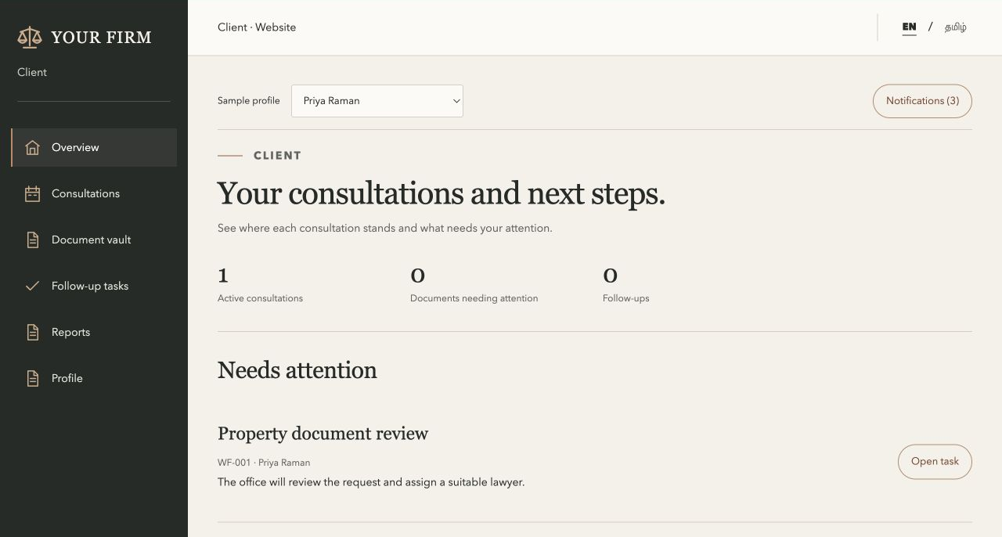
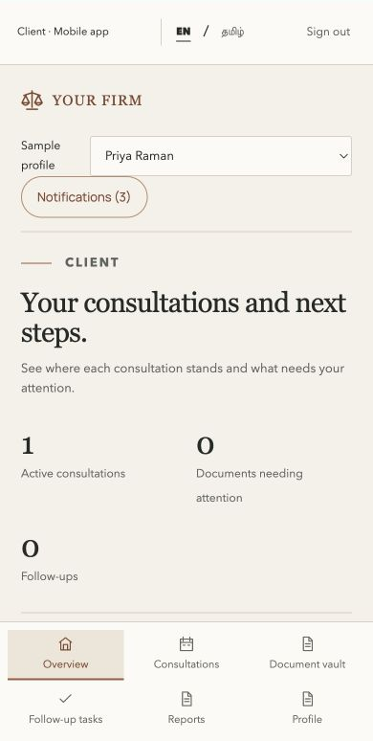
ACROSS WEBSITE & APP
The client journey, across both screens.
WEBSITE
APP PREVIEW
Choose a service → Book → Prepare → Attend → Read the summary → Follow up
YOUR FIRM
05
Notes:
Actual browser screenshots of the published synthetic demonstration: website and 390px mobile-app preview. Browser-local sample records; native mobile apps are not yet released. Workflow labels are editable text.

Slide 6
LAWYER EXPERIENCE
Prepare once. Carry the advice forward.
The lawyer workspace is organised around the work, not a repeated dashboard.
Before
During
After
Schedule & prepare
Consult & record
Summarise & follow up
Offer available times. Open assigned appointments, client context and requested documents.
Start the consultation, record internal notes and submit the outcome for office review.
Publish the client summary separately, agree the next action and retain consultation history.
Diary • Matters • Document review • Follow-ups • Availability
YOUR FIRM
06

Slide 7
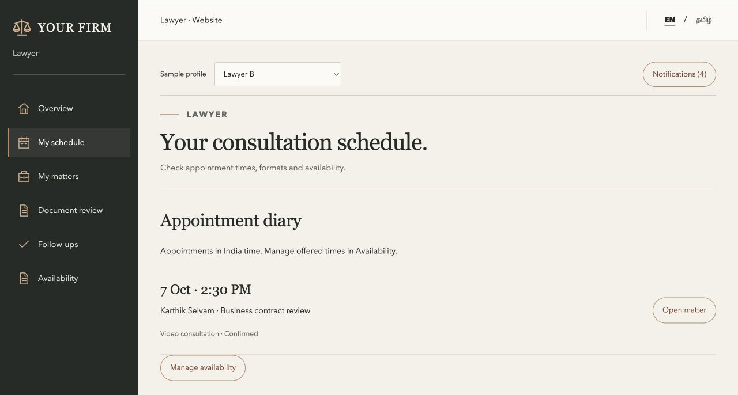
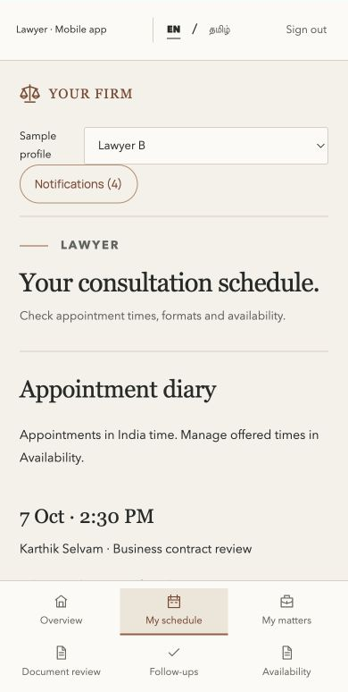
ACROSS WEBSITE & APP
The lawyer journey, from diary to follow-up.
WEBSITE
APP PREVIEW
Set availability → Review → Consult → Record the outcome → Share advice → Follow up
YOUR FIRM
07
Notes:
Actual browser screenshots of the published synthetic demonstration: website and 390px mobile-app preview. Browser-local sample records; native mobile apps are not yet released. Workflow labels are editable text.

Slide 8
FIRM ADMINISTRATION
Run the service, not just the inbox.
The administration experience covers people, coordination and a view of firm activity.
People
Add and manage users and lawyers, specializations, photos and activation.
MANAGEMENT QUESTIONS
Coordination
What needs assignment?
Assign or reassign work, monitor progress and manage follow-up and closure.
Where is work waiting?
Which services are in demand?
Oversight
Review sample collections, service demand and consultations by stage.
What has been collected?
YOUR FIRM
08
Notes:
Charts in the demo use synthetic browser-local data. Production reports and Excel exports remain in scope and are not complete.

Slide 9
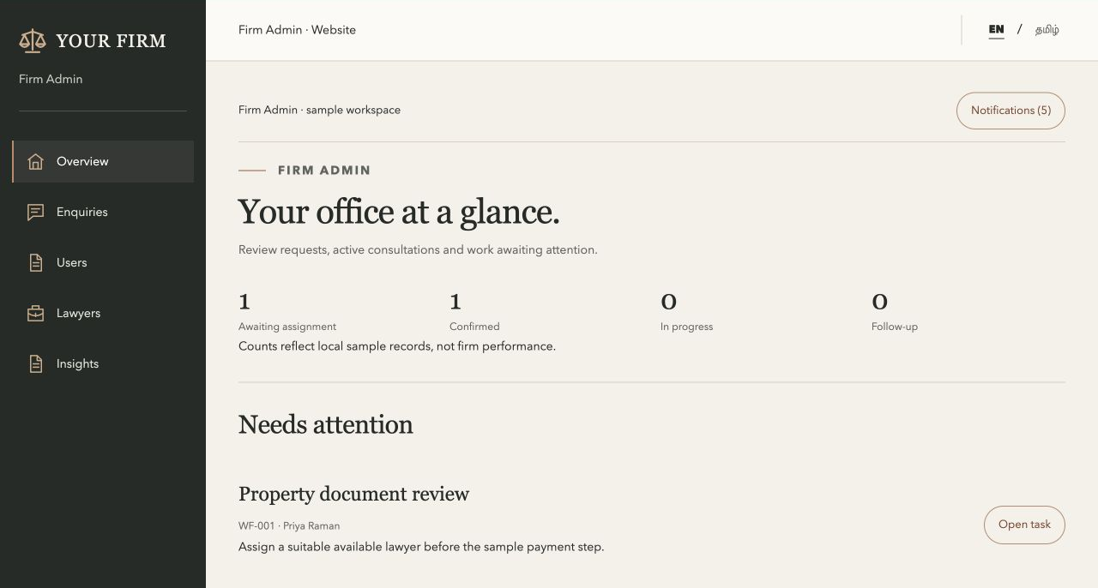
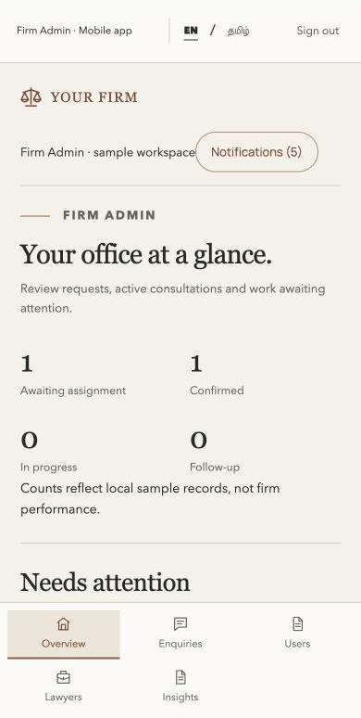
ACROSS WEBSITE & APP
The firm journey, from request to closure.
WEBSITE
APP PREVIEW
Review requests → Assign → Track progress → Review payments and outcomes → Close or reopen
YOUR FIRM
09
Notes:
Actual browser screenshots of the published synthetic demonstration: website and 390px mobile-app preview. Browser-local sample records; native mobile apps are not yet released. Workflow labels are editable text.

Slide 10
DOCUMENTS & ADVICE
Share the advice. Control the internal record.
The consultation links the documents, but does not make every note client-visible.
01
02
03
Client documents
Internal outcome
Shared summary
Upload and maintain Word, PDF and JPEG files against the booking. Track requests and review progress.
The assigned lawyer records working notes and the outcome for authorised firm users.
The client receives a separate summary, agreed actions and any follow-up requirement.
Production delivery requires private file storage, server-enforced access, retention rules and auditable changes.
YOUR FIRM
10

Slide 11
PAYMENTS & APPOINTMENT RULES
Agree the commercial journey before launch.
The original proposal includes both booking payment and an hours-based payment after consultation.
AT BOOKING
AFTER CONSULTATION
Deposit or full fee?
Time, rate and balance
Define when the slot is reserved and how long the client has to pay.
Agree duration approval, rounding and how earlier payments are reconciled.
Also decide: supported currencies • cancellations and refunds • no-shows • paid follow-ups. No live charges in the demo.
YOUR FIRM
11

Slide 12
BEYOND THE INITIAL REQUIREMENTS
Useful improvements around the core service.
OTP, profile editing, payments and account management were already requirements. These are additional workflow improvements.
01
Guided service selection
02
Separate client summaries
Help uncertain visitors reach a suitable consultation.
Keep internal outcomes distinct from client-facing advice.
03
Document preparation
04
Controlled follow-through
Request missing items and track versions and review status.
Link follow-up work, approve rescheduling and check closure readiness.
YOUR FIRM
12
Notes:
Additional demo refinements, not claims that these are original vendor requirements. Firm performance visualisations are an owner-requested enhancement to the original dashboard and reports scope.

Slide 13
DELIVERY SCOPE
From demonstration to daily operation.
The published experience lets the firm review journeys; it does not yet run real consultations.
Now
Build
Complete
Review the experience
Connect real services
Finish operating controls
Role-based journeys, sample records, mock checkout and OTP, profile editing, people management and activity charts.
Shared database, private files, secure accounts, SMS, payment gateway, Meet links and reliable push reminders.
Hourly settlement, currencies, holidays and booking cut-offs, password management, reports and Excel exports.
Native Android/iOS delivery, app-store release and production device testing remain ahead. No launch date or price is committed here.
YOUR FIRM
13

Slide 14
ACCEPTANCE & NEXT STEPS
Approve the service. Validate the operation.
Progress is measured by complete journeys, not by the number of screens.
01
02
03
Confirm scope
Validate end to end
Prepare launch
Review this deck and the interactive journeys. Resolve the firm decisions and approve the requirements.
Test booking, payment outcomes, private documents, role access, reminders and follow-up with connected services.
Complete device testing, firm-user acceptance, backups, monitoring, training and support arrangements.
Open the interactive experience →
YOUR FIRM
14

