Slide 1
Dataset Analysis
CodeAlpha Internship – Data Analytics (Task 3)
Data Visualization Report

Slide 2
Introduction
Analysis of 891 Titanic passengers.
Focus: age, class, fare, gender, and survival patterns.
Through five carefully designed visualizations, this report uncovers patterns and insights related to passenger demographics and survival rates

Slide 3
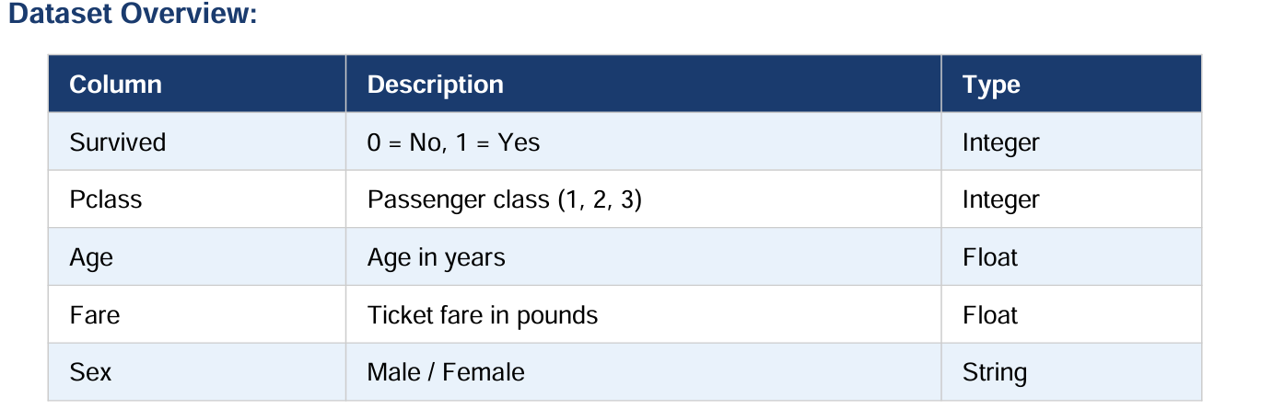
Dataset Overview
Key fields:
• Survived
• Passenger Class (Pclass)
• Age
• Fare
• Sex

Slide 4
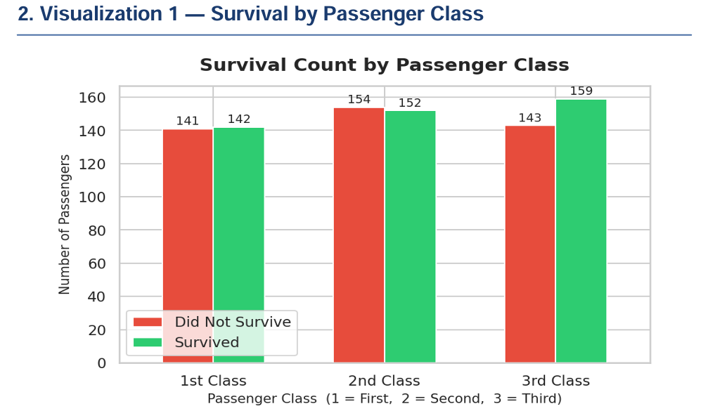
Survival by Passenger Class
1st class passengers had the highest survival rates.
3rd class passengers experienced the most fatalities.

Slide 5
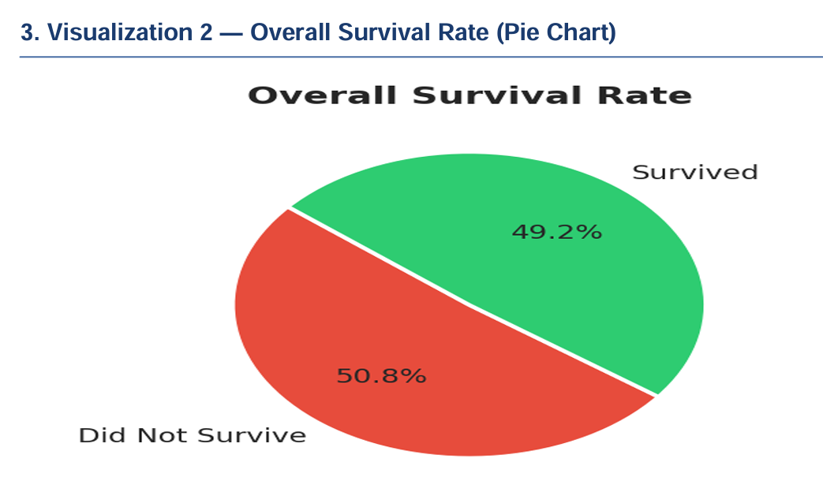
Overall Survival Rate
Approximately 38–50% of passengers survived depending on dataset interpretation.
The disaster resulted in significant loss of life.

Slide 6
Age Distribution
Most passengers were young adults aged 20–35.
Children formed a smaller but important group.

Slide 7
Correlation Analysis
Passenger class and fare were the strongest indicators of survival.
Age had a weaker relationship.

Slide 8
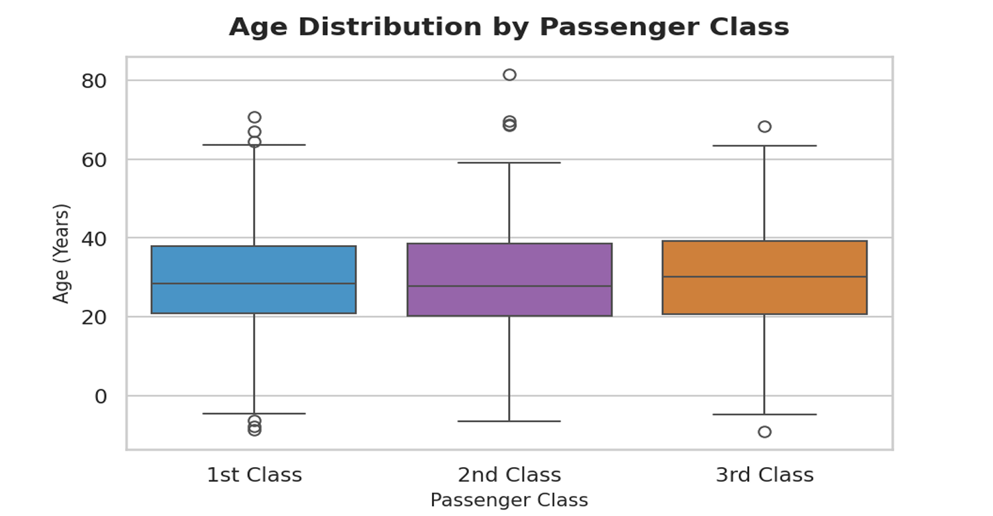
Age Distribution by Class
1st class passengers were generally older.
2nd class showed the widest age range.

Slide 9
Conclusion
Survival was strongly influenced by socioeconomic factors.
Only ~38% of all passengers survived the disaster overall.
The majority of passengers were young adults in the 20–30 age range.
Higher fare correlated positively with survival chances.
First-class passengers were older on average than second and third class passengers
Data visualization helps reveal hidden trends and insights.

