Slide 1
Sentiment Analysis
8
Report
Positive Reviews
5
CodeAlpha Internship | Data Analytics Domain
Negative Reviews
Task 4 – Sentiment Analysis
15
Total Reviews
Tools: Python • VADER Sentiment • Pandas • Matplotlib

Slide 2
What is Sentiment Analysis?
Sentiment Analysis (Opinion Mining) is an NLP technique used to determine whether text expresses a Positive, Negative, or Neutral emotion. It is widely used by businesses to understand customer feedback and monitor brand reputation.
😊 Positive
😞 Negative
😐 Neutral
Customer is satisfied.
Score > +0.05
Customer is dissatisfied.
Score < -0.05
No clear opinion.
-0.05 to +0.05
⚙️ VADER Sentiment: A rule-based NLP tool that scores text from -1.0 (most negative) to +1.0 (most positive)
15
8
53.3%
33.3%
Reviews Analyzed
Product Categories
Positive Rate
Negative Rate

Slide 3
Dataset — 15 Amazon Product Reviews
# | Category | Sentiment | Score
1 | Electronics | Positive | 1
2 | Electronics | Negative | -0.4
3 | Home | Neutral | 0
4 | Home | Positive | 0.73
5 | Fashion | Negative | -1
6 | Fashion | Positive | 1
7 | Books | Neutral | 0
8 | Books | Positive | 1
9 | Beauty | Negative | -0.62
10 | Beauty | Positive | 1
11 | Sports | Positive | 0.73
12 | Sports | Negative | -0.62
13 | Kitchen | Positive | 1
14 | Kitchen | Negative | -1
15 | Toys | Positive | 1

Slide 4
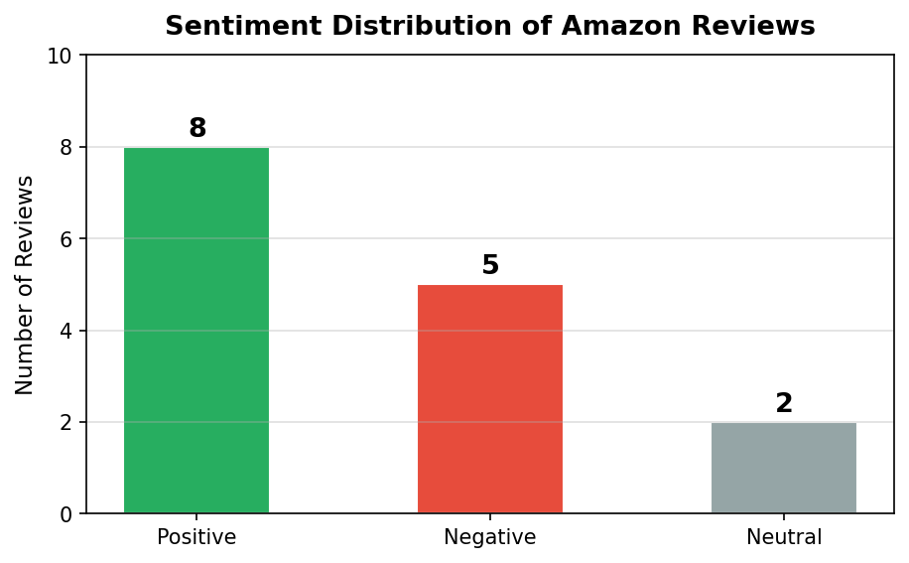
Visualization 1 — Sentiment Distribution (Bar Chart)
1/4
Analysis
Out of 15 reviews analyzed:
✅ 8 reviews (53.3%) were Positive
❌ 5 reviews (33.3%) were Negative
➖ 2 review (13.3%) was Neutral
The bar chart clearly shows that Positive reviews dominate the dataset.
💡 Key Insight: 53.3% of reviews were Positive, indicating strong overall customer satisfaction. Businesses can track this over time to monitor quality.

Slide 5
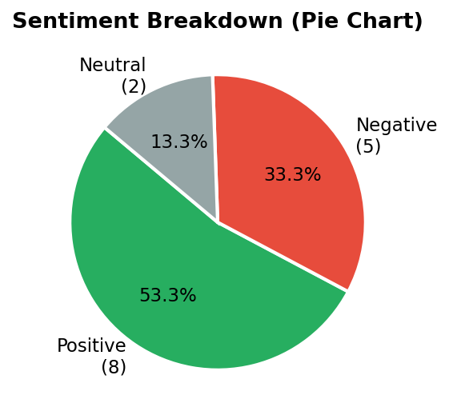
Visualization 2 — Sentiment Breakdown (Pie Chart)
2/4
Analysis
The pie chart shows the proportional split:
• Positive: 53.3% (green)
• Negative: 33.3% (red)
• Neutral: 13.3% (gray)
Green clearly dominates, meaning most customers had a satisfying experience with Amazon products.
💡 Key Insight: Over half of reviews were Positive. The 33.3% Negative rate highlights specific areas where product quality or delivery needs improvement.

Slide 6
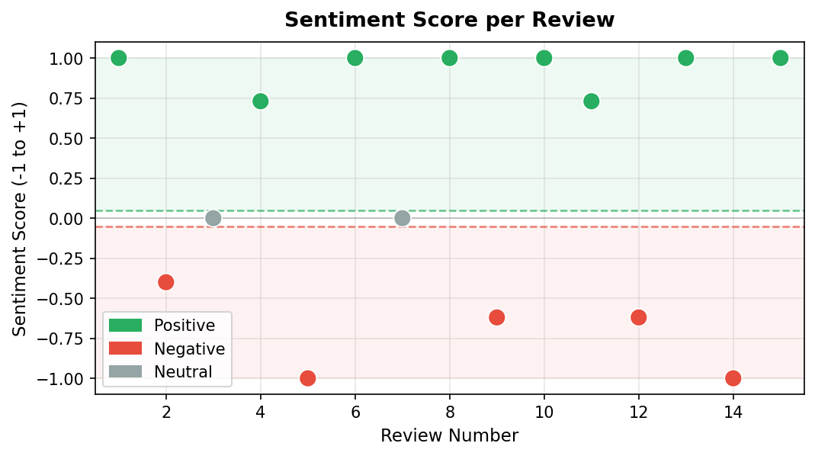
Visualization 3 — Sentiment Score per Review (Scatter)
3/4
Analysis
Each dot represents one review.
• Dots ABOVE green line → Positive
• Dots BELOW red line → Negative
• Dots IN BETWEEN → Neutral
The scatter plot shows most reviews cluster strongly at either end — very few neutral opinions.
💡 Key Insight: Reviews are clearly polarized: customers either love or hate a product. Very few sit in the neutral middle zone, showing strong emotional reactions.

Slide 7
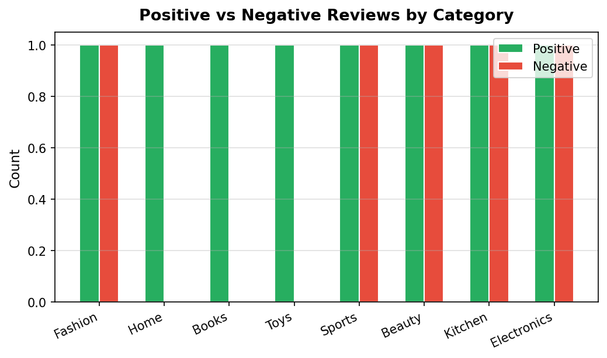
Visualization 4 — Positive vs Negative by Category
4/4
Analysis
Each product category is compared side-by-side:
• Green bars = Positive reviews
• Red bars = Negative reviews
All 8 Amazon categories received a mix of positive and negative feedback, reflecting the reality of diverse customer experiences.
💡 Key Insight: Every category had both Positive and Negative reviews. Marketing teams can use this to focus customer service efforts on the most-criticized product lines.

Slide 8
Conclusion & Key Findings
Sentiment Analysis proves that AI can understand human emotions in text — helping businesses act on customer feedback at scale.
✅ 53.3% of reviews were Positive — customers were mostly satisfied with products
❌ 33.3% of reviews were Negative — product quality and delivery need attention
➖ 13.3% were Neutral — some customers had average, unremarkable experiences
📊 Sentiment scores were strongly polarized — very few reviews fell in the neutral zone
🗂️ All 8 product categories had a mix of positive and negative customer feedback
🤖 Sentiment Analysis saves businesses thousands of hours of manual review reading

Slide 9
References
1. Hutto, C. J., & Gilbert, E. (2014). VADER: A parsimonious rule-based model for sentiment analysis of social media text. Proceedings of the 8th AAAI Conference on Weblogs and Social Media.
2. Pang, B., & Lee, L. (2008). Opinion mining and sentiment analysis. Foundations and Trends in Information Retrieval, 2(1–2), 1–135.
3. Liu, B. (2012). Sentiment analysis and opinion mining. Morgan & Claypool Publishers.
4. Amazon. (2023). Amazon customer reviews dataset. Amazon Web Services. https://aws.amazon.com/datasets/
5. Bird, S., Klein, E., & Loper, E. (2009). Natural language processing with Python. O'Reilly Media.
6. Hunter, J. D. (2007). Matplotlib: A 2D graphics environment. Computing in Science & Engineering, 9(3), 90–95.

