Slide 1
CHAPTER 2
OPERATORS IN "C++"

Slide 2
Session Objectives
Constants,Variables Declaration & Initialization
Explain 9 Types of Operators
Explain Arithmetic Operators
Understand Arithmetic Expressions
Explain Relational and Logical Operators
Explain the Conditional Operators
Explain Scope Resolution Operators

Slide 3
CHARACTER SET
A Character denotes an alphabet, digit or a special character. These characters can be combined to form variables.
Lowercase Letters – A,B,C….. Z
Uppercase Letters - a,b,c…… z
Alphabets :
Digits :
Digits – 0,1,2,3,…7,8,9
+ Plus Sign - Minus Sign , Comma
* Asterisk / Slash = Equal to
@ At Symbol < Less Than : Colon
; Semicolon
Special Characters :

Slide 4
C++ CONSTANTS
Numeric Constant
Character Constant
Integer
Real
Single Character
String
10
-356
4600.5
-0.963
“A”
“CSC”
‘A’
‘*’

Slide 5


VARIABLES
Variables are named locations in memory that are used to
hold a value that may be modified by the program.
The syntax for declaring a variable is
Data type Variablename;
Valid Examples :
CSC avg_val m1 Chennai Anu mark_1
Some erroneous identifier names are -
1stsst
oh!god
start….end

Slide 6
RULES for framing a variable :
The first character in the Variable name must be an alphabet
Alphabets can be followed by a number of digits or underscores
No commas or Blank spaces are allowed within a variable name
No Special character other than Underscore(_) can be used in a variable name.
The variable name should not be a keyword
Variable names are case sensitive
It should not be of length more than 31 characters

Slide 7
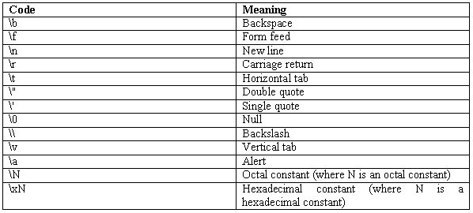
Escape Sequence
Escape sequences are specified as the first argument in
Output Statement. They are always preceded with a
backslash

Slide 8
Programming Structure
Preprocessor Directives (Incl. HeaderFile)
Global Variable Declarations;
class<class name>
{
private :
member data;
public :
Member functions;
};
void main(){
Local Variable Declarations;
Input/Output Statements;
}

Slide 9
Preprocessor Directives
Preprocessor directives are the instructions given to the
compiler.
They are not translated into machine language, but are
operated upon directly by the compiler before the
compiling process begins.
Preprocessor directives begin with a # (hash)
Preprocessor directives are often placed in the beginning of a program before the main() is declared.

Slide 10
HEADER FILE
A lot of library functions are subdivided into number of groups. This groups are called Header files.
Syntax : | #include<headerfilename.h>
Examples: | #include<iostream.h> #include<process.h>
iostream -> Input/Output Stream Conio -> Console Input/Output Void -> Keyword. It Means Returns Nothing main() -> It is a function name which can be used to indicate the beginning of the program execution

Slide 11
COMMENT LINES
The comment statements are used in a program must be started with a pair of slashes (//)
They are may or may not be present in a program
It improves the readability of a program

Slide 12
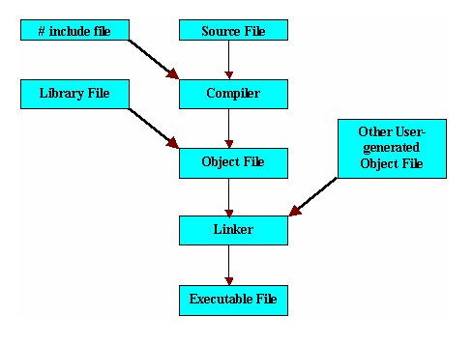
Compiling & Running A Program

Slide 13
DATA TYPES
Primary Data Types
Secondary Data Types
Character
Integer
Float
Double
structure
Union
Pointer
enum

Slide 14
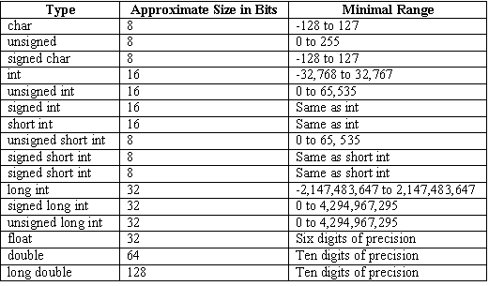
Primary Data Types

Slide 15
Secondary Data Types
1.Type Definition
Example: Typedef int age;
age male,female
2.Enumerated Datatype
Example :
enum mon{jan,feb,mar,apr,may,jun,jul,aug,sep,oct,nov,dec };

Slide 16
Arithmetic Operator
Relational Operator
Logical Operator
Assignment Operator
Increment/Decrement Operator
Conditional Operator
Bitwise Operator
Special Operator
Scope Resolution Operator

Slide 17
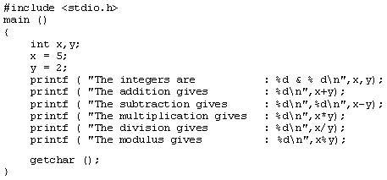

Arithmetic Operators
Arithmetic Operators are used to perform numerical operations
Operator | Meaning | Example
+ | Addition | x=10,y=5 x+y -> 21
- | Subtraction | X-y -> 5
* | Multiplication | X*y -> 50
/ | Division | x/y -> 2
% | Modulo Division | X%y -> 0

Slide 18
Relational Operators
Relational operators are used to test the relationship between two variables or constant
Operator | Meaning | Example | Result | value
< | Less Than | x=10,y=5 X<y | False | 0
> | Greater Than | X>y | True | 1
<= | Less than or Equal to | X<=y | False | 0
>= | Greater than or equal to | X>=y | True | 1
!= | Not Equal to | X!=y | False | 0
== | Equal To | X==y | False | 0

Slide 19
Logical Operators
Logical operators are used to combine two or more relational expressions. This operator is used to test more than one condition at a time.
Operator | Meaning | Example | Result
&& | Logical And | When x=9, y=5 (x>=5) && (z==‘9’) | True
|| | Logical Or | (X>=6) || (z==‘a’) | True
! | Logical Not | !(x>8) | False
Increment / Decrement Operators (++,--)
Operator | Meaning | Syntax | Example | Result
++ | Unary Plus | Variablename++; (or) ++ variable name; | X=10; X++; | X=11
-- | Unary Minus | Variablename--; (or) -- variable name; | X=10; X--; | X=9

Slide 20

Conditional Operators (?:)
Simple conditional operations can be carried out with the conditional operator(?:)
Syntax
Expression1 ? Expression 2:expression 3
Condition
True Part
False Part
#include<iostream.h>
void main()
{
int a=10,b=5,c;
C=(a>b)?a:b;
cout<<“The Result is“<<c;
}
OUTPUT
The Result is 10

Slide 21

The Assignment Operator
In C++, the assignment operator(=) can be used for assigning a value to a variable
Syntax :
variable_name = expression;
LeftHand side variable
Assignment
operator
RightHand Side value

Slide 22
Shorthand Assignment Operator
Syntax
Variablename <arithmetic Operator>=Expression;
Simple Assignment Operators | Equivalent Shorthand Assignment Operators
x=x+1 | X += 1
y=y-1 | Y =- 1
z=z*(x+y) | Z *= (x+y)
Y=y/(x+y) | Y /= (x+y)
X=x%z | X %= z

Slide 23
BitWise Operators
Used in applications which require manipulation of individual bits within a word of memory
Operators | Meaning
~ | One’s Complement
<< | Left Shift
>> | Right Shift
& | Bitwise AND
! | Bitwise OR
^ | Bitwise X-OR
Special Operators
Operators | Meaning | Example
, | Comma Operator | Z=(x=5,y=6,x+y)
* | Pointer Operator

Slide 24
SCOPE RESOLUTION
OPERATOR ::
Used to define the member function defined outside of the class

Slide 25
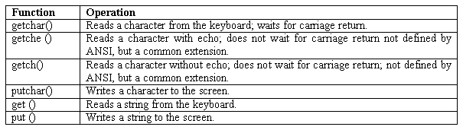
Unformatted I/O Statement
Characters can be read and written in C using the following functions.

Slide 26
Input/Output Statement
cin
It uses the standard input stream cin and the operator >> for reading the input.
It is an extraction operator used to take the values from stream object on its left and places the variable to its right.
Syntax :
cin>>variablename;
Example :
cin>>name>>age>>salary;

Slide 27
Output Statement
cout
It uses the standard output stream cout and the operator << for writing the output.
It is an insertion operator used to redirects the text output to the screen.
Syntax :
cout<<“message”<<variablename;
Example :
cout<<“The Name is”<<name;
cout<<name<<age<<salary;

Slide 28
Input/Output Statement Example
#include<iostream.h>
#include<conio.h>
const int MAX=80;
void main()
{
char s[MAX];
clrscr();
cout<<"\n Enter Your String :";
cin>>s;
cout<<"\n Your String is "<<s;
getch();
}

Slide 29
‘Const’ Keyword Example
#include<iostream.h>
#include<iomanip.h>
#include<conio.h>
const int MAX=80;
void main()
{
char s[MAX];
clrscr();
cout<<"\n Enter Your String :";
cin>>setw(MAX)>> s;
cout<<"\n Your String is "<<s;
getch();
}

Slide 30
Summary
C++ provides two pre-defined objects cin and cout for handling input and output
The stream extraction operator along with cin statement is used for reading input
The stream insertion operator along with cout statement is used for displaying the output
The comment statements are used in a program must be started with a pair of slashes (//)
The preprocessor directives <#include<iostream.h> refers to a special file which contains the information about the standard input and output operations which must be included in the program when it is compiled

Slide 31
REVIEW QUESTIONS
Explain briefly classes & Objects?
Explain about the declaration of variables in C++?
State the use of #include directive in C++?
Explain the use of memory management Operators in C++?
State the use of type cast operator in C++?

