Slide 1
' C ' PROGRAMMING
COMPUTER SOFTWARE COLLEGE, T.NAGAR

Slide 2

CHAPTER 1
"C" FUNDAMENTALS
COMPUTER SOFTWARE COLLEGE, T.NAGAR

Slide 3
Session Objectives
Discuss the Origin of C
Features of C
Characteristics of C
Current Uses of C
“C” Programming Structure
Character Set
COMPUTER SOFTWARE COLLEGE, T.NAGAR

Slide 4
“C” is a Middle Level language
LOW LEVEL
HIGH LEVEL
+
LANGUAGE
LANGUAGE
“C” is a compiler based Language
“C” is a Case Sensitive Language
COMPUTER SOFTWARE COLLEGE, T.NAGAR

Slide 5
The Origin of “C”
“C” is a Structure & Procedure Oriented Programming language developed by Dennis Ritchie at AT&T Bell Laboratories in USA in the Year 1972
BCPL - Martin Richards
(Basic Combined Programming Language)
B - Ken Thompson
C - Dennis Ritchie
COMPUTER SOFTWARE COLLEGE, T.NAGAR

Slide 6
Features of “C” Language
Economy of Expressions
Modern Control Flow and Structures
Rich Set of Operators
It is Well suited for writing both System Software like Operating Systems, Interpreters, Editors and Assembly Programs
COMPUTER SOFTWARE COLLEGE, T.NAGAR

Slide 7
CURRENT USES OF "C"
UNIX Operating System was Developed by Using “C”
Language
Developing database Systems
Graphics Packages
Spread Sheets
Word Processors
Office automation
Scientific/Engineering Applications
CAD/CAM Applications
COMPUTER SOFTWARE COLLEGE, T.NAGAR

Slide 8
Programming Structure
Preprocessor Directives (Incl. headerFile)
Global Variable Declarations;
void main()
{
Local Variable Declarations;
Input/Output Statements;
}
Note :
Every “C” Statements should end with Semicolon(;)
COMPUTER SOFTWARE COLLEGE, T.NAGAR

Slide 9
The C Program Structure
main()
Delimiters { ... }
/* Comment Lines */
COMPUTER SOFTWARE COLLEGE, T.NAGAR

Slide 10
Preprocessor Directives
Preprocessor directives are the instructions given to the
compiler.
They are not translated into machine language, but are
operated upon directly by the compiler before the
compiling process begins.
Preprocessor directives begin with a # (hash)
Preprocessor directives are often placed in the beginning of a program before the main() is declared.
COMPUTER SOFTWARE COLLEGE, T.NAGAR

Slide 11
HEADER FILE
A lot of library functions are subdivided into number of groups. This groups are called Header files
Syntax : | #include<headerfilename.h>
Examples: | #include<stdio.h> #include<conio.h>
Stdio -> Standard Input/Output Conio -> Console Input/Output Void -> Keyword. It Means Returns Nothing. main() -> It is a function name which can be used to indicate the beginning of the program execution
COMPUTER SOFTWARE COLLEGE, T.NAGAR

Slide 12
Important Topics in c Language:
1. Variables
2. Data Types
3. Constants
4. Operators
5. Booleans
6. Comments

Slide 13
Variables
Variables are containers for storing data values,
like numbers and characters
Rules for Naming Variables in C
A variable name must only contain alphabets, digits, and underscore.
A variable name must start with an alphabet or an underscore only.
It cannot start with a digit.
No whitespace is allowed within the variable name.
A variable name must not be any reserved word or keyword.

Slide 14
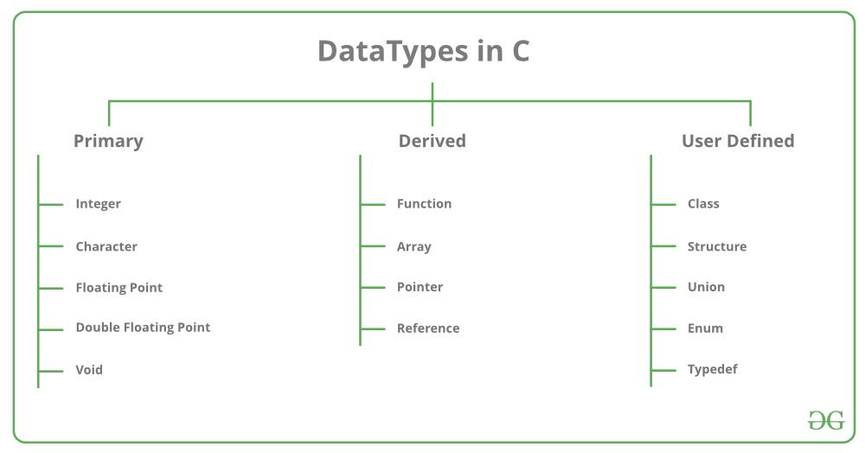
Data Types
Each variable in C has an associated data type.
It specifies the type of data that the variable can store
like integer, character, floating, double, etc.
Eg.
Int a=10;
Float b=5.6;

Slide 15
Constants
This will declare the variable as "constant",
which means unchangeable and read-only:
Eg.
const int minutesPerHour = 60;
const float PI = 3.14;

Slide 16
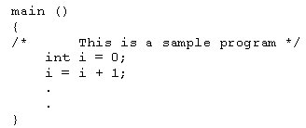
HINTS
C has 32 keywords.
These keywords combined with a formal syntax form a C
programming language.
Rules to be followed for all programs written in C
All keywords are lowercased
C is case sensitive, do while is
different from DO WHILE
Keywords cannot be used as a
variable or function name
COMPUTER SOFTWARE COLLEGE, T.NAGAR

Slide 17
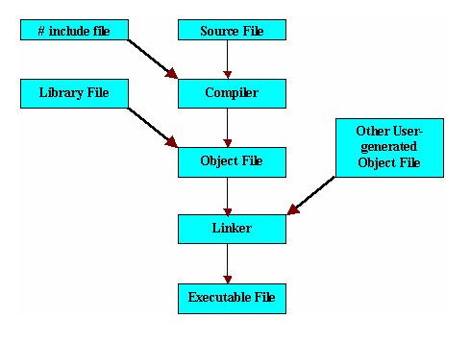
Compiling & Running A Program
COMPUTER SOFTWARE COLLEGE, T.NAGAR

Slide 18
STEPS IN LEARNING "C"
Programs
Instructions
Keywords
Constants, variables & Data Types
Alphabets, Digits,Special Characters
COMPUTER SOFTWARE COLLEGE, T.NAGAR

Slide 19

CHARACTER SET
A Character denotes an alphabet, digit or a special character. These characters can be combined to form variables.
Lowercase Letters – A,B,C….. Z
Uppercase Letters - a,b,c…… z
Alphabets :
Digits :
Digits – 0,1,2,3,…7,8,9
+ Plus Sign - Minus Sign , Comma
* Asterisk / Slash = Equal to
@ At Symbol < Less Than : Colon
; Semicolon
Special Characters :
COMPUTER SOFTWARE COLLEGE, T.NAGAR

Slide 20

'C' CONSTANTS
Numeric Constant
Character Constant
Integer
Real
Single Character
String
10
-356
4600.5
-0.963
“A”
“CSC”
‘A’
‘*’
COMPUTER SOFTWARE COLLEGE, T.NAGAR

Slide 21
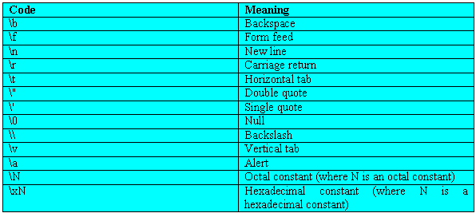
Escape Sequence
Escape sequences are specified as the first argument in
Output Statement. They are always preceded with a
backslash
COMPUTER SOFTWARE COLLEGE, T.NAGAR

Slide 22
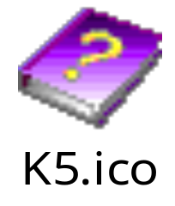


VARIABLES
Variables are named locations in memory that are used to
hold a value that may be modified by the program.
The syntax for declaring a variable is
Data type Variablename;
Valid Examples :
CSC avg_val m1 Chennai Anu mark_1
Some erroneous identifier names are -
1stsst
oh!god
start….end
COMPUTER SOFTWARE COLLEGE, T.NAGAR

Slide 23
RULES for framing a variable :
The first character in the Variable name must be an alphabet
Alphabets can be followed by a number of digits or underscores
No commas or Blank spaces are allowed within a variable name
No Special character other than Underscore(_) can be used in a variable name.
The variable name should not be a keyword
Variable names are case sensitive
It should not be of length more than 31 characters
COMPUTER SOFTWARE COLLEGE, T.NAGAR

Slide 24
DATA TYPES
Primary Data Types
Secondary Data Types
Character
Integer
Float
Double
structure
Union
Pointer
enum
COMPUTER SOFTWARE COLLEGE, T.NAGAR

Slide 25
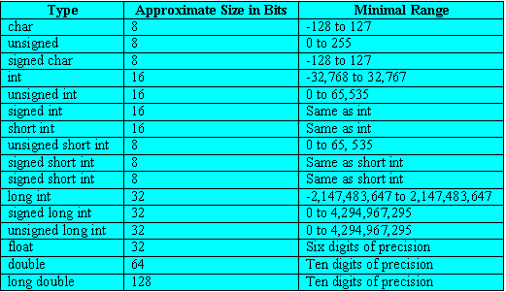
Primary Data Types
COMPUTER SOFTWARE COLLEGE, T.NAGAR

Slide 26
Secondary Data Types
1.Type Definition
Example: Typed
ef int age;
age male,female
2.Enumerated Datatype
Example :
enum mon{jan,feb,mar,apr,may,jun,jul,aug,sep,oct,nov,dec };
COMPUTER SOFTWARE COLLEGE, T.NAGAR

Slide 27
Session Summary
All variables must be declared in the program before all executable statement
Comments statements may or may not be present in a program
Comment statement improves the readability of a program
A program will always begin by executing the main() function
Every C program must contain atleast one function which must be a main()
COMPUTER SOFTWARE COLLEGE, T.NAGAR

Slide 28
EXERCISES
Why it is required to include header files your C program?
What is #include statement? Indicate its use?
Why is the main() function is so special
Write a program to calculate Simple and Compound Interest?
State the use of comment symbol in a program?
Describe the types of constants? Give example?
COMPUTER SOFTWARE COLLEGE, T.NAGAR

Slide 29
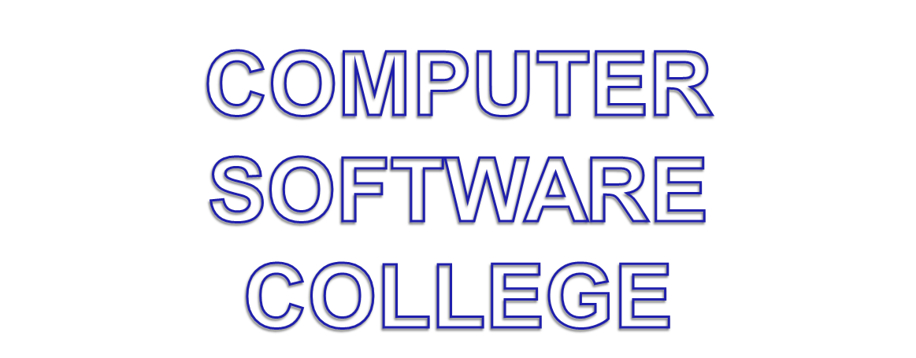
COMPUTER SOFTWARE COLLEGE, T.NAGAR

