Slide 1
Dynamic Memory Allocation
[ It is the process of allocating memory during Runtime (Execution Time) ]

Slide 2
Dynamic Memory Management Technique
Used to allocate additional memory space or to release the unwanted memory space at runtime
Used to optimize the use of storage space
The programmer can allocate memory whenever he decides and releases it after using the memory
Library Functions
malloc()
calloc()
realloc()
free()
alloc.h

Slide 3
malloc() Function
Used to allocate a contiguous block of memory in bytes.
Syntax :
Ptr_name= (*cast type) malloc(int size);
Example 1:
ptr=(int*)malloc(10);
Example 2 :
char (*a)[20];
A=(char*) malloc(10*20*sizeof(char));
Note :
If the memory allocation is success it returns the starting address else if returns NULL

Slide 4

free() function
Used to free (release or deallocate) the block of unused or already used memory
Syntax :
free(pointer_variable);
Example 1:
ptr=(int*)malloc(10);
free(ptr);

Slide 5
/* malloc() Function Example */
#include<stdio.h>
#include<alloc.h>
#include<process.h>
void main()
{
char *str;
if((str=(char *)malloc(10))==NULL){
printf("Not enough memory to allocate buffer\n");
exit(1);}
strcpy(str,"Helloworld");
printf("String is %s\n",str);
free(str);
}
Output
String is HelloWorld

Slide 6
malloc() Example 2
#include<stdio.h>
#include<conio.h>
void main()
{
int *ptr; //static memory allocation
clrscr();
ptr=(int *) malloc(sizeof(int));
*ptr=100;
printf("\n%u\n",ptr); //address of ptr
printf("\n%d\n",*ptr);
free(ptr);
getch();
}
/* note : int *ptr=100 means 100 is a address
*ptr=100 means 100 is a value */

Slide 7
To allocate memory using malloc and deallocate using free
#include<stdio.h>
#include<alloc.h>
void main()
{
int *sptr,i;
int *startptr;
sptr=(int *) malloc(sizeof(int)*5);
startptr=sptr; /*startptr maintain the base address(Ist Address) */
*sptr=100;
sptr++;
*sptr=200;
sptr++;
*sptr=400;
sptr++;
*sptr=300;
sptr++;
*sptr=500;
sptr=startptr; /*assign the address of first data into the sptr; */
for(i=0;i<5;i++)
{
printf("%d\n",*sptr);
sptr++;
}
sptr=startptr;
free(sptr); /* take sometime for deallocation */
sptr=NULL; /* so assign the null value you can't retrieve the data */
startptr=NULL;
}

Slide 8
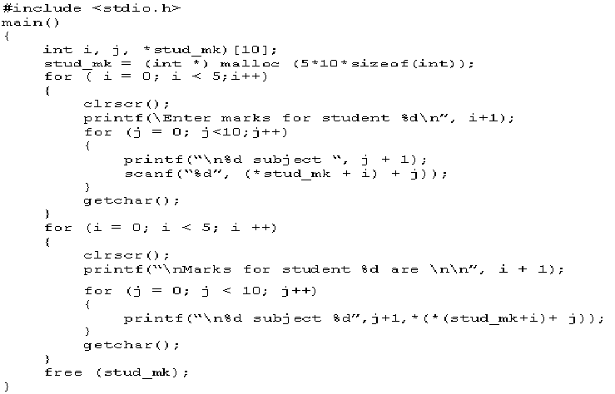
Allocating Memory
The following example uses a two-dimensional array to record
marks of 5 students for 10 subjects.
It uses pointers and malloc() function, to assign memory.

Slide 9
Pointer Increment process but malloc allocates memory only for 4 bytes
#include<stdio.h>
#include<conio.h>
void main()
{
int *ptr; //static memory allocation
clrscr();
ptr=(int *) malloc(sizeof(int)*2); //allocate 4 bytes
*ptr=100;
ptr++; // increment 2 bytes
printf("\n ptr 1= %d\n",*ptr);
*ptr=150;
ptr++;
printf("\n ptr 2= %d\n",*ptr);
*ptr=200;
ptr++;
printf("\n ptr 3= %d\n",*ptr);
*ptr=300;
ptr++; // increment 2 bytes
printf("\n ptr 4= %d\n",*ptr);
free(ptr);
getch();
}

Slide 10
calloc() Function
calloc() used to allocate multiple blocks of contiguous memory in bytes. All the blocks are of same size.
Syntax :
Ptr_name= (*cast type) calloc(No.of blocks,int size);
Example 1:
ptr=(int*)calloc(5,10);
On execution of this function 5 memory blocks of size 10 bytes are allocated and the starting address of the first byte is assigned to the pointer ptr of type int

Slide 11
/* Calloc() Function example */
#include<stdio.h>
#include<string.h>
#include<alloc.h>
void main()
{
char *str=NULL;
str=(char *)calloc(20,sizeof(char));
strcpy(str,"Welcome to world");
printf("String is %s\n",str);
free(str);
}
Output
String is Welcome to World

Slide 12
realloc() Function
This function used to increase or decrease the size of memory already allocated by using malloc() or calloc() function
Syntax :
newPtr_name= (*cast type) realloc(old_ptr,int newsize);
Example 1:
y=(int*)malloc(50)
ptr=(int*)realloc(y,30);

Slide 13
//REALLOC() FUNCTION EXAMPLE
#include<stdio.h>
#include<string.h>
#include<alloc.h>
void main()
{
char *str;
str=(char *)malloc(5);
strcpy(str,"Kalai");
printf("String is %s\n Address is %u\n",str,str);
str=(char *)realloc(str,5);
strcpy(str,"Sangeetha");
printf("String is %s\n New Address is %u\n",str,str);
free(str);
}
String is Kalai address is 65524
String is Sangeetha address is 65524
Output

Slide 14
Session Summary
Like all variables a pointer must be declared before they are used
The indirection (or) the deferencing operator is used to access the value of an address in a pointer
The three values that can be used to initialize a pointer are zero, null and address
A pointer that has not been initialized is referred to as the dangling pointer
Arrays are automatically passed by reference since the value of the array name is the address of the array
Call by reference is the process of calling a function using pointers to pass the address as argument must include a pointer as its parameter.

Slide 15
EXERCISES
Write a program to find the largest number in an array using pointers
Write a program to sort the strings in alphabetical order using pointers
Write a program to copy one string to another using pointers
Write a program to reverse an array using pointers?
Write a program to count the number of vowels in an array of characters using pointers?
Write a program to search an element in an array of “N” elements using pointers?

