Slide 1
Pointers With Arrays
The address of an array element can be expressed in two ways :
By writing the actual array element preceded by the ambersand (&) sign.
By writing an expression in which the subscript is added to the array name.

Slide 2
/* Array Using Pointers */
#include<stdio.h>
#include<conio.h>
void main()
{
int b[100],*iptr;
iptr=&b;
clrscr();
printf("The initial value of iptr is %u\n",iptr);
iptr++;
printf("Incremented value of iptr is %u\n",iptr);
getch();
}

Slide 3
POINTERS IN ARRAYS Example 2
#include<stdio.h>
#include<conio.h>
void main()
{
int arr[]={10,20,30,40};
int *ptr,i;
clrscr();
ptr=arr; // same as &arr[0];
printf("\n The Result of the array is ");
for(i=0;i<4;i++)
{
printf("%d\n",*ptr);
ptr++;
}
getch();
}
10
20
30
40
Output

Slide 4
Pointers as Function Arguments
When pointers are passed to a function :
The address of the data item is passed and thus the function can freely access the contents of that address from within the function
In this way, function arguments permit data-items to be altered in the calling routine and the function.
When the arguments are pointers or arrays, a call by reference is made to the function as opposed to a call by value for the variable arguments.

Slide 5
FUNCTION POINTER EXAMPLE
#include<stdio.h>
#include<conio.h>
int (* function) (int,int); /*function pointer prototype */
int addition(int a,int b)
{
return a+b;
}
int subtraction(int a,int b)
{
return a-b;
}
void main()
{
int val;
/* assign the func. addition into the function pointer */
function=addition;
/* Invoke the func. Addition */
val=(function) (20,100);
printf("\n Addition result =%d",val);
/* assign the function subtraction into the function pointer */
function=subtraction;
/* invoke the func. subtraction & syntax for function pointer call */
val=(function) (200,100); printf("\nSubtraction result =%d",val);
getch();
}

Slide 6
Pointers To Structures
Pointers to structures are allowed in C, but there are some special aspects to structure pointers that a user of pointers to structures must be aware of.
The following statement declares ptr as a pointer to data of that type -
struct book *ptr;

Slide 7
How the structure can be accessed by a pointer variable
#include<stdio.h>
#include<stdlib.h>
struct student
{
int roll_no;
char name[20];
float marks;
}st;
void main()
{
struct student *ptr;
printf("\n \t Enter the record");
printf("\n Enter the Roll Number");
scanf("%d",&st.roll_no);
printf("\n Enter the Name");
scanf("%s",st.name);
printf("\n Enter the Marks");
scanf("%f",&st.marks);
ptr=&st;
printf("\n display the details using structure variables");
printf( "%d %s %f", st.roll_no, st.name, st.marks);
printf("\n display the details using pointer variables");
printf( "%d %s %f",ptr->roll_no, ptr->name, ptr->marks);
}
void print_rec(int r,char n[ ],float m)
{
printf("\n You have Entered Following record");
printf("\n %d %s %f",r,n,m);
}

Slide 8
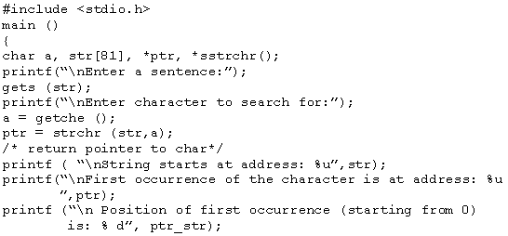

Pointers & Strings
Using strings as pointers can be explained with the help of the
Example
Output

