Slide 1
CHAPTER 9
UNIONS
CSC COMPUTER EDUCATION, M.K.B.NAGAR

Slide 2
Session Objectives
Discuss Unions
Create Union variable
Access Union member using . operator
Discuss Unions of Structures
Compare Structure and Array
Difference between structure & union
CSC COMPUTER EDUCATION, M.K.B.NAGAR

Slide 3
Unions are collection of different datatype grouped together under a single variable name for convienient handling.
syntax : union <union name >
{
datatype member1;
datatype member2;
};
union book
{
int pages;
char bookname[10];
char author[20];
float price;
};
CSC COMPUTER EDUCATION, M.K.B.NAGAR

Slide 4
For Example :
#include<stdio.h>
union amount
{
int ac_no;
char name[10];
char city [20];
int bal;
}a;
void main()
{
printf("Enter the account Details:\n");
scanf("%d%s%d",&a.ac_no, &a.name, &a.state, &a.bal);
printf(“%d\n%s\n%d\n", a.ac_no, a.name, a.city, a.bal);
printf("%d\n",sizeof(union amount));
getch();
}
CSC COMPUTER EDUCATION, M.K.B.NAGAR

Slide 5
/* For Example 2 */
#include<stdio.h>
#include<conio.h>
void main()
{
union a
{
int i;
char ch[2];
}a1;
a1.i=150;
clrscr();
printf("%d %c %c",a1.i,a1.ch[0],a1.ch[1]);
getch();
}
OUTPUT :
150 ã
CSC COMPUTER EDUCATION, M.K.B.NAGAR

Slide 6
Example 3 :
#include<stdio.h>
union amount
{
int acct_no;
int acct_type;
char name[10];
char street[50];
char city_state[20];
int balance;
}a;
void main()
{
printf("Enter the account Details:\n");
scanf("%d%d%s%s%d" ,&a.acct_no,&a.acct_type,&a.name,&a.city_state,&a.balance);
printf("The values are %d\n%d\n%s\n%s\n%d\n", a.acct_no, a.acct_type, a.name, a.city_state, a.balance);*/
printf("%d\n",sizeof(union amount));
}
CSC COMPUTER EDUCATION, M.K.B.NAGAR

Slide 7
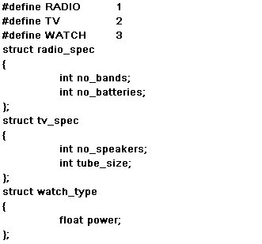
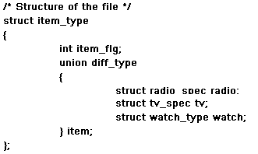
Unions of Structures
It is possible to nest unions within unions, unions in structures,
and structures in unions.
CSC COMPUTER EDUCATION, M.K.B.NAGAR

Slide 8
Session Summary
The union is another compound data type may hold the variables of different types and sizes with the compiler keeping track of the size.
The memory space reserved for a union members is large enough to store its largest member
The keyword “union” begins the union declaration followed by the tag (i.e., union name)
Within the braces union members are declared
CSC COMPUTER EDUCATION, M.K.B.NAGAR

Slide 9
EXERCISES
Define a union called student that will describe the following information student name,class,rollno, subject marks & total. Using student declare an array stu_list with 30 elements. Write program in C to read the information about all the 30 students and to display the information?
CSC COMPUTER EDUCATION, M.K.B.NAGAR

