Slide 1
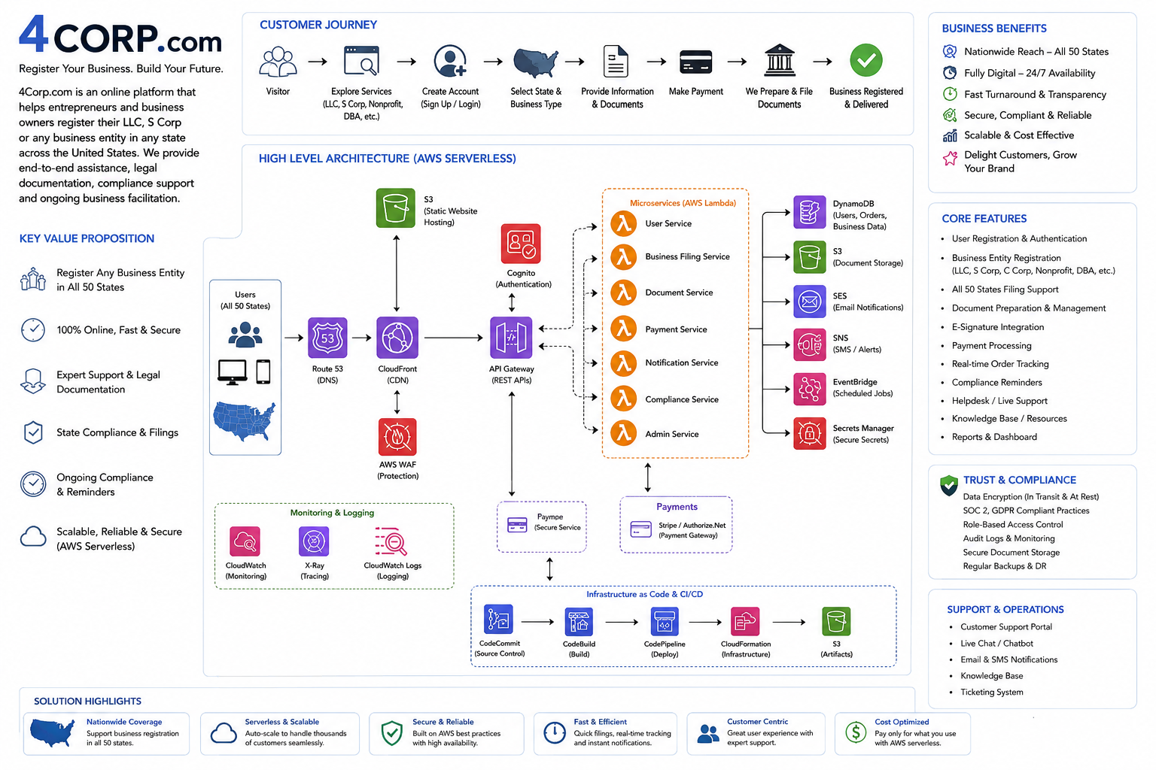
4Corp.com AWS Serverless Reference Architecture

