Slide 1
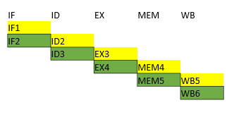
MIPS Simulator
Yong LI
2019/07/31

Slide 2
Agenda
Background
Assumptions
Naming convention
Instruction implemented
Main Components
Memory, Registers
Pipeline 5 stages
4 Latches
User Interfaces
Data Flow
Hazard handling
Data Hazard
Control Hazard

Slide 3
Assumptions
All instructions take 5 stages, no more no less
Reg writes completed at the 1st half cycle
Reg read completed at the 2nd half cycle
No forwarding, No interrupts, No branch prediction

Slide 4
Naming Convention
Clock starts from 1.
Stage + Clock:
ID2 : stage ID at Clock 2
EX3: stage EX at Clock 3
 | IF | ID | EX | MEM | WB
1 | IF1 |  |  |  |  |  | inst 1
2 | IF2 | ID2 |  |  |  |  | inst 2
3 |  | ID3 | EX3
4 |  |  | EX4 | MEM4
5 |  |  |  | MEM5 | WB5
6 |  |  |  |  | WB6

Slide 5
Instructions
16 totally
4 Categories
Branch
Load/Store
ALU-Reg-Imm
ALU-Reg-Reg
MUL function is different than standard MUL
 | ASM | Type | Type | Inst | Code
1 | beq $s, $t, offset | branch | I | beq | if $s == $t advance_pc (offset << 2)); else advance_pc (4);
2 | lw $t, offset($s) | load/store | I | lw | $t = MEM[$s + offset]; advance_pc (4);
3 | sw $t, offset($s) | load/store | I | sw | MEM[$s + offset] = $t; advance_pc (4);
4 | addi $t, $s, imm | alu_ri | I | addi | $t = $s + imm; advance_pc (4);
5 | andi $t, $s, imm | alu_ri | I | andi | $t = $s & imm; advance_pc (4);
6 | lui $t, imm | alu_ri | I | lui | $t = (imm << 16); advance_pc (4);
7 | ori $t, $s, imm | alu_ri | I | ori | $t = $s | imm; advance_pc (4);
8 | slti $t, $s, imm | alu_ri | I | slti | if $s < imm $t = 1; advance_pc (4); else $t = 0; advance_pc (4);
9 | sltiu $t, $s, imm | alu_ri | I | sltiu | if $s < imm $t = 1; advance_pc (4); else $t = 0; advance_pc (4);
10 | add $d, $s, $t | alu_rr | R | add | $d = $s + $t; advance_pc (4);
11 | and $d, $s, $t | alu_rr | R | and | $d = $s & $t; advance_pc (4);
12 | mul $d,$s,$t, | alu_rr | R | mul | $(d+1) = (uint32) MSB(s*t), $d = (uint32) LSB(s*t)
13 | or $d, $s, $t | alu_rr | R | or | $d = $s | $t; advance_pc (4);
14 | sll $d, $t, h | alu_rr | R | sll | $d = $t << h; advance_pc (4);
15 | srl $d, $t, h | alu_rr | R | srl | $d = $t >> h; advance_pc (4);
16 | sub $d, $s, $t | alu_rr | R | sub | $d = $s - $t; advance_pc (4);

Slide 6

Memory
- Address starts from 0
- 2048 Bytes.
uint8_t mem[2048]
- Addresses [0,4,8,12...2044]
- Instruction Mem/Data Mem

Slide 7
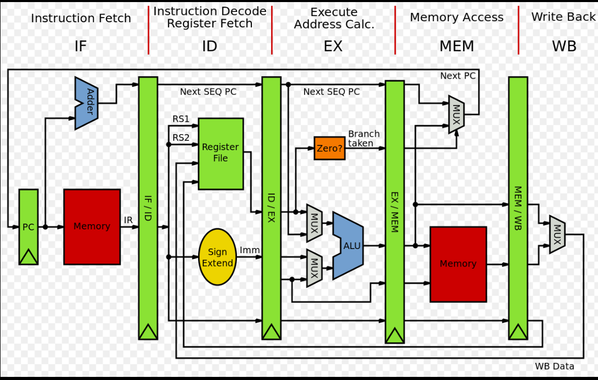
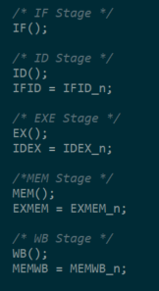
Stage Sequence
IF
ID
EX
MEM
WB
https://en.wikipedia.org/wiki/MIPS_architecture_processors
Notes:
All 5 stages are run simultaneously. ID cannot read what IF write at the same cycle, ID reads the last cycle IF output.
IF writes to new IFID_n, while ID read the IFID (old one), after ID stage, we update IFID to IFID_n.

Slide 8
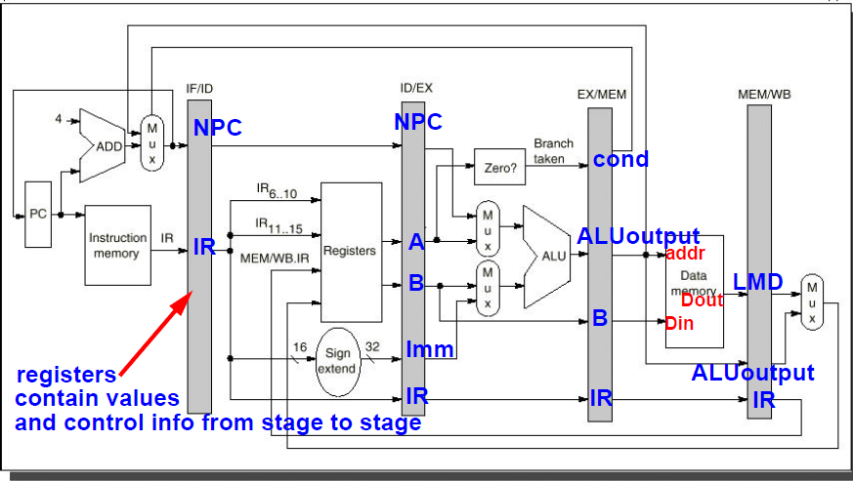
Latches and UI

Slide 9
Input/output
Input:
Instruction as a text file
User directives:
instruction/cycle mode
number of instructions/cycles to be executed
dump register/latch/statistic/inst memory/data memory
Output: At each clock cycle, or each instruction end, we can review:
32 Register contents
4 Latches register values
Simulator performance Statistic :
Utilization of each stage. UsefulworkCycle/CpuCycle
Total time in CPU cycle

Slide 10
HAZARD
Structural Hazard: Execution unit (Memory) is busy.
Solution: Duplicate resource. Separate Data Memory and Instruction Memory.
Data Hazard: Instructor i read stale register data before it is being write.
Solution:
WAR/WAW : N/A. Only exist in Variable length pipeline.
RAW: lock registers to be wrote. STALL pipeline when following inst read the locked reg.
Control Hazard: The inst right after branch inst may should not be executed.
Solution: Detect branch inst, then STALL the pipeline until inst jump.

Slide 11
Data Hazard -- RAW
Controlled by checking whether the REG to be read is locked or not
Control signal: hazard_data_raw_cnt
At ID :
Lock REGs to be wrote
If ( IF.inst.Reg == locked) { hazard_data_raw_cnt++} else {hazard_data_raw_cnt--}
At EX:
unlocked REGs to be write

Slide 12
Data Hazard Example
# addi $t0, $t2, 0xe <<< $t0 will be written. $t0 get locked at ID2, unlocked at EX3.
# sub $s0, $t0, $t3 <<< STALL until IF4
# addi $t7, $zero, 0x7 <<< Start at IF5

Slide 13
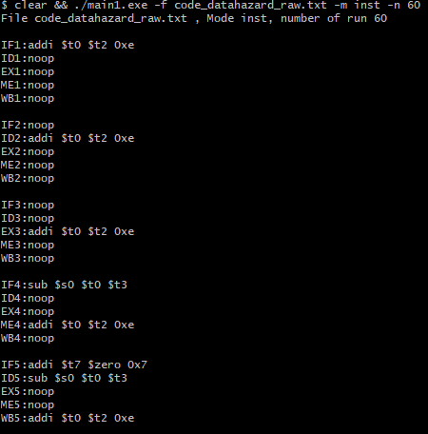

Slide 14
Control Hazard: BEQ
IF check the control signal (hazard_ctrl_cnt)
If BEQ is set, then IF
1. stop fetching
2.set NOOP as the next inst
Detected at ID stage.,
If op=BEQ:
hazard_ctrl_cnt++
IFID.inst = NOOP, pc = ppc (previous pc)
Cleared at EX stage
If op=BEQ hazard_ctrl_cnt--

Slide 15
BEQ Branch
If Branch Condition EXMEM.cond is set,
IF set PC to position instructed by branch
Then seq executing instructions from that address
Control signal: hazard_ctrl_cnt
Cleared at EX stage after condition is true and Jump Address is calculated by ALU.

Slide 16
BEQ Example
beq $s0, $t0, 0x2. PC0 <<< s0==t0, jump 2 instructions.
addi $t0, $zero, 0x0 . PC4 <<< skipped
addi $t1, $zero, 0x1 PC8 <<< skipped
addi $t2, $zero, 0x2 PC12 <<< jump to execute
addi $t3, $zero, 0x3 PC16 <<< continue

Slide 17
Improvements
Improve performance by:
Data Forwarding
Branch prediction
Variable instruction stage length

Slide 18
DEMO

Slide 19
Back up Slides

Slide 20
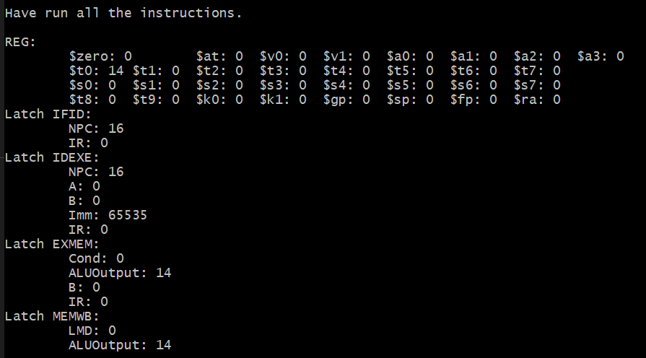
TC1. REG and Latch
# addi $t0, $t2, 0xe
00100001010010000000000000001110

Slide 21
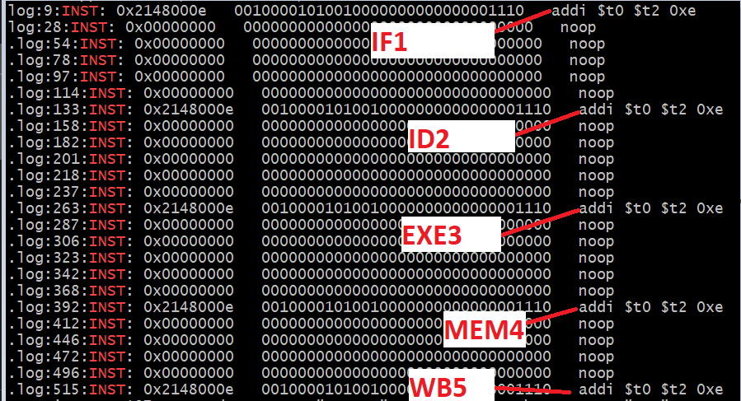
TC1, Inst being worked on each Stage/Clock
# addi $t0, $t2, 0xe
00100001010010000000000000001110

Slide 22
TC2. RAW. Demo
00100001010010000000000000001110 # addi $t0, $t2, 0xe
00000001000010111000000000100010 # sub $s0, $t0, $t3

