Slide 1

Learning Incentive System Based On Ethereum
Jinhua Bee Ham
金华蜜蜂火腿

Slide 2

Team members：
- Eoghan Lee：DApp development, solidity + nodejs

Slide 3

Problems
To deal with interference and improve mobility
Connect user's goals and acitons
Track and analyze user's academic & professional perfomance

Slide 4
Solutions
- Use new technology(blockchain) which is unalertable and creditable, user can track his own growth path in the chain and that can be their own life track records.
- Since blockchain is based on consensus mechanism like POW, users can activate themselves by setting their goals as transactions, and community members can supervise the transaction owner and owner can earn the reward from achieving the goal.
- With echarts, g2, react and some other way to visionalize user's academic and professional data.(not completed)

Slide 5
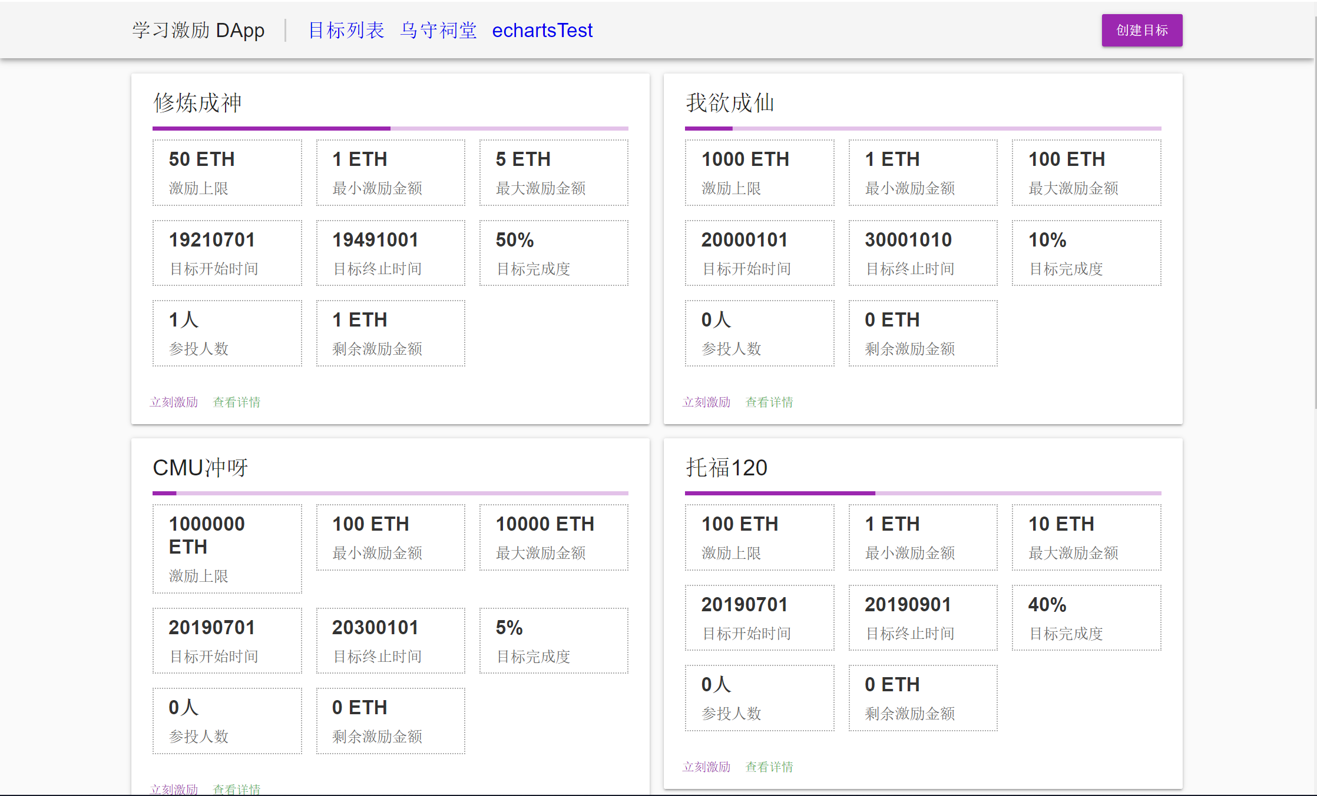
Demo

Slide 6
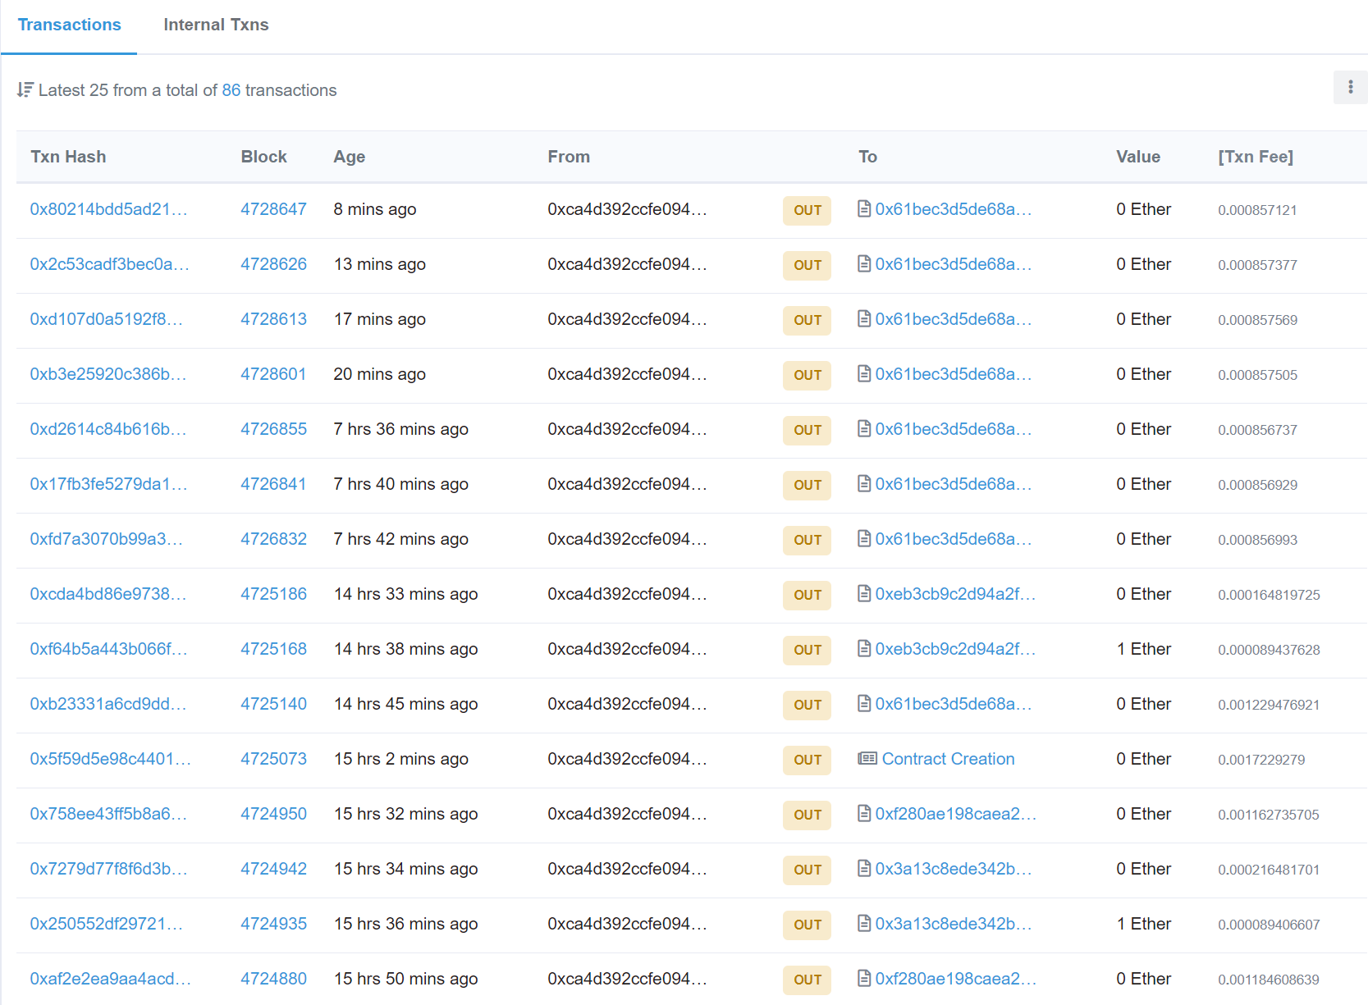
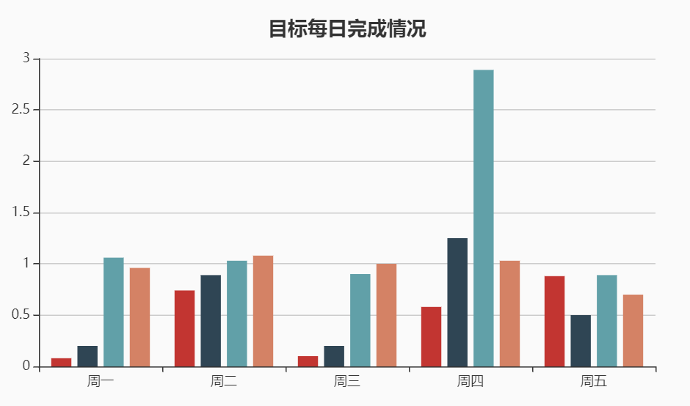
Demo

Slide 7
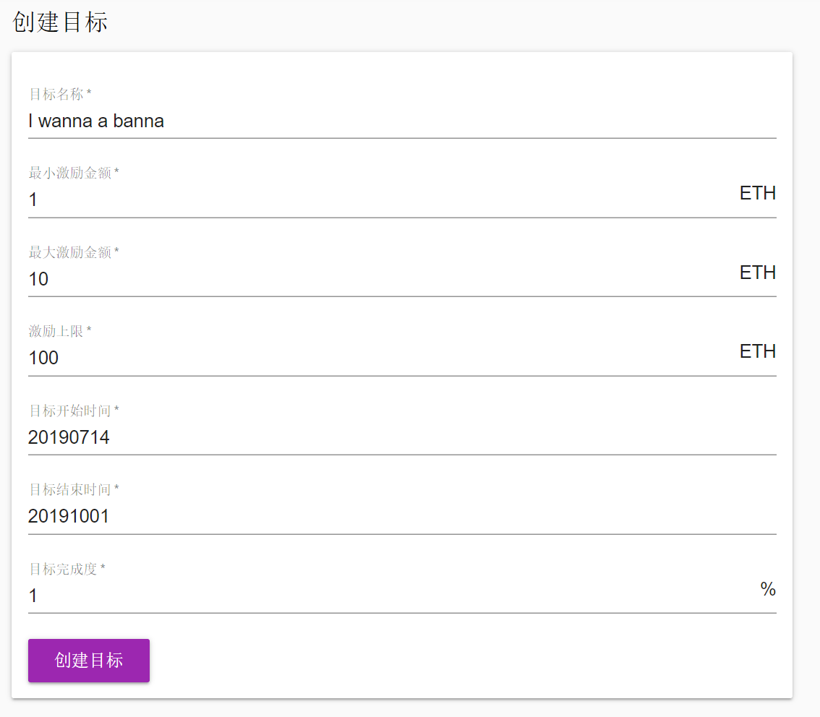
Demo
How to create your goal in our chain?

Slide 8
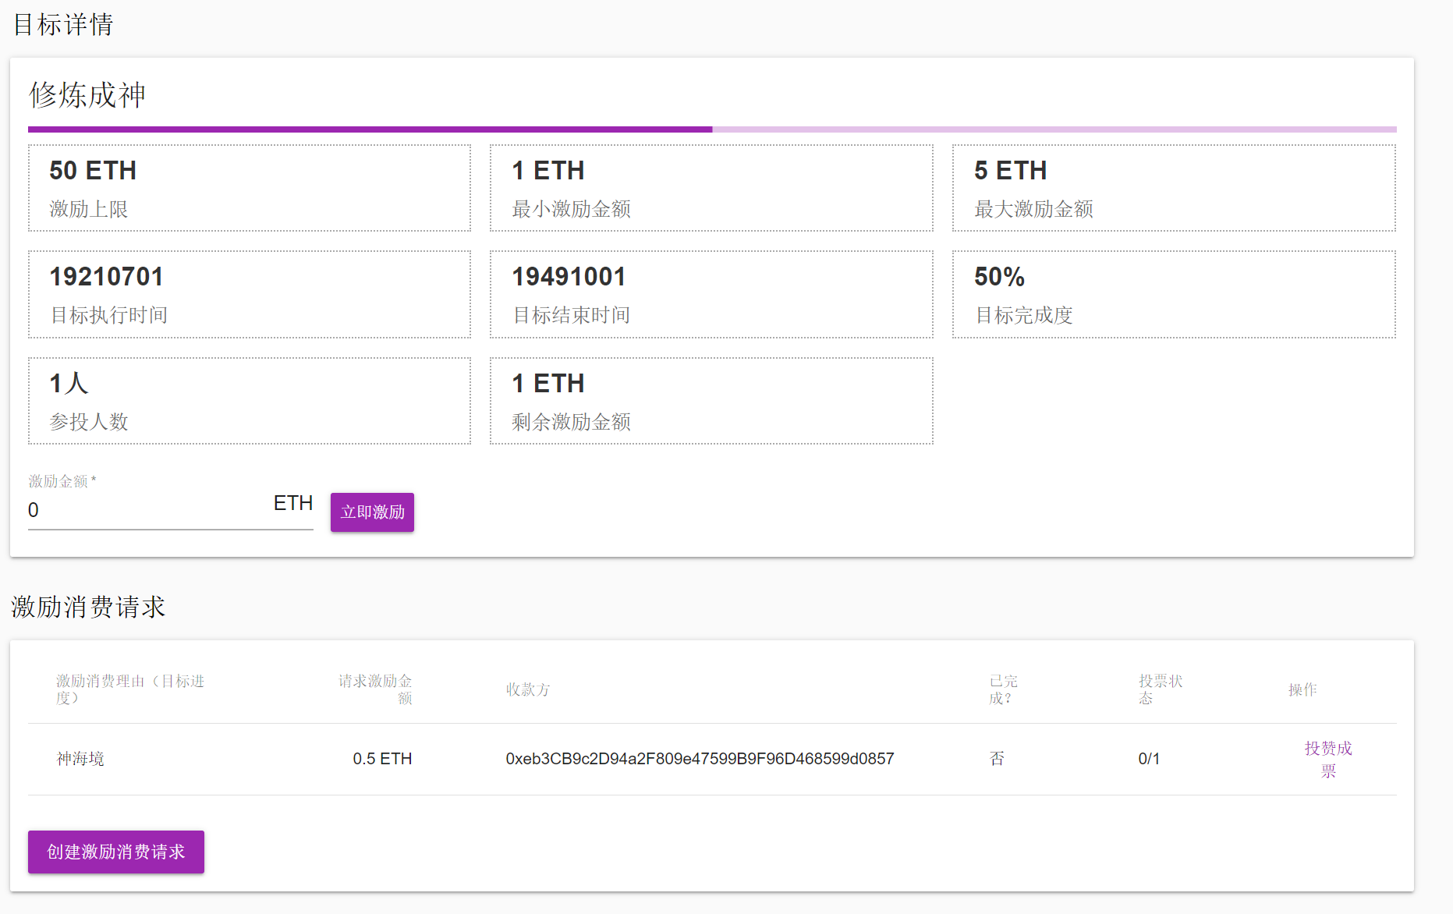
Demo
Project Details:
Invest this goal
Goal procedure &
Activation cosuming time

Slide 9
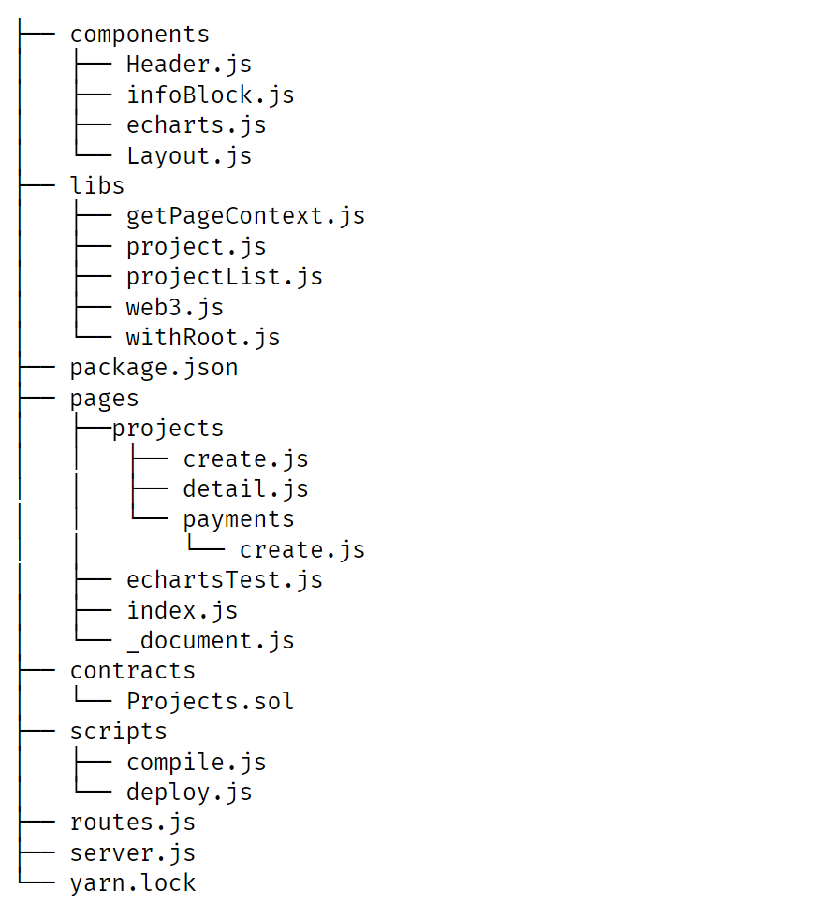
Project Structure

Slide 10

Thank for Your Time
END

