Slide 1
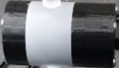

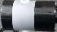
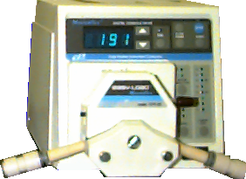
Carbon Adsorption
Effluent
Downflow through Carbon Column
Red dye #40
Photometer
Reverse Osmosis water
Valve
Tee

Slide 2
Theory of Operation
Velocity of a compound through the column depends upon affinity for the stationary phase
Area under curve is ______ of compound adsorbed to stationary phase
mass
water
Liquid phase concentration

Slide 3
Mass Transfer zone slowly moves through the fixed bed adsorber
Effluent Adsorbate Concentration
C
Time

Slide 4
Mass Transfer Zone
Mass transfer zone breakthrough
Loaded zone
Efficient removal of the adsorbate
Mass Transfer Zone
C
Clean zone
Time

Slide 5
Schematic
Effluent
Downflow through Carbon Column
Red dye #40
Photometer
Reverse Osmosis water
Valve
Tee

