Slide 1
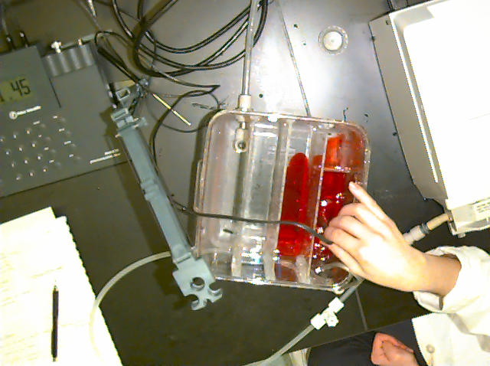
Reactors
The Case of the Chlorine Contact Tank

Slide 2
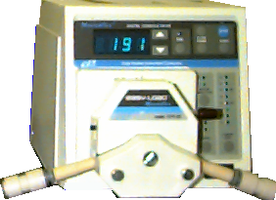
Reactor Characteristics:
Designing a Chlorine Contact Tank
Photometer
baffle
open tee
Peristaltic Pump
reactor
drain
DI Water
P

Slide 3
Outline
Objectives of chlorine contact tanks
Reactors in environmental engineering
Advection, dispersion, and reaction
Tracer studies and reactor characterization
Data analysis and curve fitting
Experimental design and ideas to probe

Slide 4
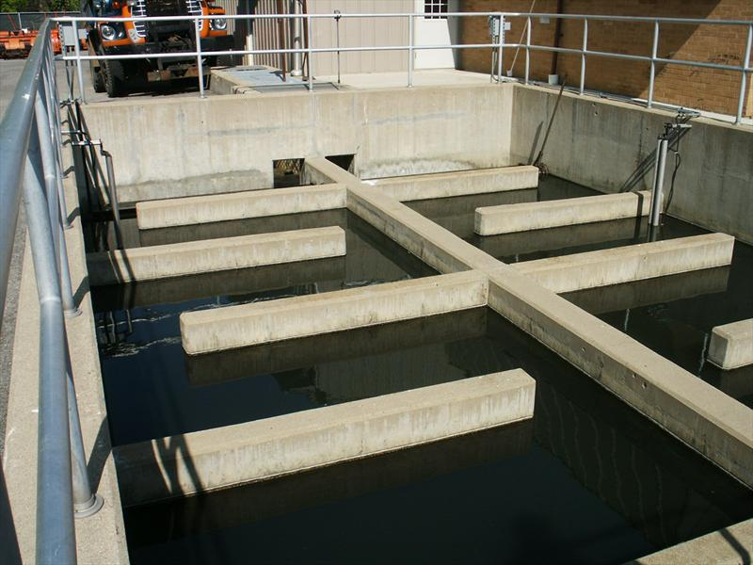
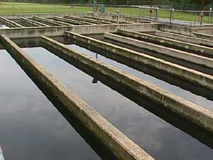
Chlorine Contact Tanks
Widely employed in water and wastewater plants as the last step in the treatment process
Takes place in a “clearwell” or “contact tank”
Key design parameter: contact time
Notes:
What do you notice about these tanks?

Slide 5
Disinfection CT Credits
To get credit for 99.9% inactivation of Giardia:
Contact time (min)
chlorine pH 6.5 pH 7.5
(mg/L) 2°C 10°C 2°C 10°C
0.5 300 178 430 254
1 159 94 228 134
Inactivation is a function of _______, ____________
______, and ___________.
time
concentration
pH
temperature

Slide 6
Contact Time Definition
The contact time for purposes of chlorine disinfection is defined by the EPA as
The time that it takes for 10% of the mass of a tracer pulse to arrive at the effluent of the tank
Or equivalently, the time it takes for the effluent concentration to reach 10% of the influent concentration after a tracer is added continuously to the influent

Slide 7
EPA Contact Time Credit
Contact time = (baffle factor)(hydraulic residence time)
Baffling Condition | Baffle Factor (BF) | Extent of Baffles | Typical Unit Processes
Unbaffled (CMFR) | 0.1 | No baffles, agitated basin with low length to width ratio, high inlet and outlet flow velocities | Clearwell, storage tank, no perforated inlet or outlet, inlet or outlet submerged.
Poorly baffled | 0.3 | Single or multiple unbaffled inlets and outlets, no intrabasin baffles | Many conventional sedimentation basins. Storage tanks with two or three baffles.
Average | 0.5 | Baffled inlet or outlet with some intrabasin baffles | Some (few) sedimentation basins. Highly baffled storage tanks.
Superior | 0.7 | Perforated inlet baffles, serpentine or perforated intrabasin baffles, outlet weir or perforated launders | Filters. Contact tanks with serpentine baffling
Perfect (PFR) | 1.0 | Very high length to width ratio (pipeline flow), perforated inlet, outlet and intrabasin baffles | Sections of pipe ten times longer than their diameter.
Notes:
How much better than a CMFR is a PFR? 10x! That’s 10 times smaller, 10 times cheaper!

Slide 8
The Meaning of Life… for Contact Tanks
Minimally – To meet EPA regulations
Better – To obtain as high a contact time as possible with a given tank
Or – To build as small a tank as possible that meets the EPA regulations

Slide 9
Reactors
Reactor: a “container” where a reaction occurs
Examples:
Clear well at water treatment plant (chlorine contact)
Activated sludge tank at wastewater treatment plant
Treated wastewater discharge into a stream: stream = reactor
Treated wastewater discharge into Cayuga lake: lake = reactor
Notes:
Environmental Engineers are interested in knowing the effects of various inputs into our environment. When we model the environment we often draw a boundary around the part of the environment we want to study and call it a control volume or a reactor.
Environmental Engineers also design reactors in the more conventional sense in treatment plants for water, wastewater, contaminated site remediation...)

Slide 10

Advection: mean flow
C
What does it look like a short time later?
x
C
x
Notes:
where concentration is increasing with x it will decrease with time given positive velocity

Slide 11

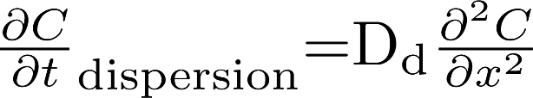
Dispersion: velocity fluctuations
Fick's first law
C
Fick's second law
x
What does it look like a short time later?
C
x
Notes:
0
0
0
+
+
-
-
2nd derivatives
0
0
0
+
-
1st derivatives
Change in concentration with time at second derivatives
Flux is in negative direction when concentration is increasing with x

Slide 12

Reaction
C
x
What does it look like a short time later?
C
x

Slide 13
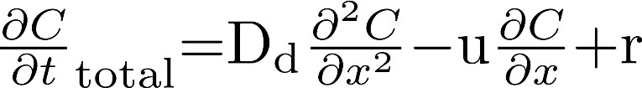

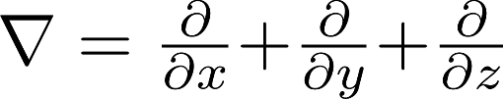
Advection/Dispersion/Reaction
C
In three dimensions
x
C
where
x

Slide 14
Reactors: Closed vs. Open
Closed: have little dispersion across the inlet and outlet boundaries
Well defined reactor volume
Examples
__________________________________
______
Open: have significant dispersion across the inlet and outlet boundaries
Backmixing
Example
_________________________________
tank with a small inlet and a small outlet
lake
Slow moving river influenced by tides

Slide 15
Reactors: Defining the Control Volume
tracer
closed
Q
open
Q

Slide 16
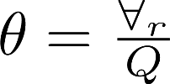
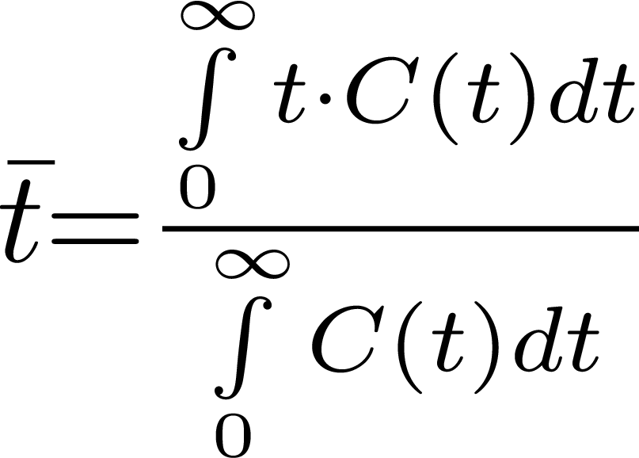




Reactor Characterization
Time scales
hydraulic residence time
average time for tracer to get from inlet to outlet
Closed systems
“dead volume”
Open systems
dispersion upstream
“dead volume”
volume
=
flow rate
$$≤$$
$$≥$$
?
$$≤$$
Notes:
Why 2 time scales?
theta assumes fluid is flowing through entire reactor volume
How is theta measured? (volume and flow rate)
tbar
what is the average time that a molecule spends in the reactor?
how many of the molecules present at time zero are leaving at time t? proportional to t*C(t)
How is t bar measured? (concentration measurements as a function of time)

Slide 17
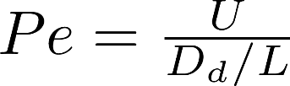
Peclet Number
Ratio of advection to dispersion
how far does advection carry the fluid/width of tracer plume
High Peclet means primarily advection (_______________)
Low Peclet means lots of mixing
plug flow

Slide 18
Characterize a Tank: Tracer Studies
Tracers
Desirable properties
Candidates
Measuring techniques
Choosing a tracer concentration
Measurement range
Interferences
Density matching
Pulse vs. Step
Requires design calculations!
Crucial for high Pe!

Slide 19
Ideal Tracer
same properties as fluid
viscosity
temperature
density
non reactive
additional properties
low background concentrations
easily measured
cheap
non toxic

Slide 20
Real Tracers
Tracer type
distinguishing
analytical
examples
property
instrument
salt
conductivity
Conductivity
NaCl
meter
Dyes
color
Spectrophoto-
Red dye #40
meter
fluorescent
fluorescence
Fluorometer
rhodamine WT
dye
acid
protons
pH probe
HCl
Dissolved gas
Gas
Gas
Sulfur
chromatograph
hexafluoride

Slide 21

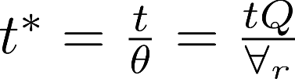
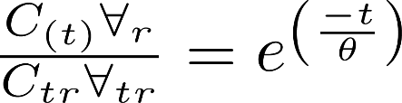
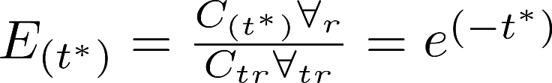
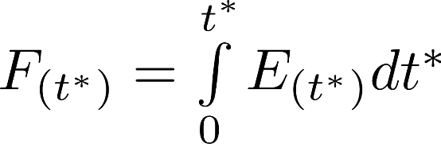
Reactor Theory: CMFR
r = reactor
tr = tracer
t = time
Dimensionless groups

Slide 22
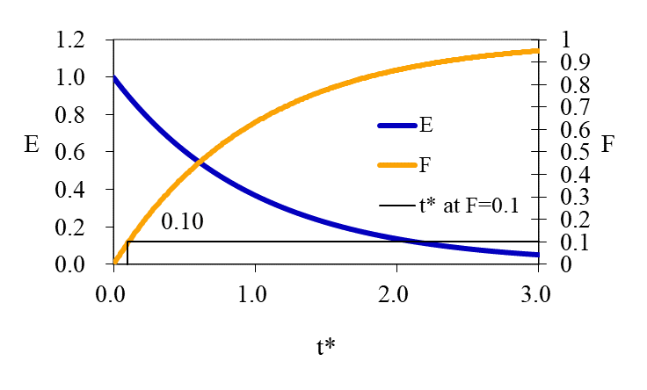
E and F curves
The E curve is a dimensionless measure of the output tracer concentration from a spike input.
The F curve is a dimensionless measure of the cumulative output from a spike (or pulse) input
The F curve is also a dimensionless measure of the output tracer concentration from a step input

Slide 23
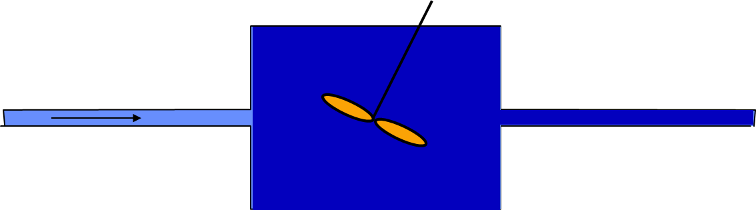
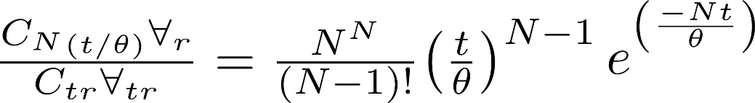
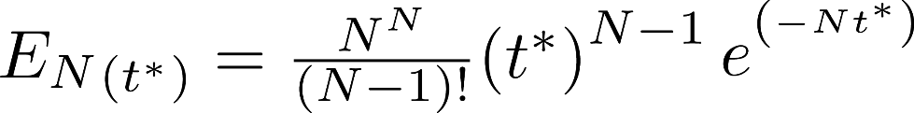
Reactor Theory: Series CMFR
N=20
N must be an integer!
N=100
N=2
Residence time is for total reactor

Slide 24

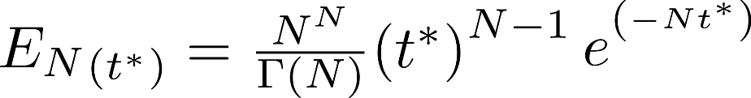
Gamma Function to Replace Factorial?
It would be better if we had a continuous function rather than one that only works for whole numbers
The (complete) gamma function is defined to be an extension of the factorial to complex and real number arguments. It is related to the factorial by
Notes:
http://mathworld.wolfram.com/GammaFunction.html

Slide 25
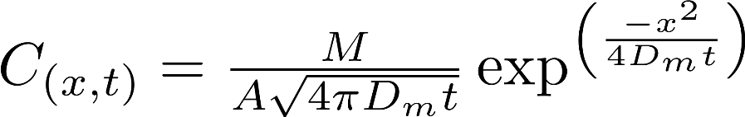
1-D Dispersion
No boundaries in x!
A
120
D_{m} = 0.673 x 10⁻⁵ cm²/s
M = 1 g
A = 1 cm²
100
1 s
80
concentration (g/mL)
60
40
10 s
20
100 s
0
-0.1
-0.05
0
0.05
0.1
Symmetric in space
distance (cm)
Notes:
What happens when we add advection to dispersion? Dispersion continues while advection happens!

Slide 26
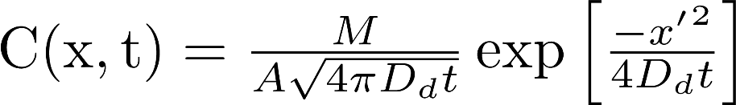
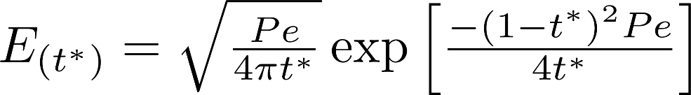



1-D Advective Dispersion Equation
Pe = 2
advection
skewed in time
dispersion
Does the advection dispersion equation assume open or closed reactor?

Slide 27
1-D Advective Dispersion Extremes: High Dispersion
How can it take 1.9 residence times for 10% of the tracer to come out?
Why is the contact time so long?
Hey! That’s not fair!
(Pe = 0.02)
Open reactor!

Slide 28
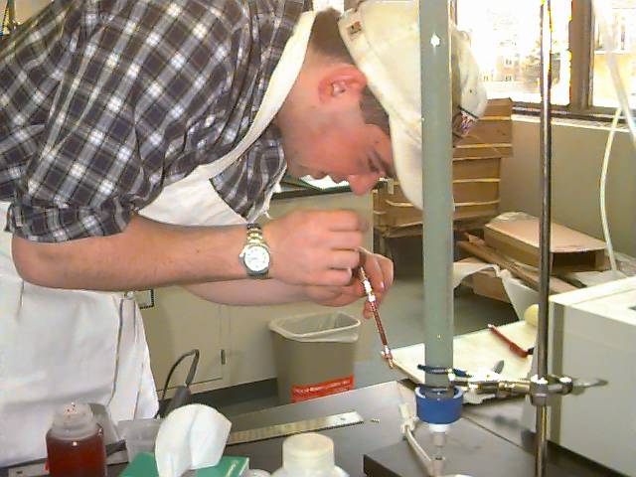
1-D Advective Dispersion Extremes: Low Dispersion
(Pe = 2000)
Approaches plug flow!
Characteristic of flow through homogeneous porous media
________________________________________________________________

Slide 29

CMFR in series ≡ Advective Dispersion
They both approach plug flow!
(N = 50)
(Pe = 100)
For Pe > 100!
What is Pe for a porous media column?
Notes:
How many reactors in series? Think sand grain pores. Thus N is something like height of filter/sand grain diameter. And Pe is 2*N. Thus for a 20 cm deep filter with 0.5 mm sand grains we have 400 reactors and Pe of 800!

Slide 30
Goals of plug flow without dead volume
Many CMFR in series
High Peclet number
Laminar pipe flow
Turbulent pipe flow
Porous media flow
Eliminating “Dead volume”
Requires more mixing!
Turbulent pipe flow: Serpentine channels
Turbulent jets: Perforated baffles
Closed reactors
Open reactors
?

Slide 31
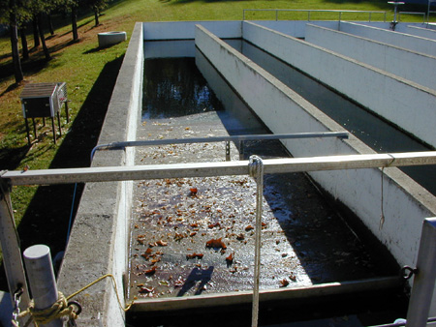
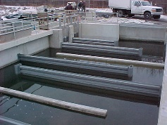
Serpentine Chlorine Contact Tanks
Model as_________________.
flow with dispersion
Baffle Factor of________.
0.5

Slide 32
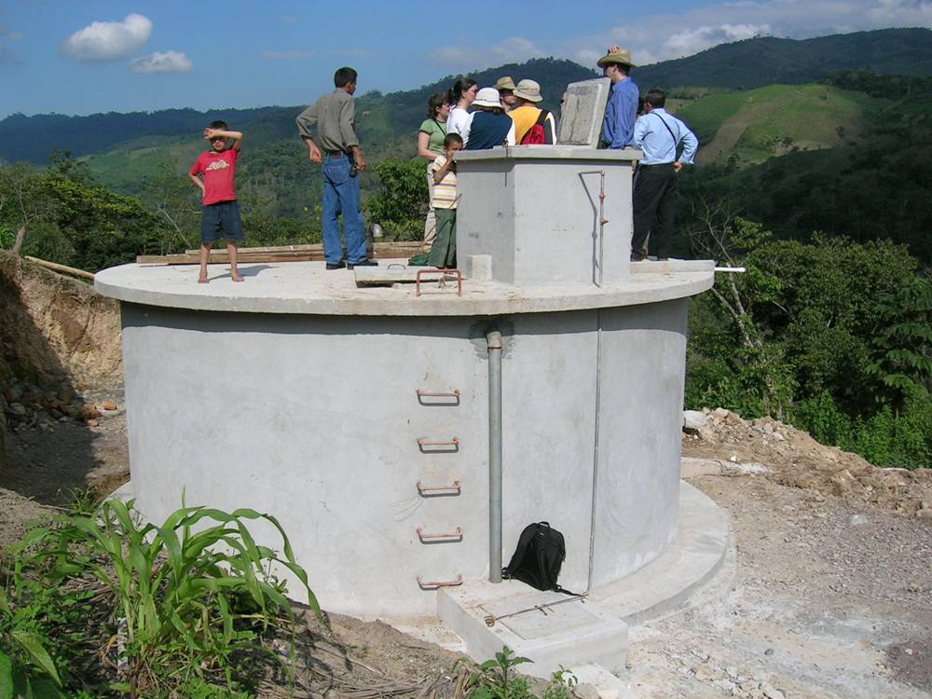
Distribution Tank (Honduras)
How would you model this tank?
__________
_______________________________________________________________________
CMFR!
The water flowing from the inlet pipe provides enough energy to mix the tank!
Baffle Factor of________.
0.1

Slide 33
Experiment Design Options
Mean circulation patterns
Serpentine vs. series CMFR
Risk of dead volumes
Baffles
With holes
(pattern, diameter, number)
Head loss
Jet Reynolds number
Partial baffles
Reactor flow rate
Reactor depth
Porous media
Packing material

Slide 34
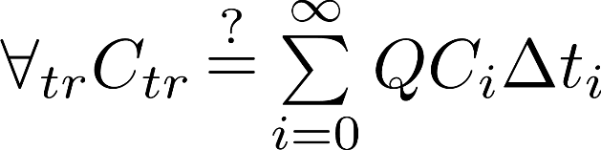
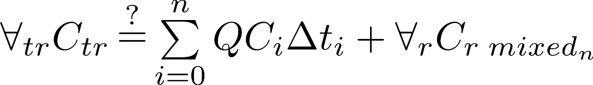
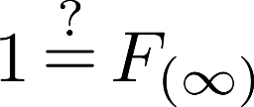
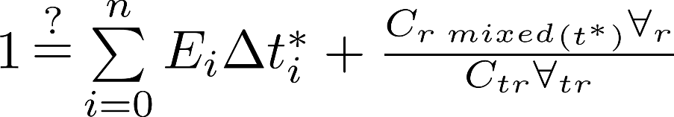
Mass Conservation
What is the purpose of checking mass conservation? _______________________
Four ways to check
Verify measurement accuracy
At infinity…
At all times
dimensionless

Slide 35
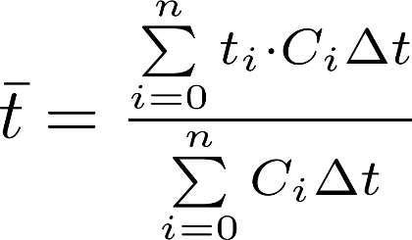
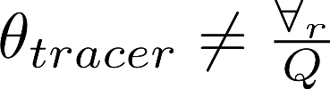
Characteristic times…
What is the difference between θ and ?
is only defined correctly if all of the tracer is accounted for!!!!!!!
What does it mean if θ is greater than ?
What does it mean if θ is less than ?
What other technique could you use to measure the tracer residence time?
Dead volume
Open reactor?
Curve fit with models

Slide 36
Comparison with Models
Which model do you expect might describe perforated baffle reactors?
Which model do you expect might describe serpentine reactors?

Slide 37
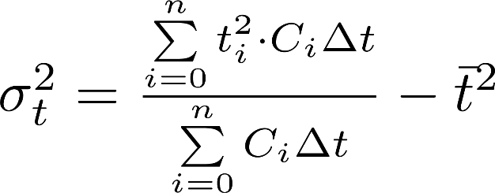
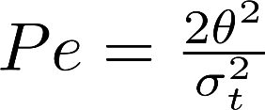
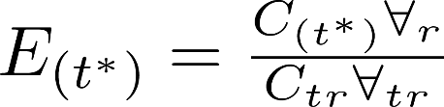


Estimating the Peclet number (or the number of CMFR in series)
Requires data from the entire tracer curve
model
data
Use multiple variable regression analysis.
Scipy.optimize.curve_fit
Minimize the SSE (sum of the squared errors) between the model and the data by changing ( and ) and (Pe or N) (use epa.Solver_AD_Pe or epa.Solver_CMFR_N)
Notes:
Why are there 3 parameters that we get to play with? Mean time, spread, amplitude

Slide 38
Data Analysis Requirements: 2 goals
Measure the baffle factor
Can be as simple as finding the time when 10% of the tracer gets to the effluent
Compare the data with the two reactor models
At minimum requires fitting N or Pe
But there is no reason to expect the hydraulic residence time to be the same as the tracer residence time – so fit and too.

Slide 39
Organizing Experiments
Protocol for sharing resources? (baffles)
What is the question you are trying to answer?
Make sure you conduct experiments that provide data to answer that question!
Jet Reynolds number is not an important parameter, but head loss is!
Only vary one parameter at a time!!!!
Distilled water
How do you choose and control reactor volume?
USE YOUR EYES!!!!!

Slide 40
Do an additional set of experiments
Vary a different parameter over at least 3 values
Effect of depth given serpentine path
Baffles in the long direction
Turbulent pipe flow
Porous media flow
Effect of Reynolds number (can you get the transition between laminar and turbulent flow in open channel flow)?
Inlet and outlet conditions matter!

