Slide 1
What makes a good final project?
Good research question/testable hypothesis
Not too complicated! Simple is beautiful.
Experiments that can be done in our lab using our resources and in the time available (phys/chem is usually faster then microbiology)
Collect LOTS of data!
Link experimental data with theoretical model OR conceptual expectation
Things we can measure:
pH, temperature, red dye, some other light adsorbing chemicals, dissolved oxygen

Slide 2
The iterative process of research
Hypothesis
based on “model”
model may be deterministic (e.g., predict methane production based on VSS), or conceptual (e.g., increase in Q gives decrease in baffle factor)
Test Hypothesis
design experiments with appropriate and/or available tools
run positive and negative controls when necessary!
Confirm or Reject Hypothesis
Confirm – compile data into convincing arguments to convince others and discuss implications
Reject – modify hypothesis as needed

Slide 3
Proposals (not graded) – what to include
Intro/context – What is the problem? Why is it important?
Objectives – What is the hypothesis? What will you do?
Experimental plan including – How will you do it?
Key design parameters
Timeline of tasks/experiments
Possible hurdles/challenges
Refs to primary, review, and other literature and possibly to previous years’ projects
Resources needed to conduct experiments – What tools will you use?
Expectations/Anticipated results
References/Bibliography

Slide 4
Project Expectations
Build your apparatus next week and conduct first experiment
Finish data collection the week before break
4 hours per week outside of class
Data collection and data analysis used for experiment design (evidence of good engineering)
Maintain records of what you did and what you learned
Collaboration between teams is fine and encouraged
What is success?

Slide 5
Aeration
Design a better reactor for aeration that has a higher oxygen transfer efficiency

Slide 6
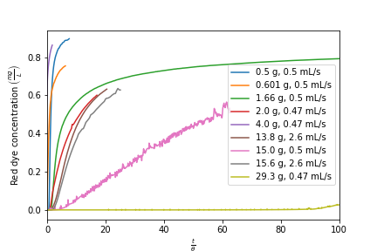
Adsorption
Test effect of flow rate on shape of adsorption curve (mass transport controls adsorption kinetics and thus time matters)
Test the effect of 3 different sizes of activated carbon (large granules, small granules, powder)

Slide 7
Test pH adjustment calculations
We have developed equations based on ANC for how to methodically adjust the pH to reach a target value. This is of particular interest in drinking water treatment.
The method involves measure the ANC of the sample and then using equations to calculate how much acid or base to add to reach the target pH
Here is an example for the town of Manzaragua in Honduras
Measure ANC of tap water and then use equations to calculate amount of acid and base required to adjust tap water to target pH. Test ability to set pH to 5, 6, 7, 8, 9

Slide 8
Acid rain
Aerate the lake to see if you can get a system that is in equilibrium with the carbon dioxide in the atmosphere

Slide 9
Reactors
Use either pulse (using the red dye leftover from the adsorption lab) or step inputs to test…
Straight vs coiled laminar flow tube flow
Laminar vs turbulent pipe flow
CMFR in series
More baffle

Slide 10
Next steps
Come to lab prepared to discuss
What seems interesting to you?
Is there anything that can help with other projects (research)?
Anything that is relevant to potential grad school research?
Anything relevant to potential internships/jobs?
BRAINSTORM and discuss with your groups.

