Slide 1
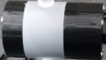
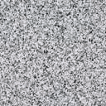
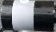
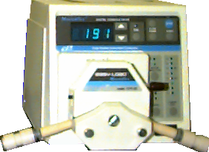
Carbon Adsorption
Effluent
Downflow through Carbon Column
Photometer
Red dye #40
Reverse Osmosis water
3 way valve

Slide 2
Activated Carbon is used to
Remove disinfection by product precursors (Dissolved Organic Matter)
Remove tastes and odors
Remove toxic organic compounds from contaminated water

Slide 3
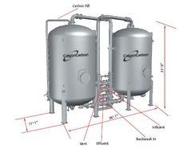
Granular or Powdered Activated Carbon (GAC or PAC) for drinking water treatment
Not to be confused with PACl (poly aluminum chloride)
GAC is used in columns (can be regenerated – YEAH!)
mean particle size 0.5 to 3 mm
Applied after rapid sand filtration
Don’t backwash GAC!
PAC is added to raw water
mean particle size 20 to 50 μm
Removed in sed tanks (as sludge)
Less (and more) efficient than GAC
Notes:
https://www.environmental-expert.com/products/calgon-carbon-model-10-modular-carbon-adsorption-system-60551

Slide 4
GAC and PAC
GAC is more efficient than PAC
The spent PAC is in equilibrium with the effluent concentration
The spent GAC is in equilibrium with the influent concentration
PAC is faster than GAC
PAC is much smaller and thus diffusion into the pores of the PAC is much faster than diffusion into the pores of GAC
doses in the range of 5 to 25 mg/L and an average dosage of 5 mg/L (Graham et al., 2000)
Notes:
Graham, M., Najm, I., Simpson, M., Macleod, B., Summers, S., and Cummings,
L. (2000) Optimization of Powdered Activated Carbon Application for Geosmin
and MIB Removal, American Water Works Association Research Foundation,
Denver, CO.

Slide 5
Non selective adsorption
When using activated carbon to remove a contaminant (such as a synthetic organic chemical) from water it is likely that other species (such as natural organic matter) will be removed too!
Non-target species will occupy adsorption sites on the activated carbon
And thus the activated carbon will reach its adsorption capacity sooner than if it were only removing the target species
This will cost you money!

Slide 6
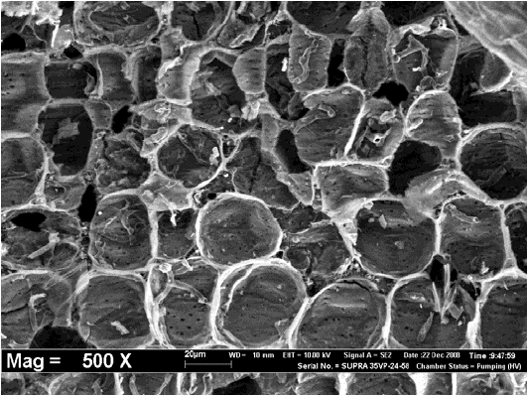
Activated Carbon is amazing because
About 1000 square meters of surface area per gram
About 0.5 gram per mL
Thus about 500 square meters per mL!
Adsorption capacity as high as 0.2 gram of contaminant per gram of activated carbon
Charcoal is not activated carbon
SEM micrographs willow tree legs -based activated carbon (500×) Fig by Jasim M. Salman
Notes:
MWH's Water Treatment: Principles and Design, Third Edition: Principles and Design, Third Edition
Author(s): John C. Crittenden
R. Rhodes Trussell
David W. Hand
Kerry J. Howe
George Tchobanoglous
First published:14 March 2012
Print ISBN:9780470405390 |Online ISBN:9781118131473 |DOI:10.1002/9781118131473
Copyright © 2012 John Wiley & Sons, Inc.
https://www.researchgate.net/figure/SEM-micrographs-willow-tree-legs-based-activated-carbon-500_fig1_258132582

Slide 7
Adsorption Column: Theory of Operation
Velocity of a compound through the column depends upon affinity for the stationary phase
Area under curve is ______ of compound adsorbed to stationary phase
mass
water
Liquid phase concentration

Slide 8
Mass Transfer zone slowly moves through the fixed bed adsorber
Effluent Adsorbate Concentration
C
Time

Slide 9
Mass Transfer Zone
Mass transfer zone breakthrough
Loaded zone
Efficient removal of the adsorbate
Mass Transfer Zone
C
Clean zone
Time

Slide 10
Why are small scale granular activated carbon studies difficult to scale up? (Why is this lab hard to connect to water treatment)
Diffusion into the large granules of activated carbon is a very slow process
This is a complex fluids similitude problem
Speed up diffusion by using smaller granules
Prepare smaller granules by grinding and sieving GAC
But then head loss thru the column increases
Perhaps can obtain a factor of 10 decrease in granule diameter and hence decrease in contact time before head loss becomes too large to be practical

Slide 11
Our approach for this lab
Recognize that break through is not necessarily due to the activated carbon reaching its full capacity
Breakthrough likely due to slow diffusion into the granules
Conduct short experiments to illustrate the power of activated carbon, but not to be able to design a full scale column

