Slide 1
What makes a good final project?
Good research question/testable hypothesis
Experiments that can be done in our lab using our resources and in the time available (phys/chem is usually faster then microbiology)
Collect LOTS of data!
Link experimental data with theoretical model OR conceptual expectation
Things we can measure:
pH, temperature, turbidity, red dye, some other light adsorbing chemicals, dissolved oxygen

Slide 2
The iterative process of research
Hypothesis
based on “model”
model may be deterministic (e.g., predict methane production based on VSS), or conceptual (e.g., increase in Q gives decrease in baffle factor)
Test Hypothesis
design experiments with appropriate and/or available tools
run positive and negative controls when necessary!
Confirm or Reject Hypothesis
Confirm – compile data into convincing arguments to convince others and discuss implications
Reject – modify hypothesis as needed

Slide 3
Proposals – what to include
Intro/context – What is the problem? Why is it important?
Objectives – What is the hypothesis? What will you do?
Experimental plan including – How will you do it?
Key design parameters
Timeline of tasks/experiments
Possible hurdles/challenges
Refs to primary, review, and other literature and possibly to previous years’ projects
Resources needed to conduct experiments – What tools will you use?
Expectations/Anticipated results
References/Bibliography

Slide 4
Project Expectations
Build your apparatus in the week after break
3 weeks of data collection
4 hours per week outside of class
Data collection and data analysis used for experiment design (evidence of good engineering)
Maintain records of what you did and what you learned
Collaboration between teams is fine and encouraged
What is success?

Slide 5
Aeration
Design a better reactor for aeration that has a higher OTE (see last year’s project that tested ability to trap bubbles in downflow velocity)
Measure aeration on water trickling down a hanging string

Slide 6
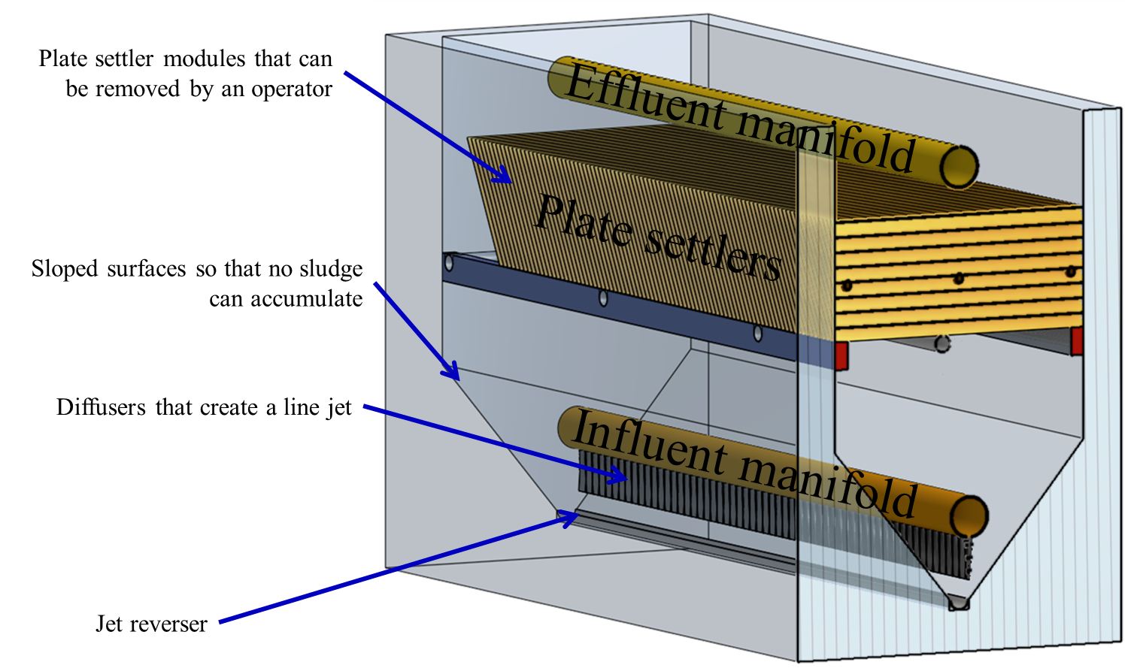
Surface water treatment: measure particle removal efficiency using a turbidimeter
Floc blanket
Plate settlers
Rapid sand filter
Or a full plant!

Slide 7
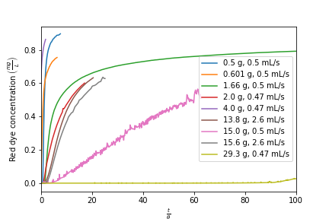
Adsorption
Test effective of flow rate on shape of adsorption curve (mass transport controls adsorption kinetics and thus time matters)
Test alternative adsorbents
PACl
Ferric chloride
Charcoal
Moringa seeds
Estimate length of mass transport zone
Test effect of granule size on adsorption kinetics

Slide 8
Nutrient removal project
Treat synthetic wastewater with a sequencing batch reactor
Measure oxygen levels
You could test…
Methods to control oxygen levels with ProCoDA
Measure oxygen uptake by turning off air and measuring oxygen uptake rate

Slide 9

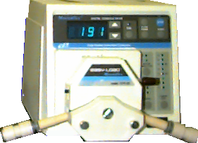
SBR OPERATION for Activated Sludge
Add tap water
Add 20x concentrated waste
Aerate
Settle
Discharge Clean Supernatant
BOD⁰
Biomass
4 h

Slide 10
Next steps
Come to lab prepared to discuss
What seems interesting to you?
Is there anything that can help with other projects (research)?
Anything that is relevant to potential grad school research?
Anything relevant to potential internships/jobs?
BRAINSTORM and discuss with your groups.

Slide 11
Class Activity in teams
Write the question you are trying to answer
List what is required to make the project successful
What parameters will you vary?
What parameters will you measure?
List expected challenges
Check Research Proposal due date

