Slide 1
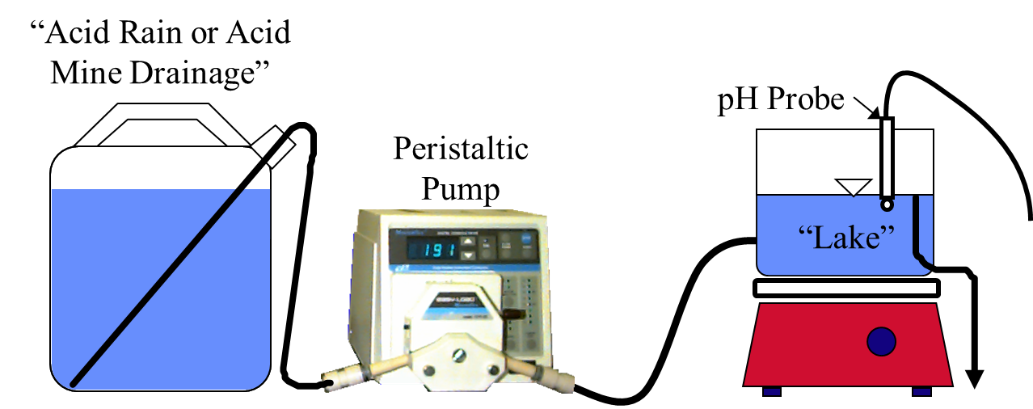
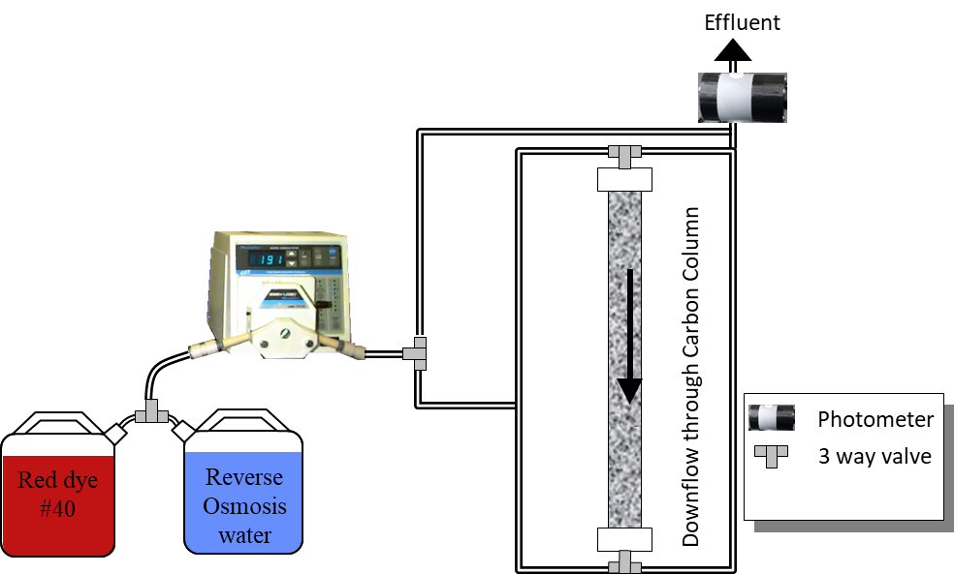
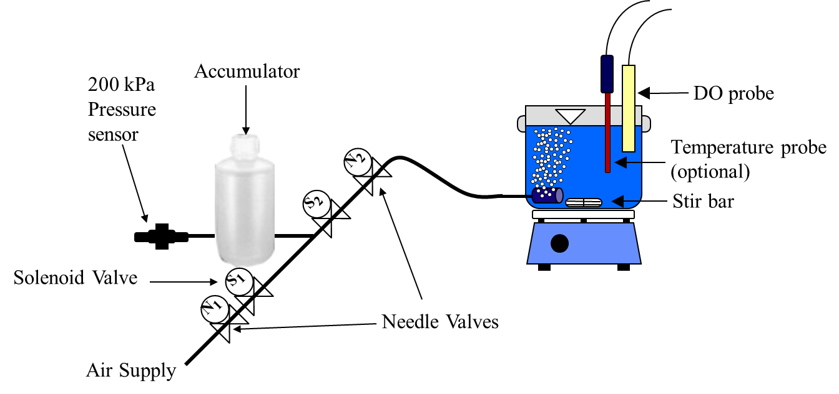
Online Intro CEE 4530
Monroe Weber-Shirk

Slide 2
Online?
Checking in
Community of learners
My office hours

Slide 3
Checking in
Where are you?
Breakout room task
One thing you are worried about
A hope for the spring semester at Cornell
An idea for how to build an online community of learners for 4530

Slide 4
Onshape
Could be done individually or in teams
Onshape is designed for collaboration
Weekly checkins where we show something we are working on
Use online tutorials

