Slide 1


Try Virtual Reality!
Bellevue College Telos Program
Instructor: Eric Zocher — zocherclass@gmail.com
Buddy System
Safety and Comfort
How to use VR devices
Notes:
License: Creative Commons Attribution Share Alike 4.0 International
https://creativecommons.org/licenses/by-sa/4.0/

Slide 2
Buddy System
Pairs of students
Team A, B, C, etc.
Help put on / take off devices
Hand controllers to buddy
Monitor safety and orientation
Consult cards for apps and directions
Notes:
Mention that buddies and/or instructor will touch your hair or head and hands
Ask everyone for mutual permission to do so
Mention that buddies should help steady person in VR or untangle them when necessary

Slide 3
Safety and Comfort
Buddies: Safety is your first priority, pay attention to your buddy in VR
Most common issue is hitting things with your hands and/or controller
Other possible issues
Bumping into furniture or walls
Getting tangled in cables
Leaning on or pushing on virtual objects or walls
Comfort
If you feel dizzy or uncomfortable, stop
If you start to get a headache, stop

Slide 4
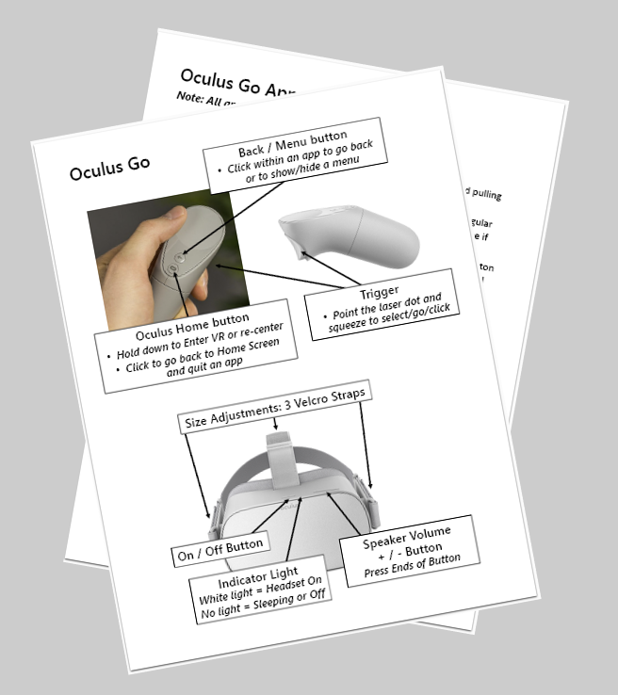
How to use VR devices
Reference cards show headset adjustment, controllers, apps and tips
Try controller(s) and learn to find important buttons and triggers with your eyes closed
Put on headset and adjust for comfort
Start an app
Explore and experience
Quit the app (please do this when your turn is over)
Start another app
Call for instructor if you get stuck

