Slide 1

GUFC-POS Staff Training
How every role uses our Point-of-Sale and Operations system
Great Unli Food Corp. · Solane LPG Distributor
Notes:
Welcome everyone. Today we learn GUFC-POS, the system we use for selling, collecting, moving stock and billing. Everyone will learn the basics, then each role gets its own section. Please have your login ready; we will practise at the end.

Slide 2








Today's training plan
01
02
03
04
Getting started
Attendant
Dispatcher
Order Taker
Log in, the menu, dashboard
POS, payments, End of Day
Dispatch, receiving, 50kg billing
Booked and online orders
05
06
07
08
Accounting
Manager
Administrator
Hands-on practice
Receivables, arrears, SOA
Invoicing, staff, promos, users
Products, locations, go-live
Try it with demo logins
Notes:
Walk through the agenda. Tell people which section is theirs, but encourage them to watch the others too, because each role hands work to another role.

Slide 3
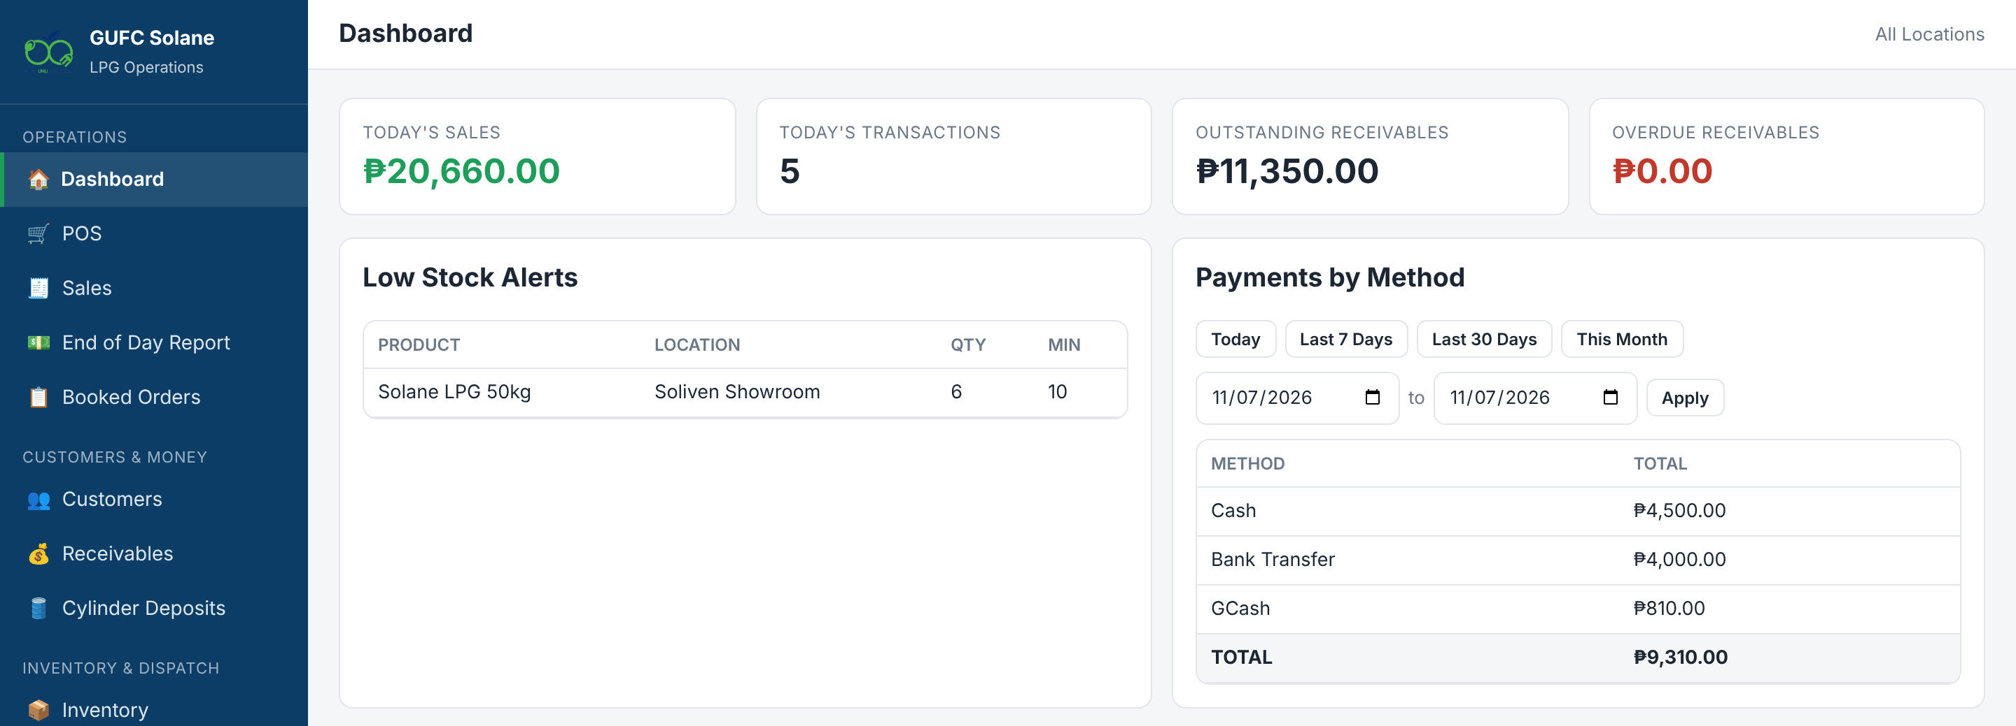



One system for the whole LPG business
Sell at the counter
Refill, deposit and swap with split payments
Stock per location
Each warehouse and showroom counted separately
Customer credit
Receivables, aging and statements
Dispatch and billing
Transfers, supplier stock, 50kg billing
Audit trail
Every action shows who did it
Notes:
Explain the big picture: every sale reduces stock at that location, credit sales become receivables, and everything is logged. Point out it runs in the browser on phones too.

Slide 4
Who can do what
Module | Admin | Manager | Accounting | Attendant | Dispatcher | Order Taker
POS (make sales) | ✓ |  |  | ✓
Receivables & payments | ✓ | ✓ | ✓ | Own loc.
End of Day Report | ✓ | ✓ | ✓ | Own
Booked Orders | ✓ | ✓ |  | Fulfil |  | ✓
Inventory | Adjust | View |  | Own loc. | Own loc.
Dispatch / Transfers | ✓ |  |  |  | ✓
50kg Commercial Billing | ✓ | Invoice |  |  | ✓
Reports & Audit Log | ✓ | ✓ | Reports
Users, Roles, Promos | ✓ | ✓
Products, Locations, Reset | ✓
Notes:
Each person only sees the menu items for their role, and the server enforces it. If something is missing from your menu, your role does not have it. Custom roles can be created by the Admin or Manager.

Slide 5
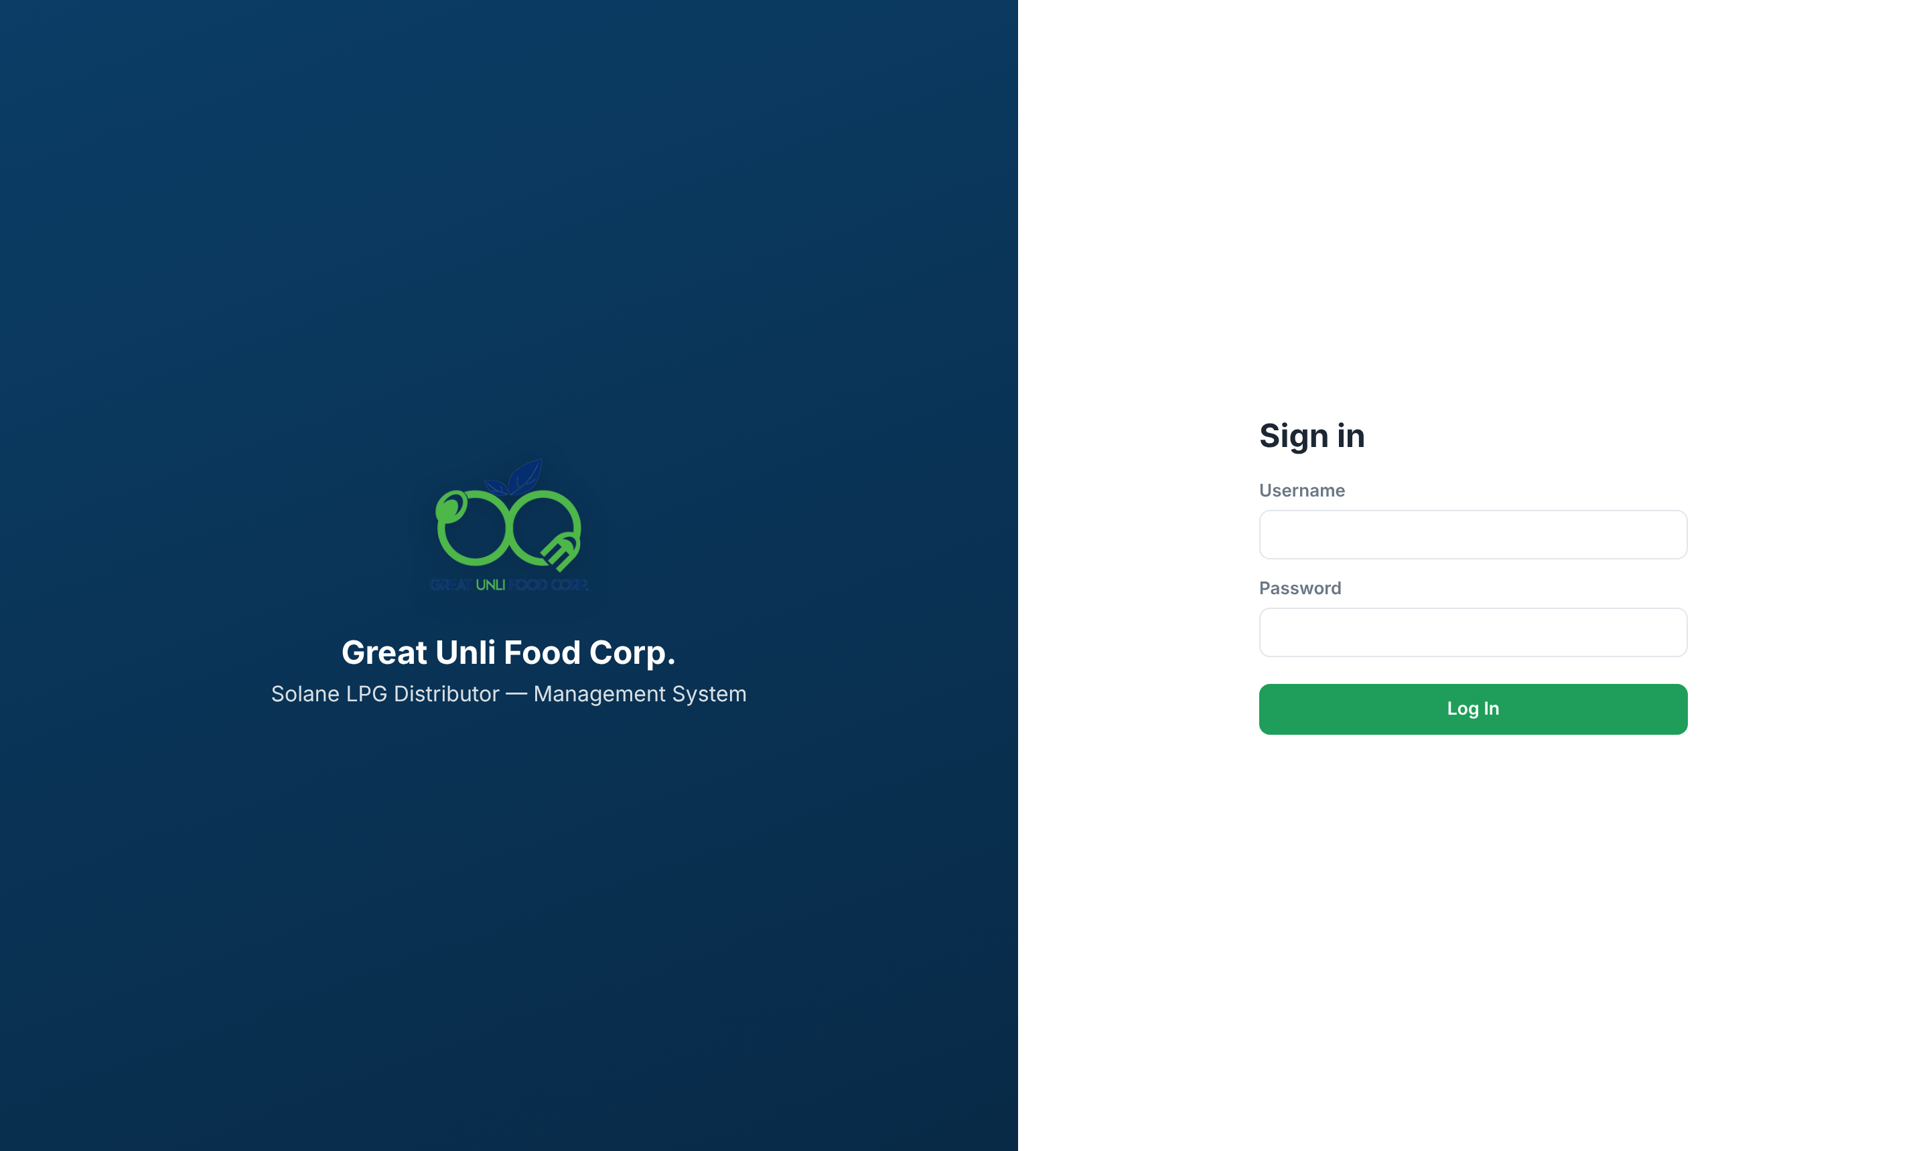
Logging in
1
Open the GUFC-POS link
Use Chrome, Safari or Edge on a phone, tablet or computer. Nothing to install.
2
Enter your username and password
Use only your own account. Never share it.
3
Tap Log In
You land on the first screen your role can use.
4
Tap Log Out when you leave
Logins and logouts are recorded in the audit log.
Notes:
Show the login page. Stress that every sale and payment is stamped with the logged-in user, so sharing accounts makes mistakes impossible to trace. Forgotten passwords are reset by an Admin or Manager under Users.

Slide 6
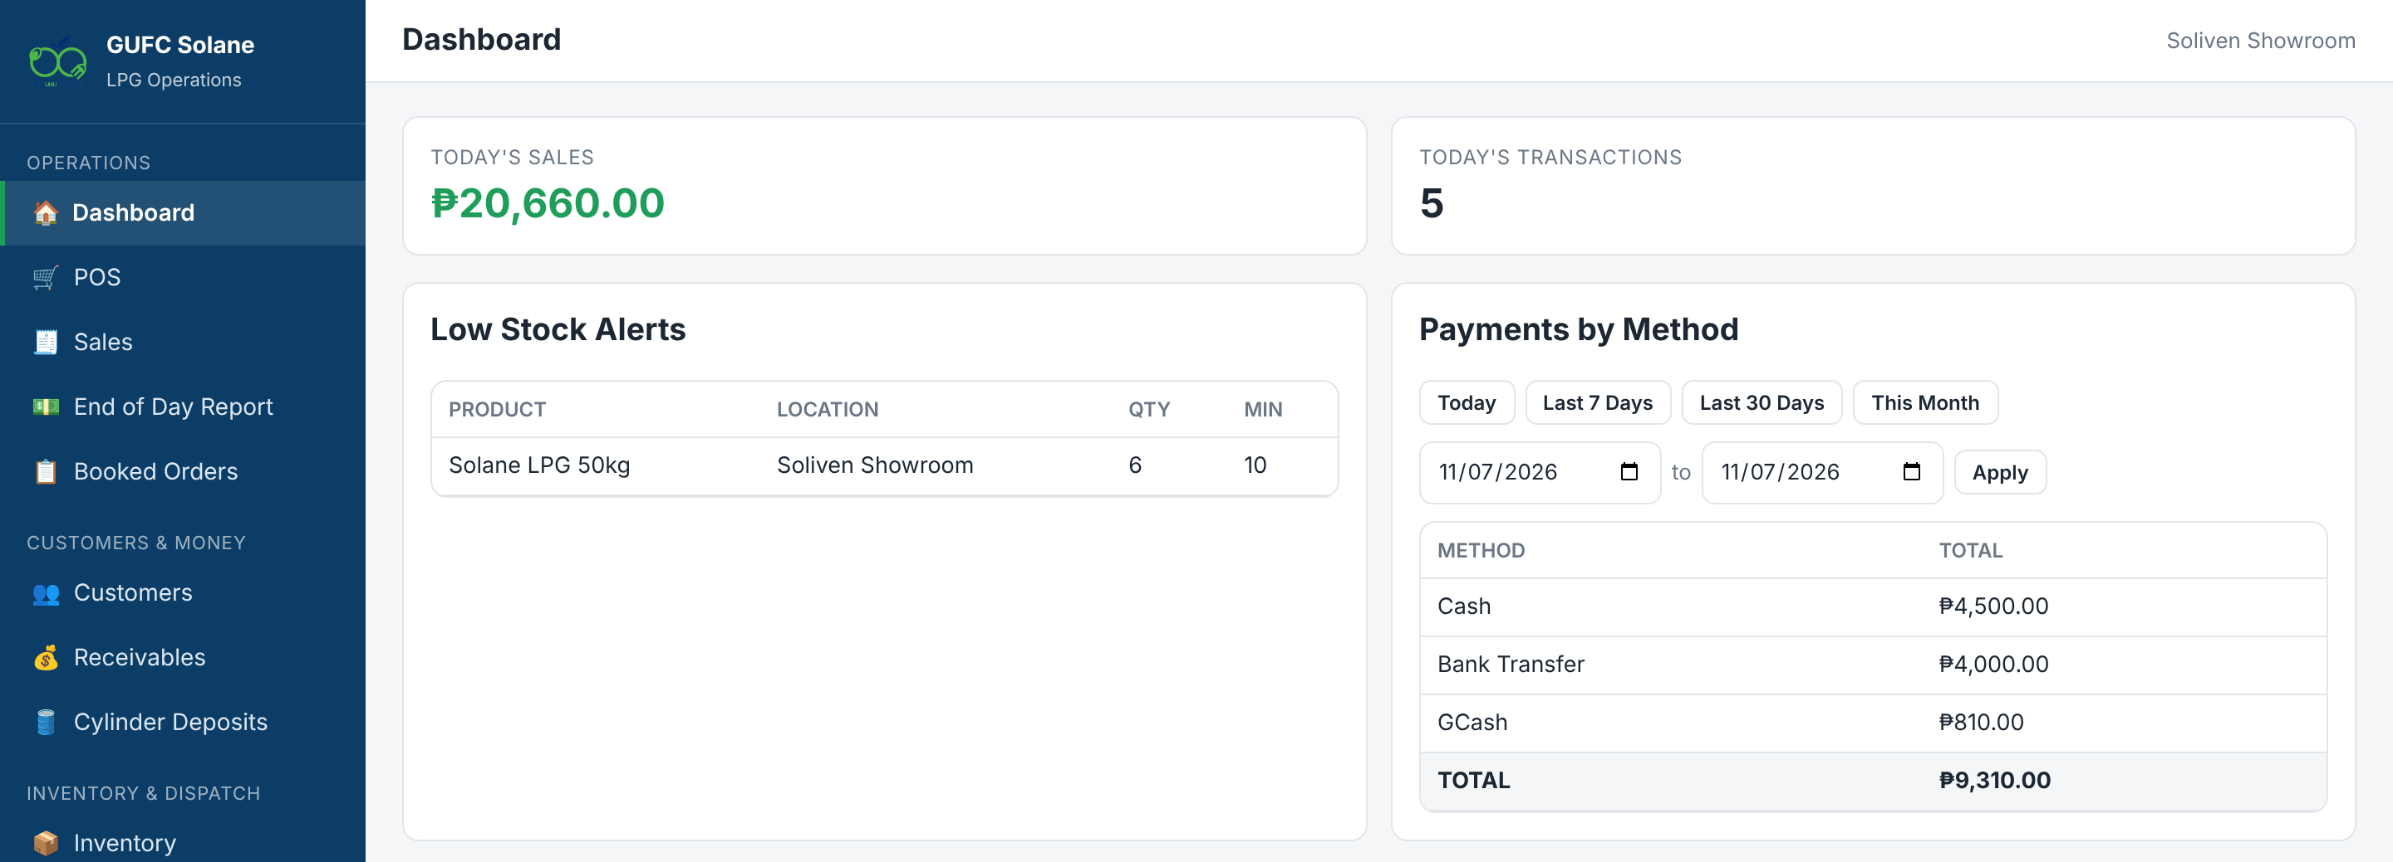
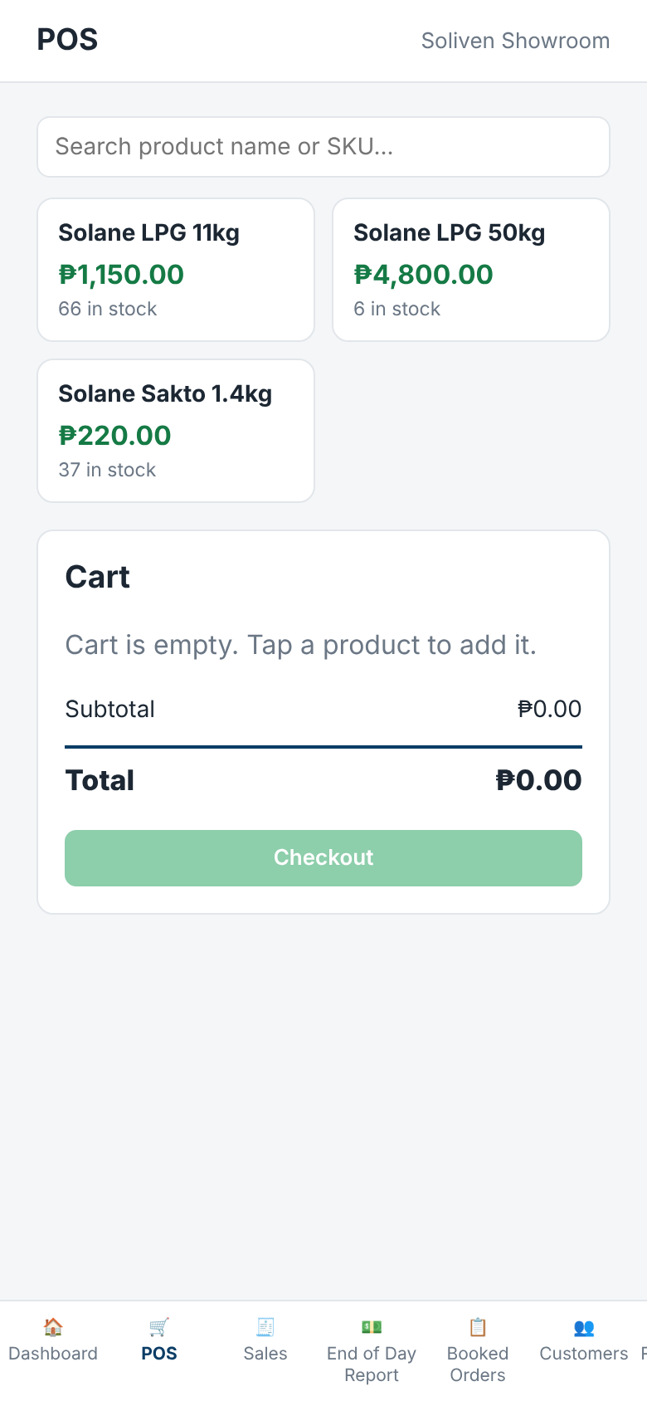
Finding your way around
On a phone, the same system fits the screen
Notes:
The left menu is grouped into Operations, Customers & Money, Inventory & Dispatch, Fleet & Staff, and Reports & Admin. On a phone it becomes a menu at the bottom. Green buttons save or confirm; red buttons remove or cancel.

Slide 7
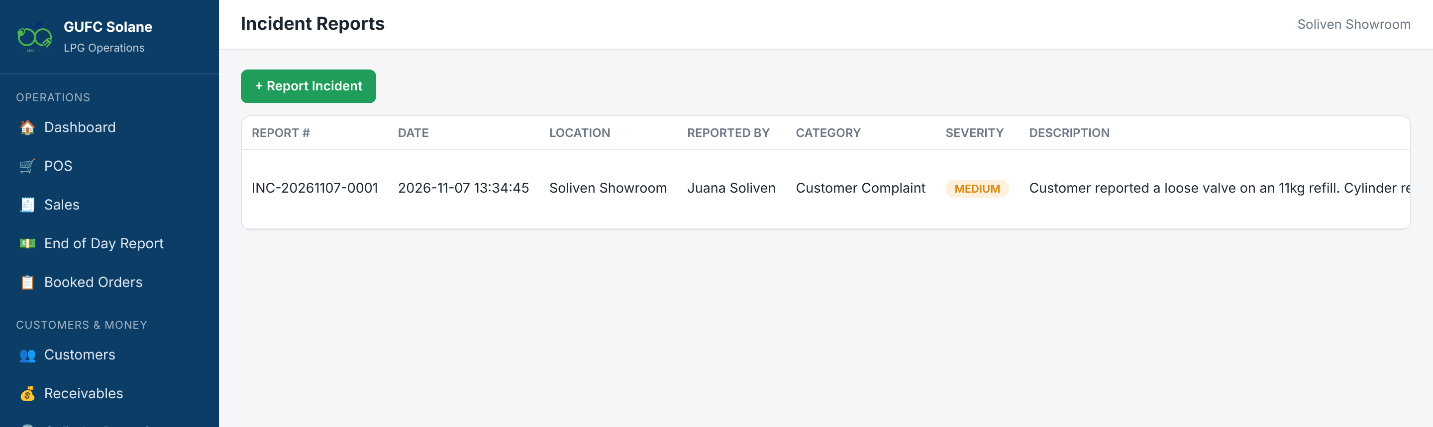
Everyone can file an Incident Report
1
Report Incident
2
Attach proof
3
Submit
4
Resolved by management
Tap + Report Incident and describe what happened.
Add photos, PDF, Excel or Word files (up to 10).
It is tagged with your location automatically.
Admin or Manager marks it resolved.
Notes:
Any role can report leaks, short deliveries, complaints, or vehicle problems. You only see your own location's reports. Only Admin and Manager can resolve them.

Slide 8
Attendant (Cashier)
ROLE 1
Sell at the counter, collect payments, serve booked orders and close the day. You only see your own location.
Notes:
This section is for showroom and warehouse cashiers. Ask attendants to log in as jsoliven during practice.

Slide 9
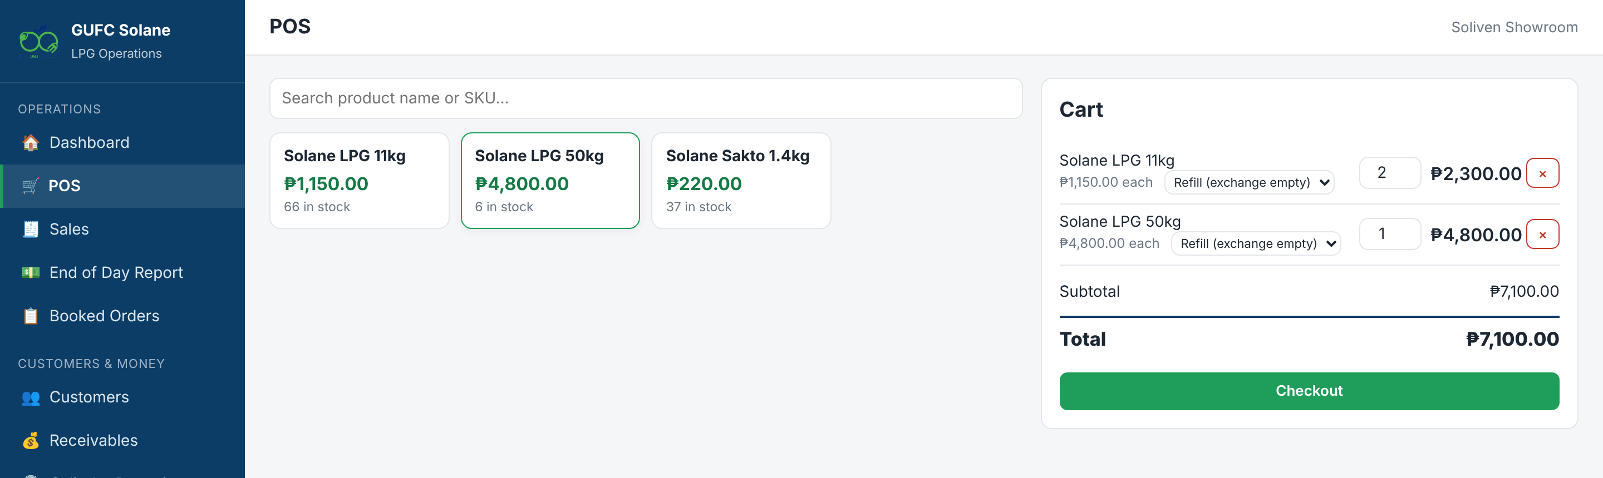
Making a sale: build the cart
1
Open POS
Products show stock at your location.
2
Tap a product to add it
Tap again to add more, or type the quantity.
3
Choose the sale type
Refill, New/Deposit or Swap on each cylinder line.
4
Pick a promo if any
Use the discount dropdown on the line.
5
Tap Checkout
Check the total first.
Notes:
Demonstrate adding an 11kg and a 1.4kg cylinder. Point out the sale-type dropdown on each line and the discount dropdown that appears when promos exist.

Slide 10




Refill, New/Deposit or Swap?
Refill
New / Deposit
Swap
When: Customer returns an empty Solane cylinder.
When: Customer takes a full cylinder and returns nothing.
When: Customer hands over another brand (Petron Gasul, Shellane...).
System: Gas price only. The empty goes back into your empty-cylinder stock.
System: Adds the cylinder deposit fee. Tracked as on loan under Cylinder Deposits.
System: Pick the brand and an optional swap fee per cylinder. Printed on the receipt.
Discounts apply to the gas price only, never to the cylinder deposit fee.
Notes:
This is where most mistakes happen, so spend time here. Refill returns an empty to our stock. Deposit adds the deposit fee and tracks the cylinder as on loan. Swap records the other brand and an optional fee.

Slide 11
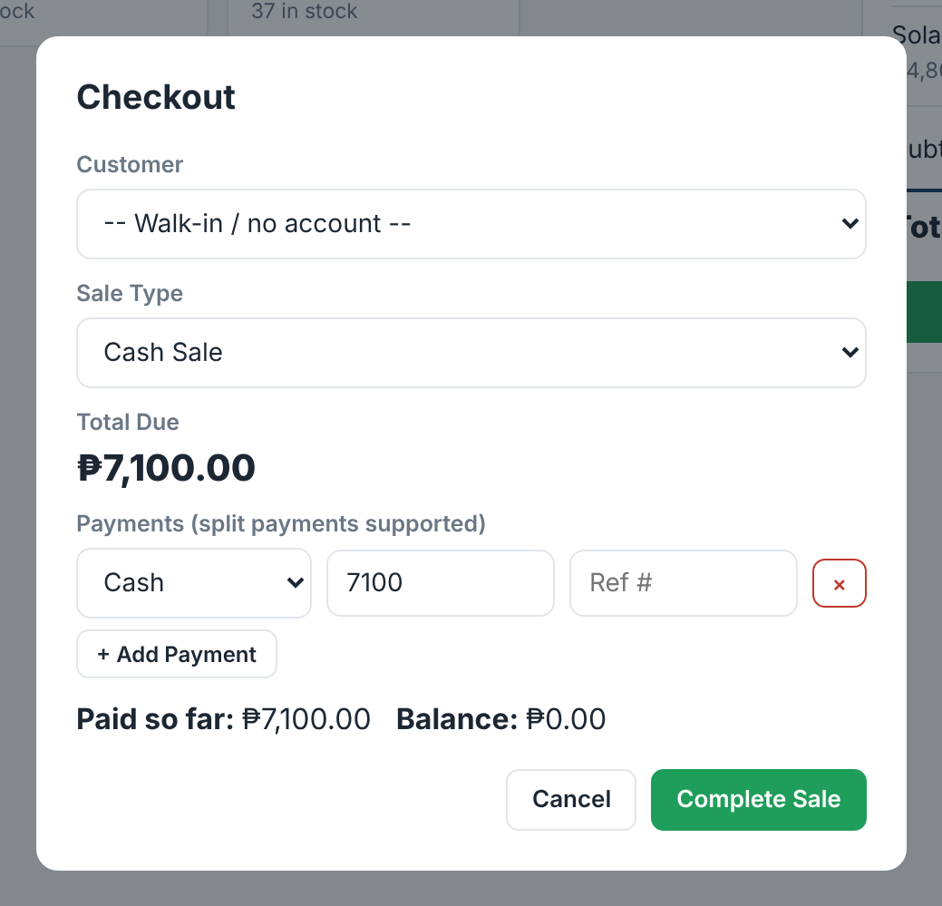

Checkout and split payments
1
Choose the customer
Or leave it as Walk-in / no account.
2
Cash or Credit / Terms
Credit sales need a customer account.
3
Enter payments
Cash, GCash, Bank Transfer, Maya, Cheque. Add a Ref #.
4
Tap Complete Sale
Receipt prints and stock is reduced.
A Cash Sale must be paid in full. If the customer can't pay it all, use a Credit sale on their account.
Notes:
Show split payment: tap + Add Payment for, say, cash plus GCash. A cash sale must be paid in full. A credit sale can't push the customer past their credit limit; the unpaid balance becomes a receivable.

Slide 12
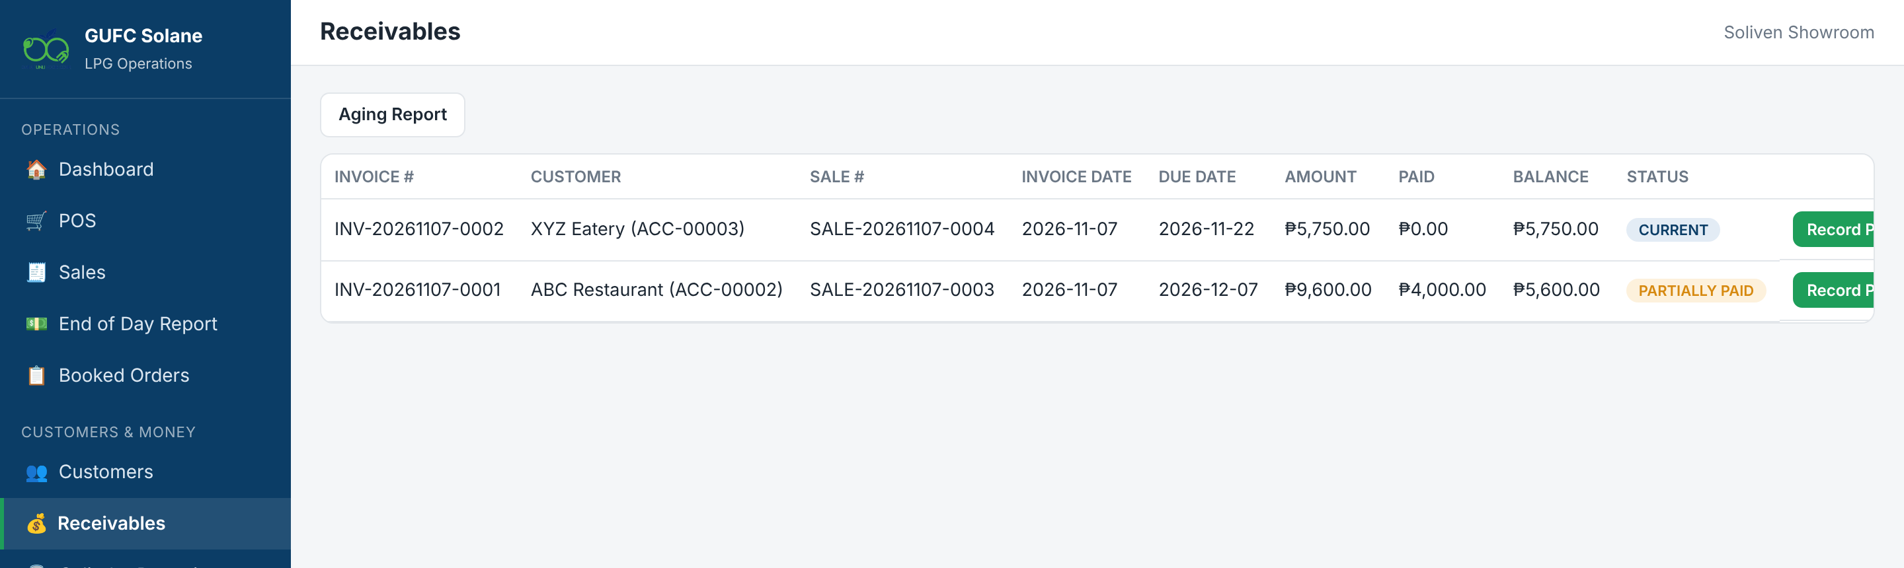
Collecting payment on an account
1
Open Receivables
2
Record Payment
3
Amount and method
4
Save Payment
You see only your location's open balances.
Tap it on the right invoice.
Partial payments are fine. Add the reference no.
Status updates to Partially Paid or Paid.
Notes:
Receivable statuses are Current, Due Soon, Overdue, Partially Paid and Paid. The Aging Report button shows how late accounts are.

Slide 13
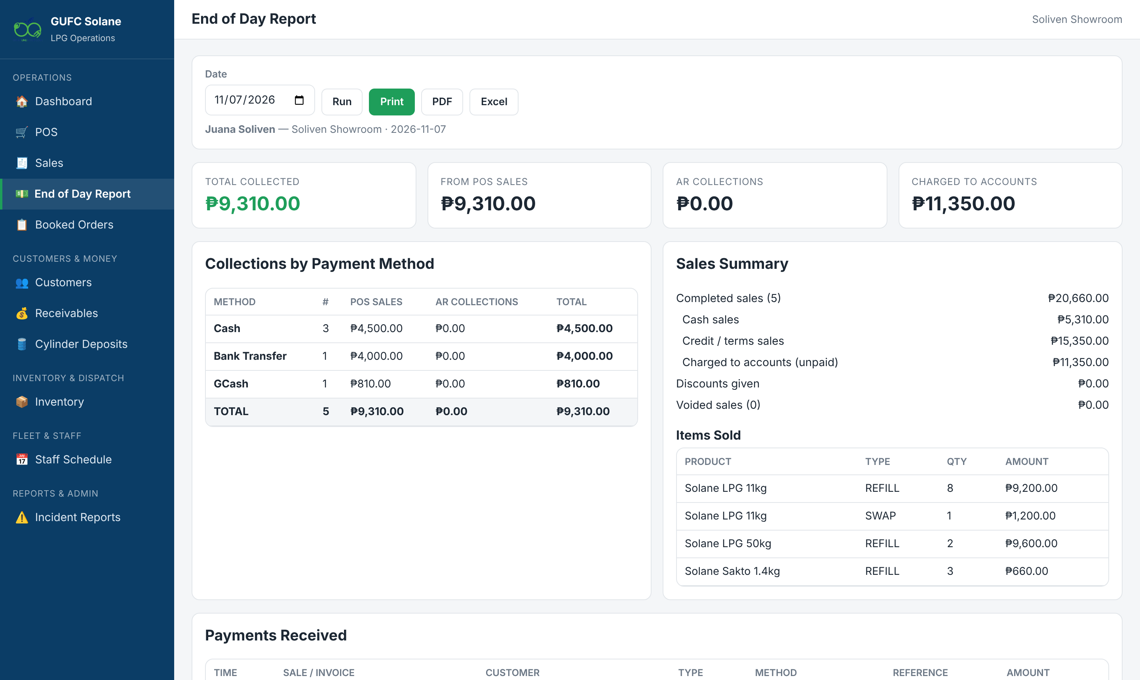
Closing the day: End of Day Report
1
Open End of Day Report
It shows your own collections for the day.
2
Check the totals
POS sales, AR collections, charged to accounts.
3
Match by payment method
Cash in drawer, GCash, bank and cheques.
4
Print or export
PDF or Excel. Hand it in with your cash.
Notes:
Run this every closing. Differences between the report and the drawer must be explained the same day. Accounting reviews these reports for every attendant.

Slide 14
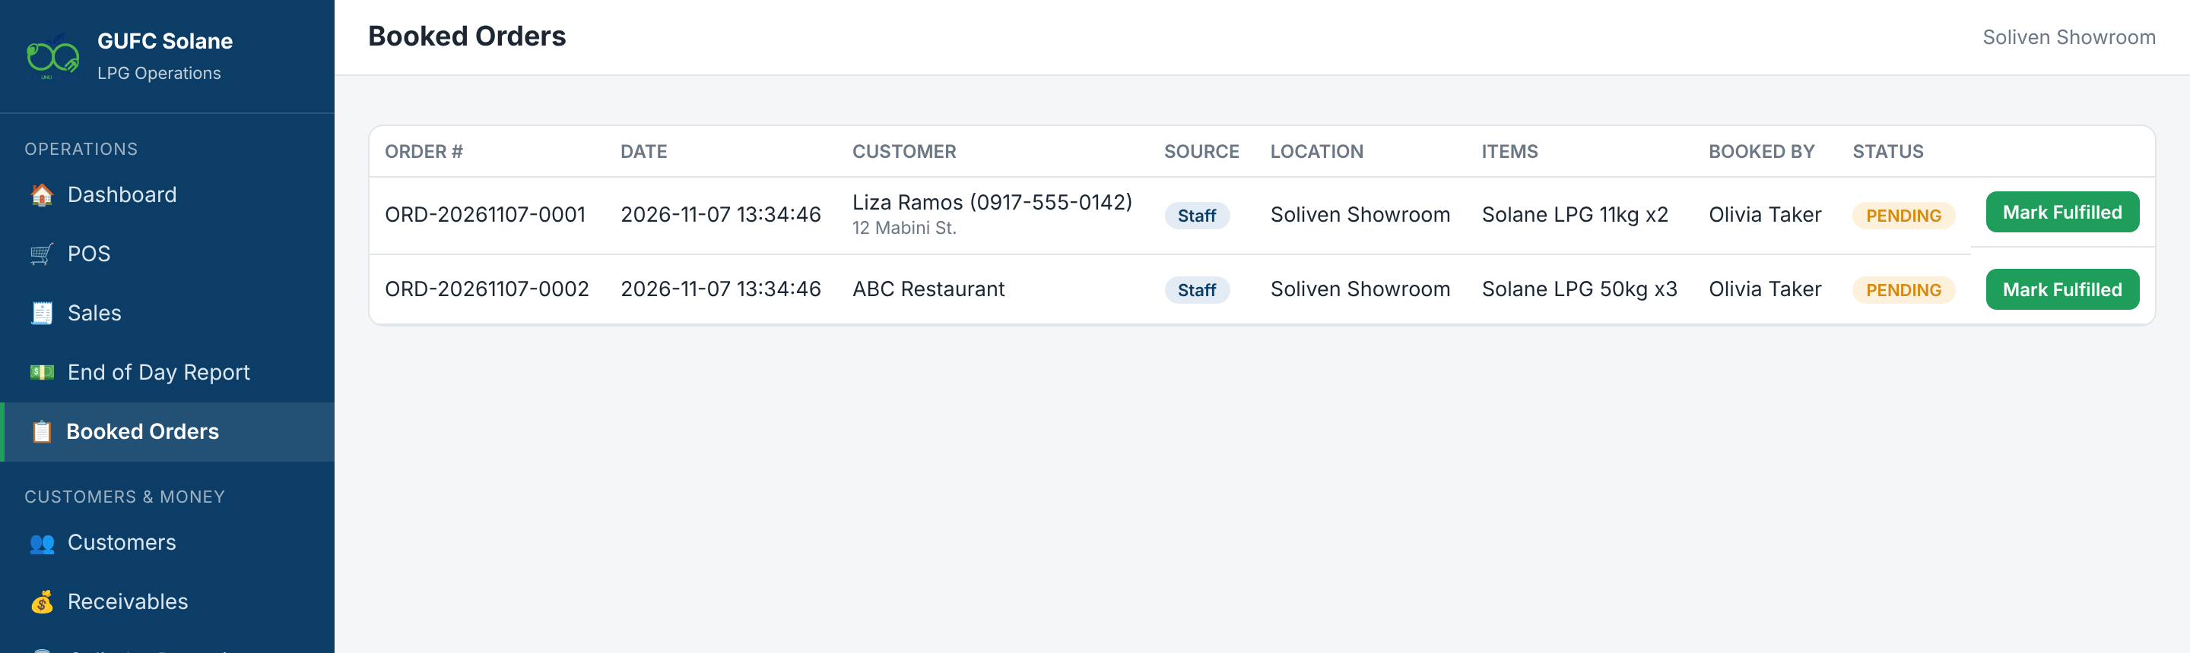
Booked orders and cylinder returns
1
Booked Orders
2
Mark Fulfilled
3
Cylinder Deposits
4
Can't cancel?
Orders assigned to your showroom appear here.
Tap it once the customer is served.
Customer returns a deposit cylinder? Tap Record Return.
Only the Order Taker or Manager can cancel orders.
Notes:
Attendants fulfil but cannot cancel booked orders. For deposit returns, enter the quantity returned and the receiving location, then Confirm Return.

Slide 15
Dispatcher
ROLE 2
Move full and empty cylinders, receive supplier deliveries, and weigh commercial cylinders.
Notes:
For warehouse dispatch and delivery staff. Practice login: pdispatch.

Slide 16
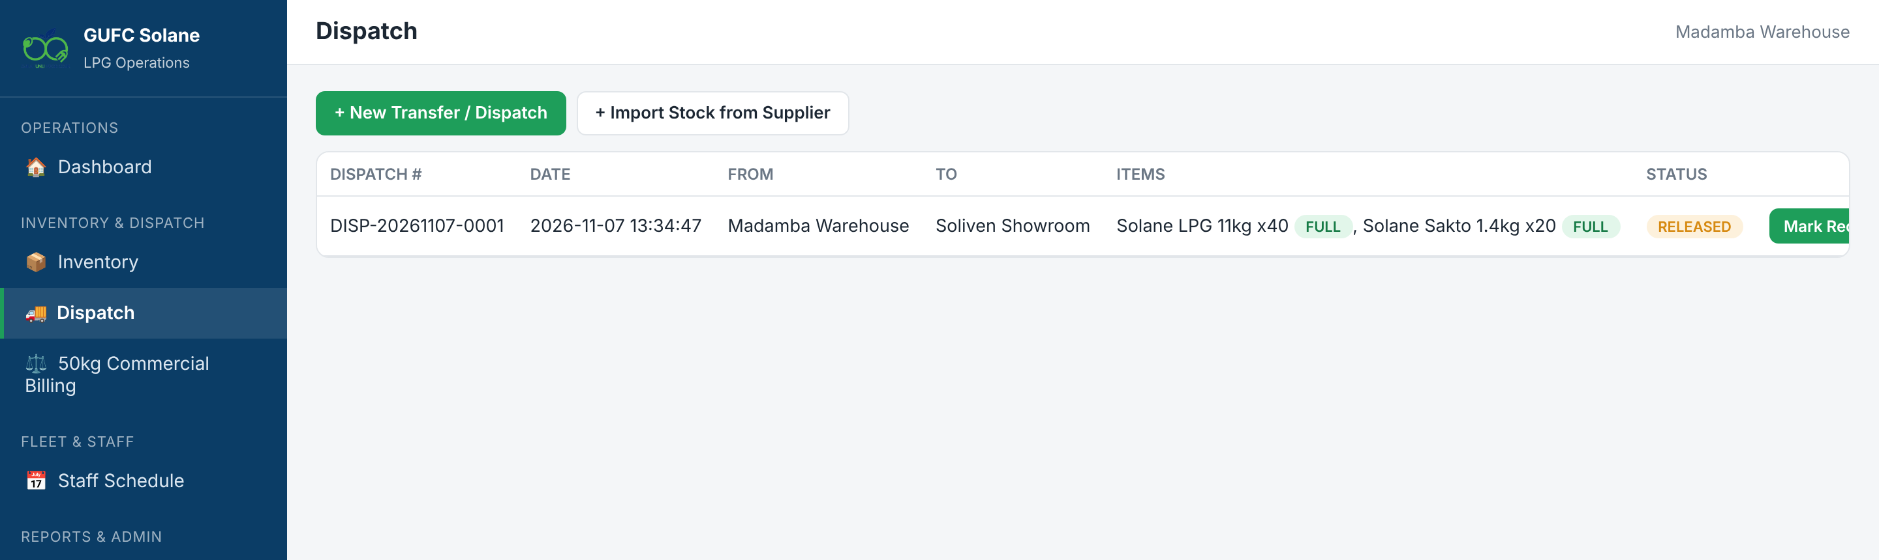
Dispatch and receiving
1
New Transfer / Dispatch
2
Add lines
3
Dispatch
4
Mark Received
Pick from and to locations, or a plant.
Mark each line Full or Empty with the quantity.
Stock leaves the source right away.
At the destination, when the truck arrives.
Notes:
Only empties can go to a plant. You can't dispatch more than is in stock. A transfer can be received only once. Supplier deliveries use + Import Stock from Supplier with the supplier name and reference number.

Slide 17

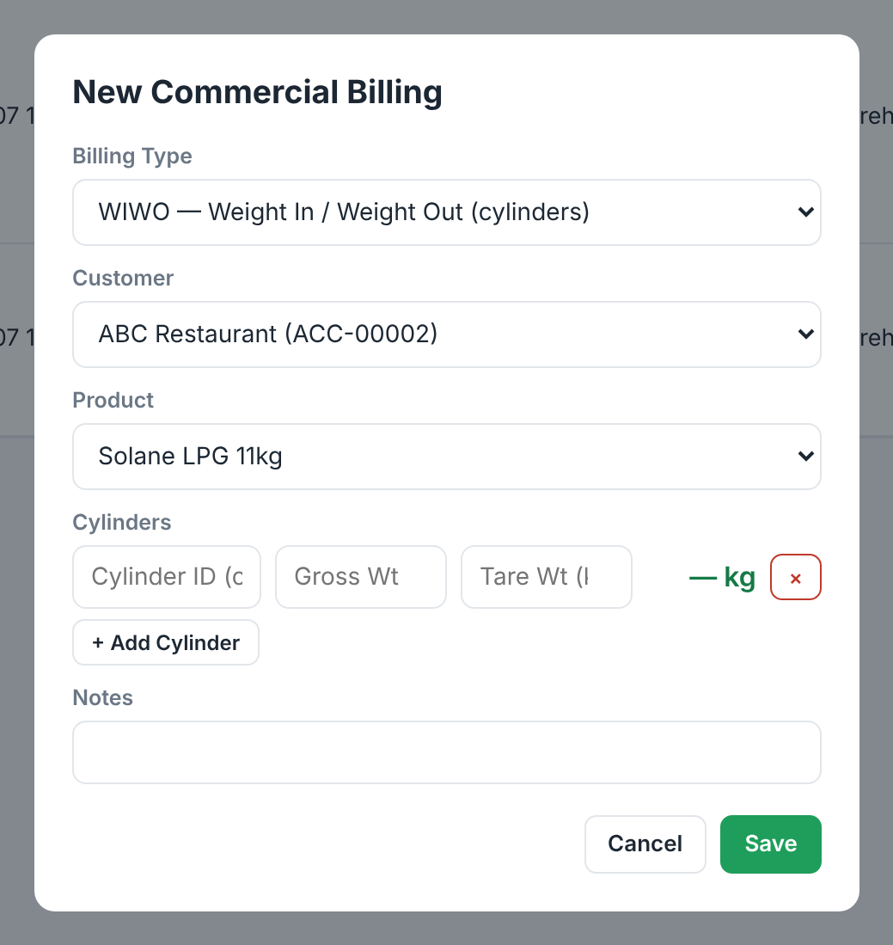

50kg commercial billing: two methods
WIWO (weight in / out)
Weigh in: gross and tare per cylinder
Record Pickup: weigh-out reading
System computes kg consumed
Manager generates the invoice
READING (meter)
Enter the current meter reading
Previous reading fills in itself
Goes straight to ready-to-bill
Manager generates the invoice
Notes:
WIWO is weight in, weight out: we bill the actual kilograms used. READING is a meter: previous reading auto-fills from the last bill. After the dispatcher records it, a Manager generates the invoice.

Slide 18
Order Taker
ROLE 3
Take phone, chat and online orders and send each one to the right showroom.
Notes:
Practice login: otaker.

Slide 19
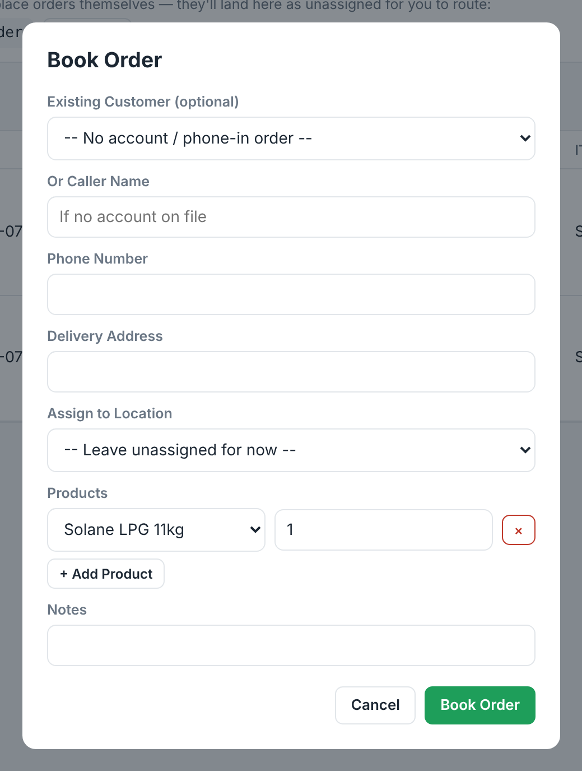
Booking an order
1
Tap + Book Order
In the Booked Orders screen.
2
Who is ordering
Pick an existing customer, or type name, phone and address.
3
Add products
+ Add Product for each item and quantity.
4
Assign to a location
Only that showroom's attendants will see it.
Notes:
Walk through booking for an existing customer and a new caller. Remind them that the showroom marks it fulfilled; the Order Taker can also cancel or reassign.

Slide 20
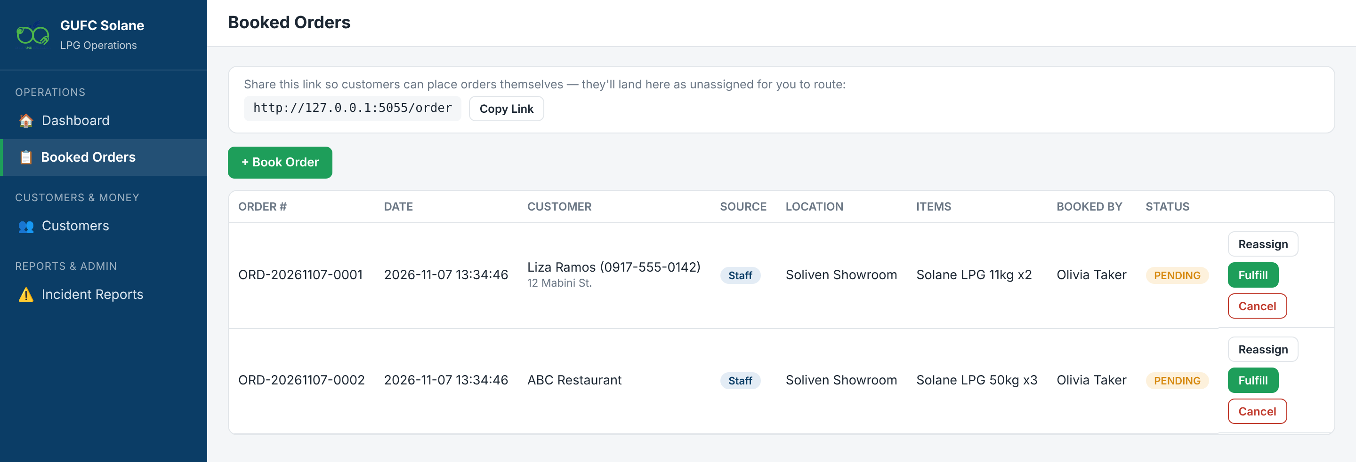
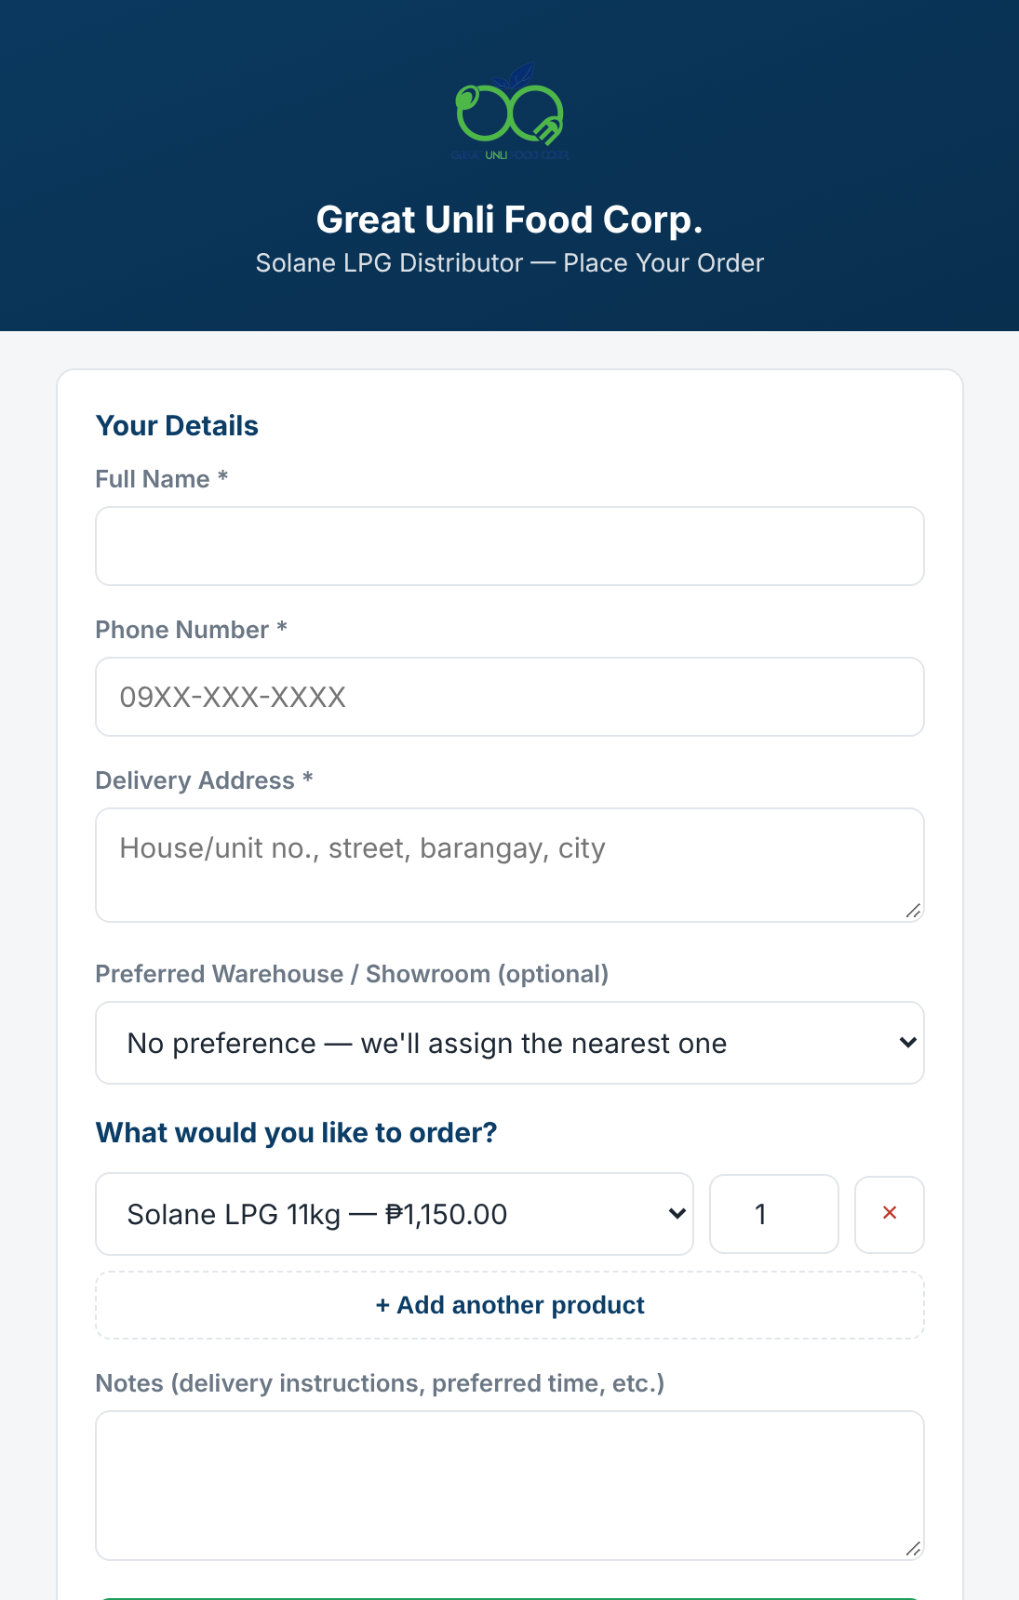
Customers can order online
1
Copy Link and share it
Customers order without logging in.
2
Assign each Online order
Send it to the nearest showroom with stock.
Notes:
Share the order link from the Copy Link button on Booked Orders on Facebook, Viber or SMS. Online orders arrive marked Online. Call the customer to confirm, then Assign or Reassign to a location.

Slide 21
Accounting
ROLE 4
Own customer balances: collections, previous arrears, statements and reports for all locations.
Notes:
Practice login: aaccounting.

Slide 22
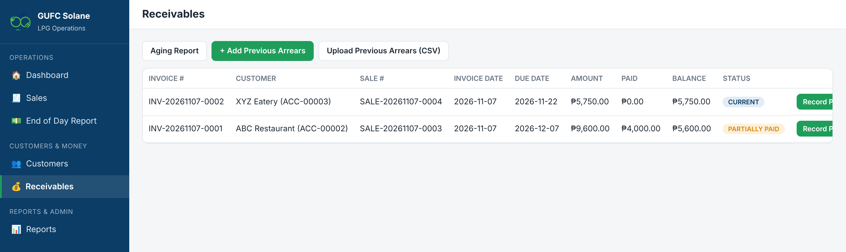
Receivables and previous arrears
1
Watch the totals
2
Aging Report
3
Previous arrears
4
CSV all-or-nothing
Outstanding and Overdue cards on the Dashboard.
Balances grouped by days past due. Export Excel/PDF.
Add one at a time, or upload a CSV.
One bad row means nothing saves. Fix and re-upload.
Notes:
Previous arrears are balances from before go-live. They behave like invoices but are not counted as sales, and they roll into the Beginning Balance on the Statement of Account. CSV columns: account_no, amount, as_of_date, then optional due_date, reference, notes.

Slide 23
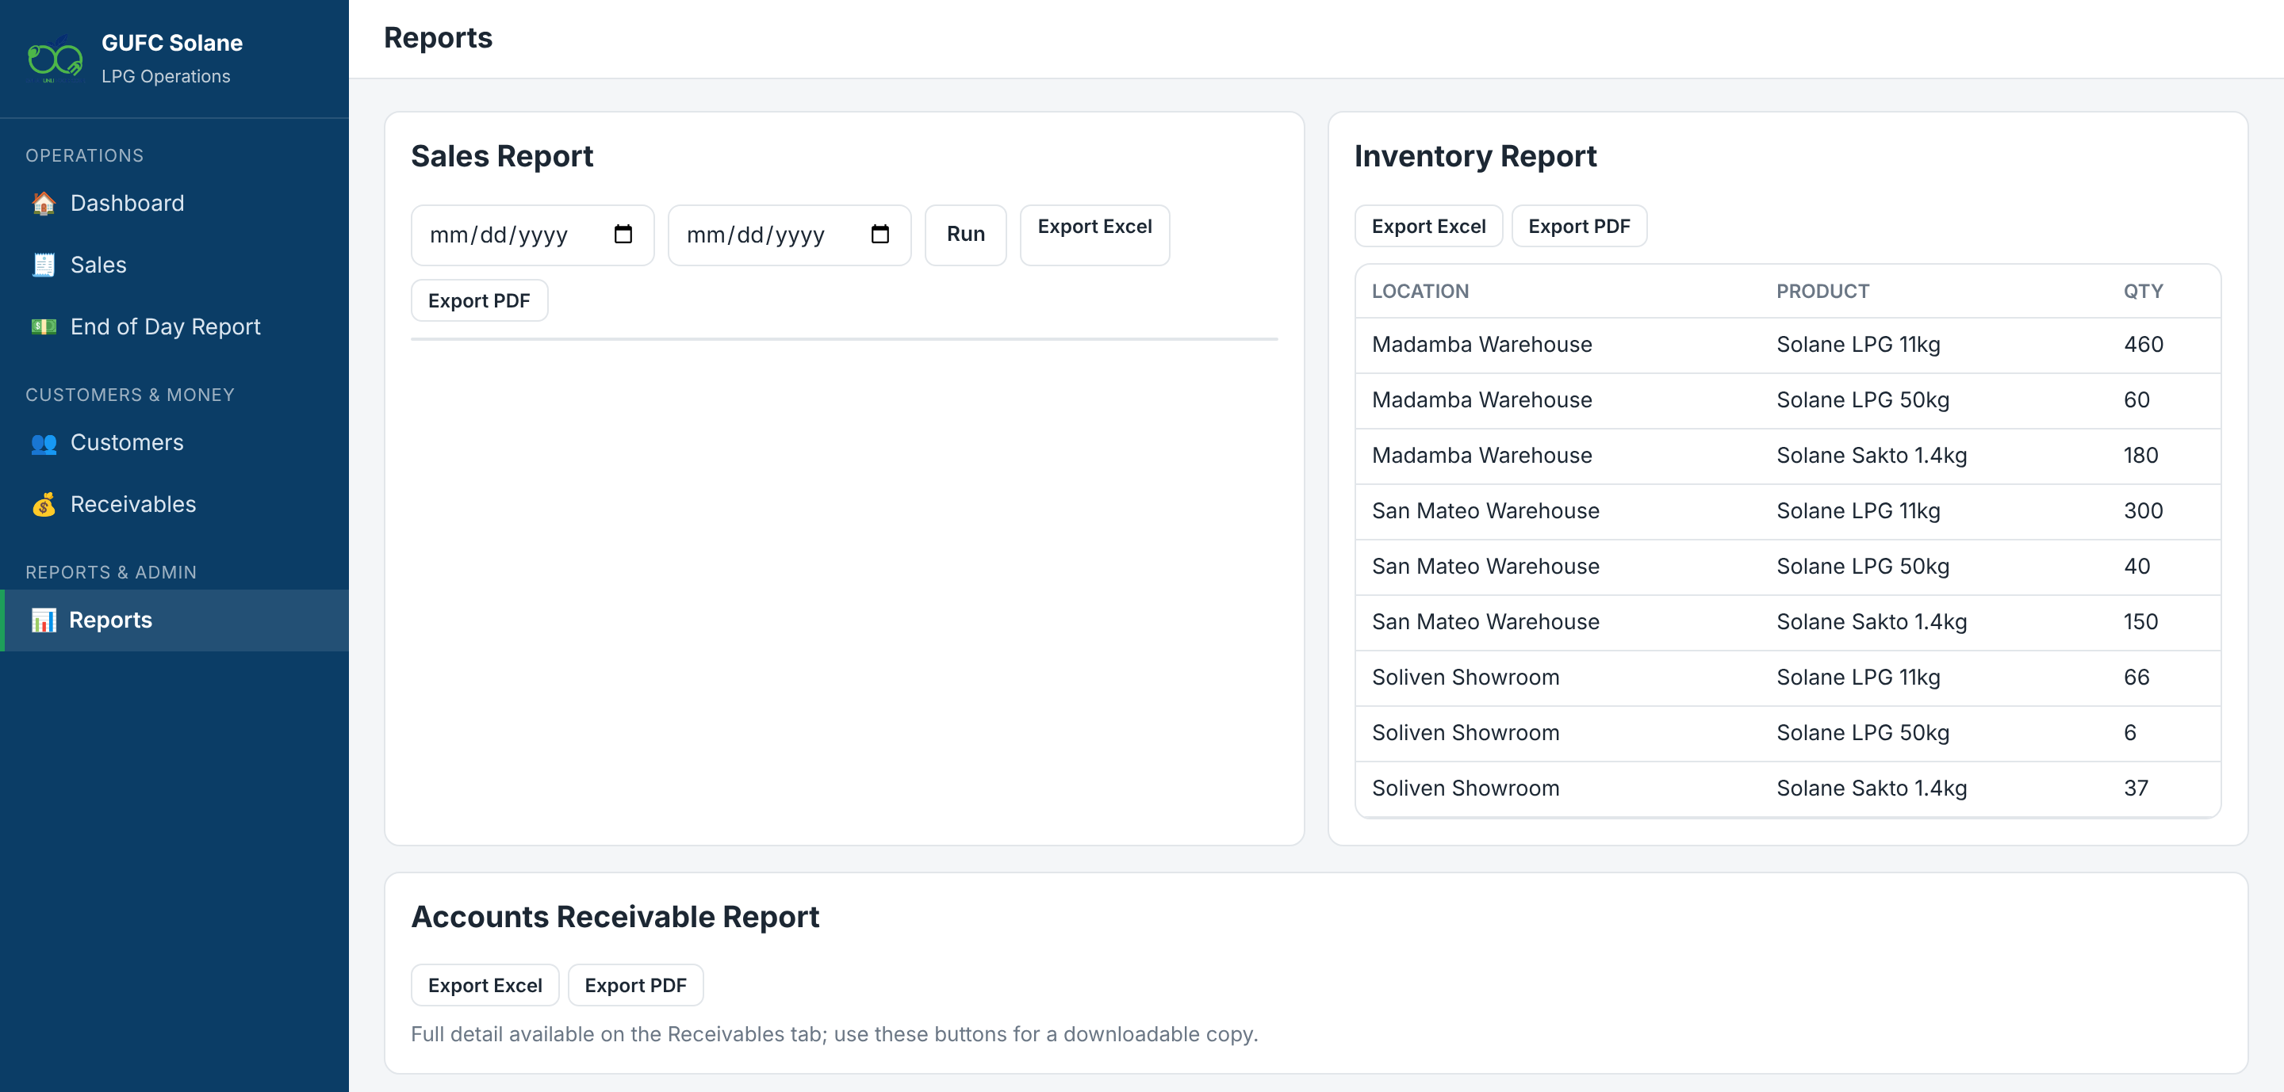
Statements, End of Day review and reports
1
Statement of Account
Customers → Ledger / SOA → download the PDF.
2
Review End of Day
Choose any staff or location; match deposits.
3
Run reports
Sales (per item), Inventory, Receivables.
4
Export
Excel or PDF for filing and the bookkeeper.
Notes:
Show the Sales Report columns: qty, unit price, discount, net amount, customer category and promo remarks.

Slide 24
Manager
ROLE 5
Oversee every location: commercial invoicing, hauling, staff, promos, users and incidents.
Notes:
Practice login: mgarcia.

Slide 25
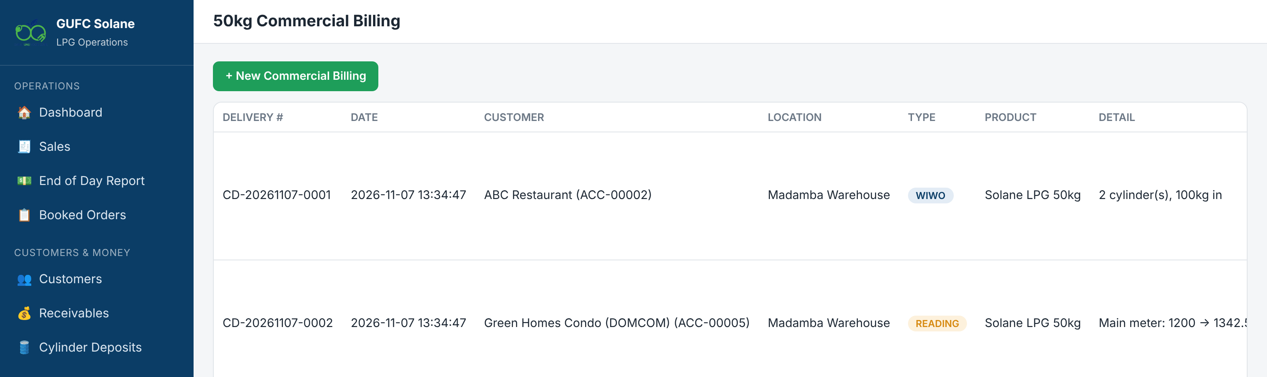
Invoicing commercial accounts
1
Find ready records
2
Generate Invoice
3
Becomes a receivable
4
Print or PDF
PICKED_UP (WIWO) or ready-to-bill (READING).
Rate defaults to Price per KG; you can override it.
Shows in Receivables, Aging and the SOA.
Send the billing document to the customer.
Notes:
Only Admin and Manager can generate commercial invoices. The invoice creates a normal credit sale.

Slide 26
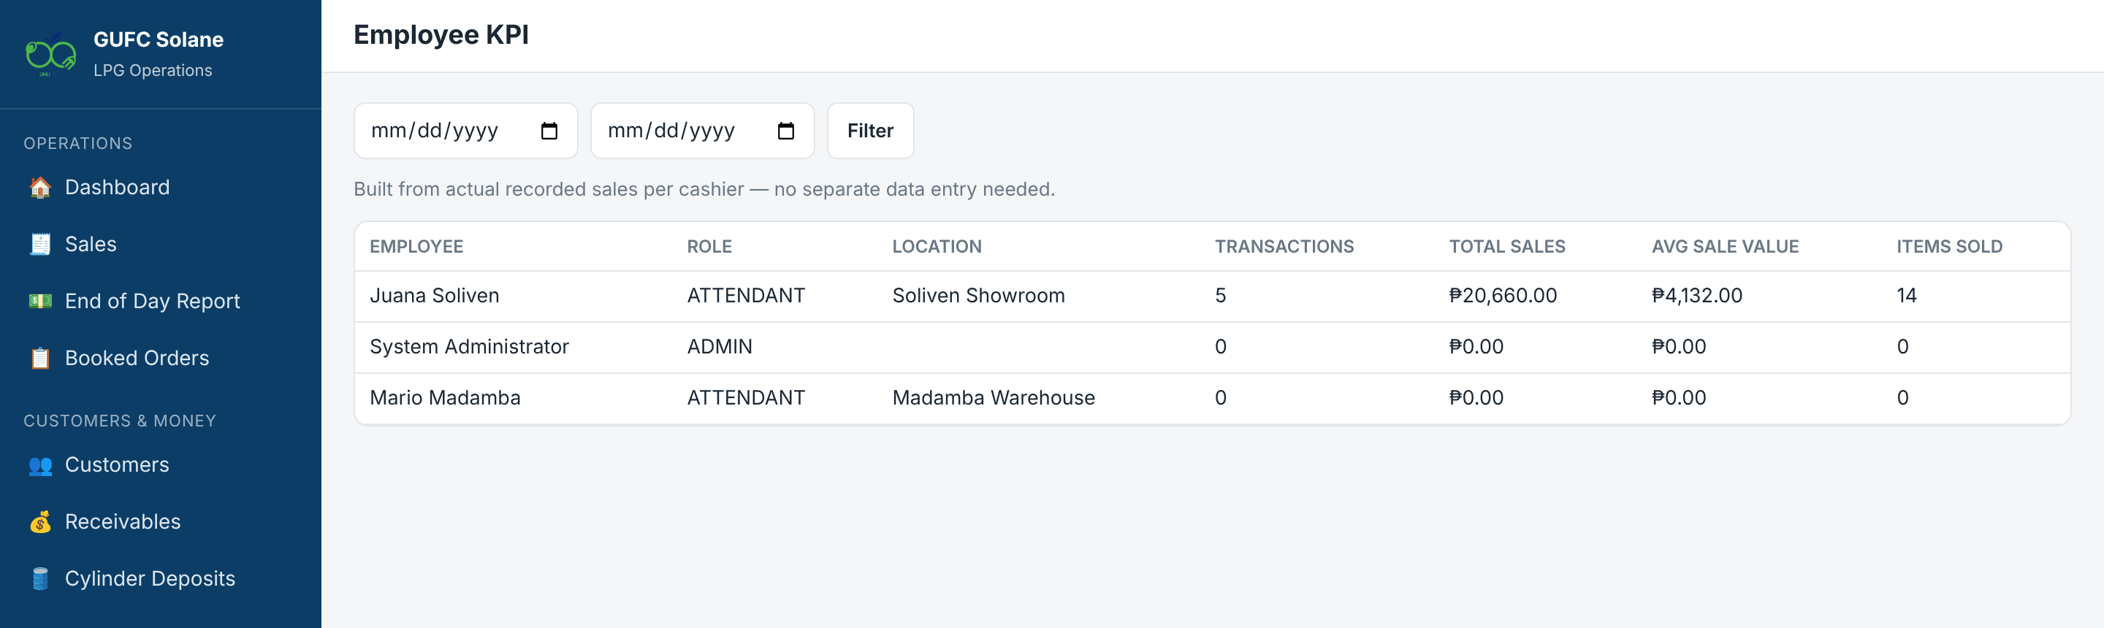
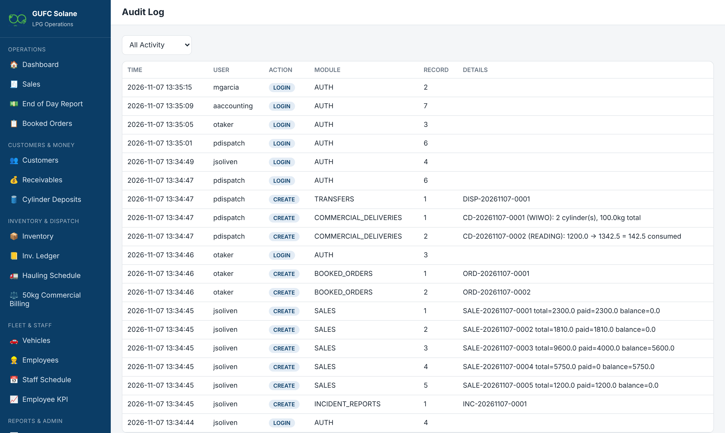
Staff, KPI and the audit trail
1
Staff Schedule
+ Add Shift. Everyone sees their own shifts.
2
Employee KPI
Sales, transactions and average sale per cashier.
3
Hauling and Vehicles
Plan plant trips; track registration and insurance.
Notes:
Employee KPI needs no extra encoding: it is built from POS sales. The Audit Log shows who did what and when; check it for voids, stock adjustments and odd-hour logins.

Slide 27
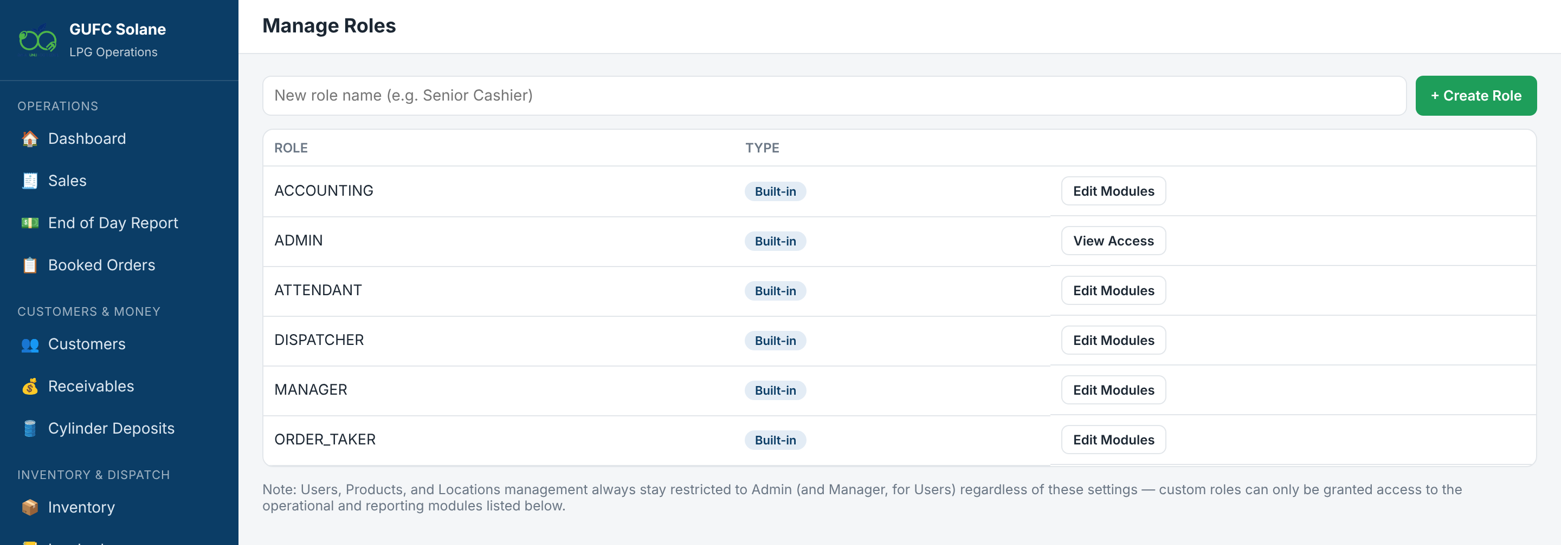
Users, roles and promos
1
Users → + New User
Set role and location. Disable staff who leave.
2
Manage Roles
Create custom roles and tick their modules.
3
Discounts & Promos
% off or ₱ off per unit, dates and minimum qty.
4
Incident Reports
View and Resolve reports from every location.
Notes:
Disable rather than delete users so their history stays. Products, Locations and System Reset stay Admin-only regardless of custom role settings.

Slide 28
Administrator
ROLE 6
Set up and maintain the system: products and prices, locations, customers, stock corrections and going live.
Notes:
Admins can do everything shown so far. This section covers Admin-only tasks.

Slide 29
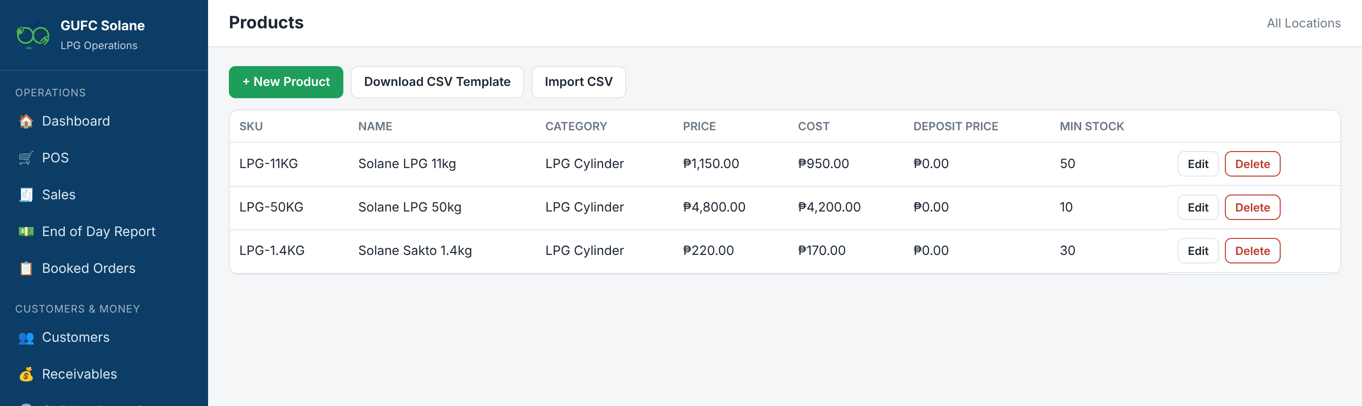
Products, prices and locations
1
Edit prices anytime
2
Deposit and per-kg
3
Import CSV
4
Locations
Past sales keep the price at the time of sale.
Set the deposit fee and Price per KG per product.
Download the template, fill it, upload.
Warehouse or Showroom. Deactivate, don't delete.
Notes:
LPG prices change often; update them under Products > Edit. Admin also creates and edits customers, adjusts stock with a required reason, and is the only role that can void a sale.

Slide 30
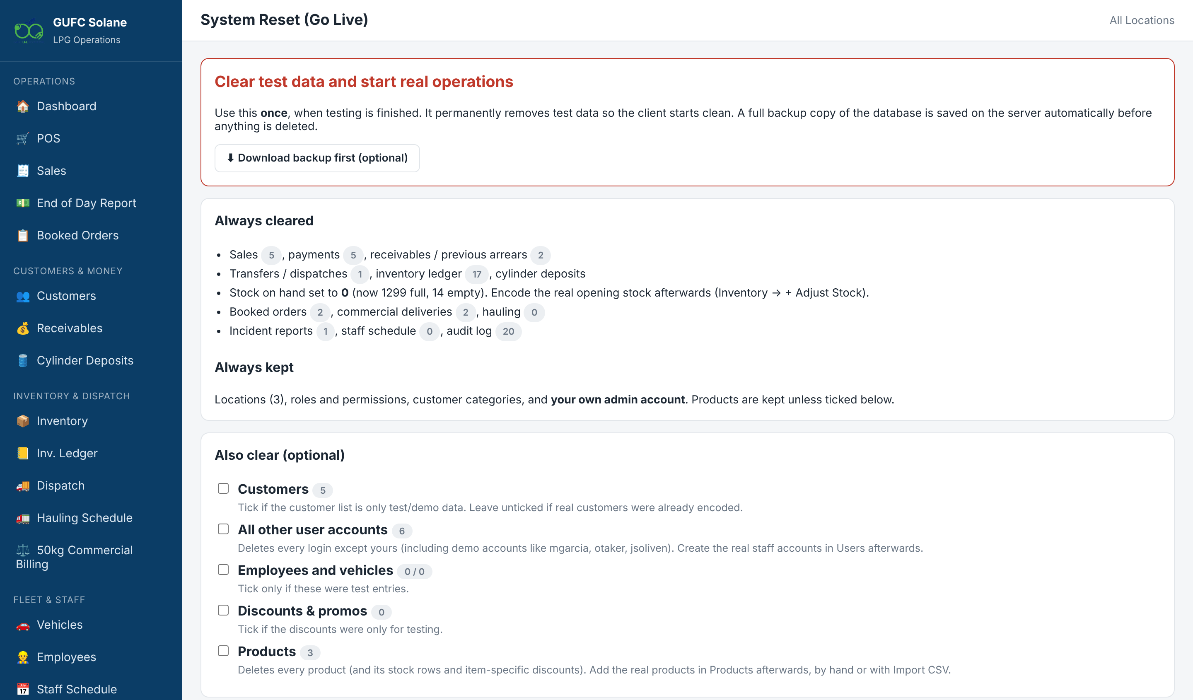
Going live: System Reset
1
Download backup first
Keep the file somewhere safe.
2
Choose what to clear
Sales and stock always; demo users optional.
3
Type RESET + password
Then tap Reset system now.
4
Load real data
Opening stock, customers, previous arrears.
Reset clears every transaction. Make sure no one is using the system before you confirm.
Notes:
Run this only once, when testing is over. It clears all transactions and sets stock to zero, but keeps locations, products, roles and your admin account.

Slide 31
Hands-on practice
Role | Practice login | Exercise
Attendant | jsoliven / Attendant123! | Sell 2 refills + 1 swap with cash and GCash. Run your End of Day.
Dispatcher | pdispatch / Dispatch123! | Dispatch 10 full 11kg to Soliven. Create a WIWO billing.
Order Taker | otaker / Order123! | Book an order for a new caller and assign it.
Accounting | aaccounting / Accounting123! | Record a payment and download an SOA.
Manager | mgarcia / Manager123! | Invoice the WIWO record. Create a 5% promo.
Practice on a test copy only. Demo logins are disabled before go-live.
Notes:
Give people 15 to 20 minutes on a test copy of the system. Remind them these demo accounts must be disabled before going live.

Slide 32

Questions?
Keep the GUFC-POS User Manual handy. It has step-by-step guides for every role.
Your login is yours alone · Report problems with an Incident Report
Notes:
Open the floor for questions. Point people to the PDF manual, especially Appendix C daily checklists.

