Slide 1
Python Dictionaries
Notes:
Ezra Heinberg Section 2

Slide 2
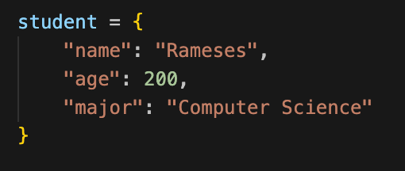
How are they created?
Dictionaries in Python are created using curly braces {} with key-value pairs
Keys have to be unique, immutable types
Values can be any type
Notes:
Ezra Heinberg Section 2

Slide 3
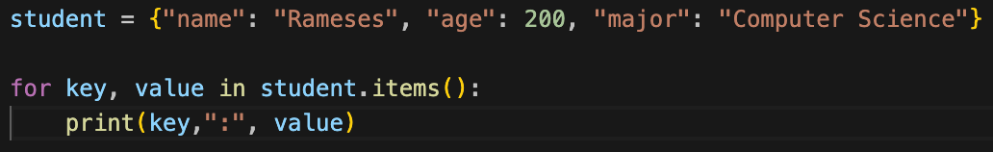
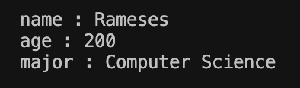
How keys and values are accessed using .items()
.items() returns all key–value pairs as tuples
.items() allows you to iterate over a dictionary in a for loop
Output:
Notes:
Ezra Heinberg Section 2

Slide 4
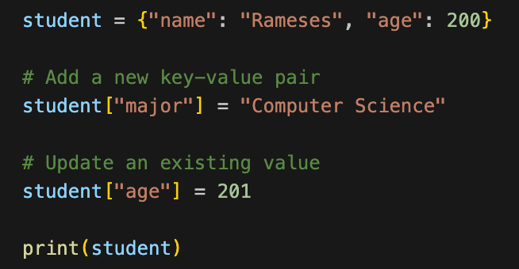
How to add elements to a dictionary
You can add new key-value pairs or update existing ones by assignment
Output:
Notes:
Ezra Heinberg Section 2

Slide 5
Data Cleaning
Notes:
Ezra Heinberg Section 2

Slide 6
What is data cleaning?
Data cleaning is the process of detecting, correcting, or removing errors and inconsistencies in datasets to improve their quality
It’s often one of the first steps in data analysis
Addresses issues such as: missing values, duplicates, inconsistent formatting, outliers or invalid values, and irrelevant data
Data cleaning transforms raw, messy datasets into structured, reliable information
Notes:
Ezra Heinberg Section 2

