Slide 1
Introduction to Pandas
Notes:
Ezra Heinberg Section 2

Slide 2
What is Pandas used for?
To change DataFrames
Update or modify values in a table
To filter rows
Pick out only the rows that meet a condition
Example: students older than 12
To select data
Choose a specific column/row or set of columns/rows
To detect missing data
find empty or NaN entries in the data
Notes:
Ezra Heinberg Section 2

Slide 3
DataFrames
Notes:
Ezra Heinberg Section 3

Slide 4
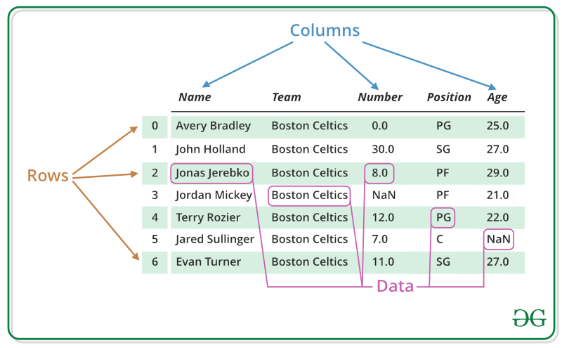
What is a DataFrame?
A DataFrame is a table of data with rows and columns, like a spreadsheet
Rows hold individual records
Example: all the info of an individual student
Columns hold categories of data
Example: names, ages, test scores
Indexes are labels (usually numbers) that identify each row
Notes:
Ezra Heinberg Section 3
picture from https://www.geeksforgeeks.org/pandas/python-pandas-dataframe/

Slide 5
Data Types
Notes:
Ezra Heinberg Section 4

Slide 6
Some common ones…
Data Type | Example | Explanation
int64 | 42, -7 | Whole numbers
float64 | 3.14, -5.6 | Decimal numbers
bool | True, False | True or false (boolean)
object | “UNC”, “apple” | Text/strings
Notes:
Ezra Heinberg Section 4

Slide 7
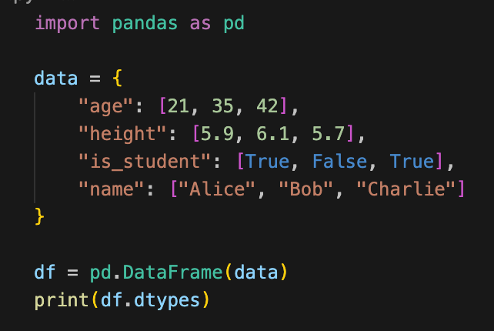
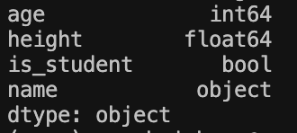
df.dtypes
df.dtypes shows the data type of each column in a DataFrame
Output:
Notes:
Ezra Heinberg Section 4

