Slide 1
Common Mistakes When Representing Data
Notes:
Ezra Heinberg Section 5

Slide 2
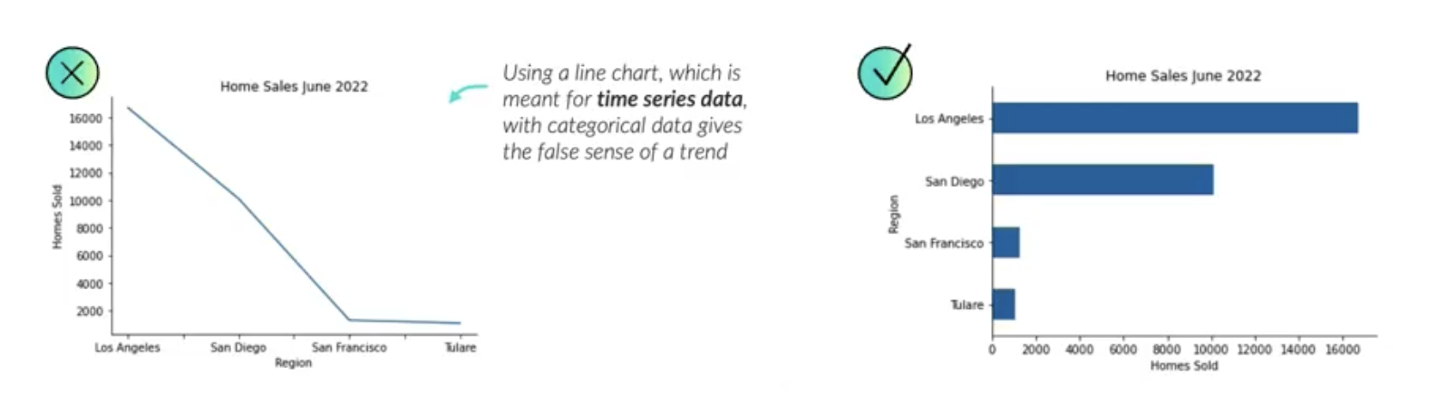
Line vs. Bar Chart for Categorical Data
Using a line chart for categorical data suggests a time-based trend, which misrepresents the data. Instead, use a bar chart!
Notes:
Ezra Heinberg Section 5

Slide 3
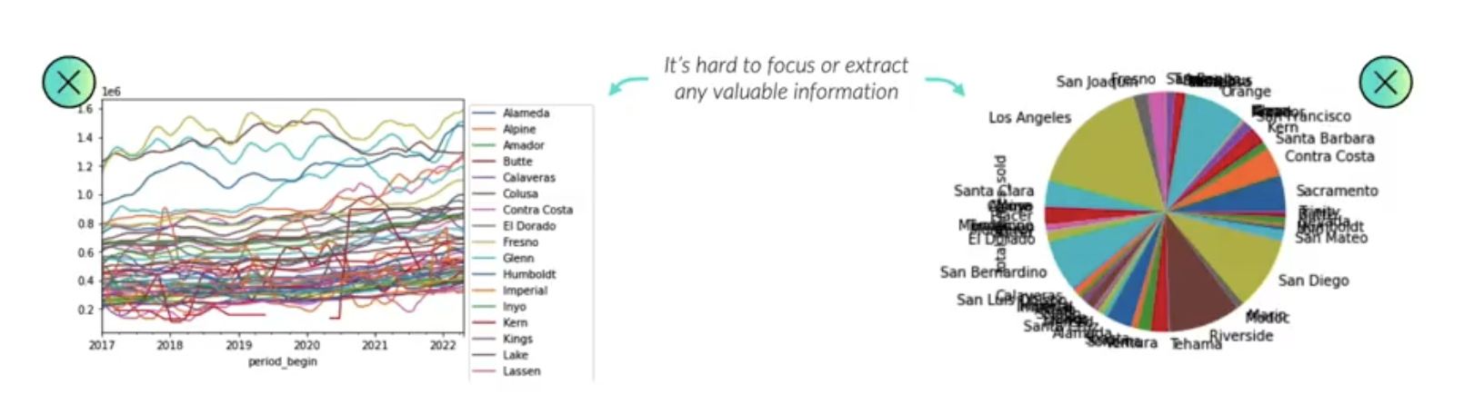
Too Many Series in One Graph
Using too many series to show a relationship can easily become confusing. Focus only on the most important categories, or split your data into multiple plots.
Notes:
Ezra Heinberg Section 5

Slide 4
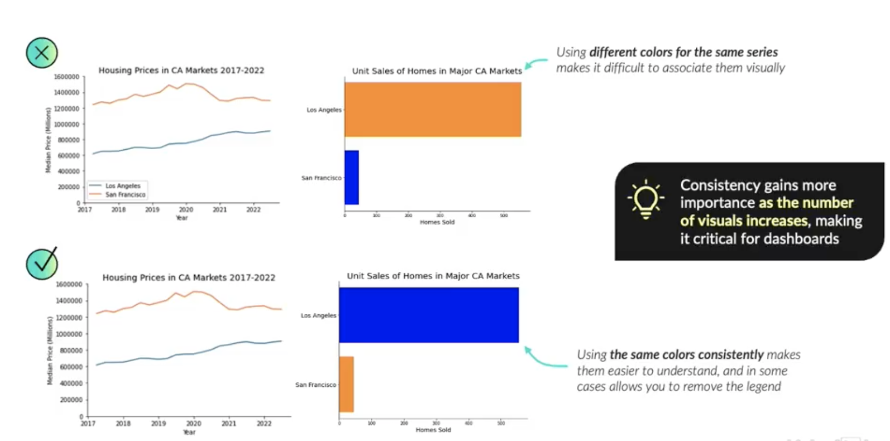
Using Inconsistent Colors
Always keep colors consistent across visuals!
Notes:
Ezra Heinberg Section 5

Slide 5
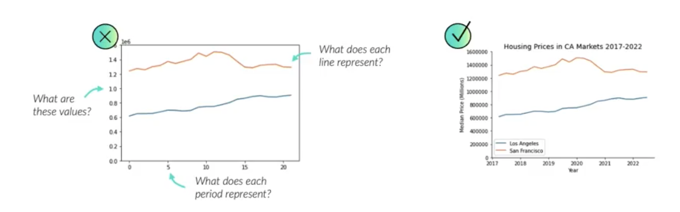
Not Labeling Axes
Always put labels that make sense with the data on the X and Y axes!
Notes:
Ezra Heinberg Section 5

