Slide 1
Fast and artifact-free excitation multiplexing
using synchronized emission scanning
30 July 2022
Ezra Bruggeman

Slide 2
Concept

Slide 3
Simulated polarisation camera images of immobilised fluorescent molecules
AMS2022, KU Leuven
Ezra Bruggeman, Lee Lab, Dept. Chemistry, University of Cambridge, 2022.
Simulations were performed as described in Backer & Moerner, J Chem Phys B, 2014.
Micropolarizer array on chip was simulated by applying Jones matrices for linear polarizers to the electric field at the image plane.

Slide 4
Results

Slide 5
Overview
…

Slide 6
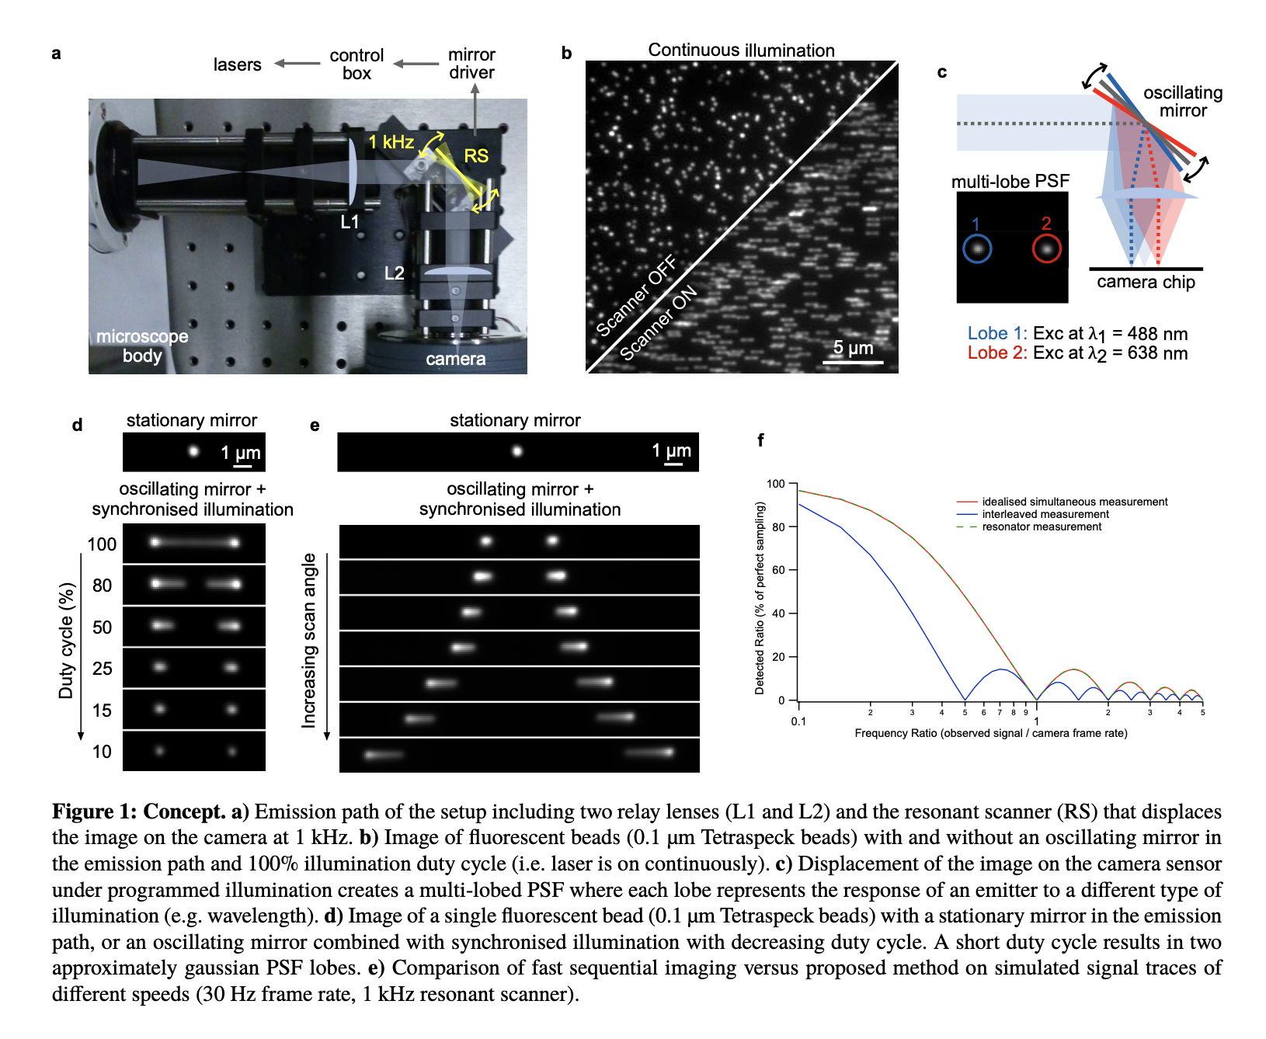

Slide 8
Validation of synchronisation

Slide 9
Single quantum dot excitation spectroscopy

Slide 10
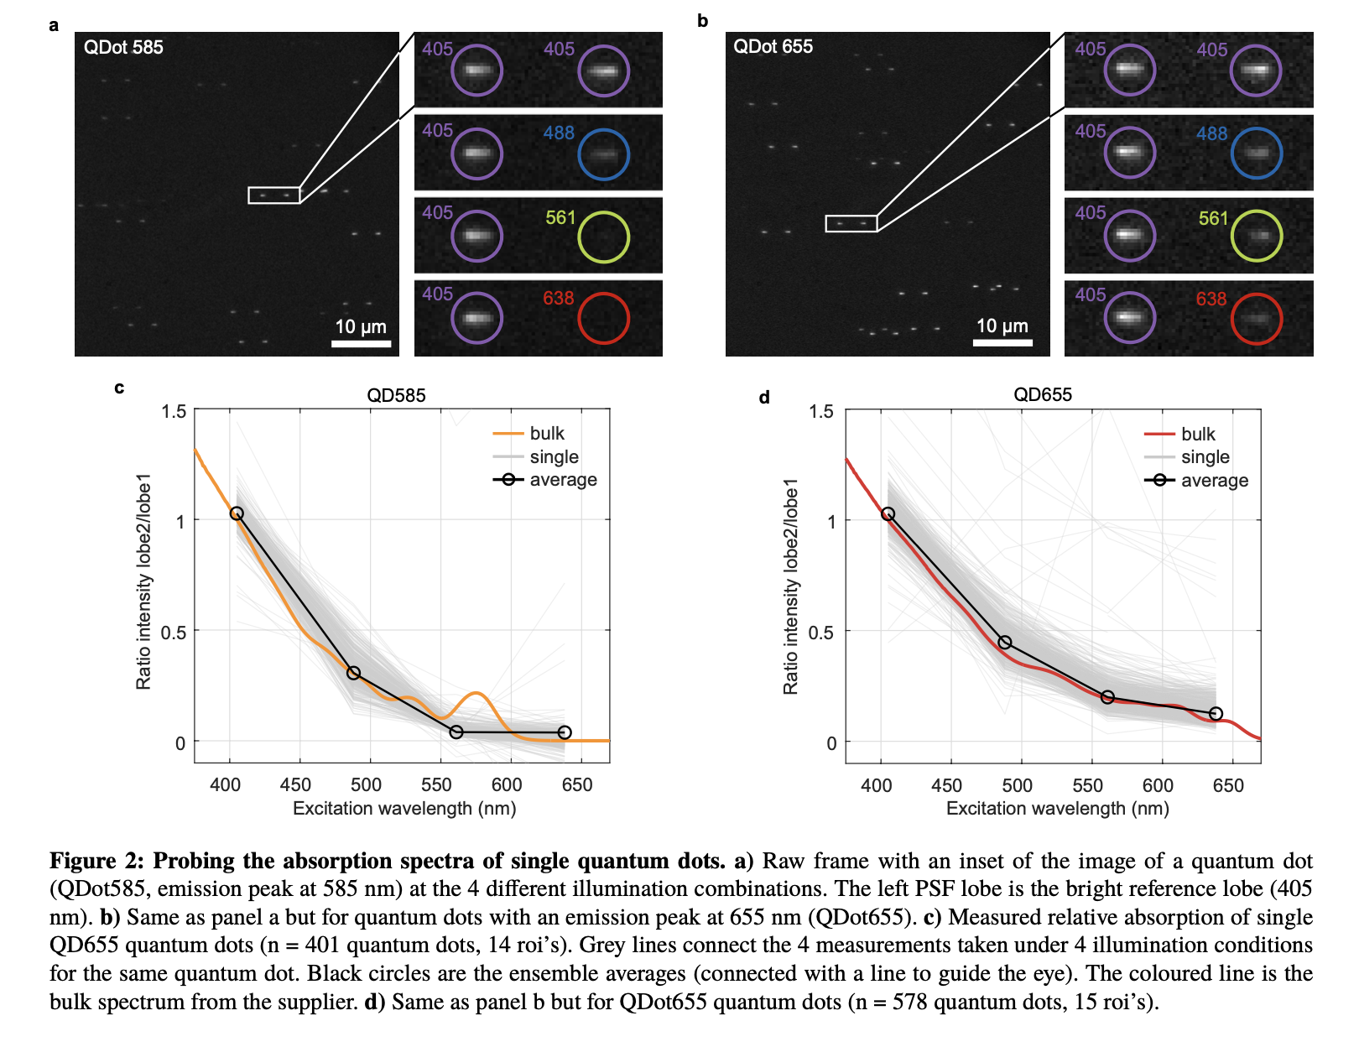

Slide 11
1
.
2
1
.
2
bulk
bulk
1
single
1
single
1
average
1
average
e
e
b
b
o
o
l
l
/
0
/
.
8
0
.
2
2
8
e
e
b
b
o
o
l
l
y
0
y
.
6
0
.
t
t
6
i
i
s
s
n
n
e
e
t
t
n
n
i
0
i
.
4
0
.
o
o
4
i
i
t
t
a
a
R
0
R
.
2
0
.
2
0
0
3
5
0
4
0
0
4
5
0
5
0
0
5
5
0
6
0
0
6
5
0
7
0
0
3
5
0
4
0
0
4
5
0
5
0
0
5
5
0
6
0
0
6
5
0
7
0
0
E
x
c
i
t
a
t
i
o
n
w
a
v
e
l
e
n
g
t
h
(
n
m
)
E
x
c
i
t
a
t
i
o
n
w
a
v
e
l
e
n
g
t
h
(
n
m
)

Slide 12
2
3
1
q
u
a
n
t
u
m
d
o
t
s
,
1
4
r
o
i
2
s
9
3
q
u
a
n
t
u
m
d
o
t
s
,
1
4
r
o
i
s
1
.
1
2
.
2
1
1
1
1
e
e
b
b
o
o
l
l
/
/
0
.
0
8
.
2
8
2
e
e
b
b
o
o
l
l
y
y
0
.
0
6
.
t
6
t
i
i
s
s
n
n
e
e
t
t
n
n
i
i
0
.
0
4
.
o
4
o
i
i
t
t
a
a
R
R
0
.
0
2
.
2
0
0
3
5
0
4
0
0
4
5
0
5
0
0
5
5
0
6
0
0
6
5
0
7
0
3
0
5
0
4
0
0
4
5
0
5
0
0
5
5
0
6
0
0
6
5
0
7
0
0
E
x
c
i
t
a
t
i
o
n
w
a
v
e
l
e
n
g
t
h
(
n
m
E
)
x
c
i
t
a
t
i
o
n
w
a
v
e
l
e
n
g
t
h
(
n
m
)

Slide 13
Fast single quantum dot excitation spectroscopy
without temporal aliasing

Slide 14
Simultaneous excitation and emission spectroscopy of quantum dots

Slide 15
Diffraction limited ratiometric Ca²⁺ sensing in firing neurons

Slide 16
Discussion

Slide 17
Discussion
Dyes don’t seem to be oriented with emission dipole moment along optical axis.
Molecules seem to be oriented with emission dipole moment parallel to the cover glass
(By eye, the CB7 data seems to contain more reorientation and translation of molecules)

