Slide 1
Realtime Soundtrack Generator
Ezra Davis

Slide 2
Audio Engine
Communicate with game via OSC messages
Trigger sound effects
Control reverb, volume, etc.
Multiple ‘voices’ feed into bus
Easy to add new voices
Melody
Global controls
Harmony
Beep sound
Ghost theme 1

Slide 3
Number of voices
Each voice is an EventStreamPlayer
Can set max_voices
Older voices are stopped temporarily
Uses player.stop, which has some latency
Doesn’t wake sound effects
Melody
Reverb
Harmony
Beep sound
Ghost theme 1

Slide 4
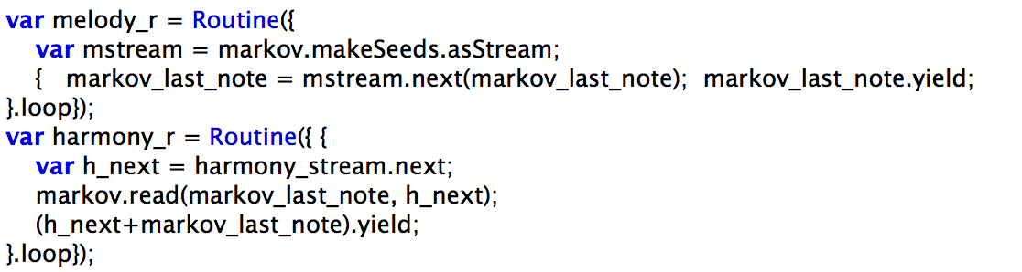
Melody and Harmony
Melody generated by Markov Chain
Harmony generated by melody + harmonyCFG
Uses Martin Rohrmeier’s Tonal Harmony CFG
Harmony CFG teaches markov chain melody -> harmonyCFG
Durations divided into (synchronized) measures

Slide 5
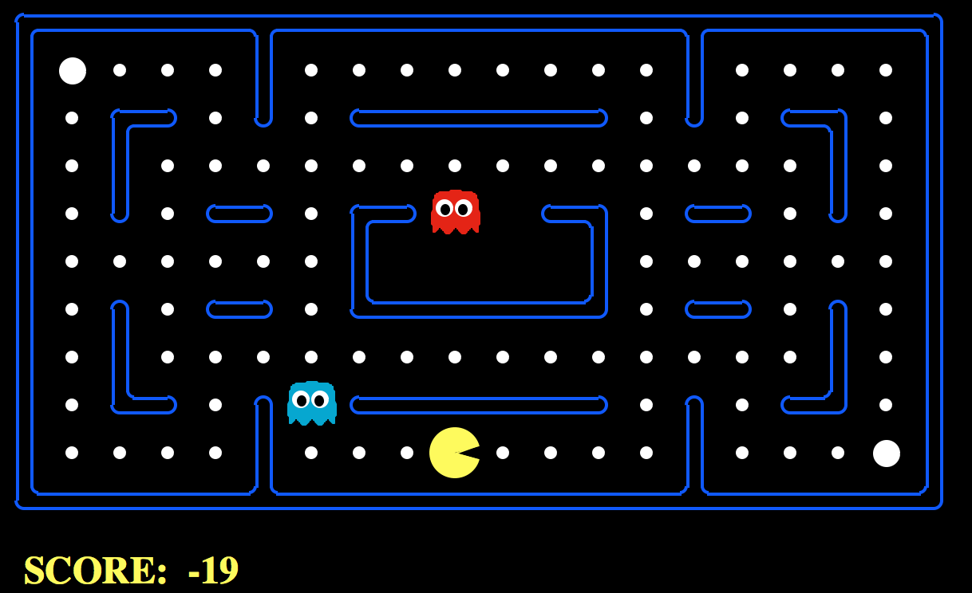
Pacman
Found Pacman for AI class (Berkeley EECS)
Sound effects from original Pacman
Volume & pan controlled by distance to ghost
Sound effect triggered by picking up food
Eating fruit doubles tempo

Slide 6
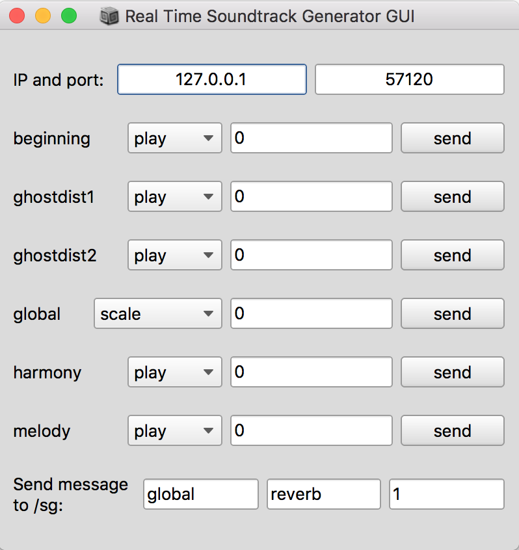
Demo

