Slide 1

SCS Assignment Part 2 : Linux Hardening
Ezra Ho Jincheng

Slide 2
Content
Upgrade and Update
Firewall - UFW
Tripwire
SSH Keys
Disk Encryption
Malware Scanner – Clamav
Vulnerability Scanner – Chkrootkit

Slide 3
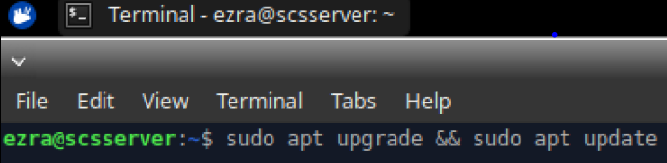
Upgrade and Update
The server must be kept up to date as bugs might be fixed in the newest version, preventing attackers from taking advantage and posing a threat to the system.
Since there are a lot of tools available for foot printing details of the ubuntu server. (collect available details of the systems such as software versions, open ports and known vulnerabilities)
The version of ubuntu server should always be updated and upgraded to prevent intruders who can exploit older versions of ubuntu server.

Slide 4
Firewall
Protects server against outside cyber attackers
Prevent malicious software from accessing a computer or network via the internet
It is recommended to use a firewall since it does not use up much resources, and yet it adds an extra layer of security to the server

Slide 5
Why UFW Firewall
This was developed to ease iptables firewall configuration
User friendly and provides a user friendly way to create an IPv4 or IPv6 host-based firewall

Slide 6

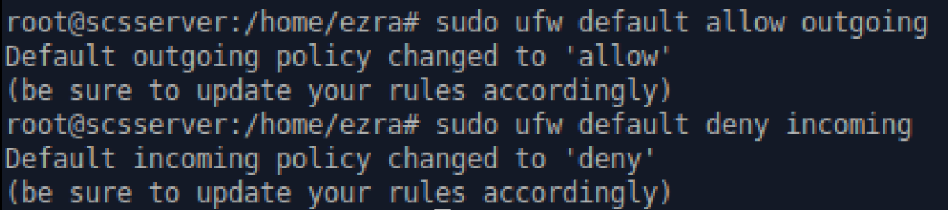
Firewall Installation
Check the status of the firewall first
Set the default outgoing status as allow, incoming status as deny
Notes:
UFW defaults:
Deny incoming – no machine can connect to your machine unless permitted
Allow outgoing – allow all outgoing request (should deny outgoing if user have public-facing cloud server, preventing remote shell connections)

Slide 7
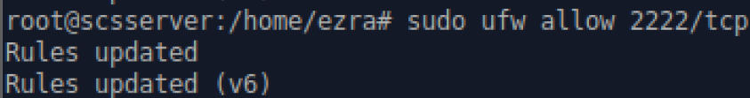
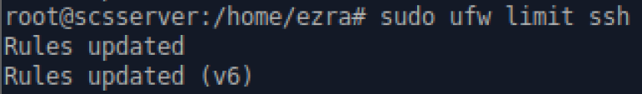
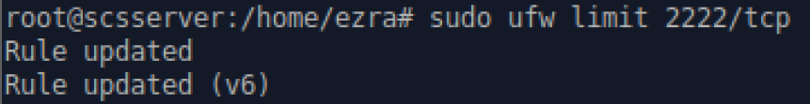
Firewall Installation
By default, port 22 is already active. But another port, 2222, will be used for other purposes. This is the command to allow incoming SSH through the port.
By limiting the SSH port, the user can deny any brute force attacks performed from the web
Limiting port 22 (default port)
Limiting port 2222 (additional port)

Slide 8
Firewall Installation
Last step is to enable the firewall once configuration is complete.
Firewall will be active from that moment and will be automatically enabled on startup

Slide 9
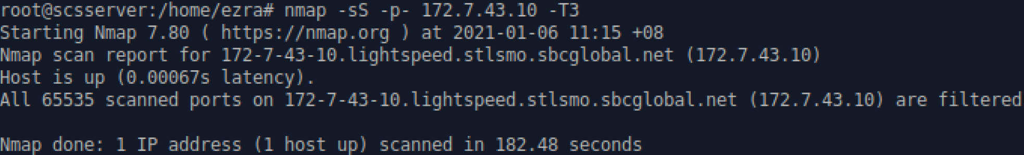
Testing Firewall
To test, I used the command nmap –sS –p- 172.7.43.10 –T3 to send packets with SYN flags raised to all the ports.
The reply shows that the host is up and that all ports were filtered.
Notes:
Source: https://purplesec.us/firewall-penetration-testing/

Slide 10
Why Tripwire
It is a popular host-based intrusion detection system on Linux platforms
It can keep track of many different filesystem data points in order to detect if any unauthorized changes has been made.
If Tripwire has detected that there are changes found between the known-good state and the current state of data in the machine, it would be a sign that the security of the device has been compromised. Since an unauthorized change has been made.

Slide 11
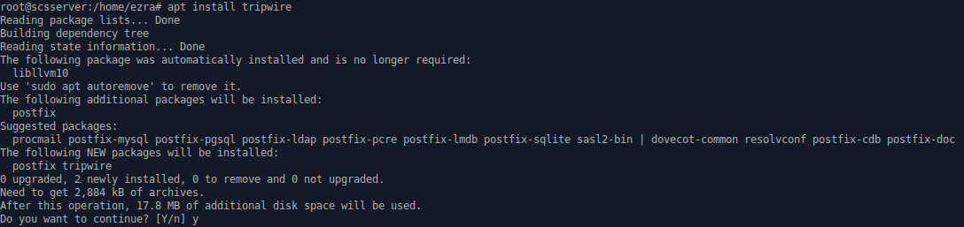
Tripwire Installation
Notes:
Installation

Slide 12
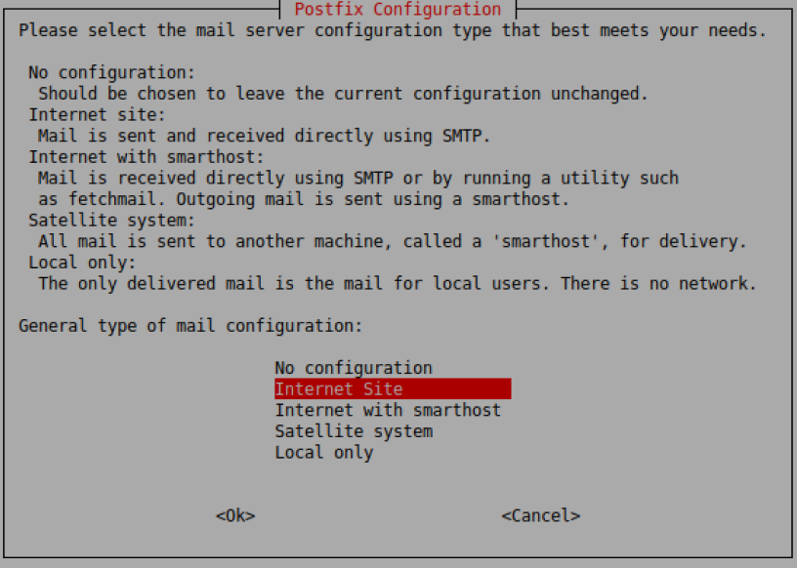
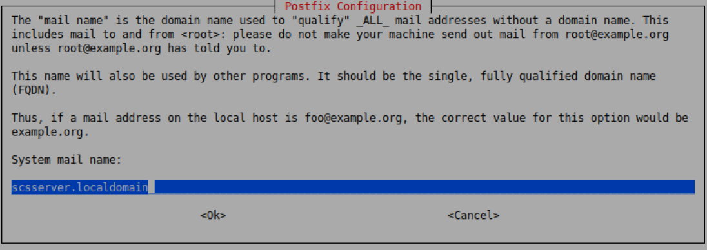
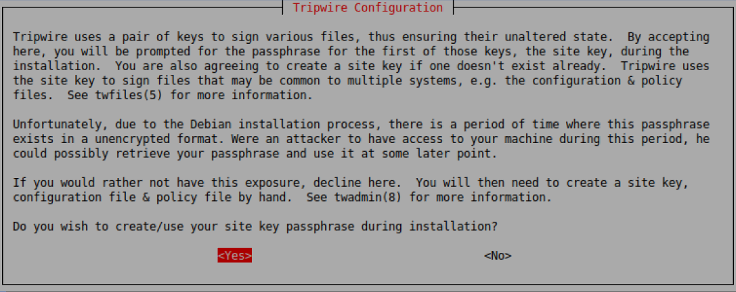
Tripwire Installation

Slide 13
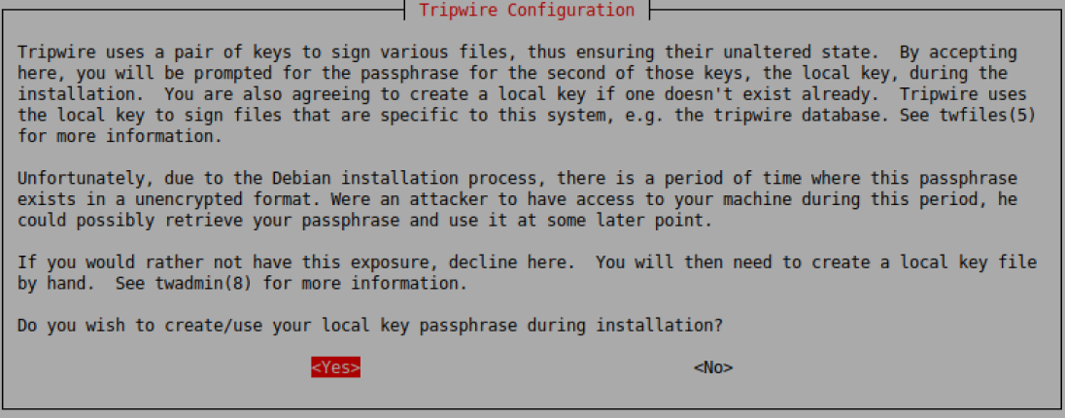
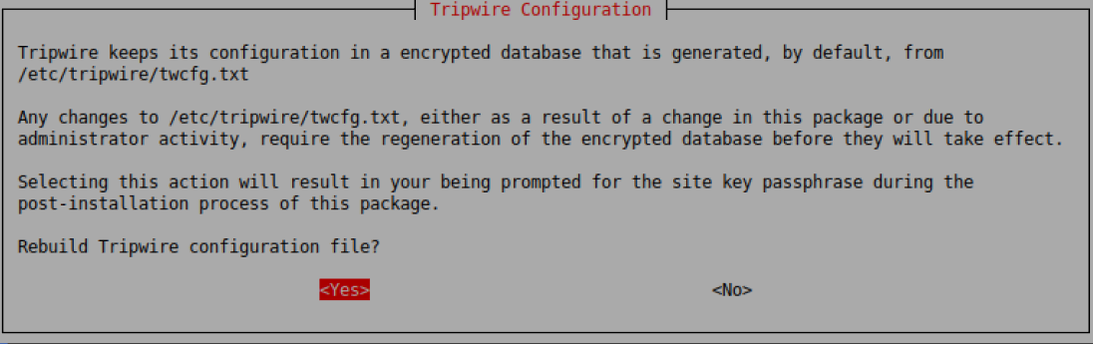
Tripwire Installation

Slide 14
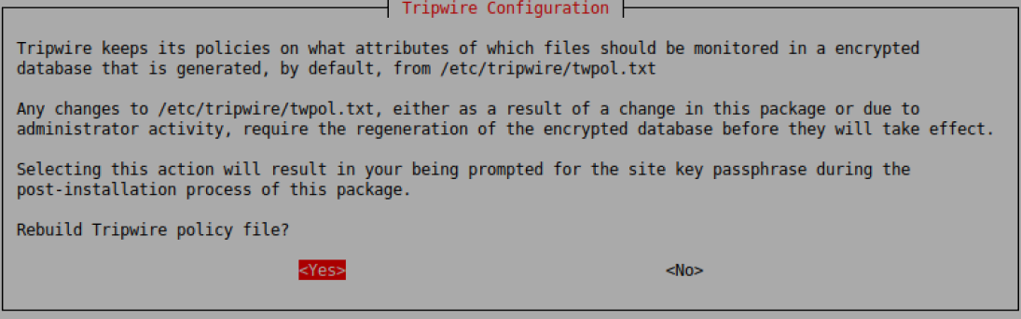
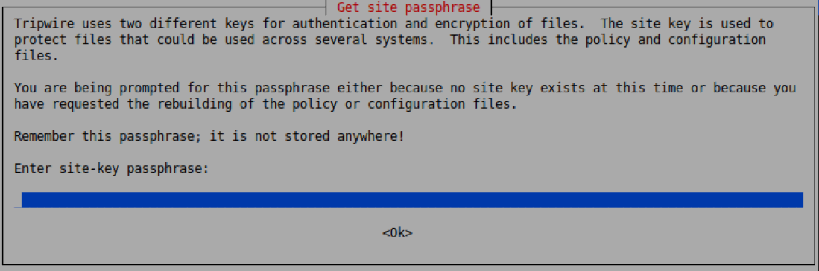
Tripwire Installation

Slide 15
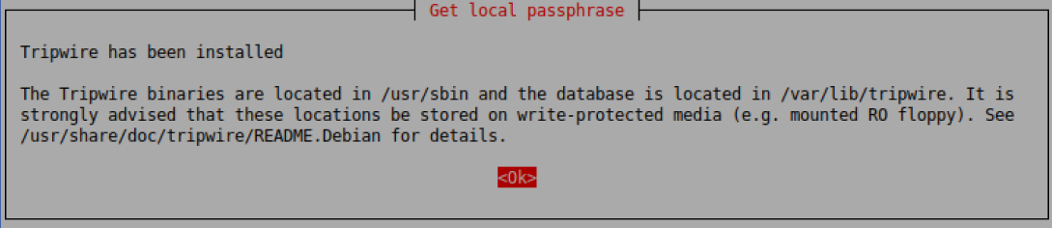
Tripwire Installation
Notes:
Must have the initiation process to generate a database, otherwise, it will not be able to scan since it does not have a database to compare to.

Slide 16
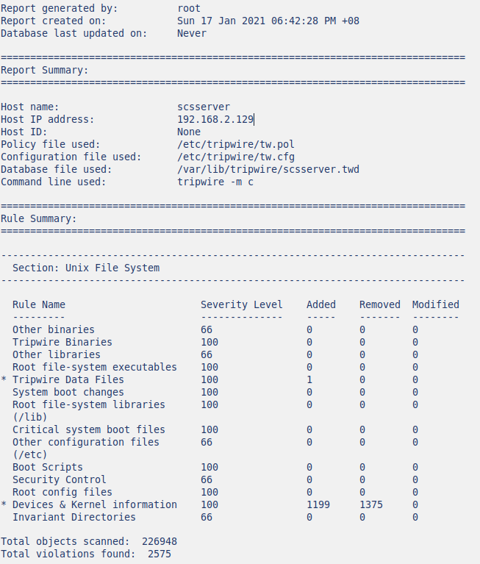
Testing Tripwire
Tripwire is used to tell admins whether there are any suspicious activities going on as the scan can detect any new or modified files and directories which are not authorized.
In my ubuntu server, it was found through using Tripwire check mode scan that there was a total of 2575 violations. And there were no instances of modified files without authorization.

Slide 17
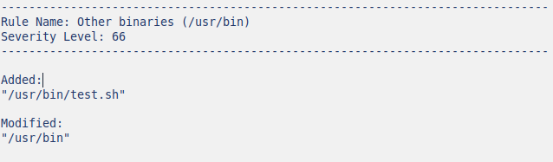
Testing Tripwire
Notes:
This shows that tripwire works and that when an unauthorized modification was made, it will show when the user checks the system using Tripwire --check

Slide 18
Why SSH Keys
SSH Keys ensure that the safety of the servers and the process of users logging in does not compromise the security
SSH is an encrypted protocol which connects to a server remotely and have access to the information associated with it
It is much safer to log in compared to using password as the password can be obtained by other people easily e.g. keylogging

Slide 19
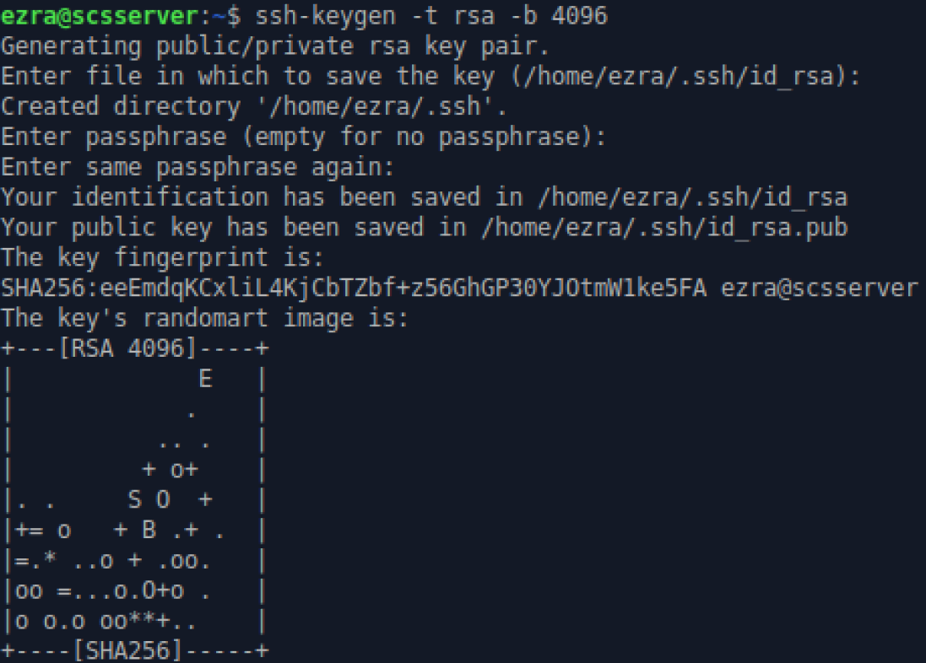
SSH Key Installation
Creating the SSH Key using 4096 bits as it is longer and harder to decrypt compared to 2048 bits RSA keys

Slide 20
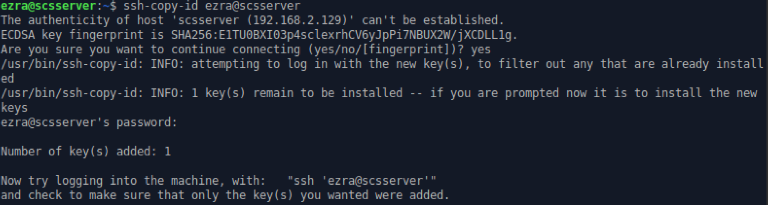
SSH Keys Installation
Transfer public key to the ubuntu server
Transferring the public key to server will authorize the server to grant access to this account without a password

Slide 21
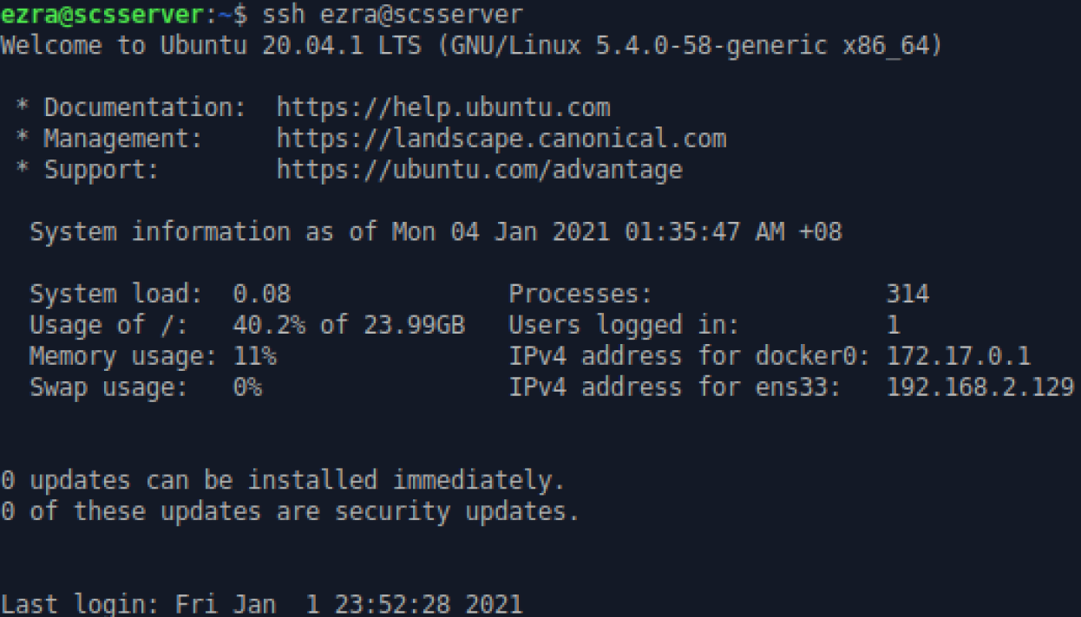
SSH Keys Installation
Authenticate SSH Key by logging into the server
This checks whether the user can successfully log into the SSH server without password

Slide 22
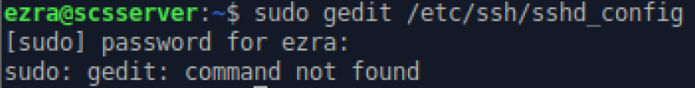
SSH Keys Installation
Disable the password authentication
This will disable the user from typing in the password in order to access the SSH server
Restart the SSHD service to see the changes take effect permanently

Slide 23
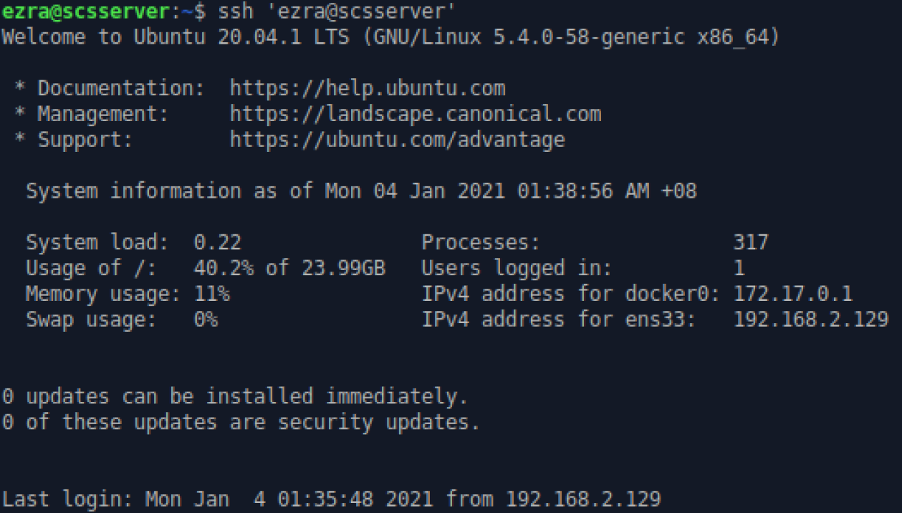
Testing SSH Keys
Type the command to log into an SSH server
If user can successfully log into the server without a password, then the SSH Key authentication process is successful

Slide 24
Why Disk Encryption
Why encrypt a disk?
Protect data during security breach
Keep the government out of the hard drive as much as possible as they are unable to monitor your actions

Slide 25
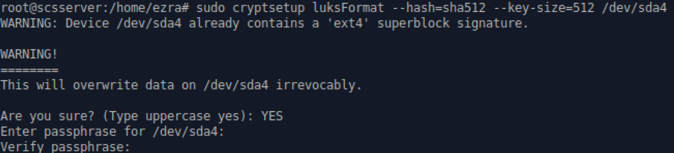
Disk Encryption
Install Cryptsetup
It is a utility for setting up encrypted filesystems using Device Mapper
Install gparted
Notes:
Enter a password which will decrypt and allow user access to the partition.
Using sha512 due to the strength and length of the hash, the keysize is also 512 bits

Slide 26
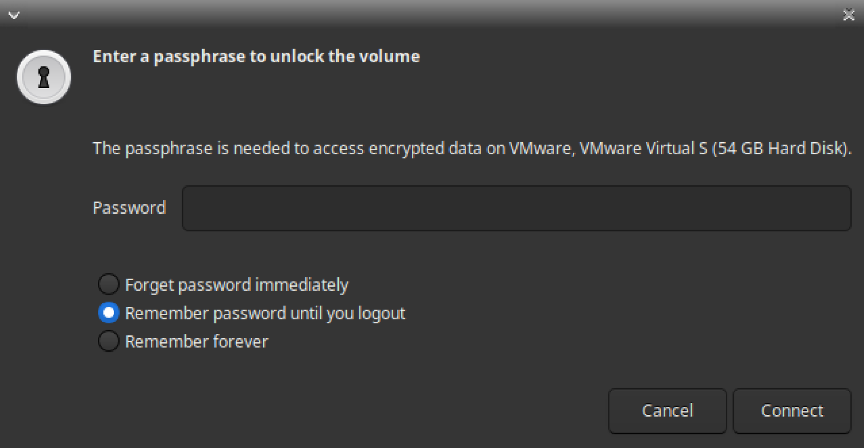
Testing Disk Encryption
Icon will appear on the home screen, double tap it to see this popup
Notes:
Unfortunately the option for “forget password immediately” does not work in this scenario and will have to use “remember password until you logout”
Enter the password to view the partition.

Slide 27
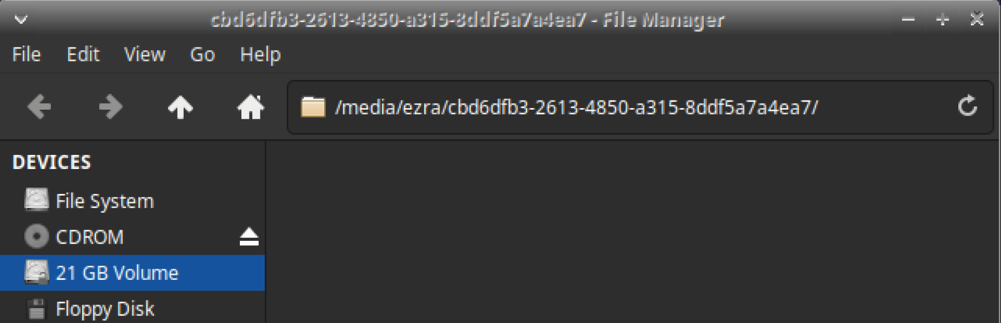
Testing Disk Encryption

Slide 28
Why Clamav
An anti-virus is crucial as the current world is so advanced that anything sent through email potentially be a virus used to infect or infiltrate a server and potentially ruin the business.
Clamav is an open-source antivirus engine that is particularly highly reliable in phishing emails.
It also has a huge virus directory that is updated continuously by users around the world. Clamav allows for scans to be automated and malicious files found to be deleted.

Slide 29

Clamav
Downloading Clamav
Stop the virus database in order to update it

Slide 30
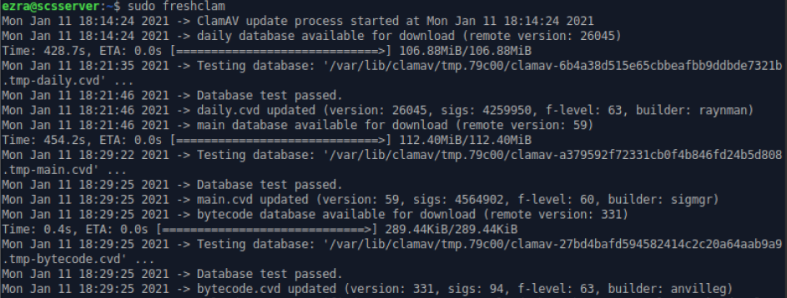
Clamav
Use “sudo freshclam” to update the database of virus so it will be the most up to date

Slide 31
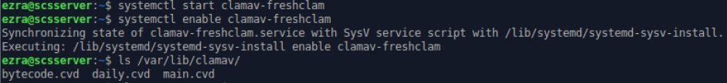

Clamav
Start and enable freshcam again to allow it to resume functioning
Changing “nano /etc/clamav/freshclam.conf” configuration to schedule daily scans
Notes:
* Need to add the daily script so they can send to email

Slide 32
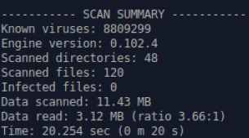
Testing Clamav
This command is run to test and run all the directories within Ubuntu Server
Here are the results after running the software
Notes:
https://www.atlantic.net/vps-hosting/how-to-install-clamav-on-ubuntu-20-04-and-scan-for-vulnerabilities/

Slide 33


Why Chkrootkit
This software tool checks the operating system binaries for rootkit modifications, which will report back if the code has been modified. It is necessary as it will check for any unauthorized changes in the code.
Downloading Chkrootkit
Changing the modification of Chkrootkit using “nano /etc/chkrootkit.conf”
Initial configuration
Desired configuration
Notes:
Shows a sample result

Slide 34
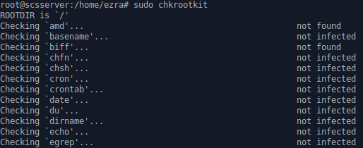
Testing Chkrootkit
Running Chkrookit
Notes:
This shows a part of the checking process

Slide 35
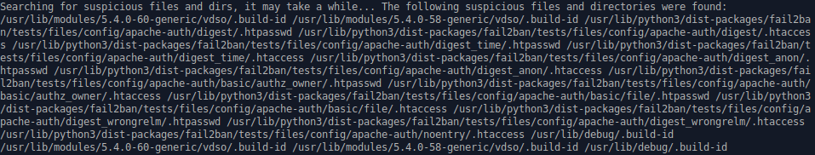
Testing Chkrootkit
Chkrookit has found a potentially suspicious file within Ubuntu
The file belongs to Fail2ban

Slide 36
Thank you

