Slide 2
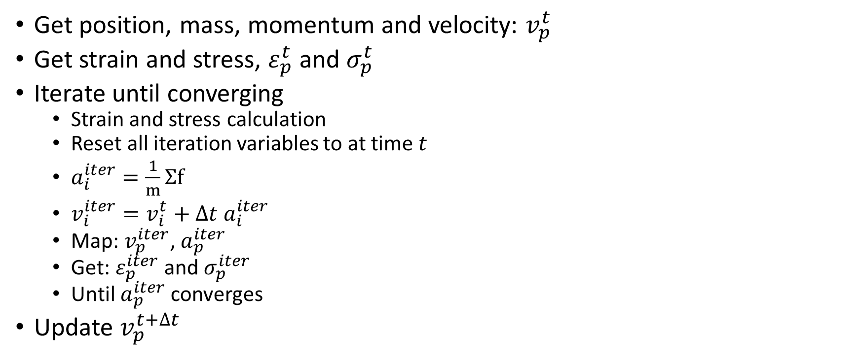
Get position, mass, momentum and velocity: $v_{p}^{t}$
Get strain and stress, $ε_{p}^{t}$ and $σ_{p}^{t}$
Iterate until converging
Strain and stress calculation
Reset all iteration variables to at time $t$
$a_{i}^{iter}=\frac{1}{m}Σf$
$v_{i}^{iter}=v_{i}^{t}+Δt a_{i}^{iter}$
Map: $v_{p}^{iter}$, $a_{p}^{iter}$
Get: $ε_{p}^{iter}$ and $σ_{p}^{iter}$
Until $a_{p}^{iter}$ converges
Update $v_{p}^{t+Δt}$

Slide 3

Iteration 1: $σ_{p}^{iter,1}=σ_{p}^{t}+Δσ_{p}$
$σ_{p}^{iter,1}→f^{int}→a_{p}^{iter,1}$
Reset stress to be $σ_{p}^{t}$
Iteration 2: $σ_{p}^{iter,2}=σ_{p}^{t}+Δσ_{p}$
$σ_{p}^{iter,2}→f^{int}→a_{p}^{iter,2}→v_{p}^{iter,2}=v_{p}^{t}+Δt a_{p}^{iter,2}$
Reset stress to be $σ_{p}^{t}$

Slide 4
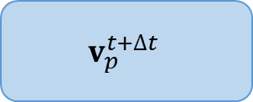
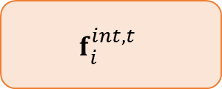
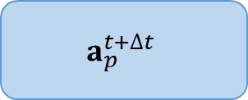
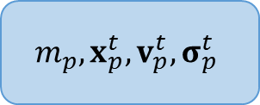
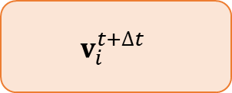

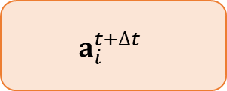
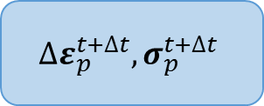
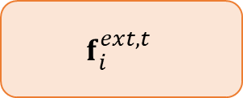

POINTS
NODES
Input Files
$$m_{p},x_{p}^{t},v_{p}^{t}, σ_{p}^{t}$$
$$f_{i}^{int,t}$$
$$f_{i}^{ext,t}$$
$$a_{p}^{t+Δt}$$
$$a_{i}^{t+Δt}$$
$$t=t+Δt$$
$$v_{p}^{t+Δt}$$
$$v_{i}^{t+Δt}$$
$$x_{p}^{t+Δt}$$
$${Δε}_{p}^{t+Δt},σ_{p}^{t+Δt}$$

Slide 5
















POINTS
NODES
Input Files
$$m_{p},x_{p}^{t},v_{p}^{t}, σ_{p}^{t}$$
$$f_{i}^{int,t}$$
$$f_{i}^{ext,t}$$
$$ε_{p}^{iter}=ε_{p}^{t}+{Δε}_{p}^{iter}$$
$$σ_{p}^{iter}=σ_{p}^{t}+{Δσ}_{p}^{iter}$$
$$f_{i}^{int,iter}$$
NO
$$a_{p}^{iter}$$
$$a_{i}^{iter}$$
Converge
$$v_{p}^{iter}$$
$$v_{i}^{iter}=v_{p}^{t}+Δt a_{i}^{iter}$$
YES
$$a_{p}^{t+Δt}$$
$$a_{i}^{t+Δt}$$
$$v_{p}^{t+Δt}$$
$$v_{i}^{t+Δt}$$
$$t=t+Δt$$
$${Δε}_{p}^{t+Δt},σ_{p}^{t+Δt}$$
$$x_{p}^{t+Δt}$$

