Slide 1
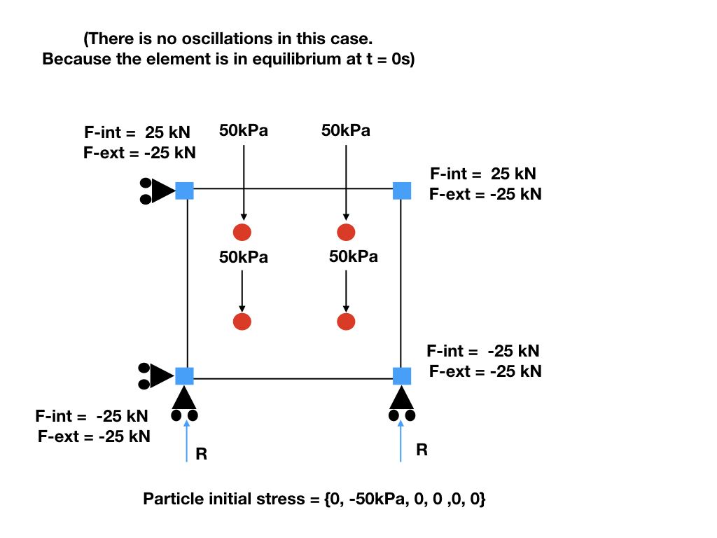
N3
N2
P2
P3
P0
P1
N0
N1
No initial stress would lead to oscillation
Figure made by Shyamini Kularathna
Modified by Ezra Setiasabda

Slide 2
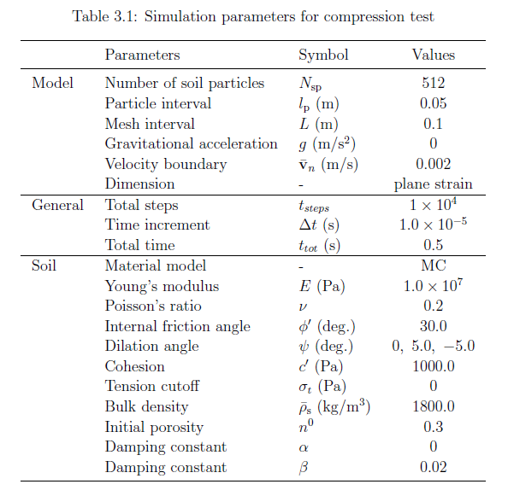
Displacement-Controlled Triaxial Test
I use 1 element

Slide 3
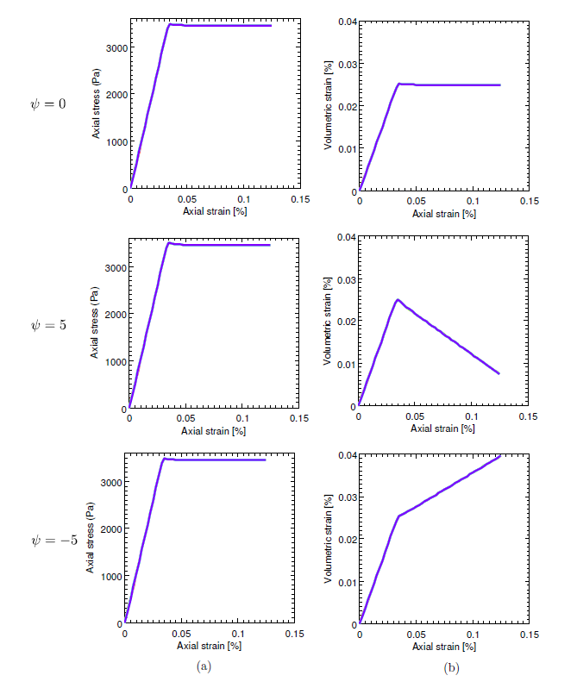

Slide 4
Samila’s Results – 128 elements
This run – using one element only (no damping

Slide 5
Observation
Need to not do element test to compare
Further take a look at the Mohr-Coulomb Model implementation

