Slide 1
Comparison
Krishna’s Codes
Shyamini’s Codes
Note she had not implemented friction boundary

Slide 2
Element Test
This was done in July
Results show both are comparable
Cases where they are in equilibrium
Cases where they oscillate

Slide 3
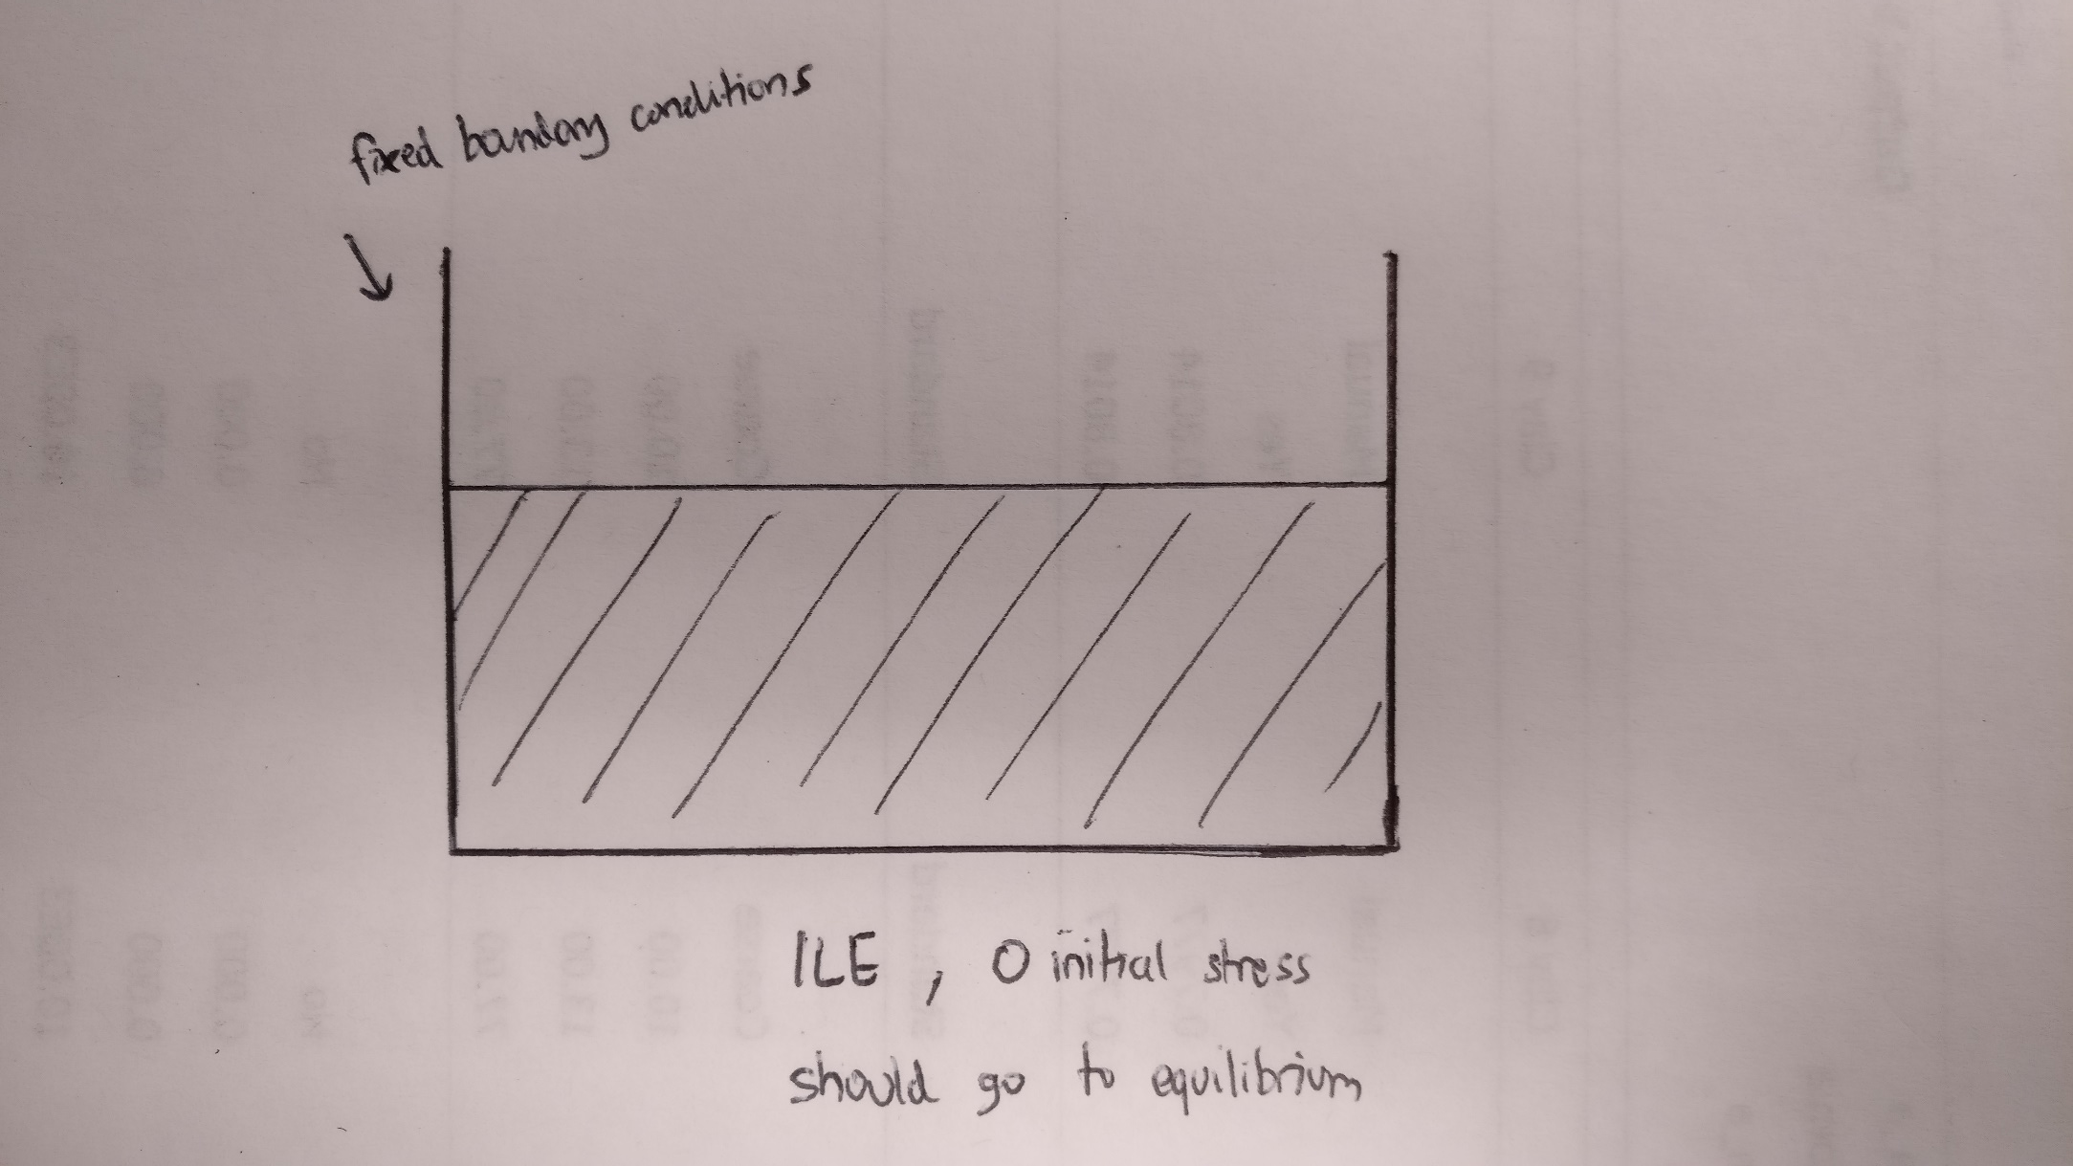
Column Collapse

Slide 4

Column Collapse
Given it’s ILE, $ν=0.0$, 0 initial stress, they should go to equilibrium
They oscillate, but ultimately converge (after a long time)
$dt=$ 1E-5 s
5 million steps
Thus need 10 s

Slide 5
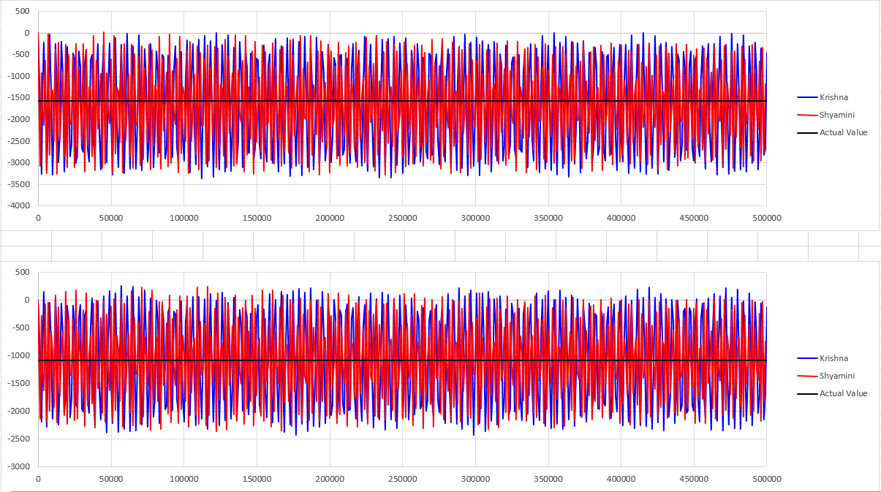
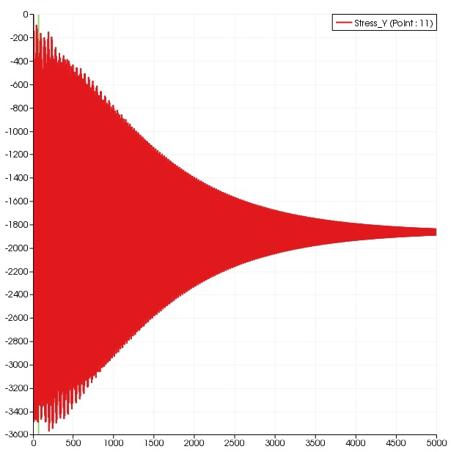
Column Collapse

Slide 6
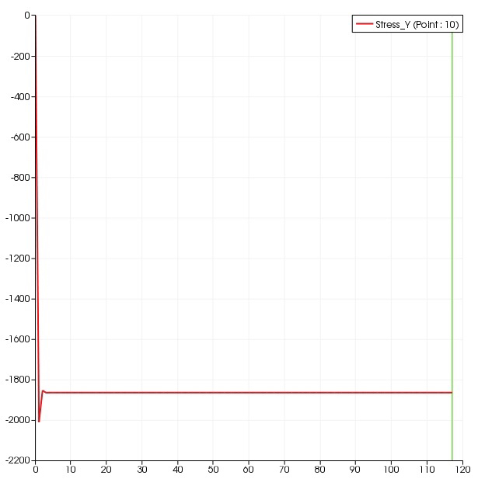
Column Collapse
Shyamini mentioned:
Instead of using nodal acceleration, then integrate to get velocity
Use nodal velocity (from momentum)
It removes the oscillation

Slide 7
Column Collapse
Is it enough to say they will converge after a long time?
Next:
Solve oscillation, with damping
Try Mohr Coulomb
Then remove side boundary conditions so they really collapse

