Slide 1
Problem: Oscillation
Damping is needed
Two implementations:
Damping the System
Artificial Damping

Slide 2
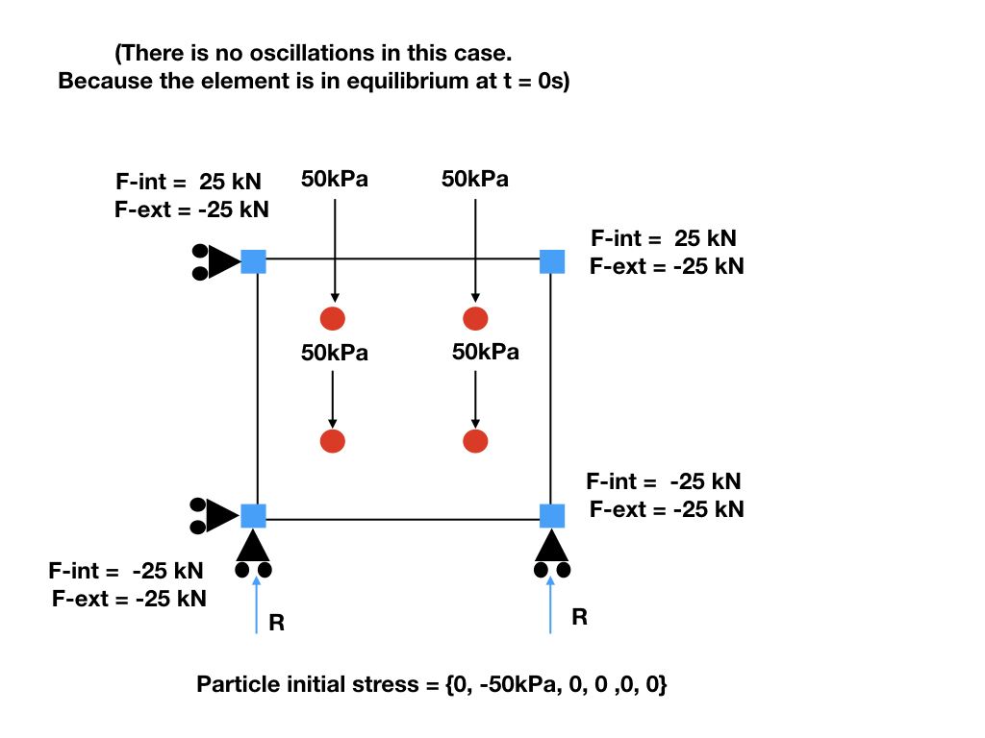
N3
N2
P2
P3
P0
P1
N0
N1
No initial stress would lead to oscillation
Figure made by Shyamini Kularathna
Modified by Ezra Setiasabda

Slide 3
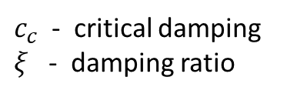
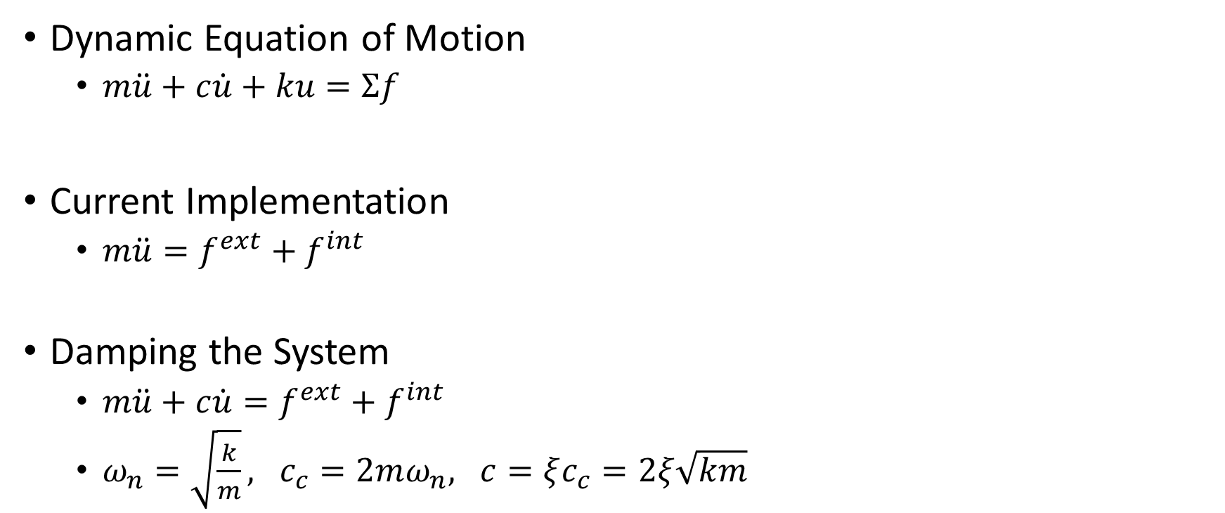
Damping (1)
Dynamic Equation of Motion
$m\ddot{u}+c\dot{u}+ku=Σf$
Current Implementation
$m\ddot{u}=f^{ext}+f^{int}$
Damping the System
$m\ddot{u}+c\dot{u}=f^{ext}+f^{int}$
$ω_{n}=\sqrt{\frac{k}{m}}, c_{c}=2mω_{n}, c=ξc_{c}=2ξ\sqrt{km}$
$c_{c}$ - critical damping
$ξ$ - damping ratio

Slide 4
Results of Element Test

Slide 5

Damping (1)
Discussion
$m\ddot{u}+c\dot{u}=f^{ext}+f^{int}$
$ω_{n}=\sqrt{\frac{k}{m}}, c_{c}=2mω_{n}, c=ξc_{c}=2ξ\sqrt{km}$
$k$ ? (N/m)
Current implementation: $k=E×\left[particle spacing\right]$

Slide 6
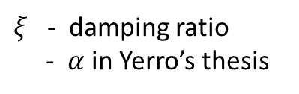

Damping (2)
Dynamic Equation of Motion
$m\ddot{u}+c\dot{u}+ku=Σf$
Current Implementation
$m\ddot{u}=f^{ext}+f^{int}$
Artificial Damping
$m\ddot{u}=f^{ext}+f^{int}+f^{damp}$
$f^{damp}=−ξ \frac{\dot{u}}{\left\|\dot{u}\right\|} \left\|f^{ext}−f^{int}\right\|$
$ξ$ - damping ratio
- $α$ in Yerro’s thesis

Slide 7
Results of Element Test

Slide 8
Other (Minor) Comments
Damping will reduce accuracy:
Final stress should be -50000
System -49752 (0.50% error)
Artificial -49744 (0.51% error)
Artificial might be the way to go (implemented by Alba)

