Slide 1
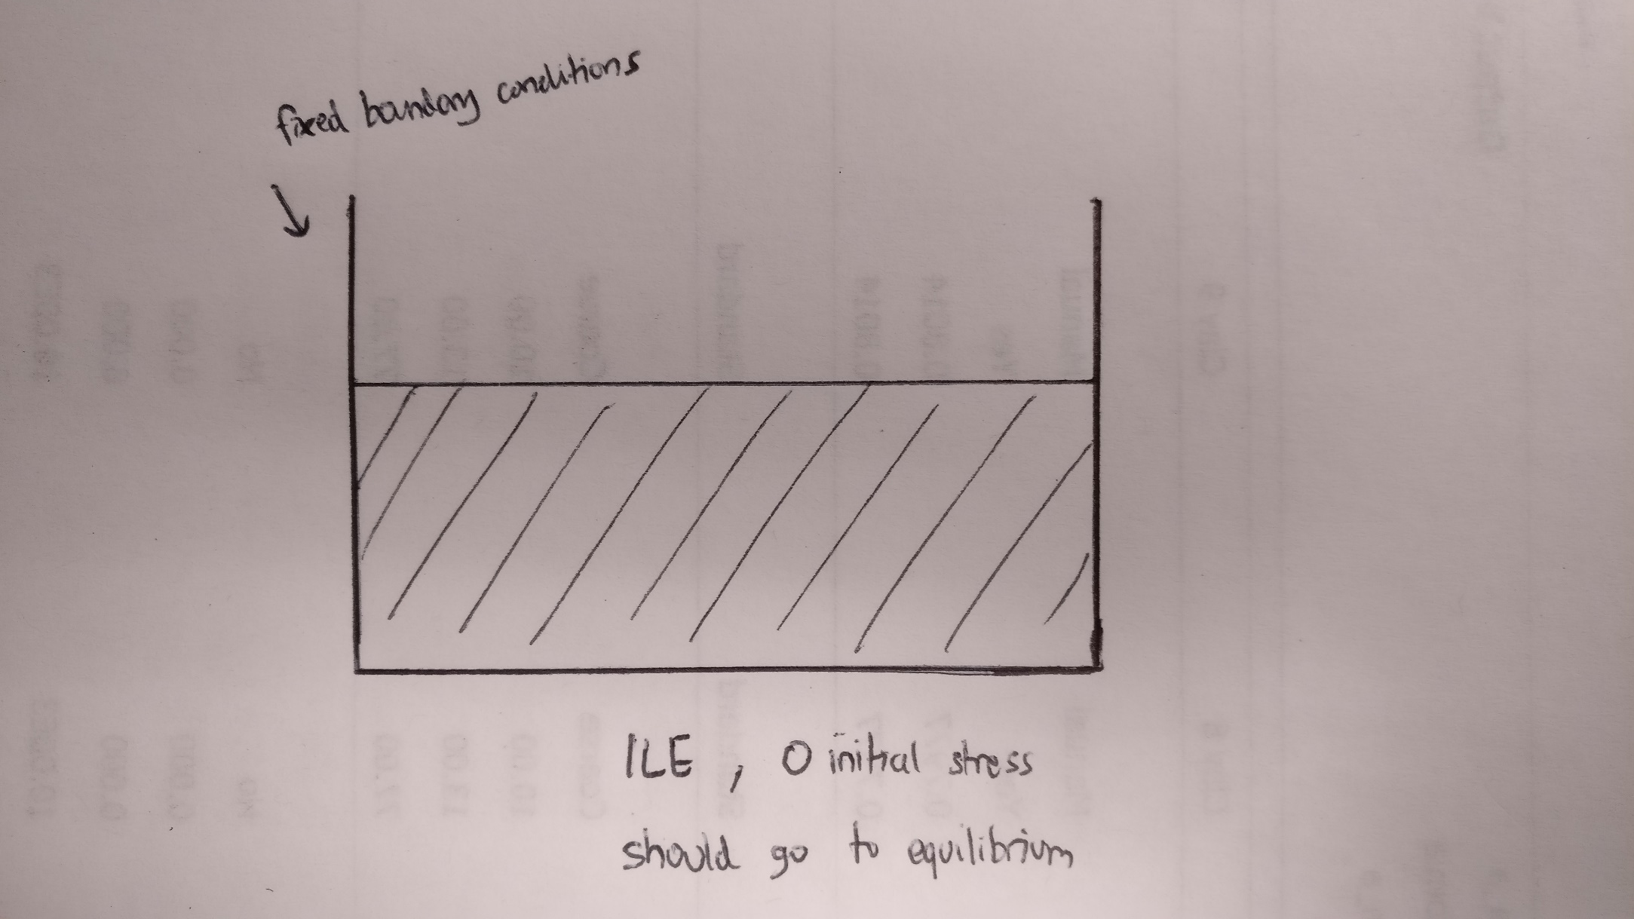
Column Collapse

Slide 2
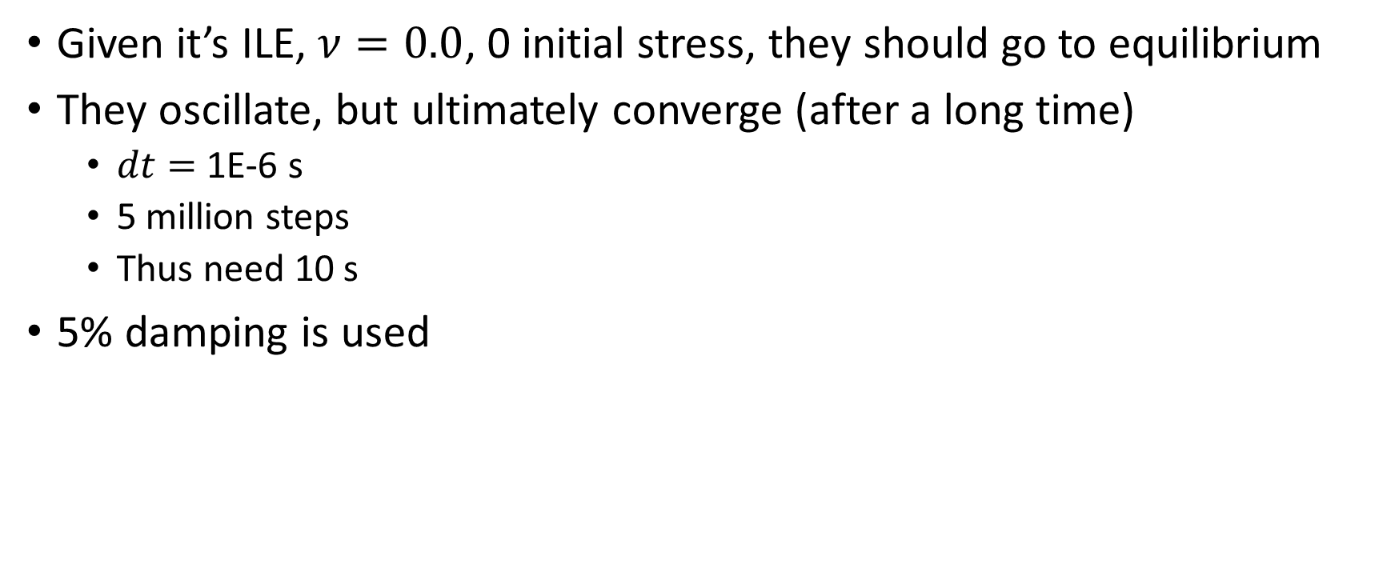
Column Collapse
Given it’s ILE, $ν=0.0$, 0 initial stress, they should go to equilibrium
They oscillate, but ultimately converge (after a long time)
$dt=$ 1E-6 s
5 million steps
Thus need 10 s
5% damping is used

