Slide 1

Data-Driven Insights for Rockbuster Stealth
By Emil Safarov

Slide 2
Introduction to Rockbuster Stealth LLC
Rockbuster Stealth LLC is a traditional DVD rental company specializing in offering a wide range of movies for rent. With its presence across various global regions, Rockbuster has been a key player in the movie rental industry, focusing on delivering a variety of movies to customers through a physical rental model.
However, the rise of digital streaming services presents significant challenges for Rockbuster Stealth. In order to stay competitive and relevant, the company has recognized the need to leverage data analytics for understanding customer preferences, optimizing rental pricing, and exploring new market opportunities.

Slide 3
Project Objectives and Key Insights
The goal of this analysis is to provide Rockbuster Stealth LLC with actionable insights that can guide strategic decisions in the following areas:
Expanding the Customer Base: Identifying high-potential regions and targeting marketing efforts to grow the customer base.
Optimizing Revenue: Refining rental rates and durations to increase profitability and attract diverse customer segments.
Digital Transition: Exploring the feasibility of introducing digital rental options to meet growing customer demand for streaming services.
Through data visualization and analysis, Rockbuster aims to achieve a better understanding of its market and make informed decisions to adapt to the evolving digital landscape.

Slide 4
The key business questions guiding this analysis were:
Which customer segments contribute the most to revenue and how can they be targeted?
What are the most popular movie categories and how do they impact rental revenue and customer retention?
Which geographic regions have the highest customer concentration and what are the opportunities for market expansion?
How do rental durations and pricing strategies influence revenue generation and customer satisfaction?

Slide 5
Key Metrics Analysis
Our analysis focuses on three key metrics: Rental Duration, Rental Rate, and Replacement Cost. These metrics offer valuable insights into customer behavior and revenue opportunities.
Rental Duration:
Min: 3 days | Max: 7 days | Average: 5 days
The average rental duration of 5 days indicates that most customers prefer shorter rental periods. This suggests an opportunity to introduce special deals for rentals extending beyond 5 days to encourage longer-term rentals.
Rental Rate:
Min: $0.99 | Max: $4.99 | Average: $2.98
With an average rate close to $3, there’s a clear distinction between standard and premium rentals. Managers could consider dynamic pricing strategies to cater to price-sensitive customers and premium offerings for high-value customers.
Replacement Cost:
Min: $9.99 | Max: $29.99 | Average: $19.98
Significant variation in replacement costs indicates a need to review insurance policies and fees for damages. This will help mitigate potential revenue losses from high replacement costs.

Slide 6
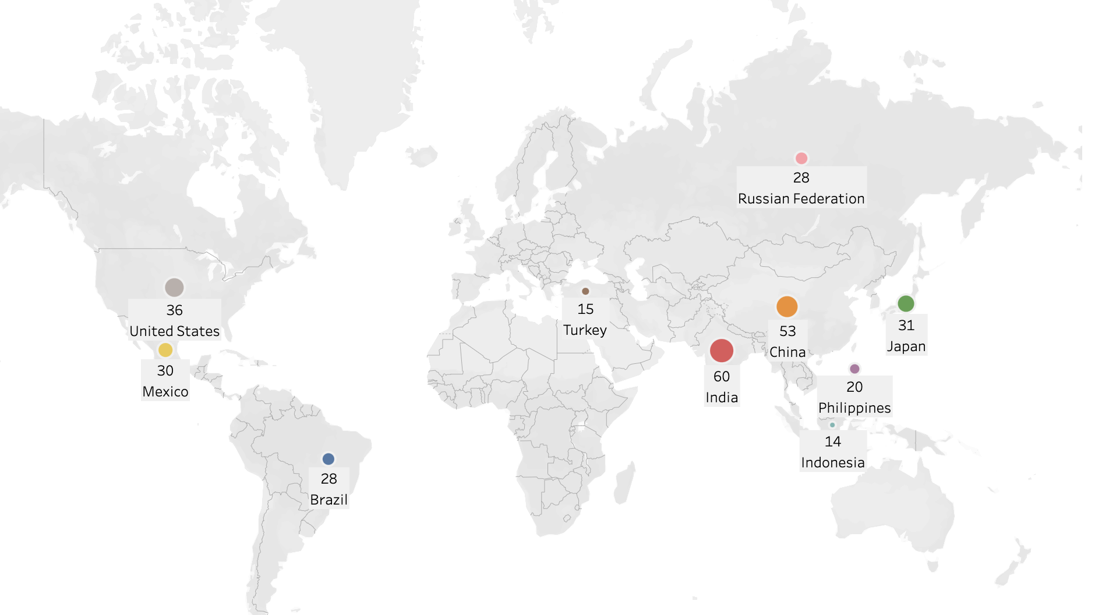
Top 10 Countries by Customer Count
countries with the highest number of customers, providing valuable insights into Rockbuster’s global reach and customer distribution
India leads with the highest number of customers, totaling 60. This indicates a strong market presence and potential for further expansion or targeted promotions in the region.
China follows closely with 53 customers, highlighting another significant market where localized strategies could boost customer engagement and revenue.
The United States ranks third with 36 customers, showcasing its role as a key market. Despite this, there is room for growth compared to India and China.
Countries like Japan, Mexico, and Brazil also demonstrate substantial customer bases, ranging from 28 to 31 customers each, indicating their potential for strategic initiatives.
https://public.tableau.com/app/profile/emil.safarov/viz/3_10Final_1/Sheet1?publish=yes

Slide 7
Top Cities with Customers Across Key Countries
These cities are crucial for understanding where Rockbuster has established a presence and where further expansion efforts may be beneficial.
Aurora, United States leads with 2 customers, showing a slightly stronger presence compared to other cities.
The remaining cities, including Atlixco (Mexico), Xintai (China), Adoni (India), Dhule (Dhulia, India), Kurashiki (Japan), and others, each have 1 customer.
These cities span diverse countries such as Mexico, China, India, Japan, Turkey, and Brazil, indicating Rockbuster’s global reach, but with limited penetration in some regions.
Opportunities for Growth: The data suggests that while Rockbuster has customers in these cities, efforts can be made to increase customer base in these regions through localized marketing and engagement strategies.
Regional Focus: Concentrating efforts on cities with existing customers provides an opportunity to solidify Rockbuster’s market presence.
https://public.tableau.com/app/profile/emil.safarov/viz/3_10Final_2/Sheet2?publish=yes

Slide 8
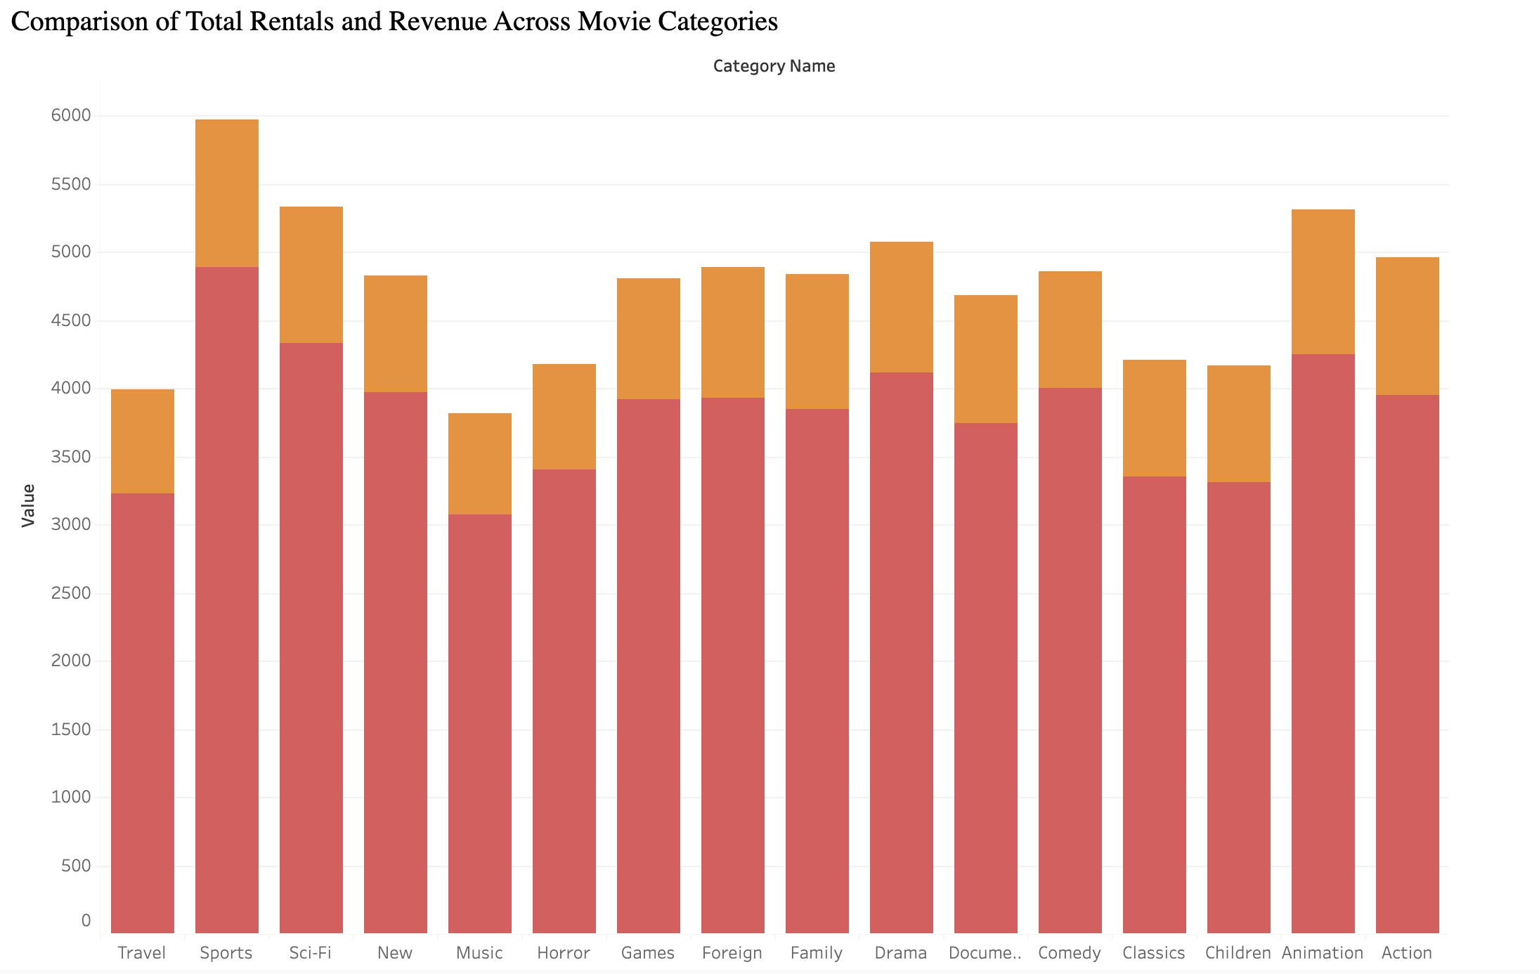
Key Insights on Movie Category Performance:
Top Performers: Sports leads in both rentals (1081) and revenue ($4892), followed by Animation and Action, highlighting customer preferences.
High Revenue Categories: Sci-Fi and Comedy show high revenue despite moderate rentals, indicating potential premium pricing.
Growth Opportunities: Categories like Drama and Documentary have solid rentals and revenue, suggesting a chance for further promotion.
Underperformers: Travel and Music have low rentals and revenue, indicating the need for strategic adjustments or targeted promotions.

Slide 9
Final Recommendations and Next Steps
Key Recommendations:
Expand Presence in Key Cities: Focus on growing customer bases in cities with an initial foothold like Aurora, Atlixco, Xintai, and Adoni. Tailor marketing campaigns to these regions.
Retain High-Value Customers: Implement loyalty programs for top customers, like Sara Perry (Atlixco) and Gabriel Harder (Sivas), to drive repeat rentals and increase revenue.
Targeted Promotions: Design exclusive offers for customers in high-potential cities to boost engagement and acquisition.
Next Steps:
Leverage Insights: Use the customer data and findings to refine regional strategies and allocate resources effectively.
Measure Impact: Regularly track customer growth and revenue changes in targeted cities to refine tactics.
Call to Action:
By focusing on these high-potential cities and high-value customers, Rockbuster can strengthen its market presence and boost long-term profitability.

