Slide 1
SMART GARDENING
By Erik Szapirko

Slide 2
Introduction
As someone passionate about both technology and nature, I have always been interested in how we can use cutting-edge technology to make everyday tasks more efficient and sustainable.
This project focuses on automating key aspects of plant care, particularly monitoring soil moisture, temperature, and humidity. These factors are crucial for plant health, but traditionally, they are managed manually, which can be inconsistent and time-consuming. With the rise of IoT technologies, it is now possible to automate and optimize these processes in a cost-effective way.
My goal is to build an innovative system that provides users with real-time data and alerts, ensuring that plants receive the right care at the right time. I'll take you through the problem I’m solving, the existing methods in place, my proposed methodology, and the plan for bringing this idea to life.

Slide 3
Problem
The problem I aim to solve is the challenge many gardeners face with environmental monitoring. Manually checking soil moisture, temperature, and humidity is time-consuming and often leads to over or under-watering plants, which negatively impacts their growth and overall health. Many gardeners, particularly those managing large areas or with limited time, struggle to maintain the optimal environment for plants, which can result in reduced yields and plant stress. The solution is to build an automated system that continuously monitors these factors and provides timely alerts, optimizing plant care, reducing water waste, and enhancing the overall efficiency of gardening.

Slide 4
Existing Methods
Currently, there are two common approaches: manual methods and commercial smart gardening systems. Manual monitoring involves physically checking the soil and weather conditions, which is time-consuming and inefficient. Commercial systems, such as smart irrigation devices, automate water distribution based on sensor readings but tend to be expensive, lack customization, and are not easily scalable for different garden setups.
For example, Dr. Jagadeesh's 2018 study utilized smart irrigation systems that monitor plant watering needs using soil moisture sensors. While effective for irrigation, these systems focus solely on soil moisture, neglecting other environmental factors like temperature and humidity that also affect plant growth. In 2019, Dr. Alsaeedi's smart system included sensors to monitor air quality and potential pollutants, offering a more comprehensive solution. However, the complexity and cost of using multiple sensors make it impractical for small home gardens.
The literature highlights limitations in both existing methods: either they fail to provide comprehensive environmental monitoring or lack timely alerts to optimize plant care. My project addresses these gaps by integrating the Arduino IoT Cloud and IFTTT for real-time monitoring and alerts, creating a well-rounded system that ensures plants thrive in their environment

Slide 5
Methodology
My proposed system will use two sensors: the Capacitive Soil Moisture Sensor v2.0 for soil moisture and the DHT11 sensor for temperature and humidity. These sensors will be connected to an Arduino board, which will send the data to the Arduino IoT Cloud. This cloud platform will allow for real-time data visualization, and I'll integrate IFTTT to send alerts based on preset conditions, such as when soil moisture is too low or temperature exceeds a certain threshold.

Slide 6
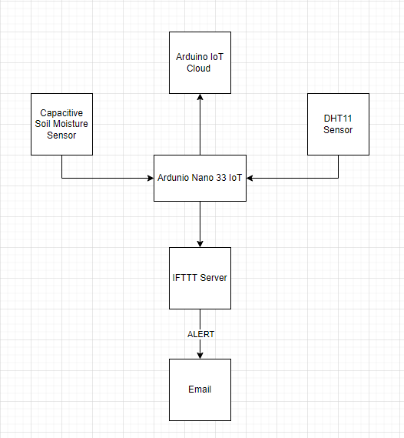
System Architecture
This diagram shows how the system works. Sensors capture soil moisture, temperature, and humidity data. The Arduino board sends this data to the IoT Cloud, where it can be visualized on a dashboard. If thresholds are breached, the system will trigger IFTTT to send alerts to your phone. The system automates plant care by keeping you informed in real time. Data captured from the sensors will be stored in the cloud, allowing for long-term trend analysis. For instance, over time, we can observe how soil moisture changes based on weather conditions or watering frequency, and this will help in making better decisions for plant care. Additionally, real-time alerts will notify users when action is required, such as watering.

