Slide 1
Multiplication

Slide 2
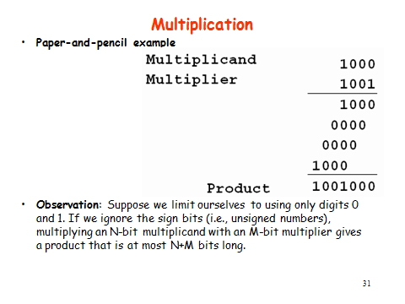

Slide 3
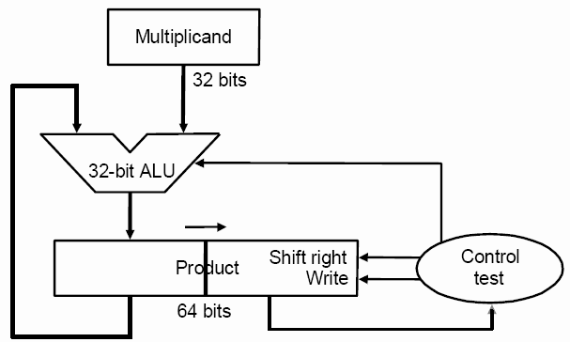
Multiplication - Final Version

Slide 4
Multiplication - Final Version
32-bit ALU
Two registers:
Multiplicand register: 32 bits
Product register: 64 bits
(right half also used for storing multiplier)
Operations:
The right half of the product register is initialized to the multiplier, and its left half is initialized to 0.
The two right-shifts at each step for version 2 are combined into only a single right-shift because the product and multiplier registers have been combined.
This version combines the right half of the product register with the multiplier register.

Slide 5
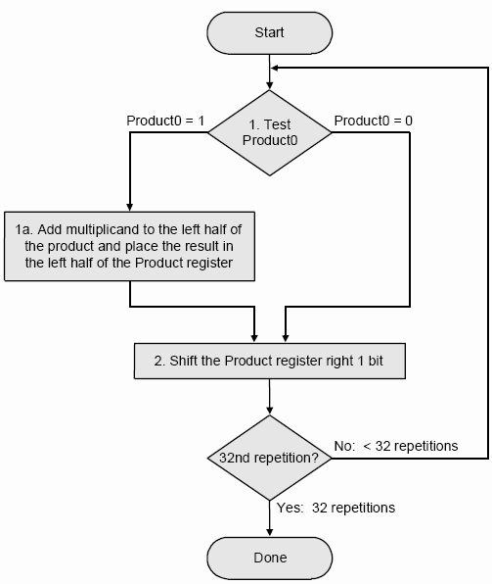
Multiplication Algorithm - Final Version

Slide 6
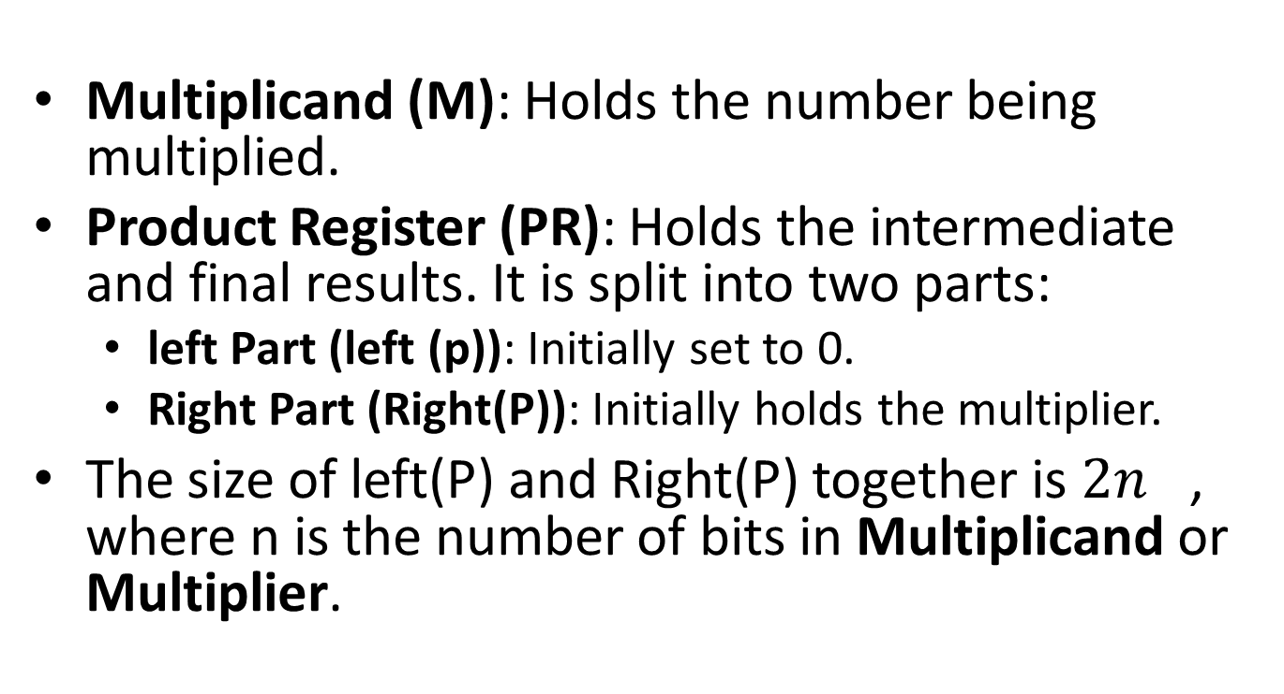
Binary Multiplication Algorithm (Double-Length Product Register)
Multiplicand (M): Holds the number being multiplied.
Product Register (PR): Holds the intermediate and final results. It is split into two parts:
left Part (left (p)): Initially set to 0.
Right Part (Right(P)): Initially holds the multiplier.
The size of left(P) and Right(P) together is ${2n}^{}$, where n is the number of bits in Multiplicand or Multiplier.

Slide 7
Steps:
Step1 : Initialization:
Load M into the multiplicand register.
Load Multiplier into the lower part of the product register Right (P).
Set the high part of the product Left(P)=0.
Determine the number of bits n in the multiplier.
Step2: Repeat for n iterations:
If the least significant bit (LSB) of Right(p) is 1:
Add M to Left(P).
Perform an Arithmetic Right Shift (ARS) on the combined Left(P) and Right(p) registers.
This shifts both registers as a single entity.
Step 3: End:
After n iterations, the combined Left(P) and Right(P) registers contain the final product.

Slide 8
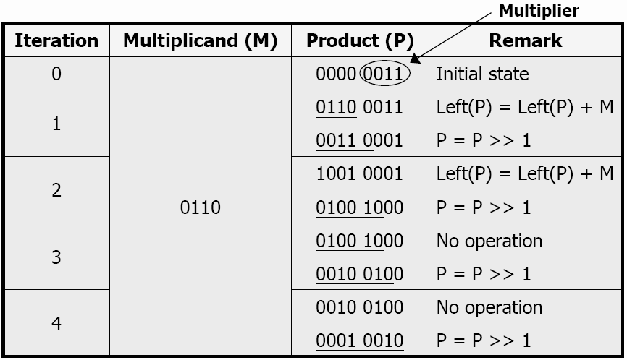
Example
Multiplication of two 4-bit unsigned numbers (0110 and 0011)

Slide 9
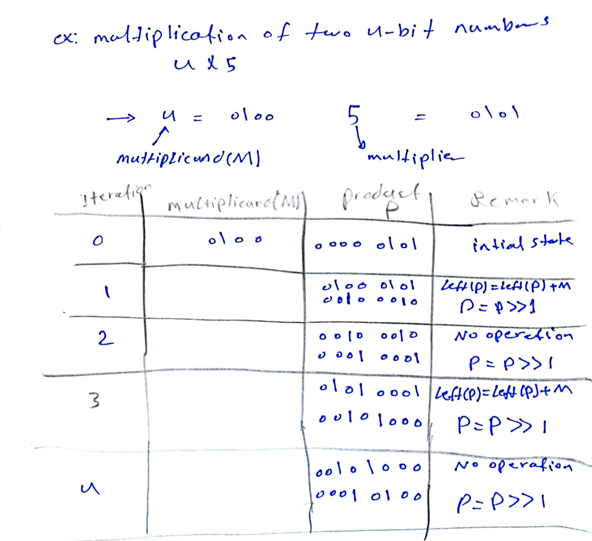

Slide 10
Signed multiplication
If the multiplicand or multiplier is negative, we first negate it to get a positive number.
Use any one of the above methods to compute the product of two positive numbers.
The product should be negated if the original signs of the operands disagree.
What is booth’s algorithm: a more efficient and elegant algorithm for the multiplication of signed numbers
Idea of Booth Algorithm
Looks at two bits of multiplier at a time from right to left
Assume that shifts are much faster than adds
Basic idea to speed up the calculation: avoid unnecessary additions

Slide 11
Division Final Version

Slide 12
Division
Long division of unsigned binary integers
0 0 0 0 1 1 0 1
1 0 1 1 1 0 0 1 0 0 1 1
1 0 1 1
0 0 1 1 1 0
1 0 1 1
0 0 1 1 1 1
1 0 1 1
1 0 0
Quotient
Divisor
Dividend
Partial remainders
Remainder
Dividend = Quotient x Divisor + Remainder

Slide 13
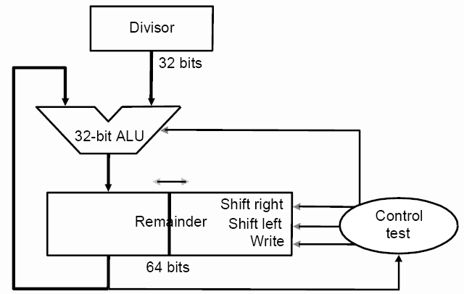

Slide 14
Division Final Version
This version combines the right half of the remainder register with the divisor register.
32-bit ALU
Two registers:
Divisor register: 32 bits
Remainder register: 64 bits
(right half also used for storing quotient)
Operations:
The two left-shifts at each step for version 2 are combined into only a single left-shift because the remainder and quotient registers have been combined.
The consequence of combining the two registers and the new order of the operations in the loop (as in version 2) is that the remainder register will be shifted left one time too many. Thus the final correction step (right-shift) must shift back only the remainder in the left half of the remainder register.

Slide 15
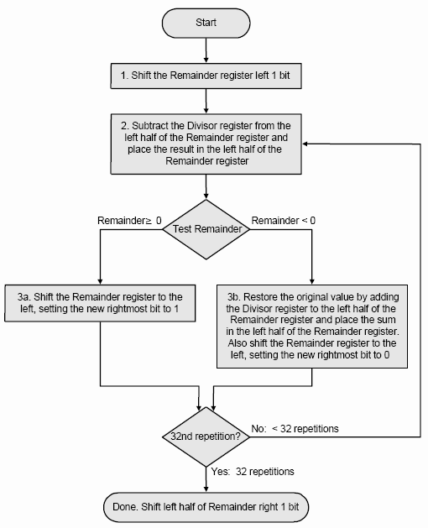
Division Final Version

Slide 16
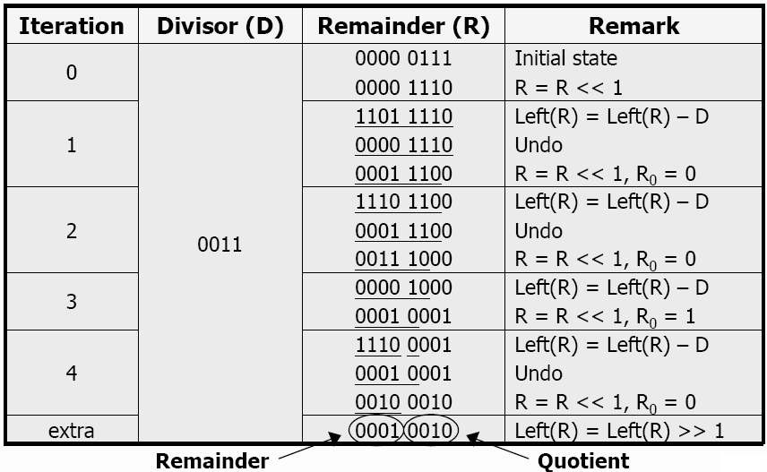
Example: Division of a 4-bit unsigned number (0111) by another one (0011)

Slide 17
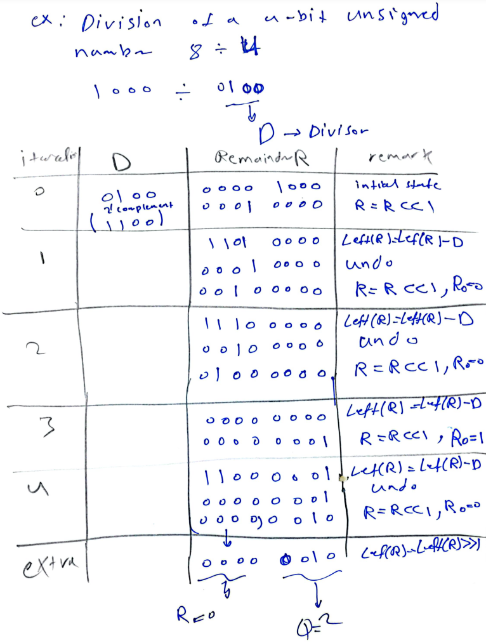

Slide 18
