Slide 1
Predicting Fate of Passengers aboard HMS Titanic
Thinkful Supervised Learning Capstone
Ezra Zanger

Slide 2
Background - Titanic Data
In the year 1912 the HMS Titanic began its maiden voyage departing from Britain.
It was deemed unsinkable and as a result was not properly equipped with insufficient amount of lifeboats if the entire bot were to sink.
The ship’s passengers were divided into three classes beginning with class 1 being the most luxurious and expensive and class 3 the cheapest and mangiest.
Along the way to its destination in America the ship picked up passengers from 3 different cities (in order) – Southampton, Queenstown and
On the tail end of its voyage, on April.. the Titanic crashed into an iceberg sinking the entire ship leaving few survivors.

Slide 3
Dataset Features
Featured are numerous prediction models utilizing some of the Titanic’s features such as the passengers’
Age
Ticket Fare
Class Number
Man, Woman or Child
City Departed
Alone
Survived
Many columns had missing data
Categorical features filled NaN with number 0
For column containing ages NaN for Numeric features were filled with the column mean
Binary features were manually encoded 0 and 1 from Y/N and T/F. Additionally binary and trinary features were used in expressing gender and adult or child.

Slide 4
Prediction Models Evaluated
Logistic Regression
KNN Classifier
Decision Tree
Random Forest
SVM Classifier
PCA was also applied and like models were compared as a validation technique for comparison

Slide 5
Model Evaluation Metrics
Train / Test Split
80 % Train / 20 % Test Split
Cross Validation
K-folds = 10
Classification Accuracy
Confusion Matrix
False Positive Rate
Precision

Slide 6
Sample of Titanic Dataframe
 | survived | pclass | sex | age | sibsp | parch | fare | embarked | class | who | adult_male | alone
0 | 0 | 3 | 1 | 22 | 1 | 0 | 7 | 0 | 3 | 1 | 0 | 0
1 | 1 | 1 | 0 | 38 | 1 | 0 | 71 | 1 | 1 | 2 | 0 | 0
2 | 1 | 3 | 0 | 26 | 0 | 0 | 7 | 0 | 3 | 2 | 0 | 0
3 | 1 | 1 | 0 | 35 | 1 | 0 | 53 | 0 | 1 | 2 | 0 | 0
4 | 0 | 3 | 1 | 35 | 0 | 0 | 8 | 0 | 3 | 1 | 0 | 0
5 | 0 | 3 | 1 | 28 | 0 | 0 | 8 | 2 | 3 | 1 | 0 | 0
6 | 0 | 1 | 1 | 54 | 0 | 0 | 51 | 0 | 1 | 1 | 0 | 0
7 | 0 | 3 | 1 | 2 | 3 | 1 | 21 | 0 | 3 | 3 | 0 | 0
8 | 1 | 3 | 0 | 27 | 0 | 2 | 11 | 0 | 3 | 2 | 0 | 0
9 | 1 | 2 | 0 | 14 | 1 | 0 | 30 | 1 | 2 | 3 | 0 | 0

Slide 7
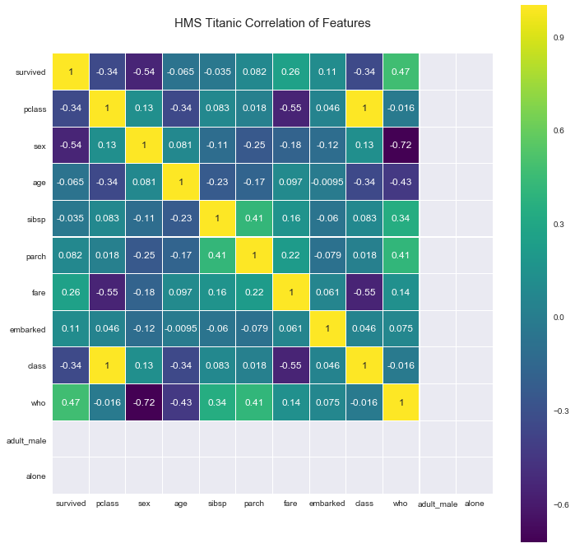
Correlation Heatmap of Titanic Dataset Features

Slide 8
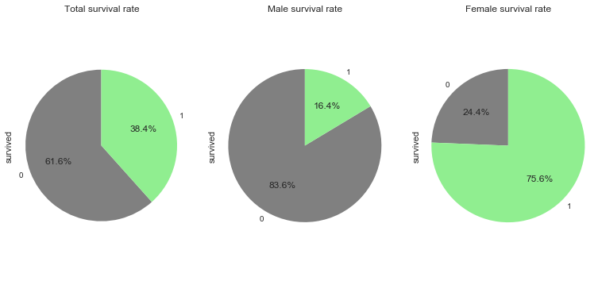
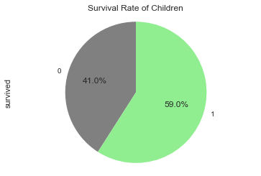
Survival Rates (Male, Female, Child and Total)

Slide 9
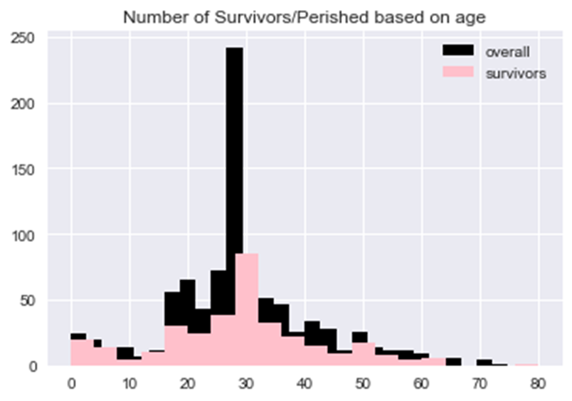
Barplot of Survived divided by age and gender (cont.)

Slide 10
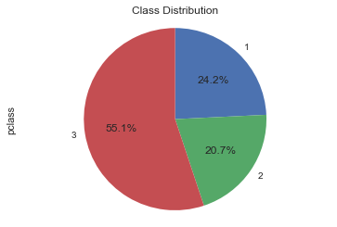
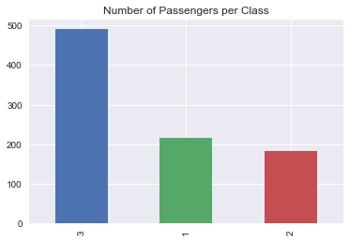
Distribution of Passengers based on Class
As obviously portrayed in these graphs, the largest class was the third considering it was the most affordable. Naturally the second class was next in popularity followed by the first and most expensive class.

Slide 11
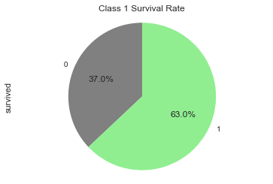
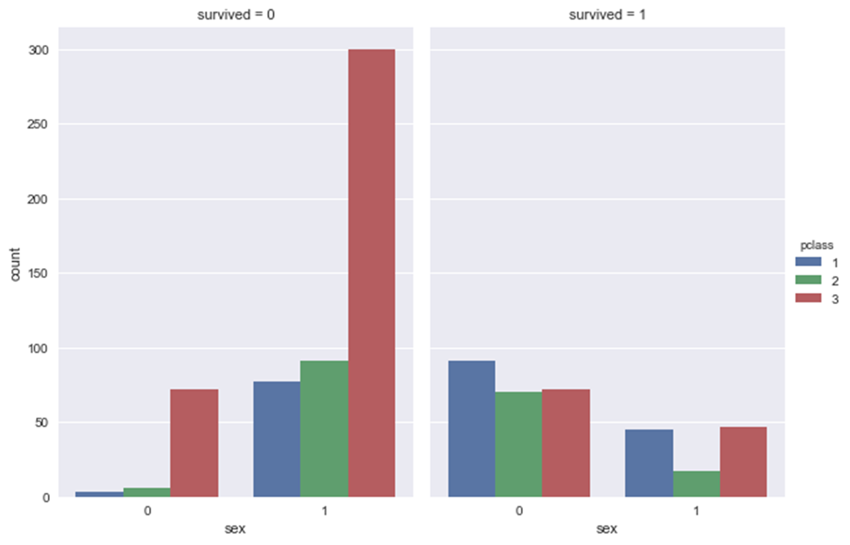
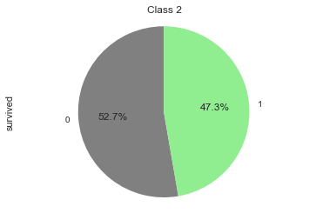
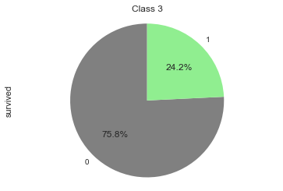
Survival Rate based on Class/Gender

Slide 12
KNN Score k neighbors = 3 k neighbors 3 (weighted) 0.70391061 0.70949721 0.7247191 0.70224719 0.72316384] 0.7127075910343583
[0.67597765 0.69273743 0.73033708 0.7247191 0.70621469] 0.7059971905679401
K neighbors = 3 (PCA)
The KNN proved to work modestly resulting in an accuracy rate of 70% when implemented with 3 neighbors. When implemented with PCA, the KNN did considerably better but avoided overfitting.
[0.75977654 0.75977654 0.79213483 0.80337079 0.81355932]
0.785723602527425
K neighbors = 3 (PCA) (weighted)
[0.7597654 0.7418994 0.80898876 0.75280899 0.79661017] 0.7744748805494883

Slide 13

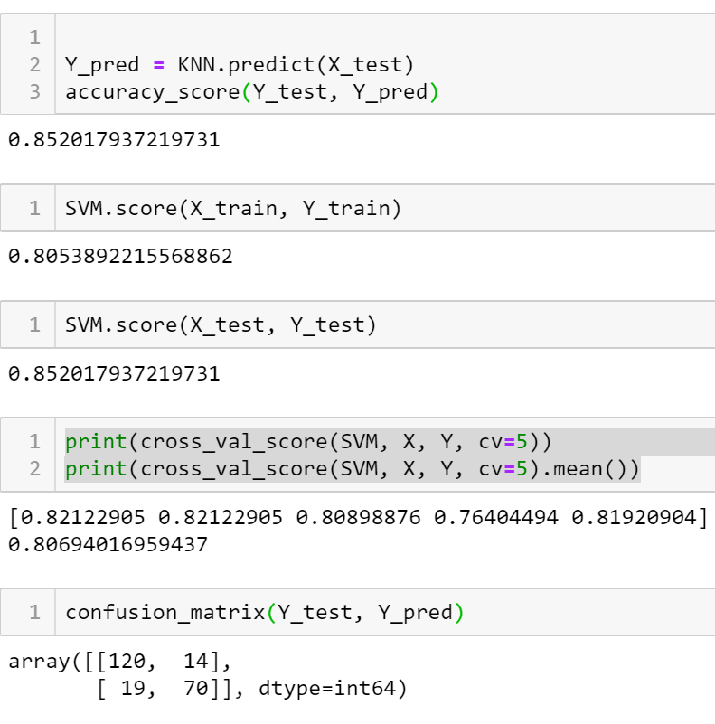
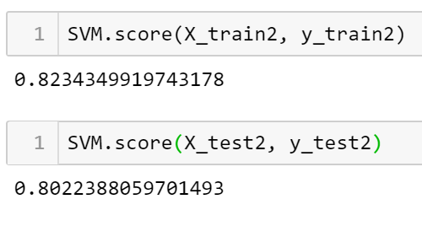
SVM Score
[
The SVM scores also fared moderately with the cross val scores/confusion matrixes providing close to a 80 percent accuracy rate. There was minimal increase when implemented with PCA>

Slide 14
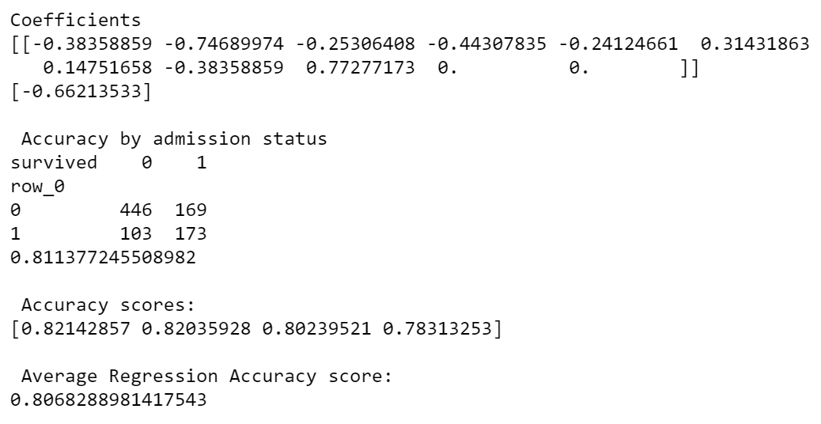
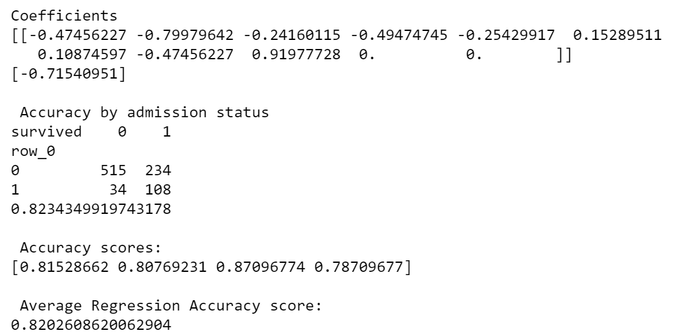
Logistic Regression
The Logistic Regression fared just as moderately as the SVMs providing us with an average accuracy rate of 80% and an average of 82% when implemented with PCA
Logistic Regression (PCA)

Slide 15
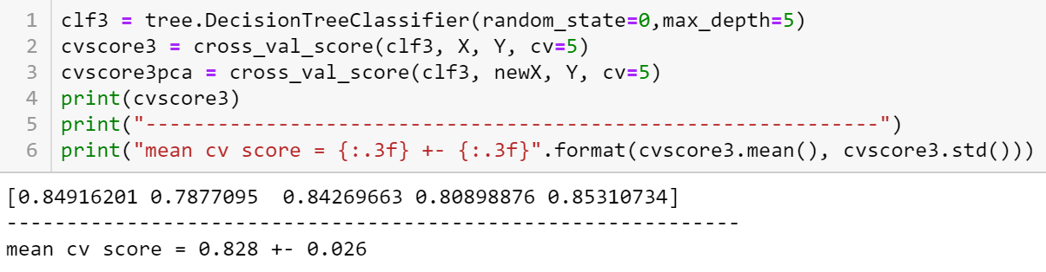

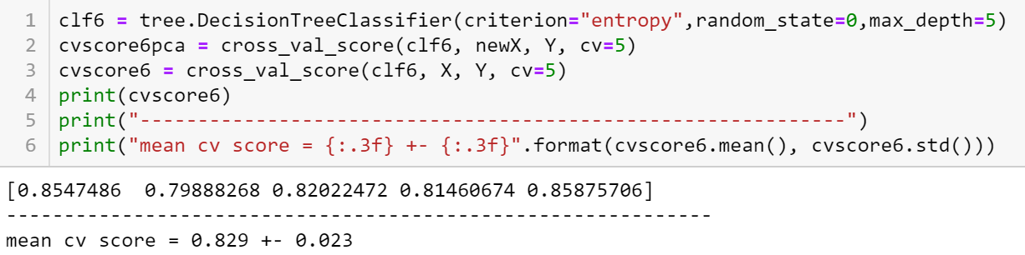

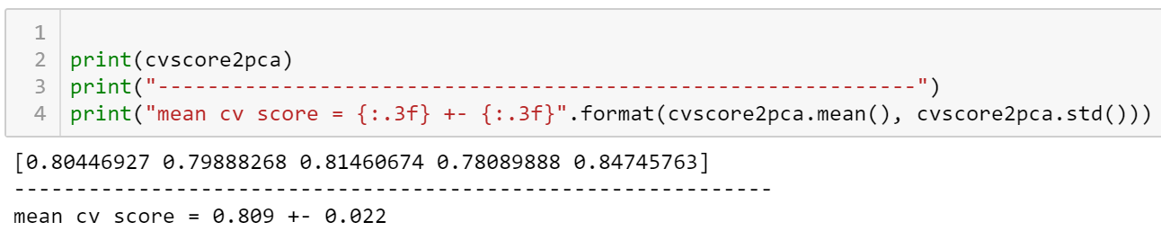
Decision Tree

Slide 16
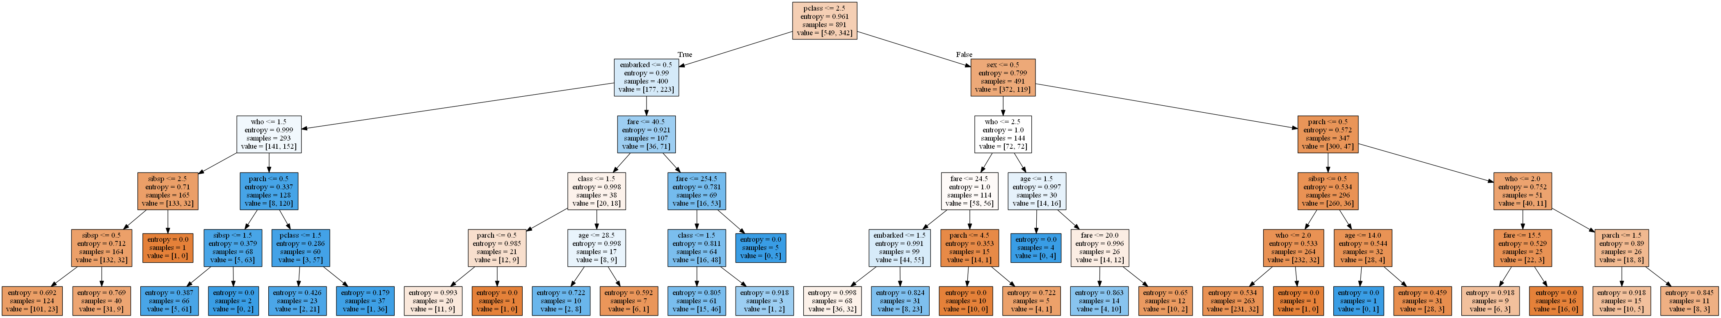
Decision Tree (displayed)

Slide 17
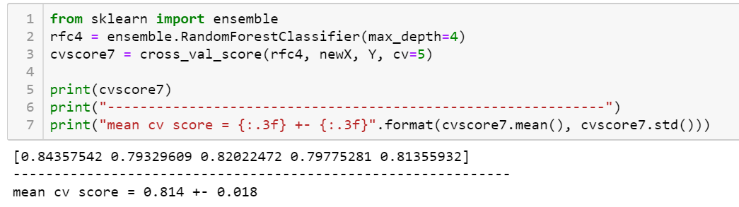

Random Forest

Slide 18
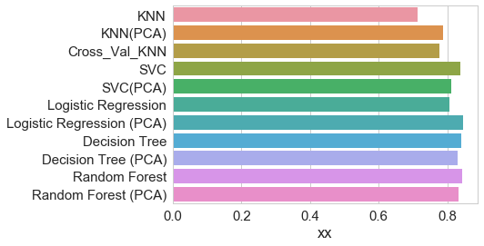
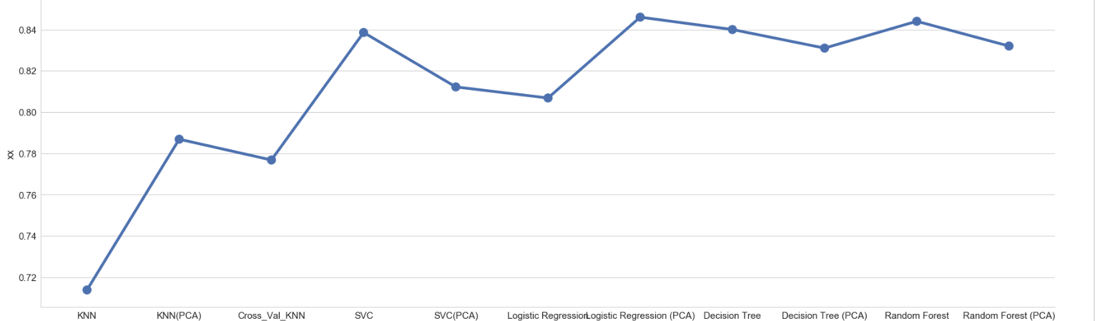
Classification Accuracy
Why do some perform better than others?

Slide 19
Survivors based on Class & Gender

