Slide 1
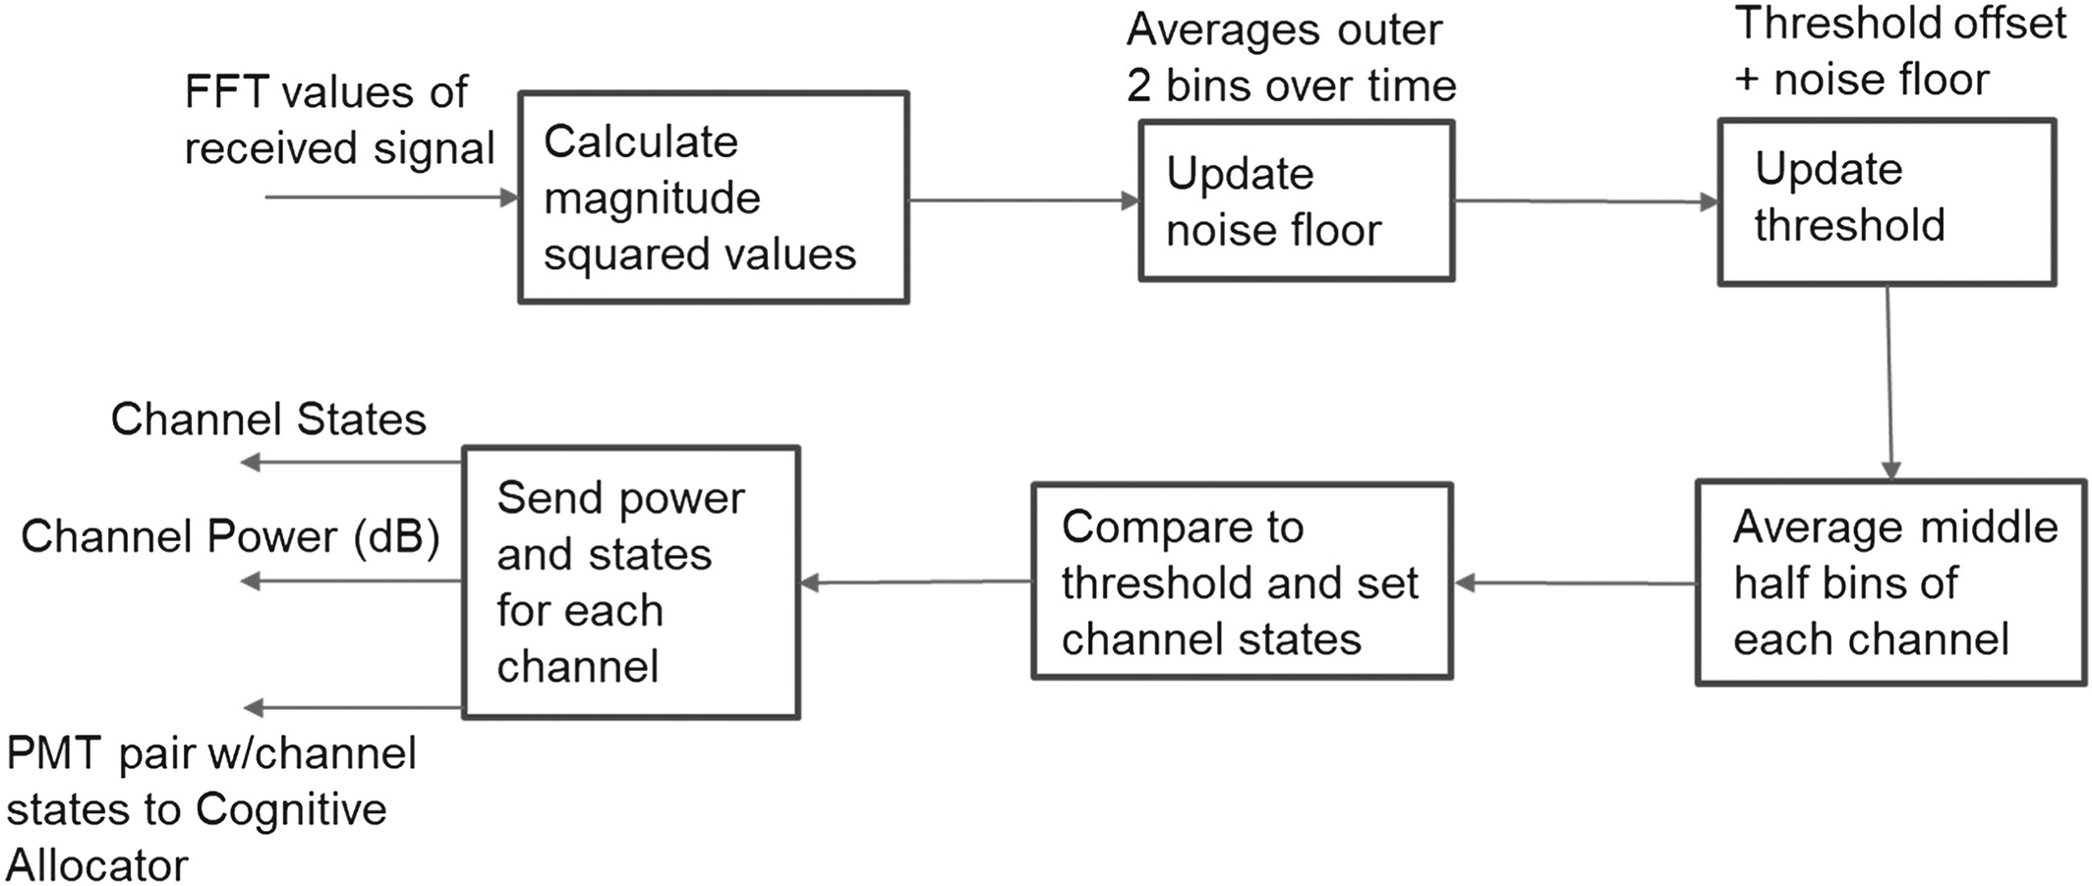
Dynamic wireless spectrum access using GNU Radio and software‐defined radios
Int J Communication, Volume: 33, Issue: 4, First published: 12 November 2019, DOI: (10.1002/dac.4233)
Notes:
Energy detector block diagram
IF THIS IMAGE HAS BEEN PROVIDED BY OR IS OWNED BY A THIRD PARTY, AS INDICATED IN THE CAPTION LINE, THEN FURTHER PERMISSION MAY BE NEEDED BEFORE ANY FURTHER USE. PLEASE CONTACT WILEY'S PERMISSIONS DEPARTMENT ON PERMISSIONS@WILEY.COM OR USE THE RIGHTSLINK SERVICE BY CLICKING ON THE 'REQUEST PERMISSIONS' LINK ACCOMPANYING THIS ARTICLE. WILEY OR AUTHOR OWNED IMAGES MAY BE USED FOR NON-COMMERCIAL PURPOSES, SUBJECT TO PROPER CITATION OF THE ARTICLE, AUTHOR, AND PUBLISHER.

