Slide 1
Ruby on Rails by EZZIE INFOSYSTEMS Training Program

Slide 2
Day 1
Ruby on Rails by Ezzie
Notes:
Our company success depend upon level of automation you achieve.
One more important thing. We are not here for selling software but to partner with you, to build long lasting relationship so that both of us can create opportunities for each other.
These are not marketing lines. I will tell you why and how after couple of slides.

Slide 3
Agenda – Day 1
Environment Setup
Ruby Language – Part 1
Create Sample Project
Design Patterns – Singleton, MVC, Decorator
Understand Rails project Folder Structure
Understand GIT

Slide 4
Environment Setup
Ensure pre requisites
Clean your earlier environment
Install supporting applications
Setup Rails environment along with GIT
REVIEW WHAT WE ACHIEVED
Notes:
Refer to text file

Slide 5
Ruby Language
Strings and Numbers
Conditional logic
Local vs Global Variable
OOP’s concepts
Classes and Objects

Slide 6
First Rails Application
Create intro_app in aptana
Convention over Configuration
Folder name and structure
Entitles names
Path names
Understand rails folder structures
Understand default gems
Run project

Slide 7
Version Control with GIT
What is Version Control System
DVCS vs VCS
Git an open source VCS
Easy to install
Git working area, staging area and repository
GIT 101
Changing Readme file and Pushing to Git
Notes:
git config --global user.name "Your Name“
git config --global user.email your.email@example.com
git init
git add .
git commit –m”first commit”
Delete some folder
git checkout –f
git remote add origin git@github.com:<username>/first_app.git
git push -u origin master
git checkout -b modify-README
git branch
git mv README.rdoc README.md
git status
git commit -a -m "Improve the README file“
git checkout master
git merge modify-README
git branch -d modify-README
git push

Slide 8
Design Patterns
MVC
Singleton
Decorator

Slide 9
Day 2
Ruby on Rails by Ezzie
Notes:
Our company success depend upon level of automation you achieve.
One more important thing. We are not here for selling software but to partner with you, to build long lasting relationship so that both of us can create opportunities for each other.
These are not marketing lines. I will tell you why and how after couple of slides.

Slide 10
Agenda – Day 2
Domain Driver Development
Create Scaffolding
HTTP Introduction
Understanding REST architecture
Deploy project on Heroku
Ruby Language Continue

Slide 11
Ruby Language
Inheritance
Assessors
Class Variables
Ranges, Hashes and Arrays
Loops and iterator
Methods
Singleton

Slide 12

Domain Driven Design
What is domain model?
Entities in System and their relationships
Example – User, Student, Department, Message etc.
In rails starting point is one of domain
Lets start working with User

Slide 13
Scaffolding - CRUD
Run these commands
rails generate scaffold User name:string email:string
rake db:migrate
Naming Conventions of generated entities
Table name – users (plural)
Controller name – UsersController (plural)
Model name – User (singular)
Name of views and matched to methods name in controller

Slide 14
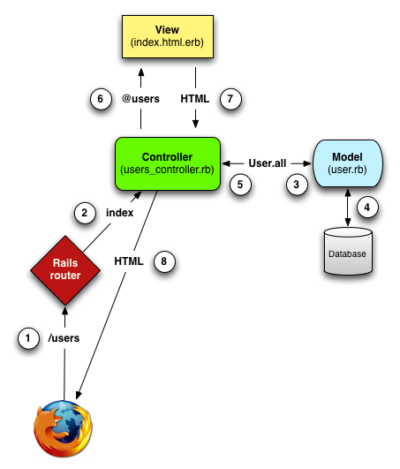
MVC in Action

Slide 15
Representational State Transfer
HTTP protocol
Protocol between browser and http server
Text based protocol
HTTP methods
GET
POST
DELET
PUT
REST Architecture – most application components are modeled as resources

Slide 16
URL Conventions
HTTP request | URI | Action | Purpose
GET | /users | index | page to list all users
GET | /users/1 | show | page to show user with id 1
GET | /users/new | new | page to make a new user
POST | /users | create | create a new user
GET | /users/1/edit | edit | page to edit user with id 1
PUT | /users/1 | update | update user with id 1
DELETE | /users/1 | destroy | delete user with id 1

Slide 17
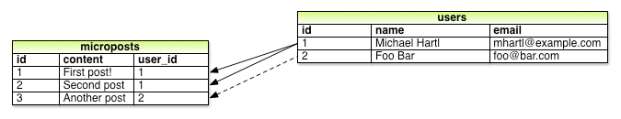
Adding Relationships
Create micropost – run application again
Add validation to it
Assign relationship
User
Micropost

Slide 18
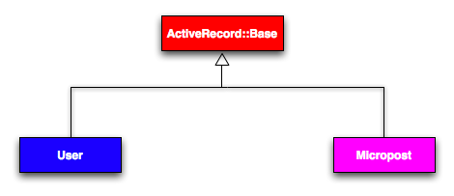
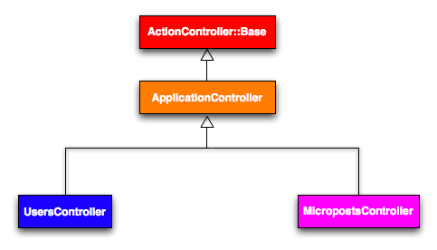
Rails Classes

Slide 19
Deployment in Heroku
Create account at Heroku
heroku login (might need to restart aptana)
heroku create (create new application at heroku)
git push heroku master (deploy application)
Regenerate keys in case of issues
heroku run:detached rake db:migrate
heroku open
Heroku logs

Slide 20
Agenda – Day 3
Ruby Language Introduction Continue
Links and Rails Routing
Add static pages to application
Assets Pipeline (Saas and Coffee Script)
Layouts and Partials
Embedded Ruby
Write Unit test cases
Importance of Unit test cases

Slide 21
Ruby Language
Exception Handling
Blocks, Proc and Lambda
Symbols
Module and Mixin
Dynamic Programming

Slide 22
Agenda – Day 4
Domain Modeling
XML and JSON as output
Use of Rails console
Id and version
Advance finders
Constraints and Validation
Relationships
One to one
One to many
Many to many

Slide 23
Agenda – Day 5
Controller
Views
Filters
Functional Tests
Sessions
Implement Use cases – signup, sign in, sign out, password management

Slide 24
Agenda – Day 6
CRUD for resource
Internationalization
Database migration
Ajax
Production environment
Asset management
Database management
Passenger integration

Slide 25
Ruby Language Fundamentals - 1 Session 2
Day 1
Notes:
Our company success depend upon level of automation you achieve.
One more important thing. We are not here for selling software but to partner with you, to build long lasting relationship so that both of us can create opportunities for each other.
These are not marketing lines. I will tell you why and how after couple of slides.

Slide 26
Ruby - 1
Ruby as dynamic language
Static type vs Dynamic type
Simple ruby 1+1

Slide 27
REST Architecture
HTTP protocol
GET
POST
DELETE
Concept of Resources

Slide 28
Application Integration
REST architecture
HTML as output
JSON as output
XML as output

Slide 29
Rails in Production
Pre compile of Assets
MySQL database
Database migration
Deployment on Heroku

Slide 30
Optimist locking
http://guides.rubyonrails.org/active_record_querying.html
Eager Loading and Lazy Loading
Dynamic Finders

Slide 31
Thank You

