Slide 1
QUALIFIED RESUMES
ABDULAZIZ
WALEED

Slide 2

What Do We Mean By Qualified Resume?
Notes:
Resume screening is the process of determining whether a candidate is qualified for a role based his or her education, experience, and other information captured on their resume

Slide 3


Slide 4
Workflow
EDA
Results
NLP
Modeling

Slide 5
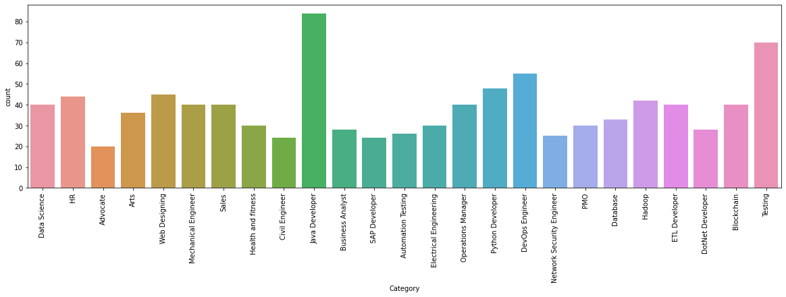
EDA
Features
Category: Represent majors
Resume: Content of the candidates
Data Set
Number of Candidates in each major

Slide 6
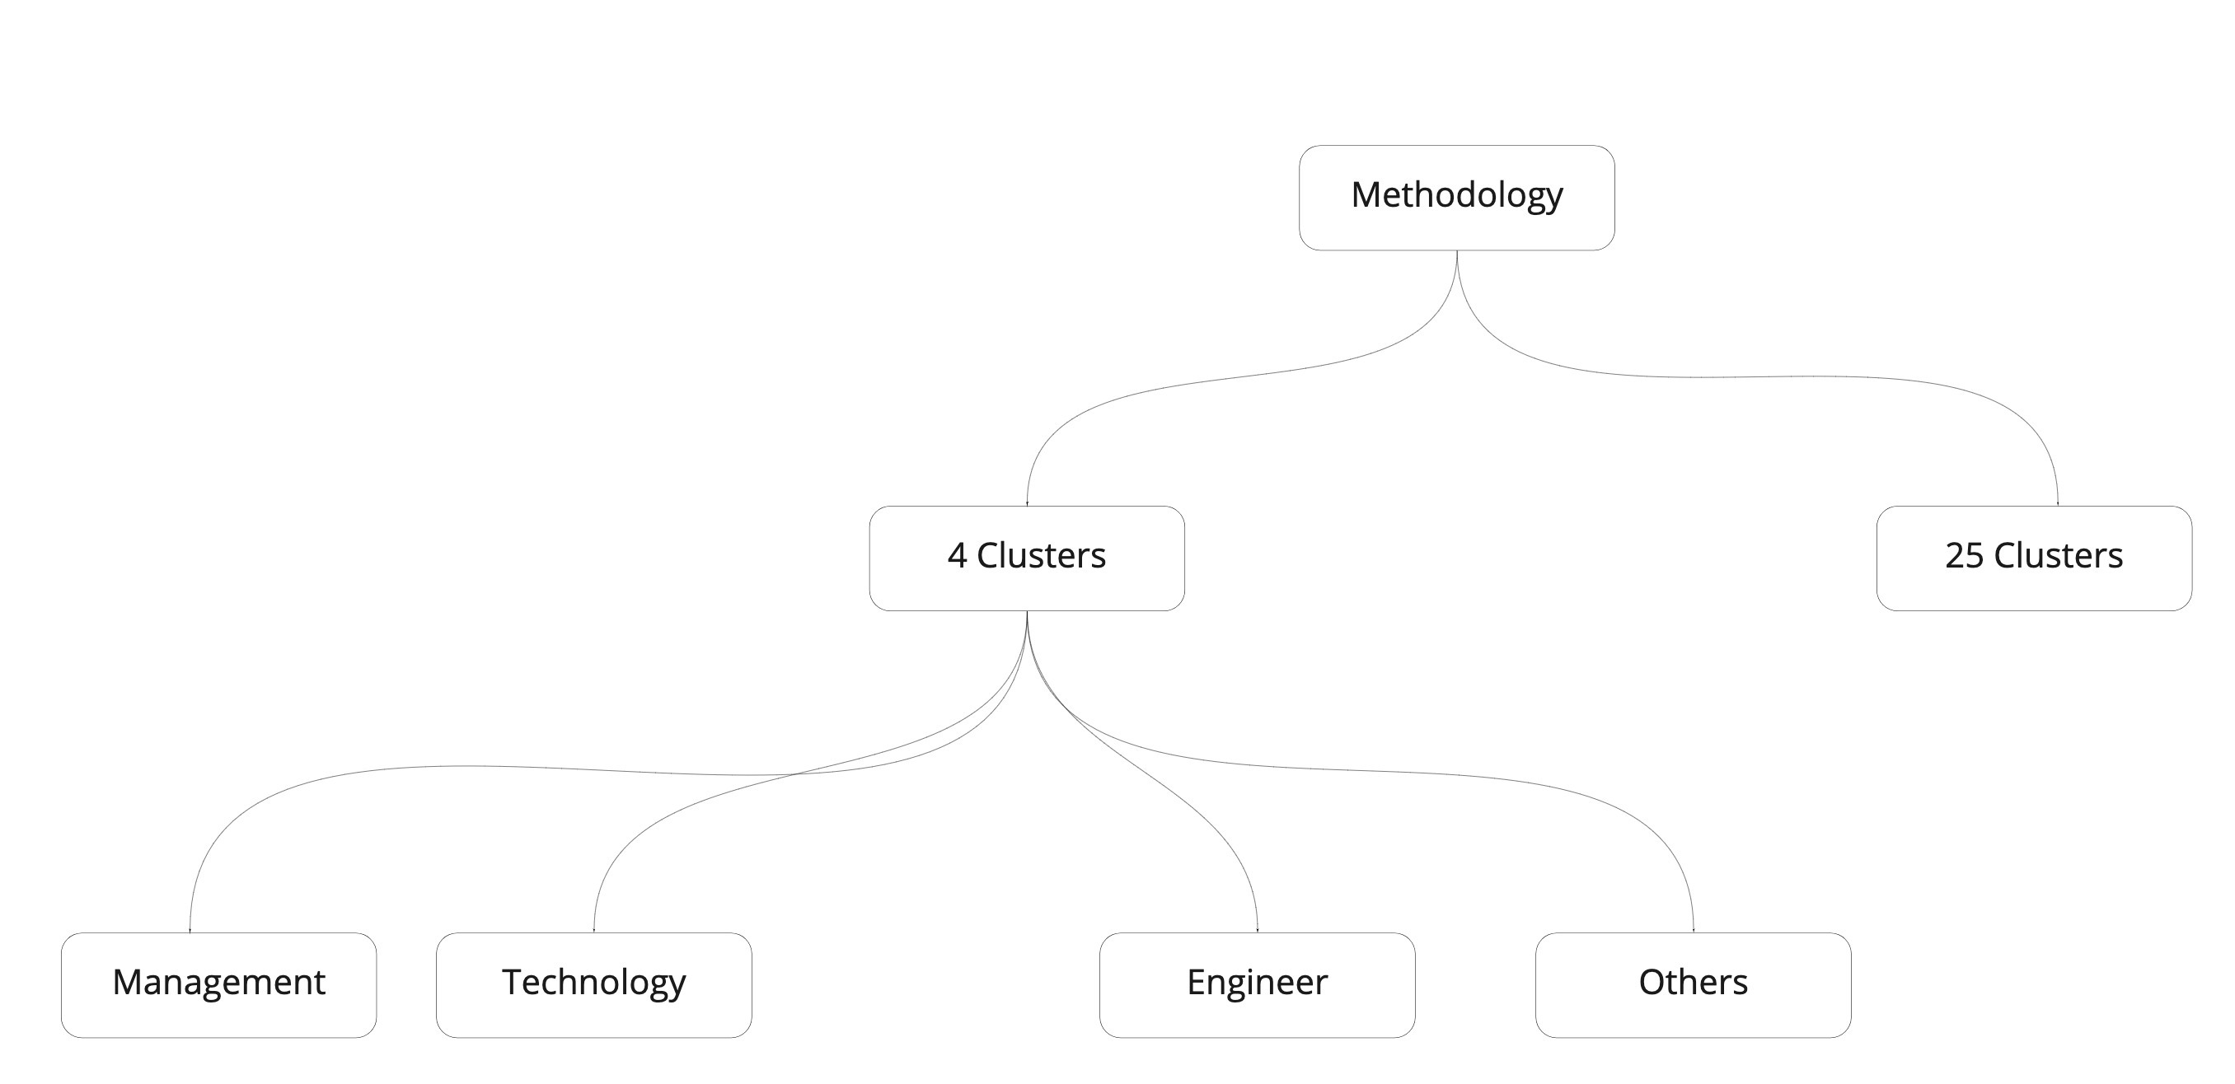
Methodology

Slide 7
NLP
Tokenization
Remove stop words
Punctuations
Text Preprocessing
Bag of words
TF-IDF
Text Similarity

Slide 8
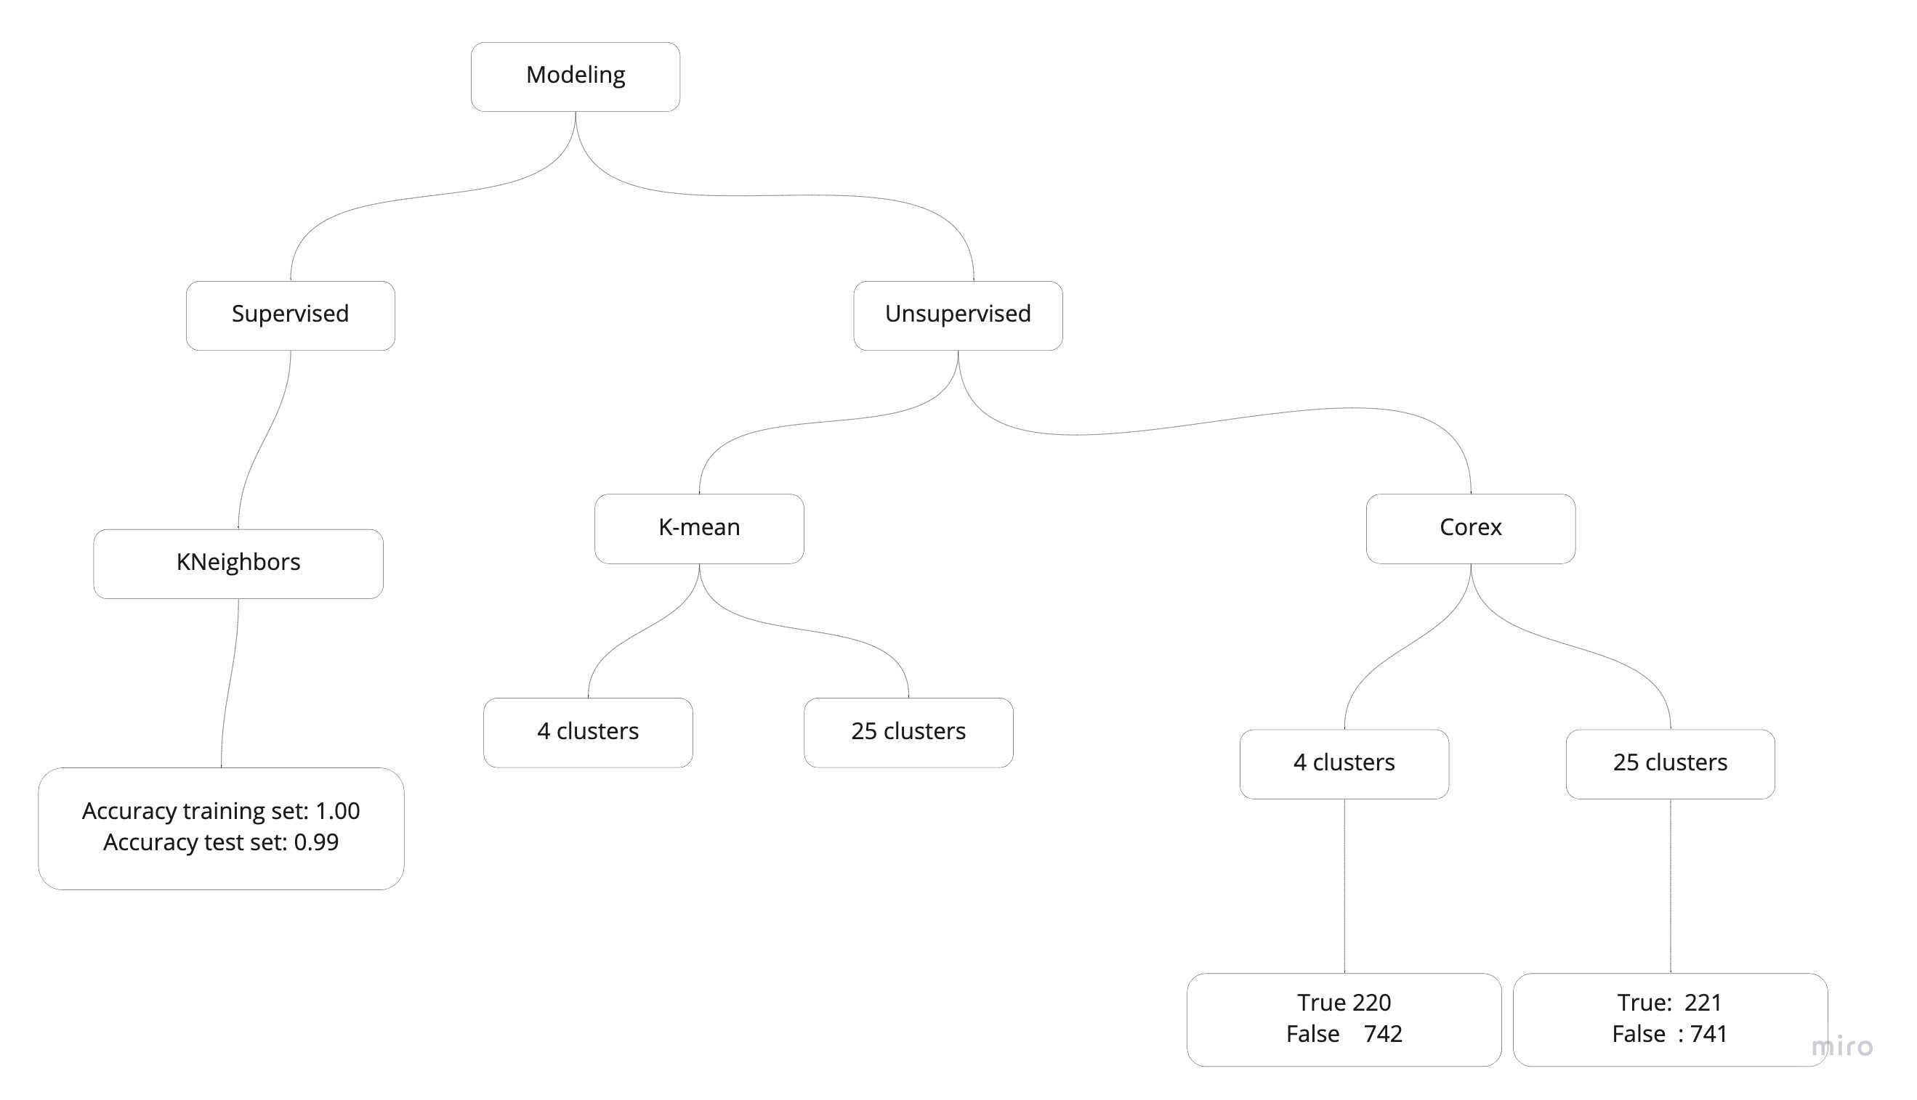
Modeling

Slide 9
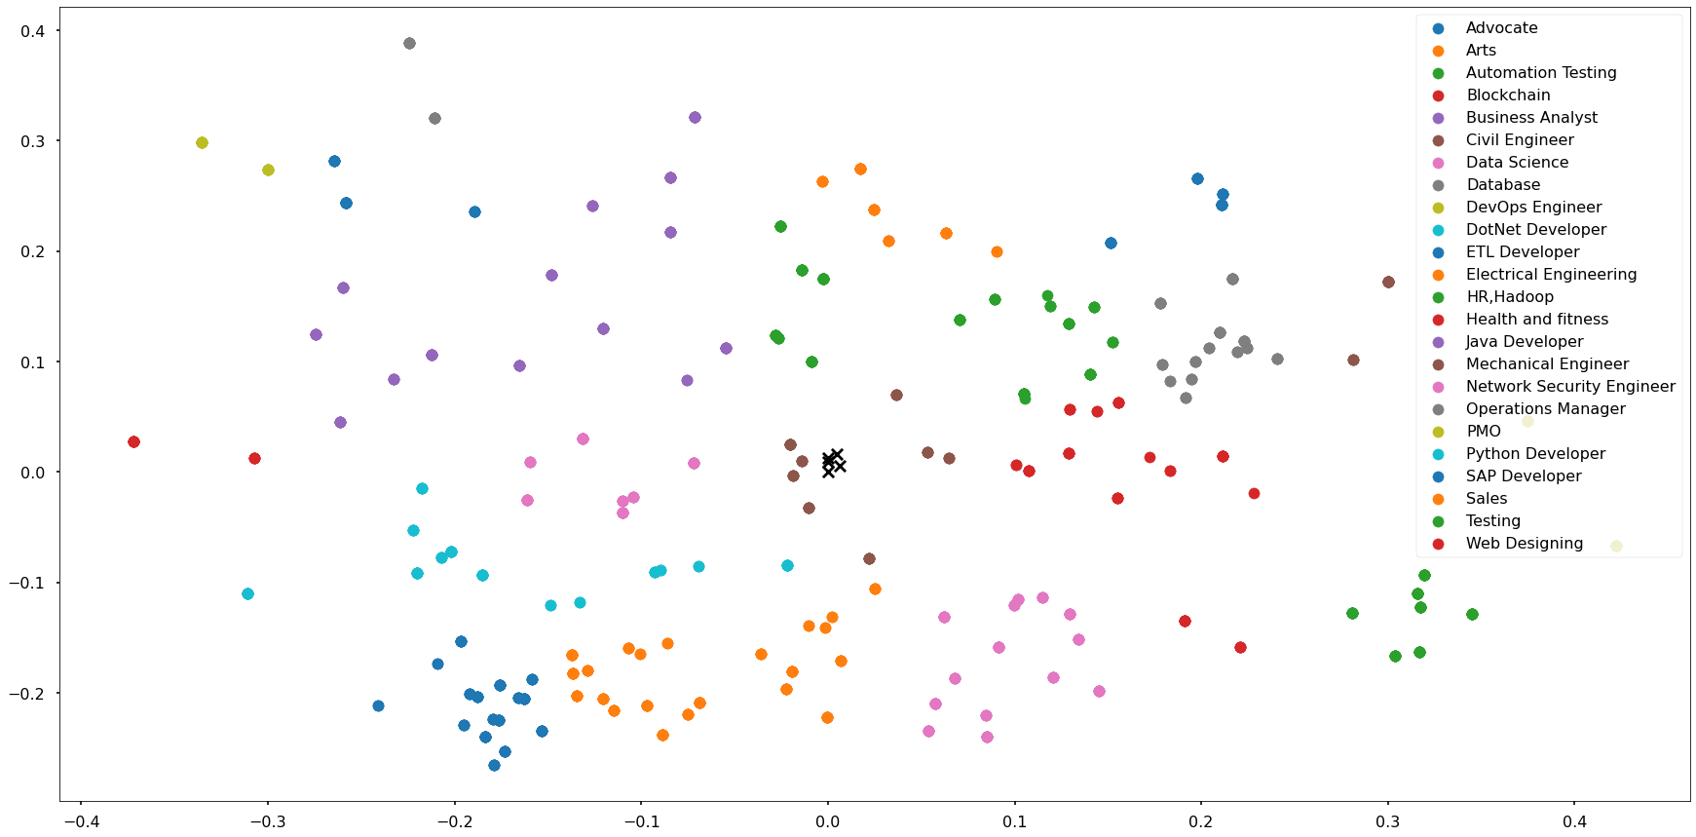
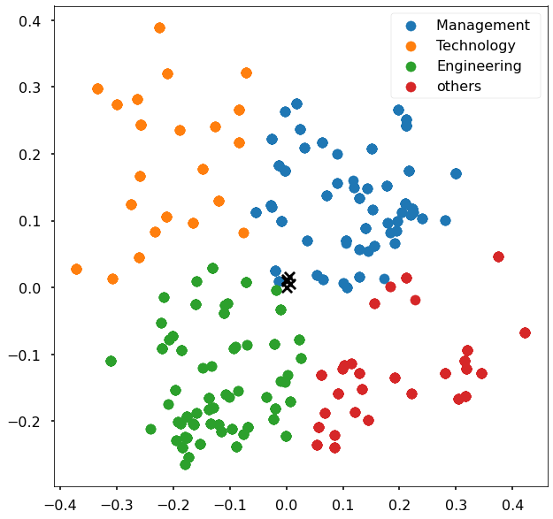
K-Mean with 25 clusters
K-Mean with 4 clusters

Slide 10
Conclusion
Filtering Resumes easily.
Automating the process of resumes selection.
Ability to handle larger number of resumes in short time.

