Slide 1

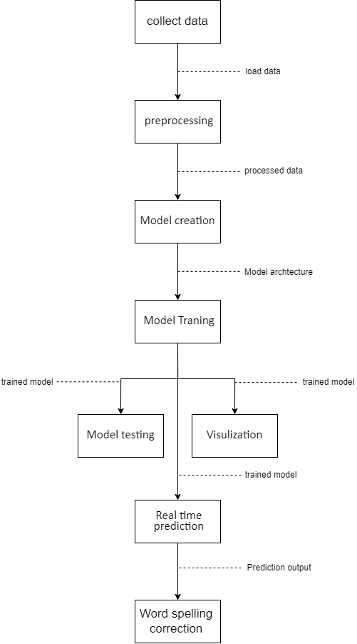
Title : Integrative Real-Time Sign Language Recognition for Enhanced Communication By: Ezzeldein yasser 206879 supervisor: Nermin Othman
Abstract
Sign language is a crucial communication tool for the Deaf and mute community, yet a significant portion of the global population is unfamiliar with it, leading to communication barriers and isolation for Deaf individuals. To address this, modern machine learning and deep learning techniques have been used to develop a real-time fingerspelling application that translates sign language into text, enhancing interaction between Deaf individuals and those who do not know sign language. This project is significant in our diverse society, where effective communication solutions are needed for the growing number of individuals with hearing impairments, as highlighted by WHO statistics showing a rise from 278 million in 2005 to 466 million in 2019. By leveraging advanced technology and rigorous accuracy testing, this application aims to bridge the communication gap, fostering inclusivity and improving accessibility for the Deaf community, ultimately contributing to greater social integration and equality.
System Design
Image Results
pipeline
SVM Result
EfficientNetB0 Result
CNN Result
Video (frames) Result
VGG-19 Result
Conclusions
This project developed a system for translating sign language into text using various models:
1.Model Development:
CNN: 96.53% accuracy on ASL.
VGG19: 100% training accuracy but overfitted.
EfficientNetB0: 99.7% accuracy, highest performance.
2.Comparative Analysis:
EfficientNetB0 outperformed SVM in accuracy but required more computational resources.
3.Video Recognition:
Improved performance with LSTM and VGG19 models using background removal and feature extraction.
4.Real-Time Application:
Created a real-time system translating gestures to text via webcam, enhancing user interaction and accessibility.

