Slide 1
EDD vs LDF
A discussion of implementation and performance
A presentation by Fahim Ahmed

Slide 2
What is the Earliest Due Date Algorithm?
The Earliest Due Date is an algorithm where we concentrate our priorities on having the system (generally a processor), complete tasks based on the earliest deadline (di).
This does not factor in the completion time (ci) for other tasks, which can consequently cause no deadline being met.
Also known as Jackson’s Algorithm, and this also presumes that the tasks provided are provided synchronously.
Performance: O(nlogn)

Slide 3
What is the Latest Deadline First Algorithm?
The Latest Deadline First is an algorithm where we concentrate our priorities on having the system (generally a processor), complete tasks based on the latest deadline (di). A given reciprocal of the previous EDD.
This does not factor in the completion time (ci) for other tasks, which can consequently cause no deadline like EDD.
Also presumes that the tasks provided are provided synchronously.
Performance: O(n^2)

Slide 4
Design Constraints
Each algorithm must take in 20 tasks, each with computation time (ci) & deadline (di).
To make this program have more flexibility to the end user, I will allow text-based input, the user can select what ci & di they would like.
Coding language I can quickly get the task done with.
Python seemed ideal since I was more acquainted with that language, widespread support and libraries that will alleviate the need to ‘hard-code’.
Downside: This implementation will provide you, the viewer a simple idea on the basics of how these algorithms can work but I would not recommend this for a practical case since real time systems are developed in lower-level languages compared to python.

Slide 5
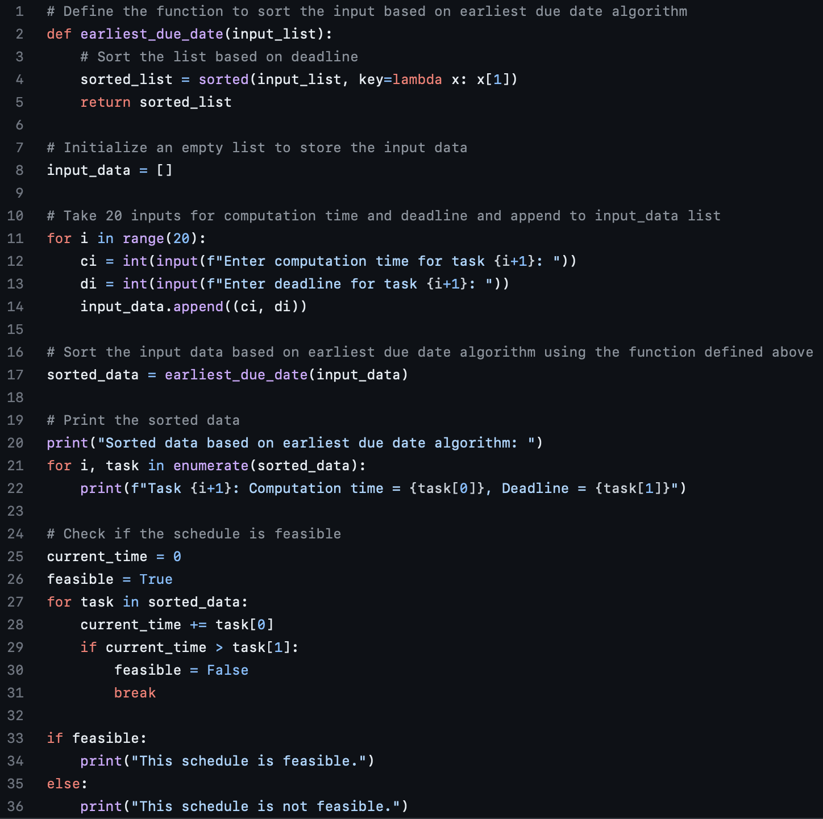
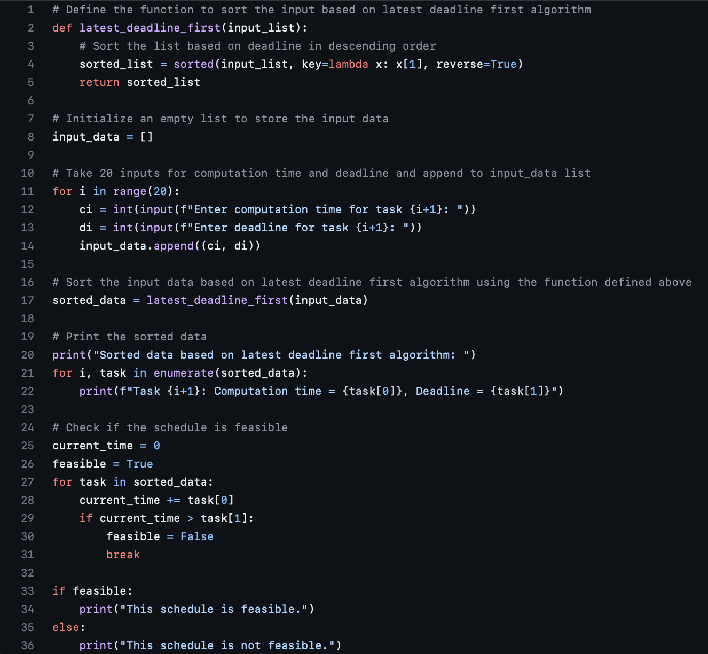
Python Based Implementation
EDD
LDF

Slide 6
Test Plan
Based on my design constraints of my algorithms, I will create a sample of 40 randomly generated numbers. I will put boundaries on these numbers, to at least get a grasp of the feasibility.
ci: Computation Time will receive 20 of these, and I will restrict the size of it to between (1-5), to ensure the deadlines and computation times aren’t outrageously big to provide realistic performance.
di: Similarly, I will generate 20 randomly generated deadlines with the maximum being 75. This was done to give room for failure, but not completely out of the range for success.
ci | 1 | 3 | 5 | 2 | 1 | 4 | 2 | 5 | 1 | 4 | 5 | 2 | 3 | 4 | 5 | 3 | 1 | 4 | 3 | 2
di | 54 | 16 | 29 | 41 | 70 | 48 | 37 | 60 | 3 | 69 | 7 | 19 | 12 | 32 | 26 | 52 | 65 | 34 | 56 | 39

Slide 7
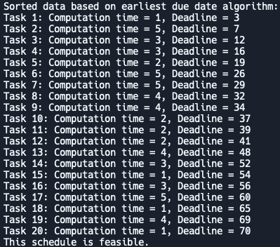
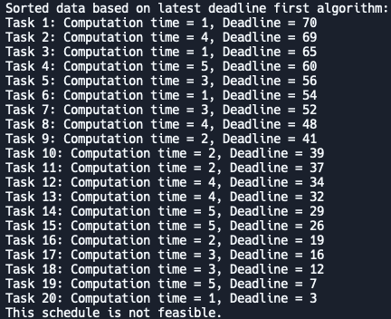
Results
EDD
LDF

Slide 8
Discussion & Future Works?
As we have seen here, EDD successfully completed its tasks & LDF was unable to. But does that mean LDF is a bad algorithm?
Not exactly. LDF in this instance under performed when compared to EDD, however, LDF has better performance in general for large datasets at O(n^2) compared to EDD at O(nlogn).
Future iterations of this would be helpful to have a more sophisticated test set up, since I picked those boundaries largely based on my intuition on the topic. Which means there could definitely be bias.
Additionally, it would be helpful for the program to randomly generate the same set of numbers in one script for both algorithms to use instead of manually typing in all the numbers. Unfortunately, I wrote these 2 in different scripts without having that realization.

Slide 9
References, Resources & Special Thanks
Dr. Mike Borowczak, Adjunct UCF ECE Faculty & Templeton Associate Professor at the University of Wyoming.
Teaching EEL 5862 (Real Time Systems), Spring 2023
OpenAI’s ChatGPT platform version 3.5
https://chat.openai.com
User ‘th-rpy’ on Github and their project ‘Jackson Algorithm with Python’
https://github.com/th-rpy/Algo_Cds_Ordanncement#jackson-algorithm-with-python

