Slide 1




CAPSTONE PROJECT
EduNet Hotel Booking Analysis - Exploratory data analysis (EDA)
By - Farhan Akhtar
farhanakhtar358@gmail.com

Slide 2


Table of contents
Agenda of Data Analysis
Hotel Booking Data-Introduction
01
02
Benefits for doing this Hotel Booking Analysis Project
Short introduction of the Dataset
Data Description & Summary
EDA (Exploratory Data Analysis)
03
04
Dataset Summary & Description of all the data
Data Visualization, Overall Stats and Conclusion

Slide 3



Agenda of Data Analysis
Have you ever wondered when the best time to book a
hotel room is?
Or the optimal length of stay in order to get the best daily rate?
What if you wanted to predict which hotel likely to receive a disproportionately high number of special requests?
So, this hotel booking dataset can help us to explore all of this questions!

Slide 4


Hotel Booking Data Introduction
This Dataset contains data that compares various booking information between two hotels, City Hotel and Resort Hotel. So, here i will be using the data to analyze the factors affecting the hotel bookings. These factors can be used for reporting trends and predict the future bookings.
This Dataset contains the booking data
of hotels from year 2015-2017.

Slide 5

Data Description
hotel | There are two types of hotels, one is City Hotel and another is Resort Hotel
is_canceled | Here 0 and 1 value indicates booking was cancelled (1) or not (0)
lead_time | Time-lapse between reservation and actual arrival date
arrival_date_year | Year of arrival date
arrival_date_month | Month of arrival date
arrival_date_week_number | Week number of arrival date
arrival_date_day_of_month | Day of arrival date
stays_in_weekend_nights | Number of weekend nights (Saturday or Sunday) spent at the hotel by the guests

Slide 6
Data Description
stays_in_week_nights | Number of weeknights (Monday to Friday) spent at the hotel by the guests
adults | Number of adults among guests
children | Number of children among guests
babies | Number of babies among guests
meal | Type of meal booked
country | Country of guests
market_segment | Designation of market segment
distribution_channel | Name of booking distribution channel

Slide 7
Data Description
is_repeated_guest | If the booking was from a repeated guest (1) or not (0)
previous_cancellations | Number of previous bookings that were cancelled by the customer prior to the current booking
previous_bookings_not_canceled | Number of previous bookings not cancelled by the customer prior to the current booking
reserved_room_type | Code of room type reserved
assigned_room_type | Code of room type assigned
booking_changes | Number of changes/ amendments made to the booking
deposit_type | Type of the deposit made by the guest
agent | ID of travel agent who made the booking

Slide 8
Data Description
company | ID of the company that made the booking
days_in_waiting_list | Number of days the booking was in the waiting list
customer_type | Type of customer, assuming one of four categories
adr | Average Daily Rate, as defined by dividing the sum of all lodging transactions by the total number of staying nights
required_car_parking_spaces | Number of car parking spaces required by the customer
total_of_special_requests | Number of special requests made by the customer
reservation_status | Reservation status (Canceled, Check-Out or No-Show)
reservation_status_date | Date at which the last reservation status was updated

Slide 9


Data Summary
This data set contains a single file which compares various booking information between two hotels: City Hotel and Resort Hotel. Includes information such as when the booking was made, length of stay, the number of adults, children, and/or babies, and the number of available parking spaces, among other things.
The dataset contains a total of 119390 rows and 32 columns.
All the columns are divided into three dtypes : Object, float64 and int64.
This dataset does have duplicated values as well as null values. There are total of 31994 duplicate values and four columns have missing values/ null values.
The maximum number of missing values are from 'Company' column then followed by 'Agent', 'Country' and 'Children' columns. The 'Children' column consists of only 4 null values, while 'Company' column consists of 112593 null values.

Slide 10


Points for Discussion
Top Most Preferred Hotel & Hotel Rooms
ADR (Average Daily Rate)
Repeated Vs Non-Repeated Guests
Requirement of Car Parking Space
Most Preferred Meal
Distribution Channel Vs ADR
Top Booking Months & Year
Optimal Stay Length
Confirmation Vs Cancellation
Mostly Arrived Customers/ Visitors
Overall Stats
Conclusion

Slide 11
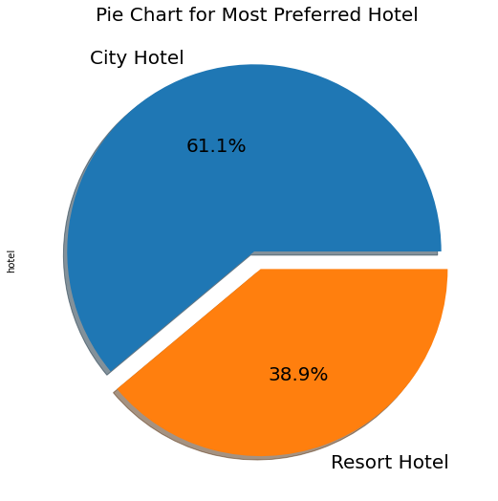

Top Most Preferred Hotel
Insights found
From the chart, we got to know that City Hotel is most preferred hotel by the guests. Thus City Hotel has maximum bookings. 61.1% guests are preferred City Hotel, while only 38.9% guests have shown interest in Resort Hotel.

Slide 12

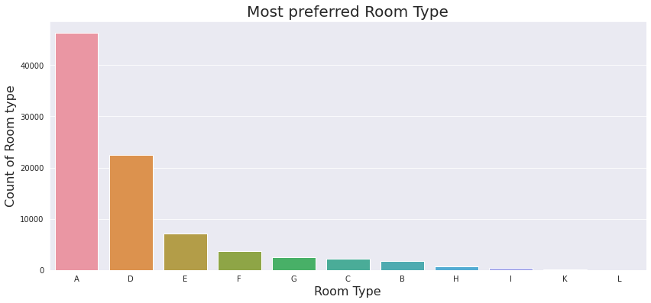
Most Preferred Hotel Rooms
It is found that the most preferred Room type is 'A'. So, majority of the guests have shown interest in this room type.
There are positive impacts because 'A', 'D', 'E' is more preferred by guest due to better services offered in room type.

Slide 13
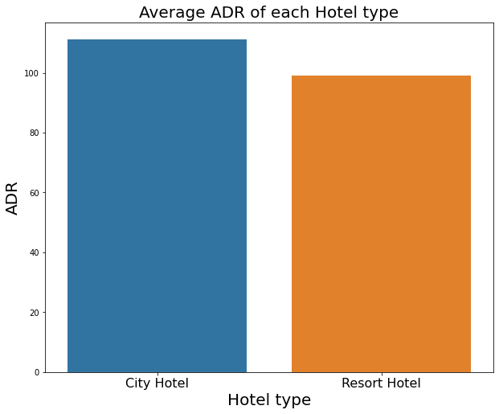
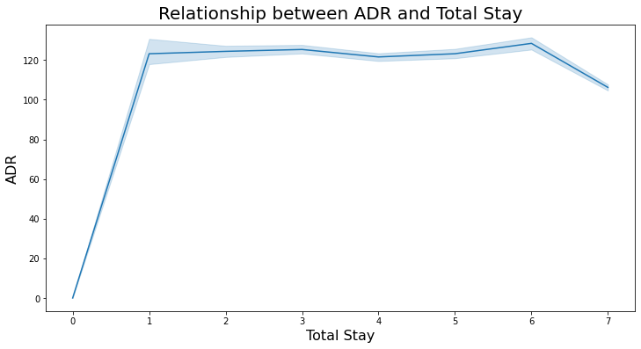

Average Daily Rate
City Hotels are generating more revenues than the Resort Hotels, because City hotel has the highest ADR. More the ADR, more will be the revenue.
From the line chart, we have found that as the total stay increases the ADR is also getting high. So, ADR is directly proportional to total stay.

Slide 14
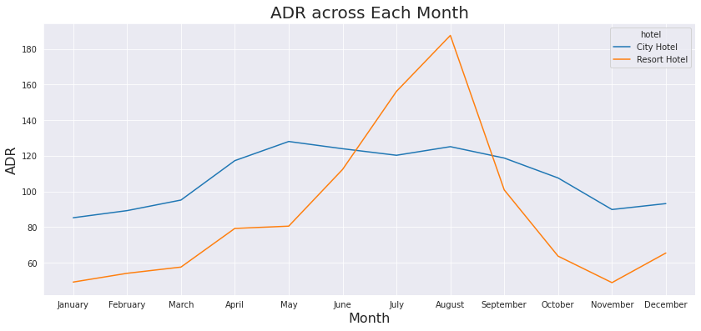
Average Daily Rate
ADR across months
For Resort Hotel, ADR is high in the months of June, July, August as compared to City Hotels. The reason may be that customers/people want to spent their summer vacation in Resort Hotels.

Slide 15
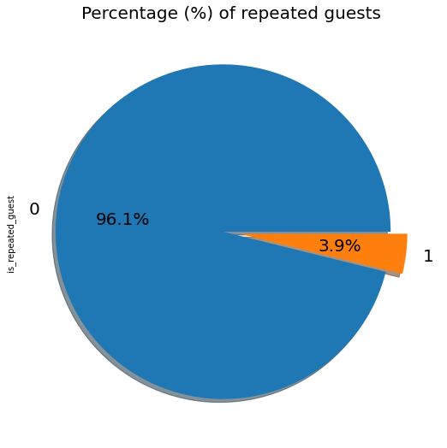
Repeated Vs Non-Repeated Guests
Insights found
The pie chart show the percentage of repeated guests or not (where 0 is not repeated guest and 1 is repeated guest)
Repeated guests are very few which is only 3.9% while 96.1% guests are not returning to the same hotel.
The guests management should take feedbacks from guests and try to improve the services.

Slide 16
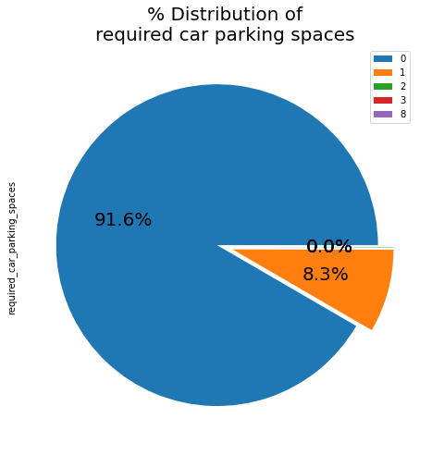

Requirement of Car Parking Space
Insights found
This chart shows that 91.6% guests did not required the parking space. Only 8.3% guests required the parking space.
The demand for car parking area is less. It can be said that hotels need to work less on car parking spaces as only 1 car parking space was required by 8.3% of guests.

Slide 17
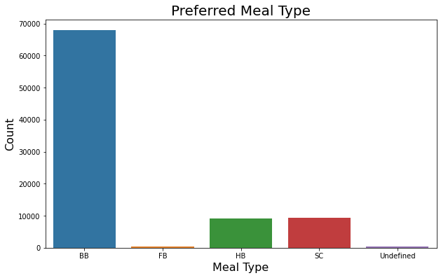
Most Preferred Meal
Insights found
The most preferred meal type by the guests is BB (Bed and Breakfast) while HB (Half Board) and SC (Self Catering) are equally preferred.

Slide 18
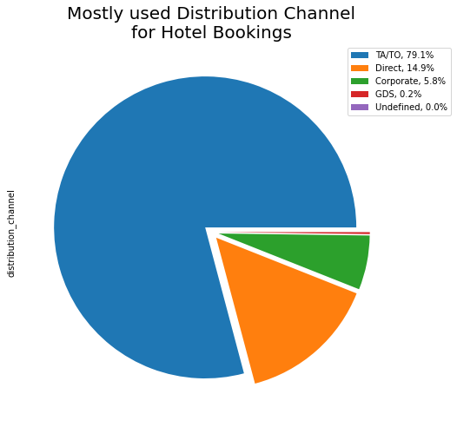
Maximum used Distribution Channel
Insights found
'TA/TO' has been mostly (79.1%) used for booking hotels. Direct market segment of 14.9%, Corporates market segment of 5.8%, GDS market segment of only 0.2% and rest unidentified are 0%.

Slide 19
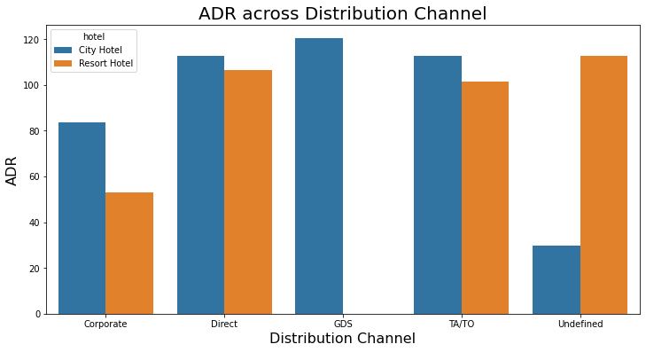
Distribution Channel Vs ADR
'Direct' and 'TA/TO' have almost equally contribution in ADR in both type of hotels. While, GDS has highly contributed in ADR in 'City Hotel' type. GDS needs to increase Resort Hotel bookings.

Slide 20
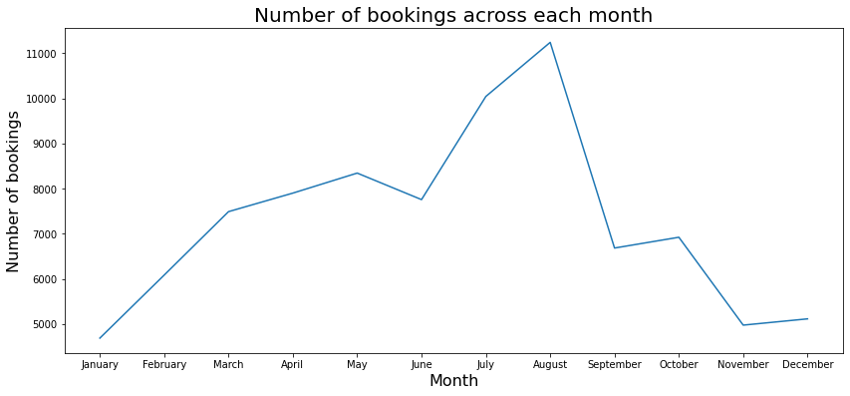
Top Booking Months
From this graph, we can say that July and August months had the most Bookings. As, July and August generally surrounds in and near the summer vacation.
Hotels should be well prepared for the month of July and August as maximum bookings takes place for this month.

Slide 21
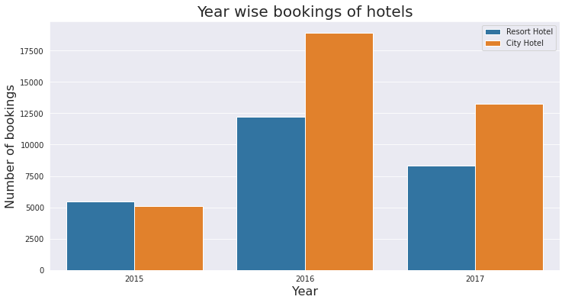
Top Booking Year
It can be summarised that in the year 2016 both the hotel saw a massive increase in their bookings and by far the year 2016 is the year of the highest bookings of both hotel. In 2016 and 2017 the City hotel is having the highest number of bookings but in 2015 the Resort hotel is having the highest number of bookings.

Slide 22
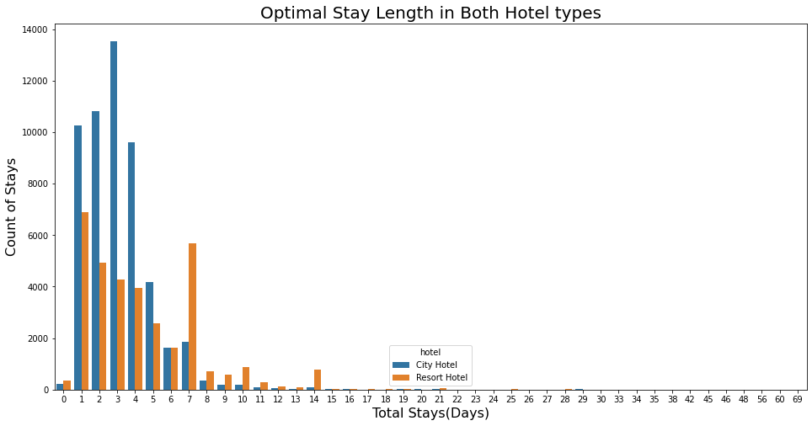
Optimal Stay Length
We have found that the Optimal stay in both the type hotel is less than 7 days. So, after that staying numbers have declined drastically.
Customers usually prefers a one week stay in a hotel. So, hotels need to work efficiently in these seven days so that customers would return to the same hotel again.

Slide 23
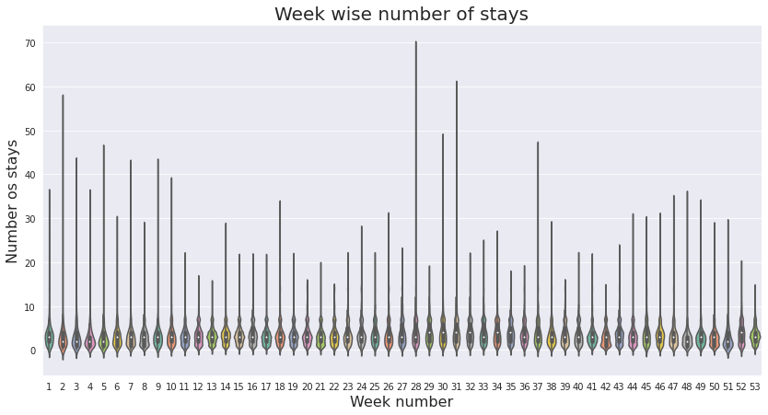
Optimal Stay Length
Week Wise Number of Stay
From the week 28 to 31, it has shown the highest days of stay whereas from the week 1 to 11 has shown a very steady trend in the number of stays and also the week 18 to 22 has shown the least number of stays by the visitors in aggregate of all 3 years 2015, 2016 and 2017.

Slide 24
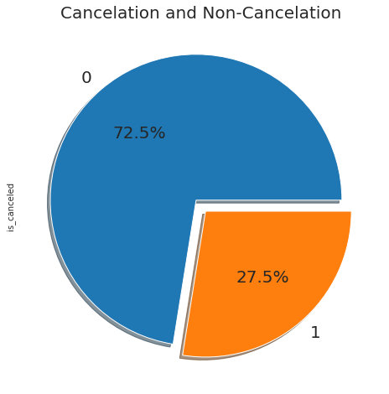
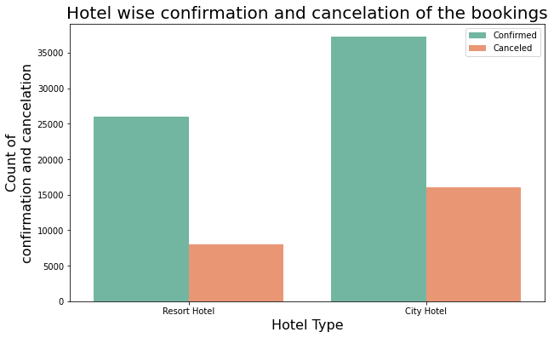
Confirmation Vs Cancellation
More than 1/4th of the overall bookings i.e. approx 27.5% of the tickets was got canceled.
We can clearly deduce from the 2nd graph that the City hotel is having greater number of bookings as compared to Resort hotel. But, the cancelation percentage is also high of the City Hotel.

Slide 25
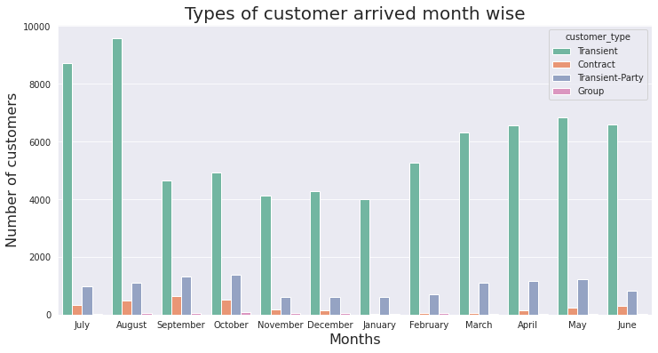
Mostly Arrived Customers/ Visitors
It can be summarised that the Transient type of customers visit the most whereas the visitors who are in group comes in the category of least visitors.

Slide 26
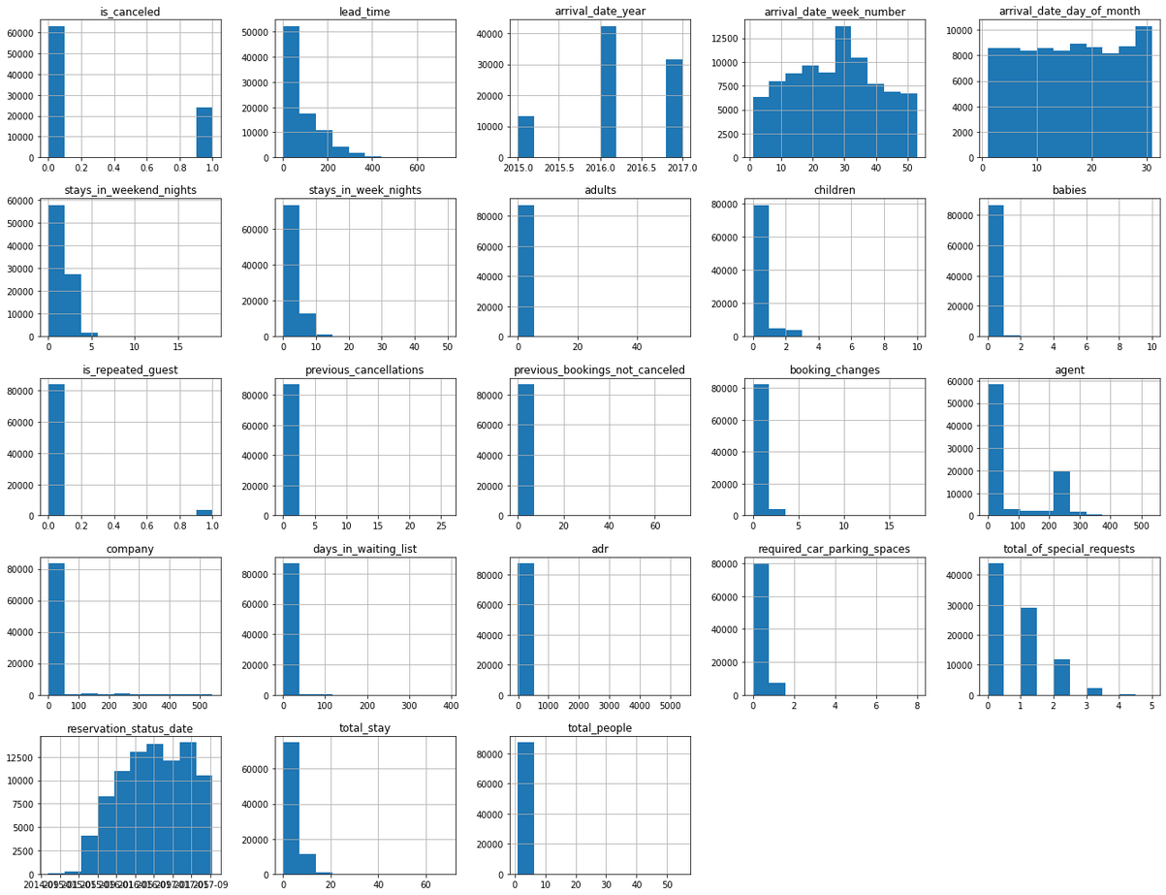
Overall Stats
Insights found
Maximum guest came in the year 2016.
Maximum arrival week number is 30.
Maximum arrival happens in the last of the month.
Maximum guests comes with no children.
There is very less requirement of Car parking spaces.

Slide 27
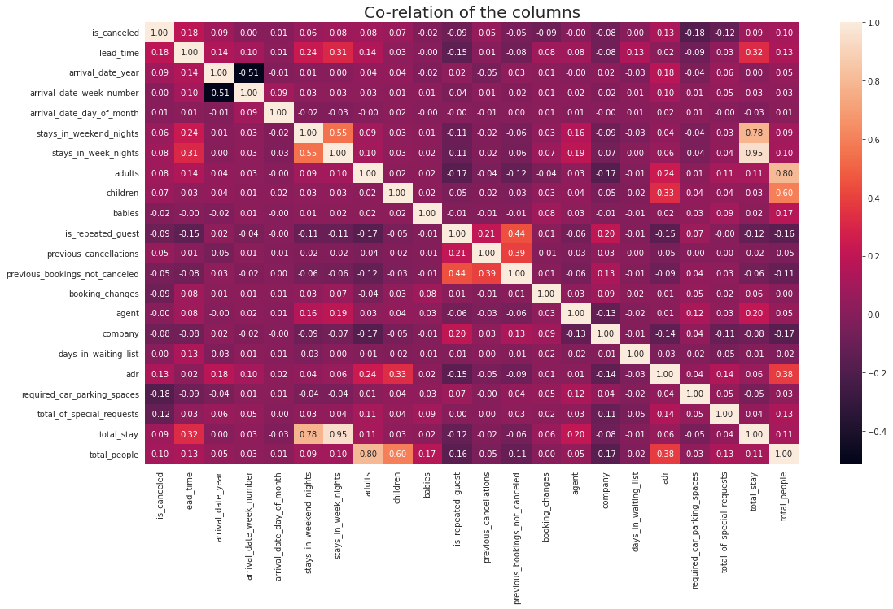
Overall Stats
Correlation Heatmap

Slide 28
Overall Stats
Insights found
From Heatmap
is_canceled and total_stay are negatively correlated. This means customers are unlikely to cancel their bookings if they don't get the same room as per reserved room.
lead_time and total_stay is positively correlated. This means more the stay of customer is, more will be the lead time.
adults, childrens and babies are correlated to each other. This indicates more the people, more will be ADR.
is_repeated guest and previous bookings not canceled have a strong correlation. This may be due to the reason that repeated guests are not more interested to cancel their bookings.

Slide 29

Conclusion
City hotels are the most preferred hotel type by the guests. So, we can say that City hotels are the busiest hotel in comparison to the resort hotel.
The average ADR of city hotels is higher as compared to the resort hotels. So, it can be said that these City hotels are generating more revenue than the resort hotels.
The total stay of guests is directly proportional to the adr. So, higher the days of stay, the higher will be ADR and revenue as well.
The percentage of repeated guests is very low. Only 3.9% people had revisited the hotels. Rest 96.1% were new guests. So, retention rate is much low.
The percentage of required car parking spaces is very low. This means less car parking spaces don't affect the business much. Most of the customers (91.6%) do not require car parking spaces.
Among different types of meals, BB (Bed & Breakfast) is the most preferred type of meal by the guests. So, guests love to opt for this meal type.

Slide 30


Conclusion
'Direct' and 'TA/TO' have almost equally contribution in ADR in both type of hotels. While, GDS has highly contributed in ADR in 'City Hotel' type.
Optimal stay length in both the hotel types (City and Resort Hotel) is less than 7 days. Usually people stay for a week. So, after 1 week, the optimal stay length declined drastically.
Most number of bookings have taken place in the month of July and August. July and August are the favourite months of guests to visit different places.
The mostly used distribution channel for booking is 'TA/TO'. 79.1% bookings were made through TA/TO (travel agents/ tour operators).
While calculating ADR across different month, it is found that for Resort hotel, ADR is high in the months of June, July, August as compared to City Hotels.
Almost 1/4th of the total bookings is canceled. Approx, 27.5% bookings have got canceled out of all the bookings.
Majority of the guests have shown interest in the room type 'A'. Room type 'A' is the most preferred room type.

Slide 31
Future scope
The future of IBM Watson Studio looks promising, with expectations for enhanced integration with advanced AI and machine learning tools, support for hybrid and multi-cloud environments, and increased automation capabilities.
As AI ethics and explainability gain importance, Watson Studio is likely to introduce more features to ensure transparency and fairness in AI models. Collaboration tools are expected to improve, facilitating better teamwork and sharing across projects.
The platform will likely continue integrating with other IBM products, offering a more cohesive ecosystem for data-driven decision-making. Additionally, there will be a focus on end-to-end AI lifecycle management, industry-specific solutions, and advanced analytics to handle big data.
These developments aim to make AI development more accessible, ethical, and integrated within business processes.

Slide 32
References
BM Watson Studio Documentation: Official guides on using Watson Studio, covering setup, tools, and features. IBM Watson Studio Documentation
IBM Developer Tutorials: Practical tutorials and code patterns for real-world data science and AI applications. IBM Developer Tutorials
IBM Watson Studio Learning Path: Structured learning with tutorials, videos, and labs for mastering Watson Studio.IBM Watson Studio Learning Path
IBM Community and Forums: A platform to ask questions and learn from other users' experiences and best practices IBM Community

Slide 33

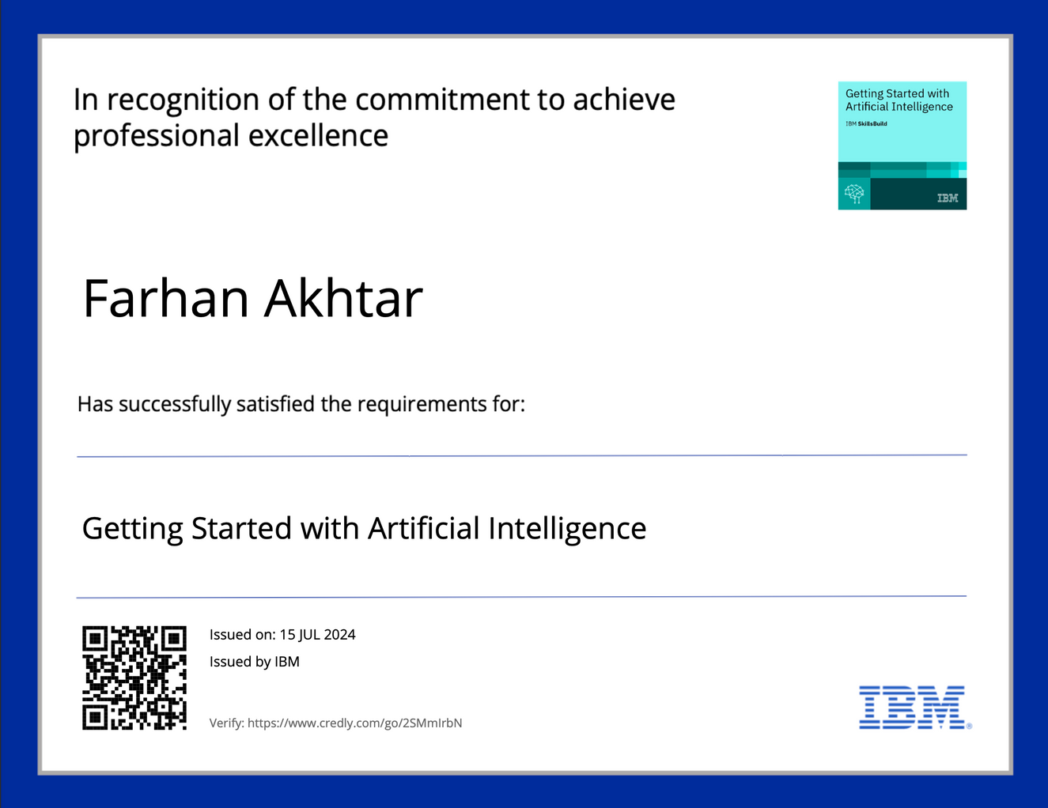
course certificate 1

Slide 34
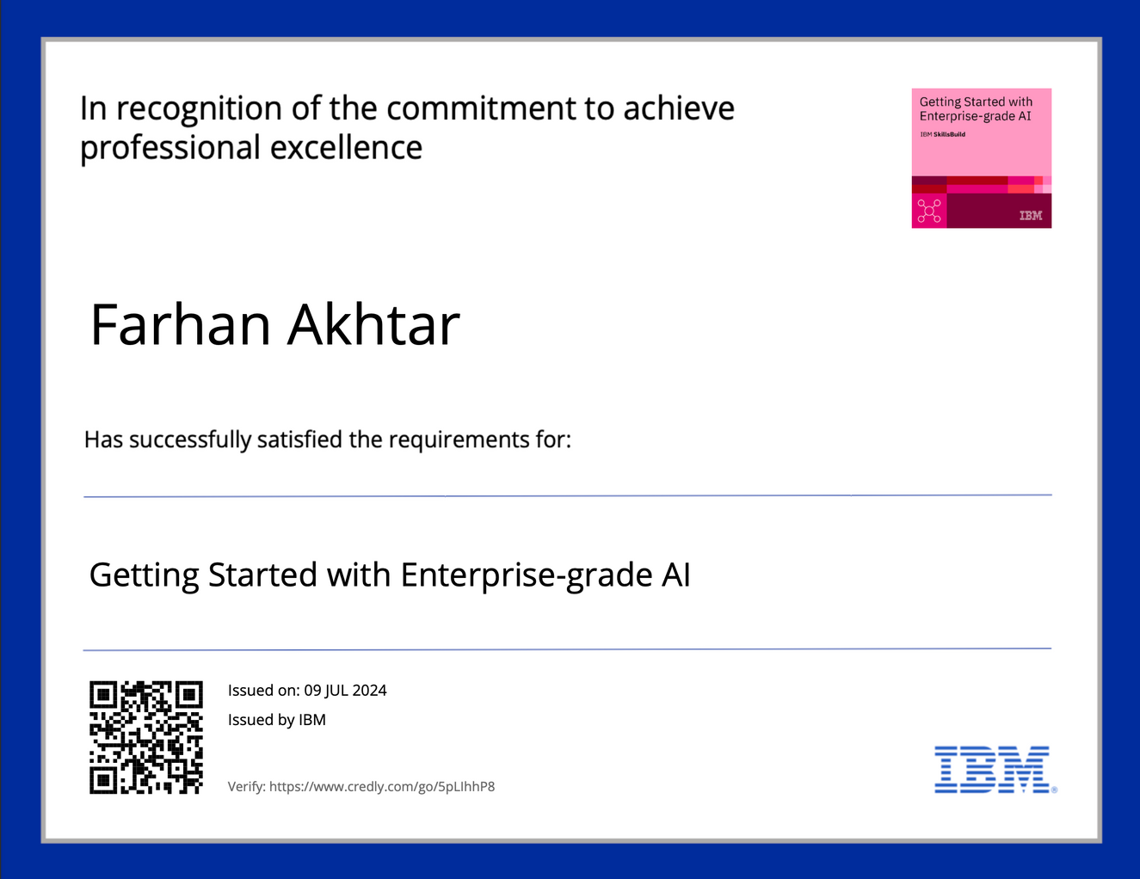
course certificate 2

Slide 35
Thank You

