Slide 1

Hierarchical Representation of Natural Images
Visual and Capable Hippopotamuses
NeuroMatch Academy
James Brissenden
Fahimeh Arab
Dennis Maharjan
Ming-Ray Liao
Majid Abbasi
Utilized Dataset: Kay et al., 2008
TAs: Chang-Hao Kao, Dalton Sakthivadivel
Mentors: Luis Gonzalo Sánchez Giraldo, Rafael Grigoryan

Slide 2
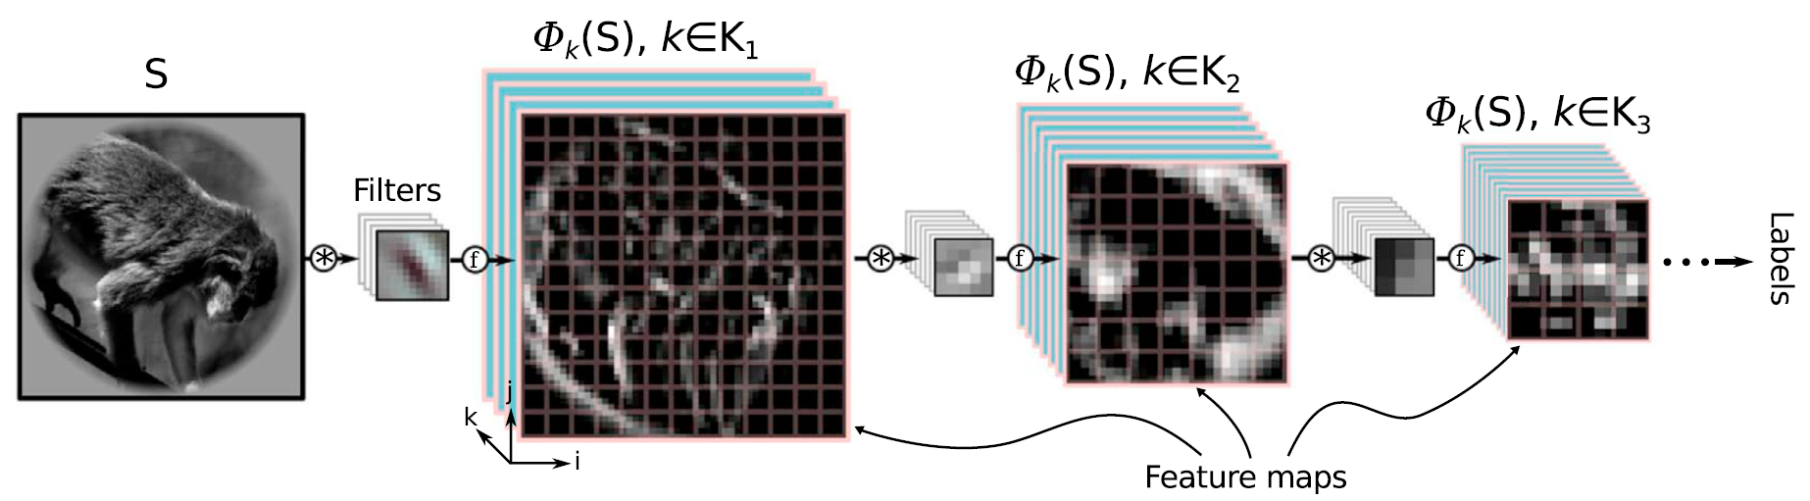
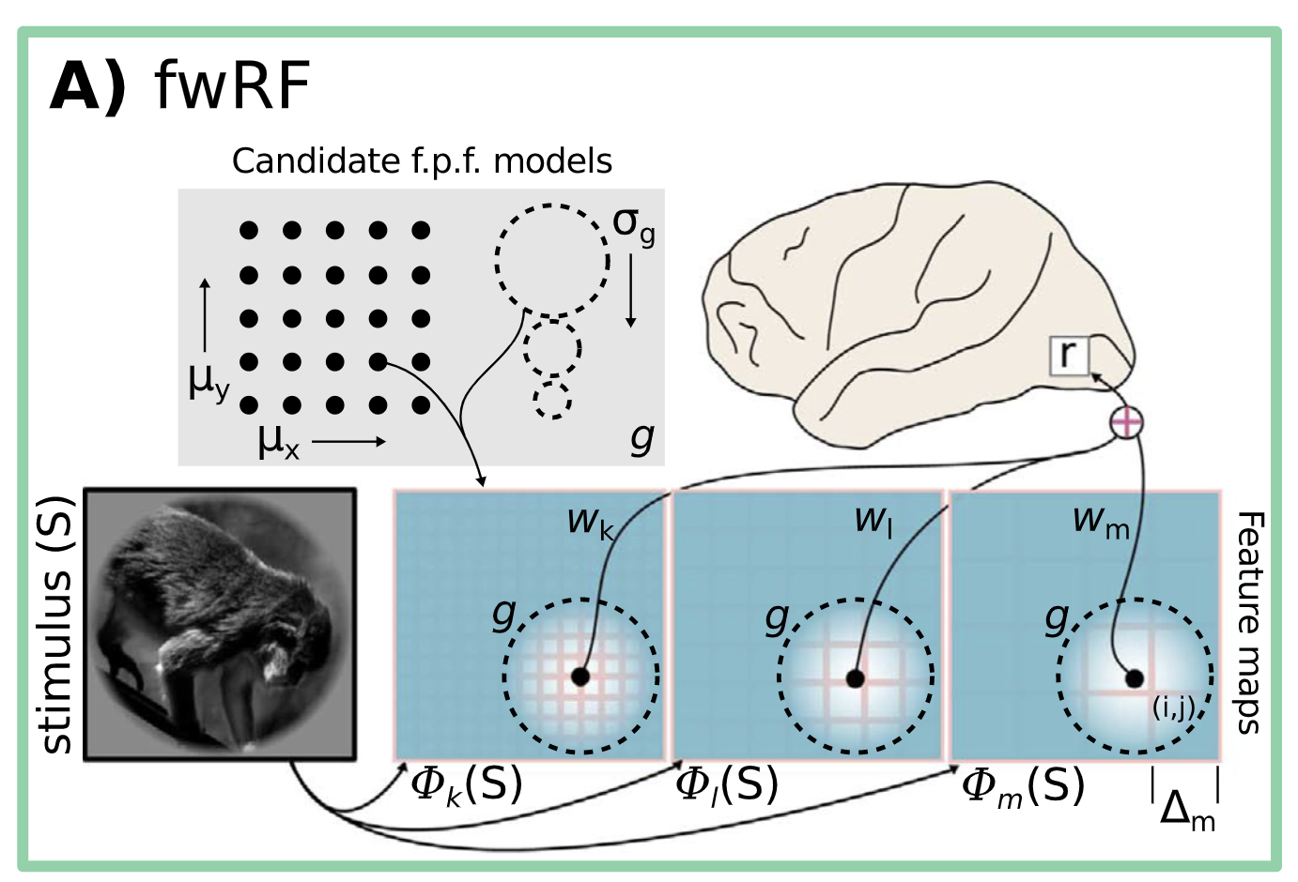

Can a DCNN feature-weighted receptive-field (fwRF) encoding model reveal the hierarchical representation of visual features across visual cortex?
Kay natural images --> pre-trained AlexNet
Activation from each convolution layer
Convolve w/ 2D Gaussian (i.e. feature pooling field)
Ridge regression relating features to voxel activity
Images from Kay et al (2008) Nature
fwRF with DCNN features;
St-Yves & Naselaris (2018) Neuroimage
Notes:
Deep Convolutional Neural Networks (DCNNs) and primate brains represent features of visual images hierarchically, and encoding models of functional Magnetic Resonance Imaging (fMRI) data can predict activity based on the stimuli presented. We sought to compare a DCNN feature-weighted receptive field (fwRF) encoding model with fMRI activity from the Kay dataset to reveal hierarchical representation of features across visual cortex.
There are many different encoding models but we chose to use the fwRF since it reduces dimensionality while retaining both feature and spatial information.
We first fed our Images through alexnet and extracted the features after relu and maxpooling for each convolutional layer. We then convolved the extracted features with a 2D gaussian feature pooling field, before fitting a ridge regression model relating these features to voxel activity. Through cross-validation we found the 2D Gaussian that produced the best fit to each voxel’s activity. We then aimed to assess how different layers contributed to the accurate prediction of brain activity across visual cortex.
##
Deep Convolutional Neural Networks (DCNNs) and primate brains represent features of visual images hierarchically, as we have seen in the intro of deep learning day. On that same day, we also learned about encoding models of functional Magnetic Resonance Imaging (fMRI) data that can predict activity based on the stimuli presented. There are many different encoding models but we chose to use a feature-weighted receptive field (fwRF) model because it reduces dimensionality while retaining both feature and spatial information.
We then sought to compare a DCNN fwRF encoding model with fMRI activity from the Kay dataset to reveal hierarchical representation of features across visual cortex.
We first fed our Images through alexnet and extracted the features after relu and maxpooling for each convolutional layer. We then convolved the extracted features with a 2D gaussian feature pooling field, before fitting a ridge regression model relating these features to voxel activity. Through cross-validation we found the 2D Gaussian that produced the best fit to each voxel’s activity. We then aimed to assess how different layers contributed to the accurate prediction of brain activity across visual cortex.

Slide 3
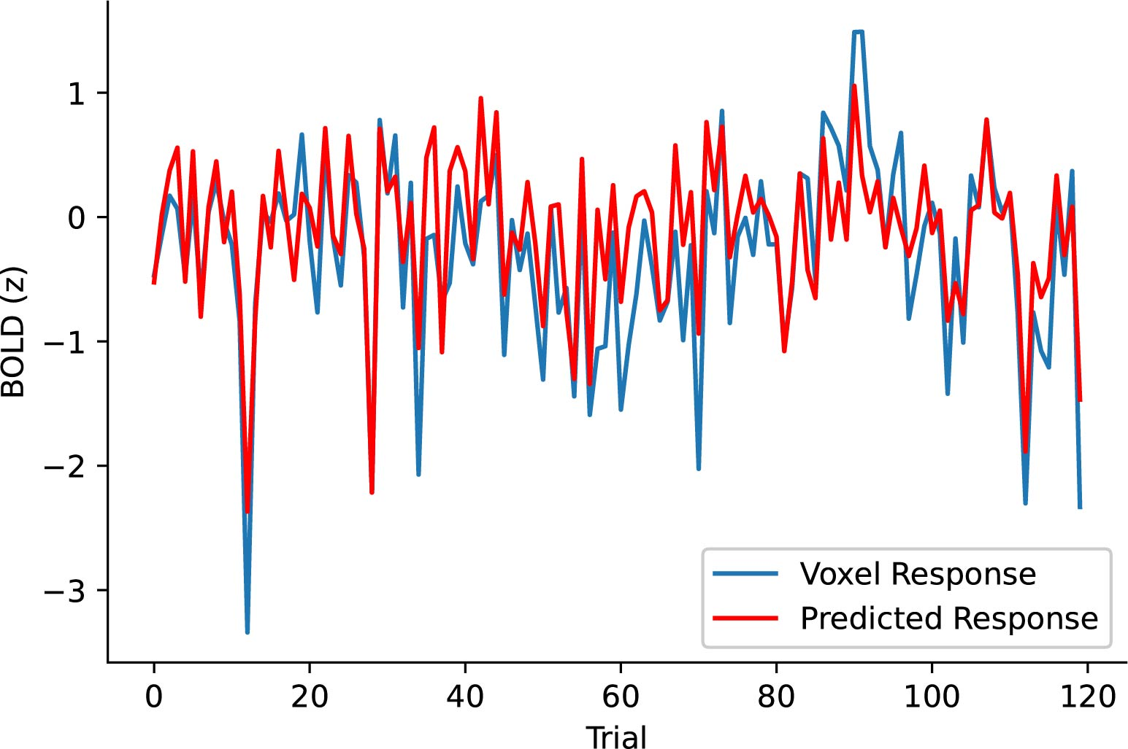
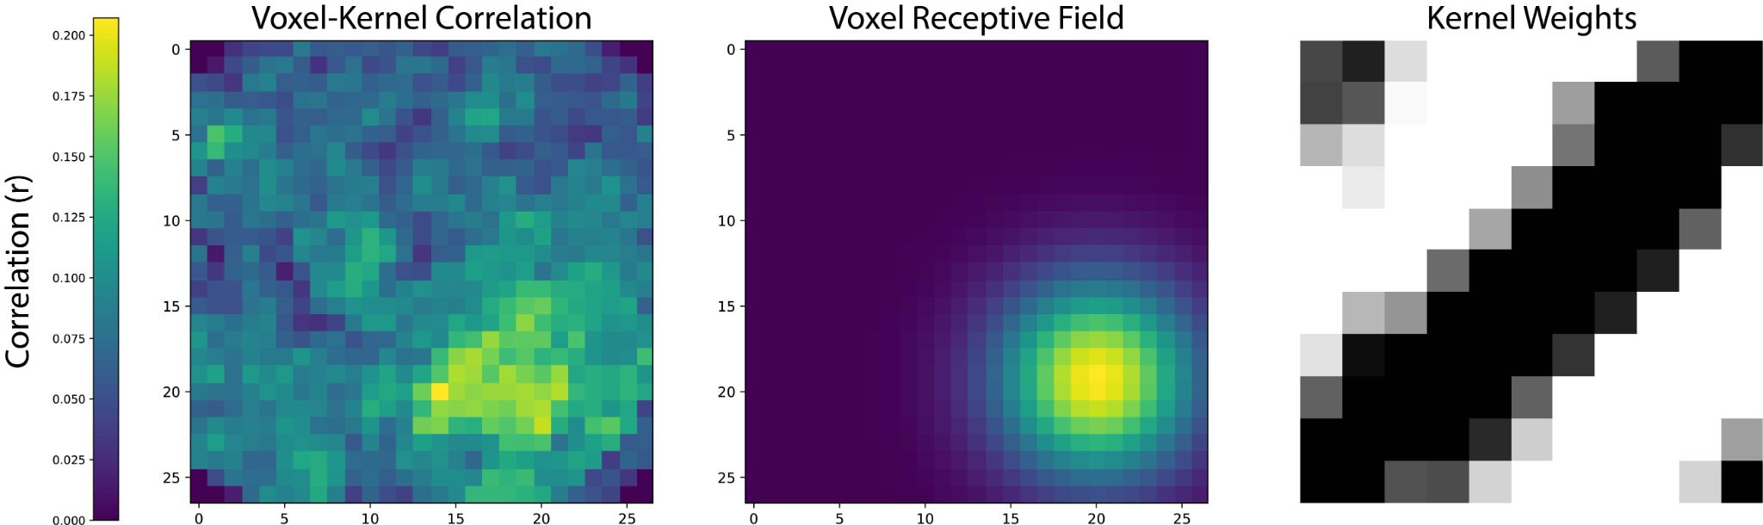
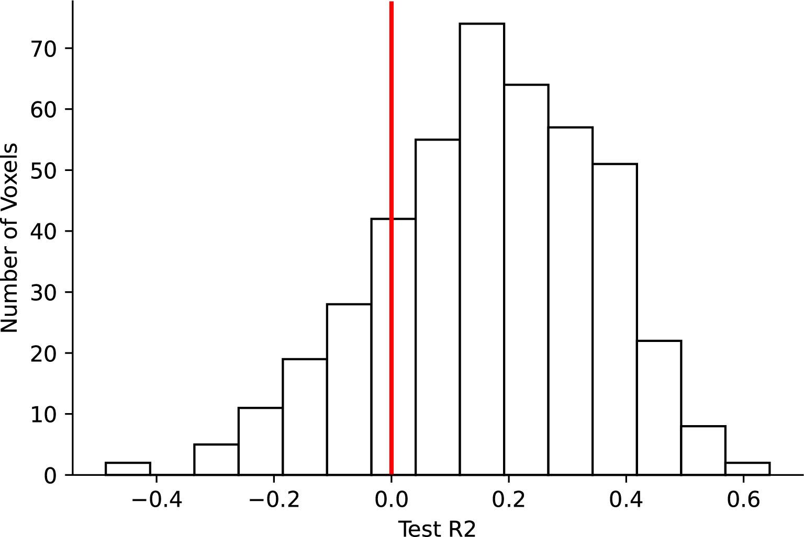
Sample voxel (1137)
Accurate prediction of test set activity
Test R²: 64.4%
fwRF model recovers voxel receptive field and feature tuning
Distribution of test performance
across V1 voxels
Correlation between one V1 voxel and each unit from layer 1 over all images
Best-fitting 2D Gaussian
Feature weights for best fitting kernel
Voxels: volumetric pixels from fMRI
Units: hidden layer units from DCNN
Kernels: convolutional filters
Notes:
(We then aimed to assess how different layers contributed to the accurate prediction of brain activity across visual cortex.) Before that though, we sought to evaluate (understand?) our encoding model by focusing on a sample voxel and the kernel that best predicts its response.
###
Here in the center we show the 2d gaussian (or receptive field) that produced the best fit for an example voxel. On the left we show an independent analysis that simply correlated this voxel’s timecourse with the timecourse for each unit in the 1st convolution layer (units in convolutional layer correspond with locations in the original image/visual field). We can see that our fwRF analysis accurately recovers the location preference of this voxel. On the right we show the feature weights corresponding to the kernel that this voxel is most correlated with. So our model recovers both the receptive field of each voxel as well as its feature representation.
When we then apply our encoding model to the test set we are able to accurately predict this particular voxel’s response to test set images. The model does reasonably well for around 25% of voxels in V1. Below we show the distribution of test set prediction performance for voxels selected on the basis of training set performance, and you can see that we are performing reasonably well.

Slide 4
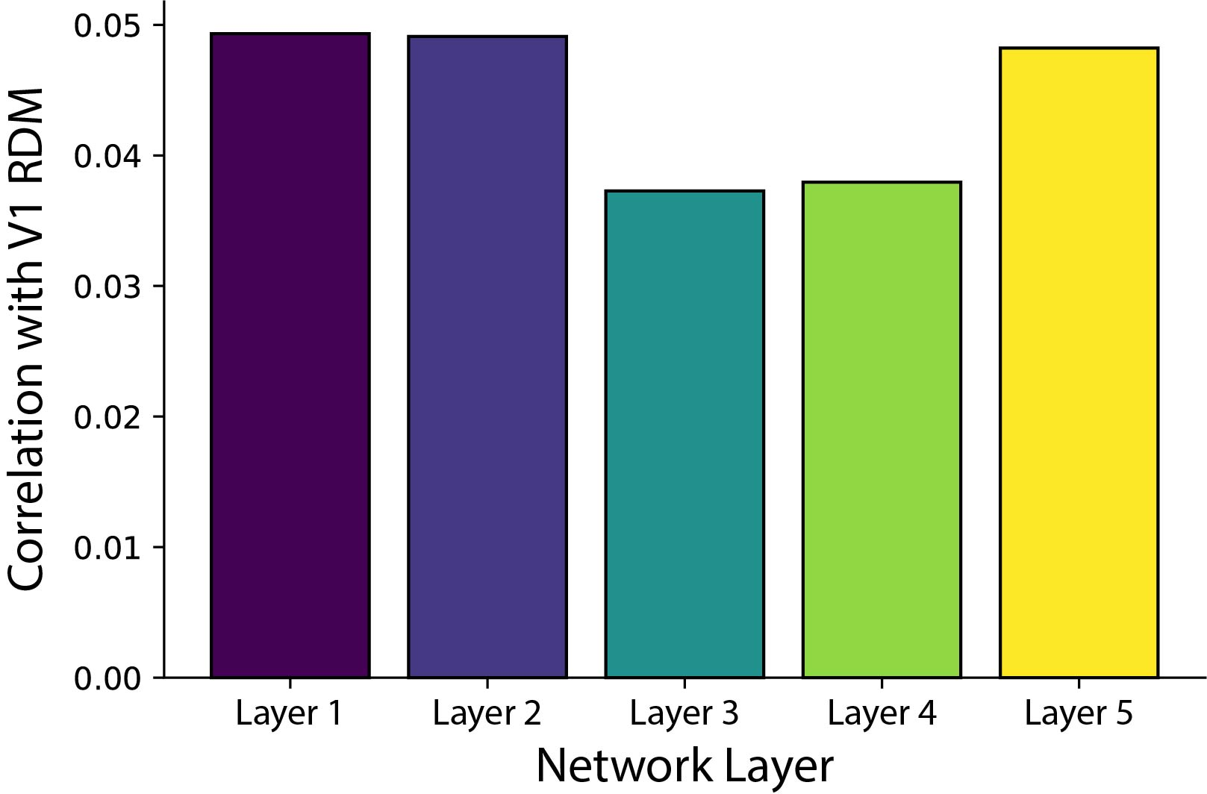
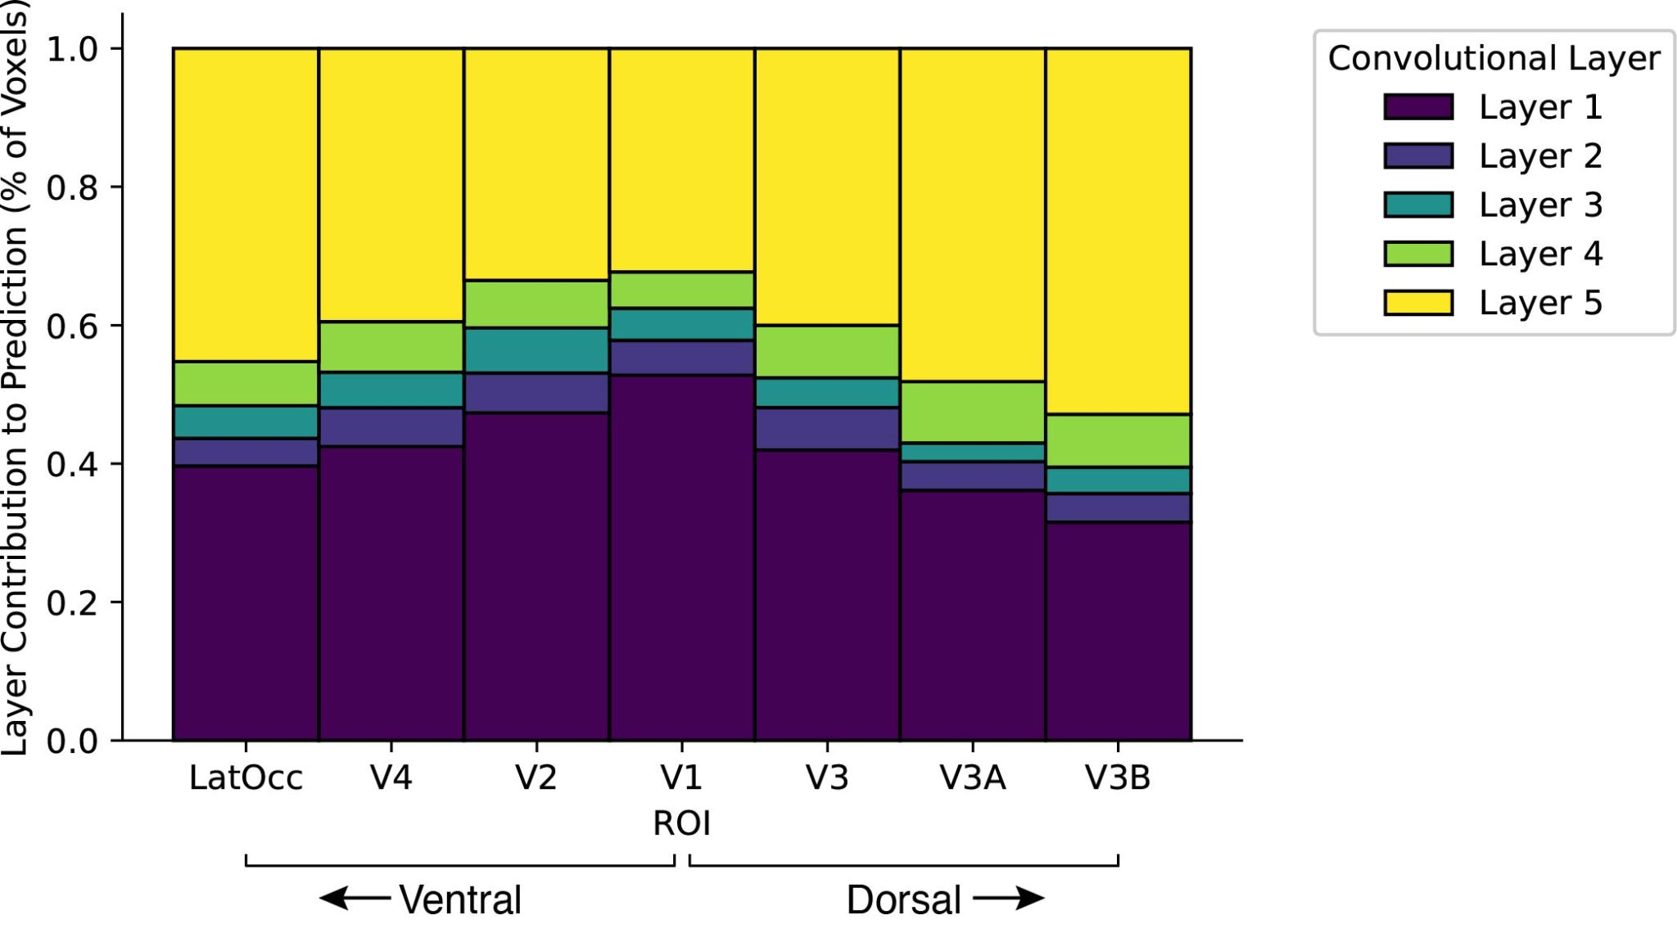
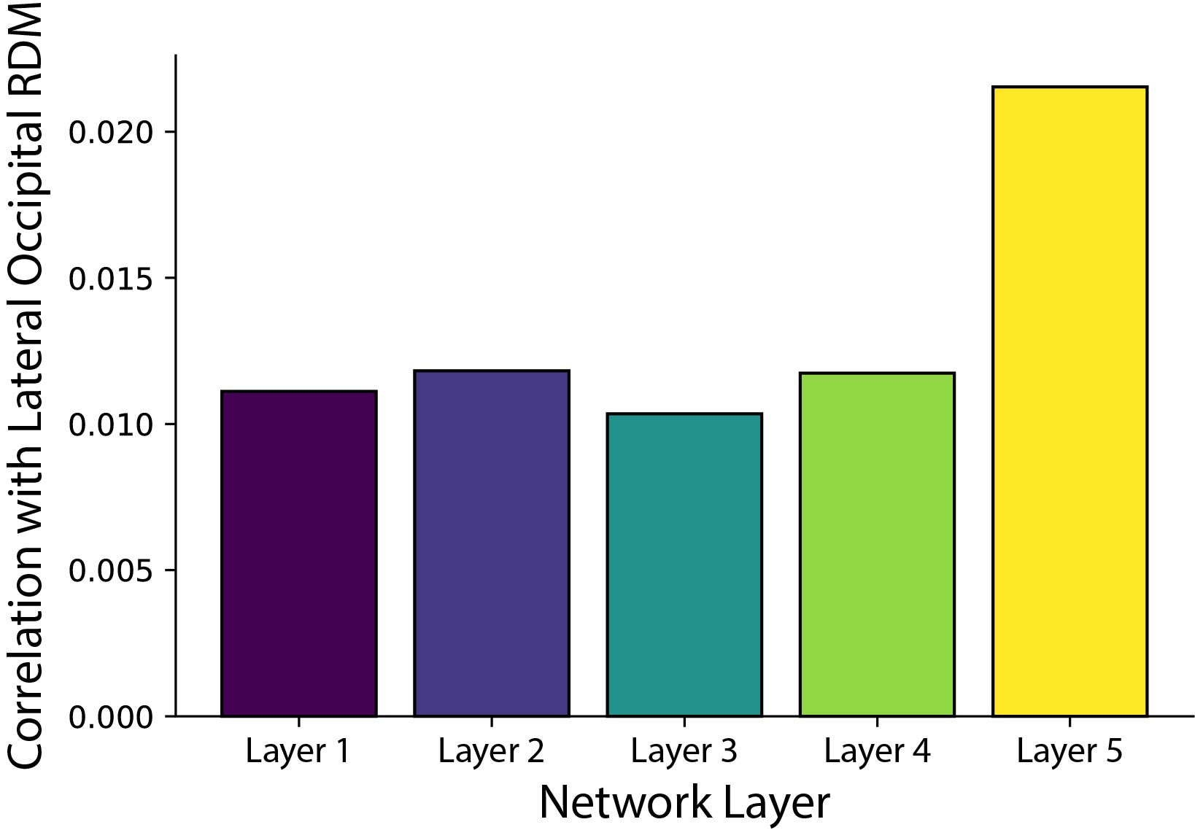
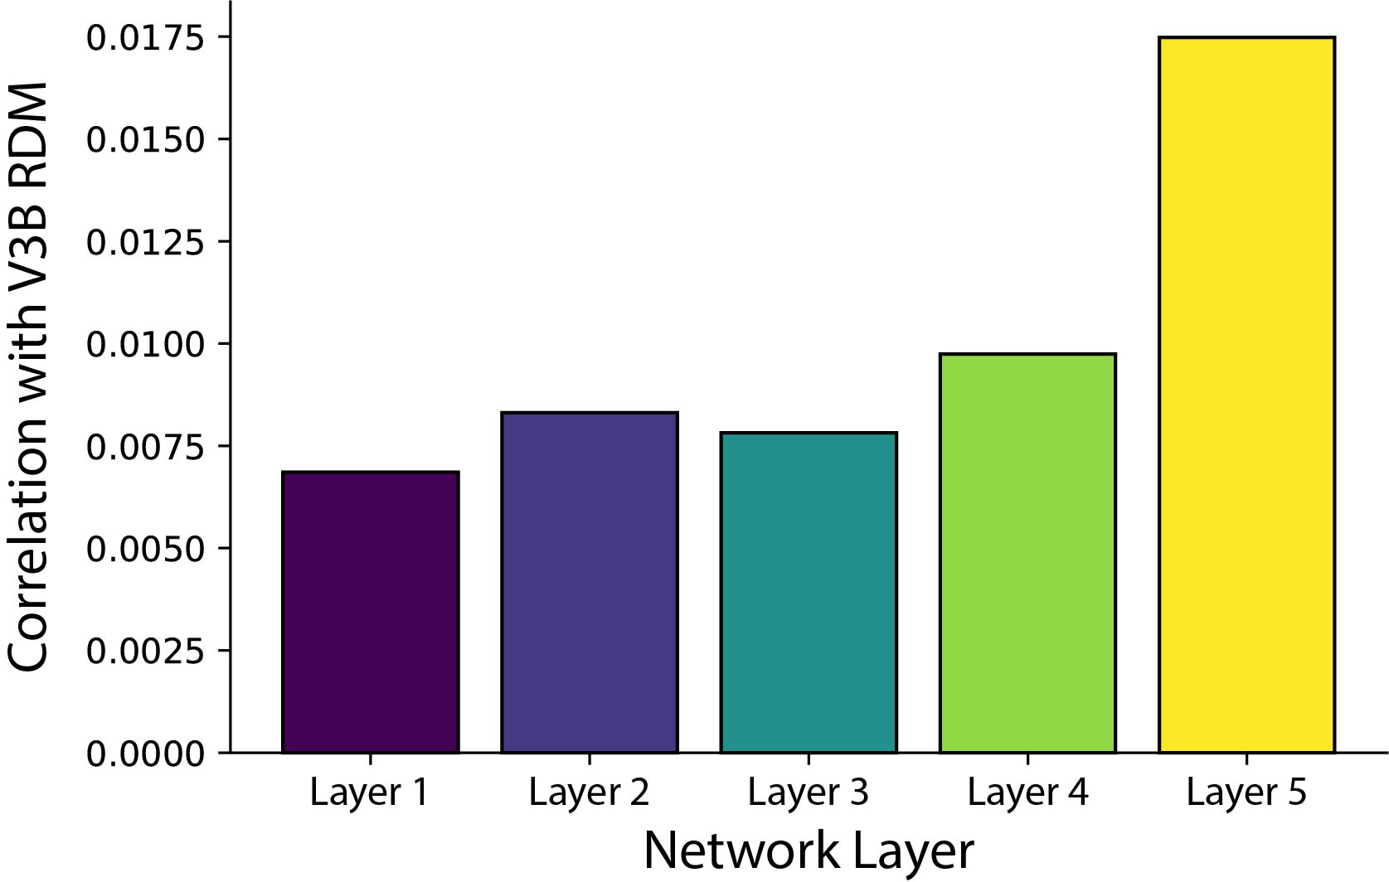
Correlations between DCNN layers and neural regions
V1
Lateral Occipital
V3B
Notes:
(Below we show the distribution of test set prediction performance for voxels selected on the basis of training set performance, and you can see that we are performing reasonably well.)
Here on the left we show which layer yielded the best prediction performance as a percentage of voxels in each region. We show that the first convolutional layer yielded the best prediction accuracy for a large majority of V1 voxels. In contrast, the final convolutional layer produced the best fit for the majority of voxels for higher order regions (e.g., V3A, V3B, LOC).
To confirm these findings, we also performed a representational dissimilarity analysis (RDA). Here we show correlation between brain RDMs and CNN RDMs for V1, V3B, and LatOcc. This analysis replicates the finding that representations in V1 are more similar to early convolutional layers, whereas higher order visual areas are representationally more similar to later convolutional layers.
######
We showed that the first convolutional layer yielded the best prediction accuracy for a large majority of V1 voxels. In contrast, the final convolutional layer produced the best fit for the majority of voxels for higher order regions (e.g., V3A, V3B, LOC). To confirm these findings, we also performed a representational dissimilarity analysis (RDA) and replicated the finding that early visual cortex contained representational structure similar to early convolutional layers, whereas higher order visual areas such as lateral occipital cortex were representationally more similar to later convolutional layers.

Slide 5
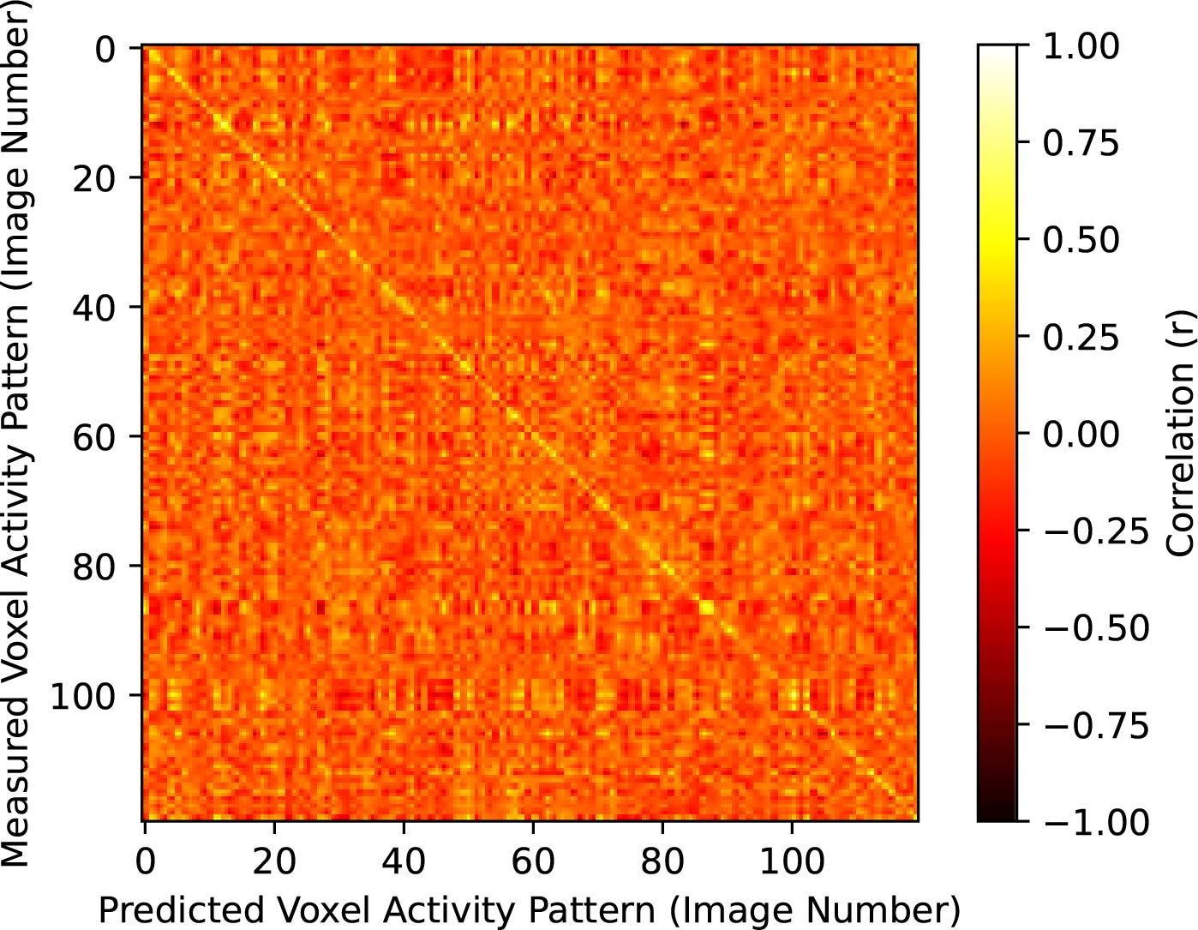
Predicted activity accurately identifies test set images
Feature selection
Train R² > 0.01
440 V1 voxels
Layer 1
Predictions displayed for
440 V1 voxels w/ train
R² > 0.01 (layer 1)
70% Accuracy (Chance accuracy is 1/120 or 0.83%)
Notes:
(whereas higher order visual areas are representationally more similar to later convolutional layers.)
Lastly, we performed a decoding analysis in which we correlated the actual pattern of brain activity for a particular test set image to the predicted pattern of activity for each possible test image. We then select the image corresponding with the highest correlation. The diagonal corresponds with the correct image. If the highest correlation for each row is on the diagonal that is a correct prediction.
For V1 and layer 1 we correctly identified 70% of test set images (where chance accuracy is 0.83%)

Slide 6
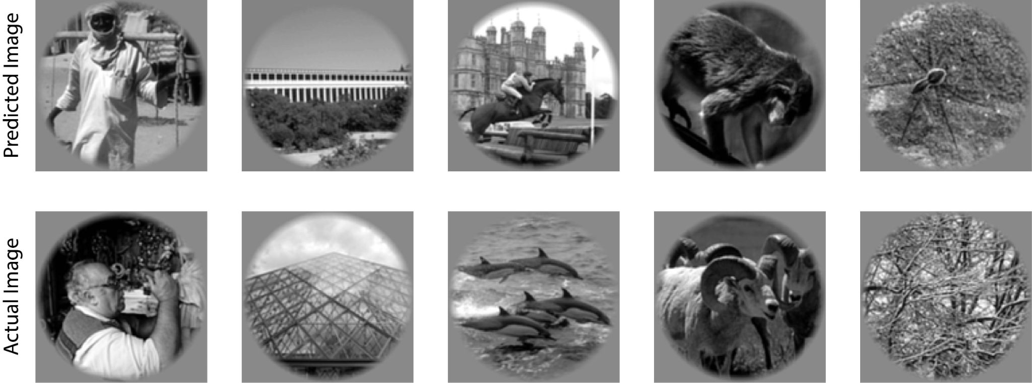
Subsample of model errors reveal perceptual similarities
Notes:
Although our decoding model performed relatively well, we were interested in the kinds of errors being made. Here we show a subsample of model errors and you can see perceptual similarities between the predicted and actual image.

Slide 7
Conclusions
Model accurately recovers voxel spatial and feature tuning preferences
Feature representation varied across regions
Region feature tuning could be linked with specific CNN layers
We corroborate others in affirming the validity of using DCNNs in the study of hierarchical representation of visual stimuli
Future Direction
Using generative adversarial networks (GANs) to reconstruct images from fMRI activity

Slide 8
Reference
Cichy, R. M., Khosla, A., Pantazis, D., Torralba, A., & Oliva, A. (2016). Comparison of deep neural networks to spatio-temporal cortical dynamics of human visual object recognition reveals hierarchical correspondence. Scientific reports, 6(1), 1-13.
Kay, K. N., Naselaris, T., Prenger, R. J., & Gallant, J. L. (2008). Identifying natural images from human brain activity. Nature, 452(7185), 352-355.
Krizhevsky, A., Sutskever, I., & Hinton, G. E. (2012). Imagenet classification with deep convolutional neural networks. Advances in neural information processing systems, 25, 1097-1105.
Naselaris, T., Prenger, R. J., Kay, K. N., Oliver, M., & Gallant, J. L. (2009). Bayesian reconstruction of natural images from human brain activity. Neuron, 63(6), 902-915.
Shen, G., Horikawa, T., Majima, K., & Kamitani, Y. (2019). Deep image reconstruction from human brain activity. PLoS computational biology, 15(1), e1006633.
St-Yves, G., & Naselaris, T. (2018). The feature-weighted receptive field: an interpretable encoding model for complex feature spaces. NeuroImage, 180, 188-202.
Wen, H., Shi, J., Zhang, Y., Lu, K. H., Cao, J., & Liu, Z. (2018). Neural encoding and decoding with deep learning for dynamic natural vision. Cerebral cortex, 28(12), 4136-4160.
Zuiderbaan, W., Harvey, B. M., & Dumoulin, S. O. (2017). Image identification from brain activity using the population receptive field model. Plos one, 12(9), e0183295.

Slide 9
