Slide 1
Swarm Bots
Fabrizzio Coronado, Kautilya Chappidi

Slide 2
Overview
Swarm project using burger turtlebot where each bot will follow a circular trajectory is our objective defined in the proposal. Future goal is to use these bots to scan and create a map. This is a useful application for exploring unknown dangerous areas
3 Classes:
Path
Independent CPP library
Creates user defined circular path list consisting of coordinates the bots will follow
User defines the radius and number of points
Control
Converts coordinates into velocity and creates a vector for bots to follow
Sends velocity commands to topic
Agent
Creates instances of each node
Each node will listen to same topic

Slide 3
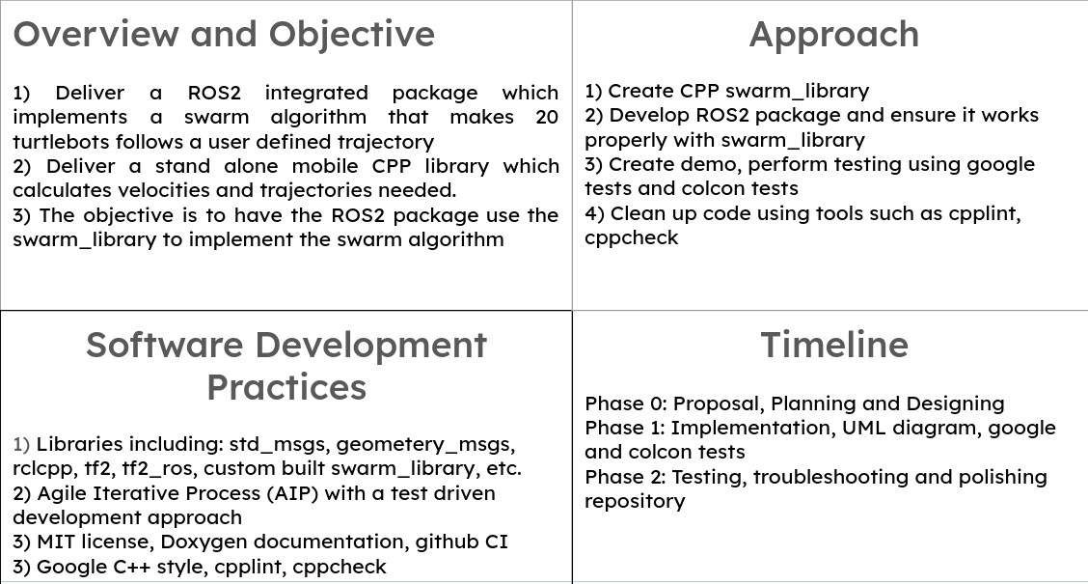
Quad Chart

Slide 4
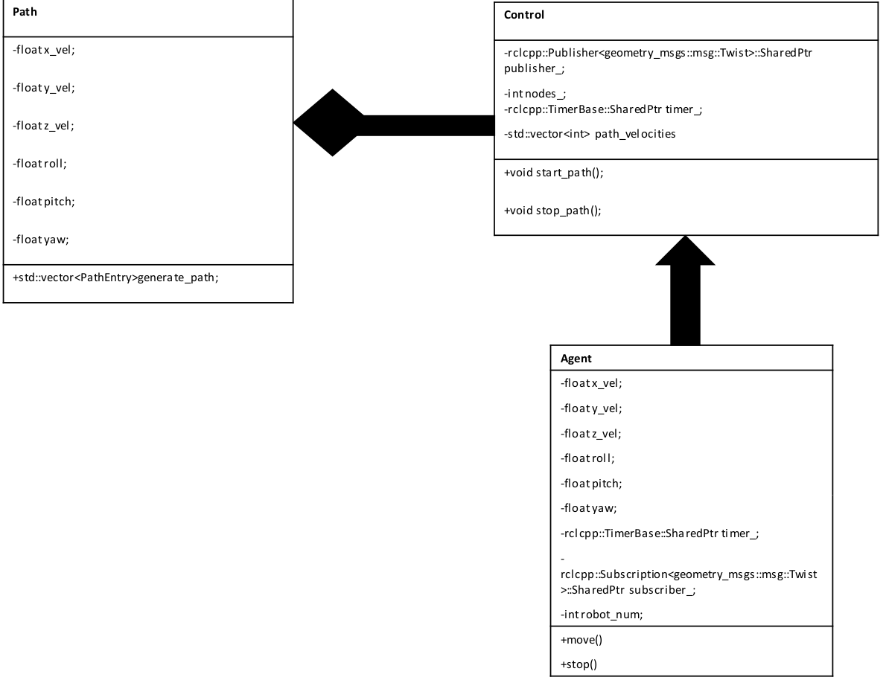
UML Design

Slide 5
Software Development Process
Test Driven Development Approach
Pair programming: driver, navigator
Agile Iterative Process
Time, iteration and product logging
Sprints and planning meetings
Phase 0 | Phase 1 | Phase 2
Planning | UML Design | Implementation
Proposal | Unit tests & Github CI | Debugging and Testing
 | Defining Classes | ROS2 Integration & Demo

Slide 6
Obstacles
Getting an accurate trajectory for the bots to follow
Creating multiple publishers resulted in segmentation faults
Aiming to have all bots listen to same topic so we only need one publisher
Spawning the robots

Slide 7
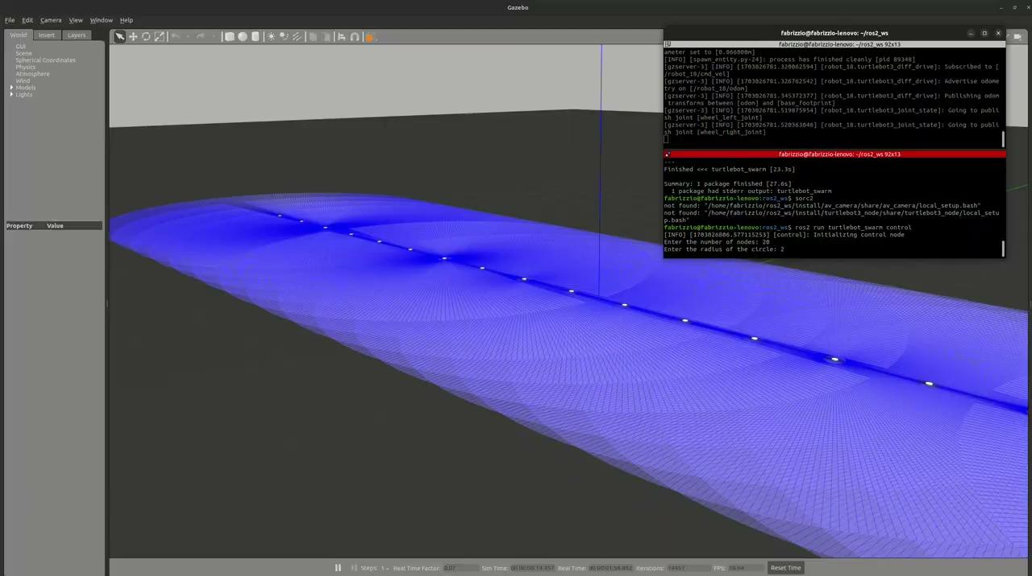
Demo Video

Slide 8
Questions?

