Slide 2


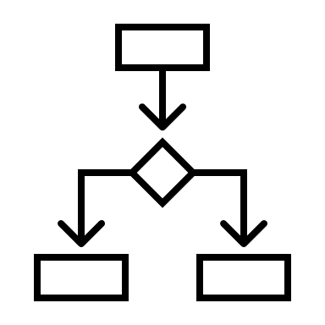
CDEs
Prediction modelling
Decision-support
Trial Inclusion

