Slide 1

Census Income Analysis
Francesco Gibellini

Slide 2
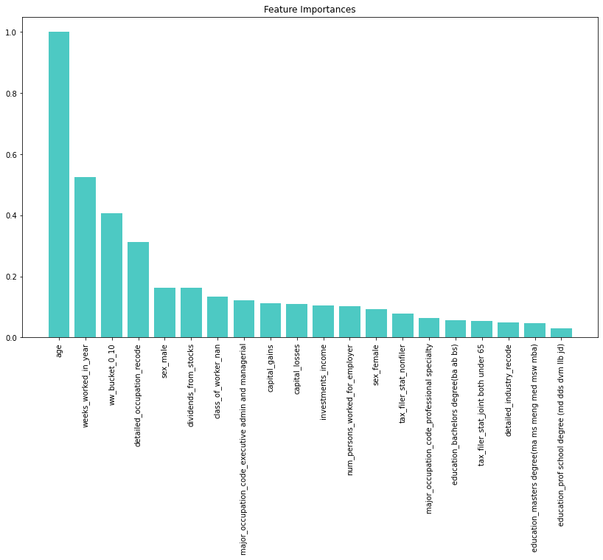
Executive Summary
Predicting Income Based on the Provided Datasets is possible with ~96% accuracy
Different data processing methods were tested
Different Machine Learning models were compared
The best performing models achieve 96% accuracy across this binary classification problem (beating baseline of 93%)
Different models available depending on precision vs recall prioritization
Feature Importances can help identifying the most relevant factors affecting income

Slide 3
Problem Definition
Data Insights
Features Engineering
Modeling
Conclusions
AGENDA

Slide 4
Problem Definition
Identifying Whether a Person will Earn More or Less than 50k $ / Year
Knowing whether someone’s income is exceeding $ 50k per year is an important task that can for example be used to detect tax evasion
Census data provided by the customer can be used in combination with advanced analytics techniques
A high imbalance is present in the target class as, a majority (93%) of the population earns less than $ 50k / year

Slide 5
Problem Definition
Data Insights
Features Engineering
Modeling
Conclusions
AGENDA

Slide 6
Data Ingestion
Expected column order based on metadata file had to be reviewed and improved
The columns ordering in the metadata file provided was shown to be incorrect
A heuristic method was developed to map the correct columns to their respective values
For discrete columns, values are checked against expected values in the metadata file
For continuous values, the ordinal location of the column in the table is considered for mapping, assuming a column will be near its expected location in ordinal sense (after mapping discrete values)
Before
After
Age | Work Class | Education
Private | High School Grad | 55
Self Employed | Bachelors Degree | 26
Government | Associates Degree | 39
Age | Work Class | Education
55 | Private | High School Grad
26 | Self Employed | Bachelors Degree
39 | Government | Associates Degree

Slide 7
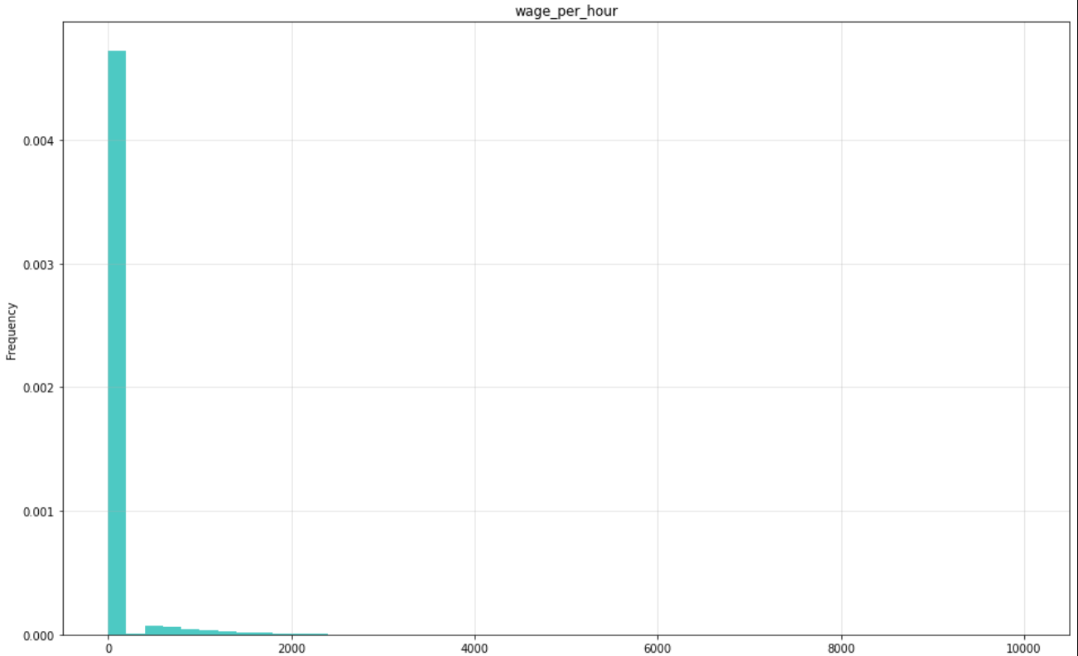
Data Insights
Few features are exponentially distributed, outliers handling might be required

Slide 8
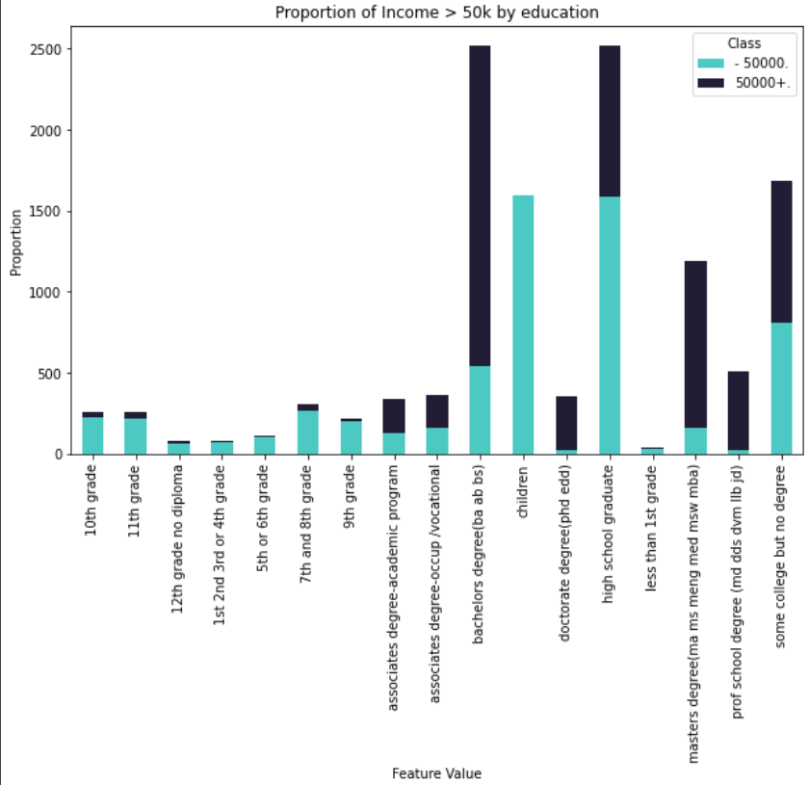
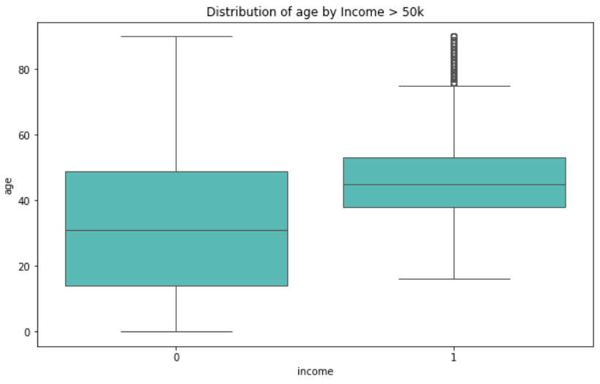
Data Insights
Several Features are correlated to the target class
This was verified by Pearson Correlation for Continuous variables and Chi Squared test for discrete ones
Plots were also produced to visually inspect test results

Slide 9
Problem Definition
Data Insights
Features Engineering
Modeling
Conclusions
AGENDA

Slide 10
Features Engineering
Several Features were engineered in order to try improving decision boundaries
Discrete Features were One Hot Encoded to ensure high compatibility with a variety of ML models
Continuous Features were scaled in 0 to 1 range to ensure numerical consistency
Age buckets were created to discretize the concept of age
Yearly worked weeks buckets were created similarly
The concept of total investment income was introduced summing capital gains and dividends, subtracting capital losses, buckets were created from this variable
Marital status was simplified, mapping different values to a simple ‘married’ / ‘unmarried’ column
Worker class (Government / Private / Self-Employed) was also remapped to more general columns
Total salary was calculated as wage per hour * weeks worked * hours/week (assumed 40)

Slide 11
Features Selection
Based on experiments, features selection does not yield performance benefits
The dataset obtained with the previously mentioned features has 425 dimensions
Feature importance of the best performing model(s) was used to determine the most relevant features to select
Experiments were conducted to decide whether all these features are required (more details in modeling section)

Slide 12
Problem Definition
Data Insights
Features Engineering
Modeling
Conclusions
AGENDA

Slide 13

Modeling
Multiple interpretable models were tested to ensure capability of extracting features relevance
Logistic Regression, simple linear model, has problems with non-linear relationships
Decision Tree, good interpretable model
Random Forest, ensemble of decision trees trained indipendently, less easily interpreted than individual trees
Boosted Decision Trees (CatBoost) , ensemble of decision trees trained sequentially, less easily interpreted than individual trees
Models were first trained on original dataset without any features engineering (baselines experiment)
Then features engineering was applied, first adding new features then trying features selection
Last hyperparameters were optimized for the best performing model from above experiments to find the best settings to use in the final model

Slide 14
Modeling – Baseline Model Selection
CatBoost consistently outperforms other models in F1-Score, other models have better precision but lower recall
1 - CatBoost
F1-Score: 0.58
Precision: 0.46
Recall: 0.77
Confusion Matrix:
2 - Logistic Regression
F1-Score: 0.42
Precision: 0.89
Recall: 0.28
Confusion Matrix:
3 - Decision Tree
F1-Score: 0.41
Precision: 0.84
Recall: 0.27
Confusion Matrix:
4 - Random Forest
F1-Score: 0.20
Precision: 0.11
Recall: 0.86
Confusion Matrix:
 | Pred N | Pred P
True N | 0.93 | 0.03
True P | 0.01 | 0.03
 | Pred N | Pred P
True N | 0.80 | 0.01
True P | 0.14 | 0.05
 | Pred N | Pred P
True N | 0.80 | 0.01
True P | 0.14 | 0.05
 | Pred N | Pred P
True N | 0.94 | 0.05
True P | 0.00 | 0.01

Slide 15
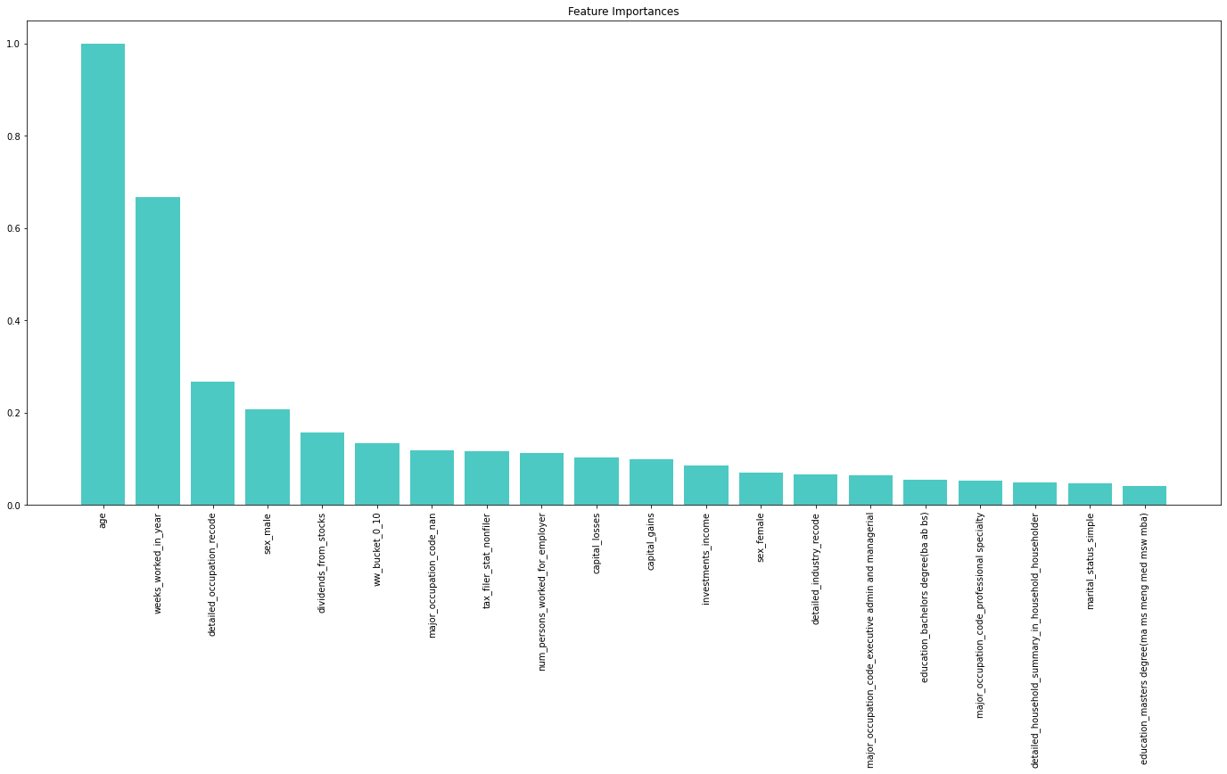
Modeling – Features Engineering
Models with engineered features do not outperform existing baselines possibly due to new features not being very important

Slide 16
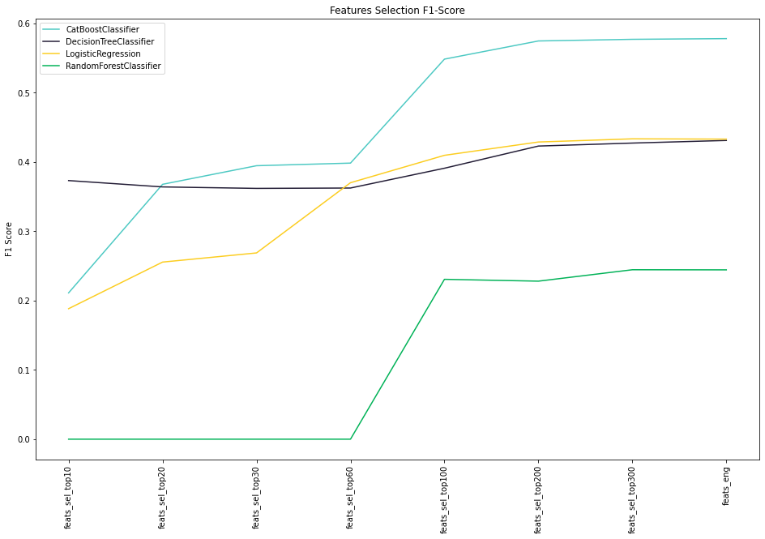
Modeling – Features Selection
Selecting features doesn’t improve performance in any of the models used
Baseline

Slide 17
Modeling – Hyperparameters Tuning
HP Tuning was applied to CatBoost to search for best model settings
Experiments were conducted using the Bayesian search optimizer from the Optuna library
The optimizer efficiently searches the hyperparameters space for the best values, being faster than grid search (brute force)
The optimizer was run for 100 search iterations of 3-fold stratified cross validation, balancing results robustness and computational speed
The best hyperparameters found for the CatBoost classifier were:
CatBoost Test Set
F1-Score: 0.59
Precision: 0.48
Recall: 0.76
Confusion Matrix:
 | Pred N | Pred P
True N | 0.93 | 0.03
True P | 0.01 | 0.03
N Estimators | Depth | Learn. Rate | L2 Leaf Reg
2486 | 4 | 0.12 | 0.95

Slide 18
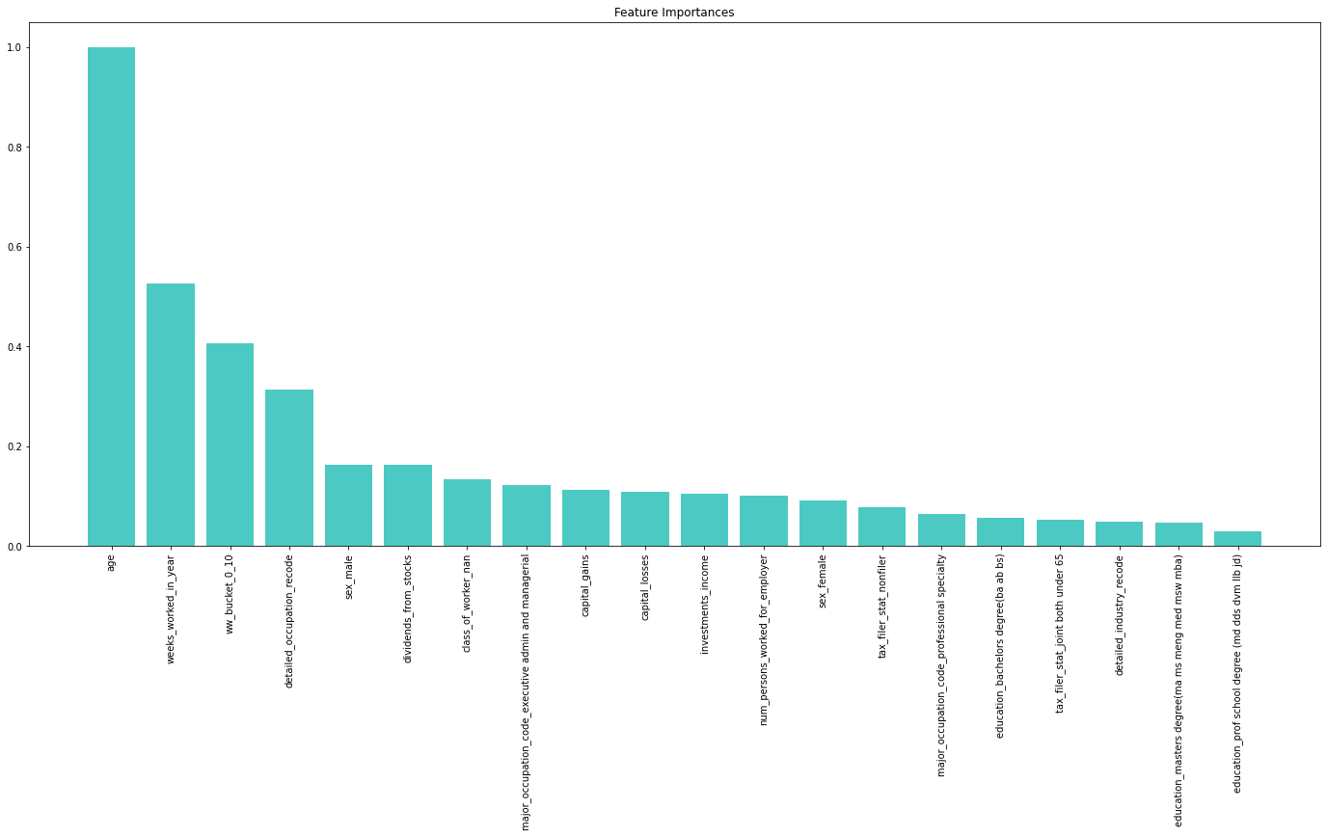
Modeling – Features Importances Best Model

Slide 19
Problem Definition
Data Insights
Features Engineering
Modeling
Conclusions
AGENDA

Slide 20
Conclusions and Next Steps
The main characteristics associated with a person making more or less than $ 50k were found in the provided datasets via feature importance analysis
Different interpretable Machine Learning models were trained to answer the research question
The so obtained models are capable of identifying correctly 96% of all test data
If a higher accuracy is required, the generation of more advanced features could be explored
Additional datasets could be merged with the current one in order to create more features
Less interpretable models (e.g. Deep Learning) could be used, in conjunction with explainability techniques like SHAP

Slide 21

Thank you for your attention
Q & A
Notes:
Transactions_2021 : 9
Transactions_2022 : 9
Merchant_info : 5
Cardholder_info : 7
Least frequent reward program : dining_entertainment (if trainees find a different one, if means they have computed their analysis only on the sample, and not the whole data)

