Slide 1
Stripe_8block
Training
Validation

Slide 2
Stripe_4block
Training
Validation

Slide 3
Stripe_2block
Training
Validation

Slide 4
Stripe_1block
Training
Validation

Slide 5
1-block permutations
2-block permutations
Training
Training
Validation
Validation
4-block permutations
8-block permutations
Training
Training
Validation
Validation

Slide 6
25Stripe_8block
Training
Validation

Slide 7
25Stripe_4block
Training
Validation

Slide 8
25Stripe_2block
Training
Validation

Slide 9
25Stripe_1block
Training
Validation

Slide 10
1-block permutations
2-block permutations
Training
Training
Validation
Validation
4-block permutations
8-block permutations
Training
Training
Validation
Validation

Slide 11
01mat_1block
Training
Validation

Slide 12
01mat_2block
Training
Validation

Slide 13
01mat_4block
Training
Validation

Slide 14
01mat_8block
Training
Validation

Slide 15
1-block permutations
2-block permutations
Training
Training
Validation
Validation
4-block permutations
8-block permutations
Training
Training
Validation
Validation

Slide 16
stripe_1block95ratio
Training
Validation

Slide 17
stripe_99ratio1block
Training
Validation

Slide 18
Training
Training
Validation
Validation

Slide 19
audio_16block
Training
Validation

Slide 20
audio_8block
Training
Validation

Slide 21



混合系
分離系

Slide 22









Frequency
･･･
$$j−τ$$
$$j$$
$$j+τ$$
Time
･･･
Frequency
･･･
$$j−τ$$
$$j$$
$$j+τ$$
Time

Slide 23
Frequency
･･･
$$j−τ$$
$$j$$
$$j+τ$$
Time
･･･
Frequency
･･･
$$j−τ$$
$$j$$
$$j+τ$$
Time

Slide 24
Frequency
･･･
$$j−τ$$
$$j$$
$$j+τ$$
Time
･･･
Frequency
･･･
$$j−τ$$
$$j$$
$$j+τ$$
Time

Slide 25
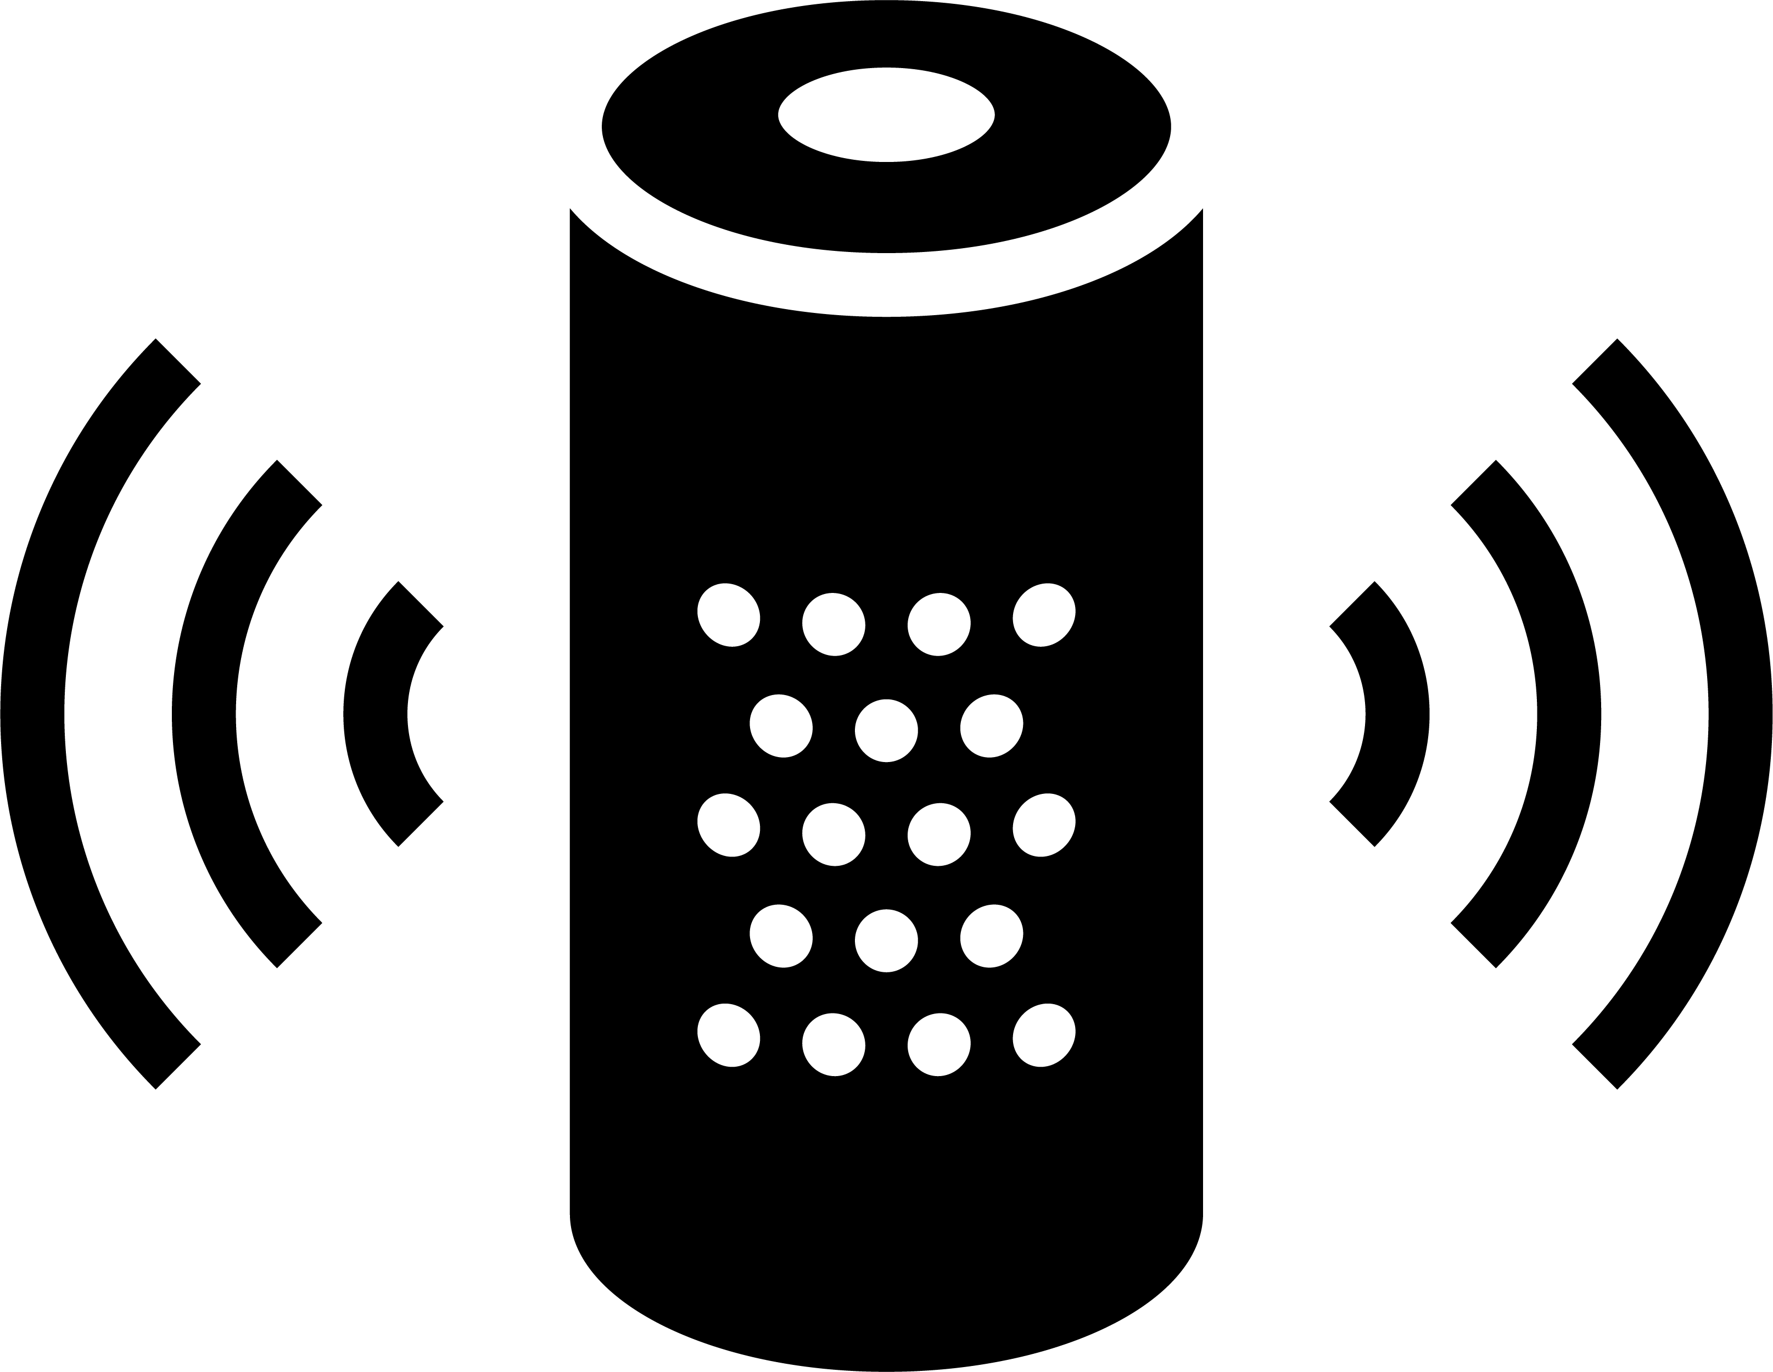

Hearing aid
Smart speaker

Slide 26

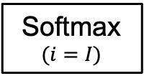
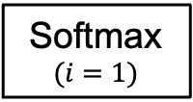
Three hidden layers
･･･
Softmax
$$(i=1)$$
･･･
ReLU
1st dense layer
3st dense layer
･･･
ReLU
Output layer
･･･
Input vector
Output vector
･･･
･･･
Softmax
$$(i=I)$$

Slide 27























元のパワポ
Output vector
Frequency
Frequency
Frequency
･･･
Time
$$j−τ$$
$$j$$
$$j+τ$$
$$j−τ$$
$$j$$
$$j+τ$$
Time
$$j−τ$$
$$j$$
$$j+τ$$
Time
Frequency
Frequency
Frequency
･･･
Time
$$j−τ$$
$$j$$
$$j+τ$$
$$j−τ$$
$$j$$
$$j+τ$$
Time
$$j−τ$$
$$j$$
$$j+τ$$
Time

Slide 28
MSE

Slide 29




Stride
0
1
0
1
0
0
1
0
1
0
0
1
0
1
0
0
1
0
1
0
Frequency
Majority
decision
･･･
Time

Slide 30





$$×$$
･･･
$$+$$
$$×$$
･･･
$$×$$
$$+$$
$$×$$

Slide 31





Time domain
Time-frequency domain
Waveform
…
…
Frequency
Discrete Fourier transform
Window function
Time
Spectrogram
Discrete Fourier transform
complex-valued matrix
Shift length
Discrete Fourier transform
Short-time length

Slide 32




Frequency
$$j−τ$$
$$j$$
$$j+τ$$
Time
Frequency
$$j−τ$$
$$j$$
$$j+τ$$
Time

Slide 33
100
100
Row
Row
50
50
0
0
0
50
100
0
50
100
Column
Column

Slide 34
100
100
Row
Row
50
50
0
0
0
50
100
0
50
100
Column
Column

Slide 35
100
100
Row
Row
50
50
0
0
0
50
100
0
50
100
Column
Column
Zoom in
Zoom in

Slide 36
100
50
Row
0
0
0
50
100
Column
100
100
50
50
Row
Row
0
0
0
0
50
100
0
50
100
Column
Column

