Slide 1
practice
Article development led by ACM queue queue.acm.org
addressing their risks, and improving their ways of working. For that, they need an effective thinking framework that bridges the gap between their current way of working and any new ideas they want to adopt. This article presents such a thinking framework in the form of an actionable kernel, which could benefit any team wishing to balance their risks and improve their way of working.
Work on the kernel, the essence of software engineering, was inspired by and is a direct response to the Software Engineering Methods and Theory (SEMAT) call for action (see Figure 1). It is, in its own way, one small step toward redefining software engineering.
SEMAT was founded in September 2009 by Ivar Jacobson, Bertrand Meyer, and Richard Soley, who felt the time had come to fundamentally change the way people work with softwaredevelopment methods.3,4,8 They wrote
a call for action statement, which in a few lines identifies a number of critical problems, explains why there is a need to act, and suggests what needs to be done. The call for action is:
Some areas of software engineering today suffer from immature practices.
Specific problems include:
˲ The prevalence of fads more typical of the fashion industry than an engineering discipline;
˲ The lack of a sound, widely accepted theoretical basis;
˲ The huge number of methods and method variants, with differences little understood and artificially magnified;
˲ The lack of credible experimental evaluation and validation; and
˲ The split between industry practice and academic research.
The SEMAT call for action’s assertion that the software industry is prone to fads and fashions has led some people to assume that SEMAT is resistant to new ideas. This could not be further
from the truth. As you will see in this article and in a soon-to-be-published book (The Essence of Software Engineering—Applying the SEMAT Kernel),6 SEMAT supporters are very keen on new
A thinking framework in the form
of an actionable kernel.
bY Iver Jacobson, Pan-Wei NG, Paul E. Mcmahon,
Ian Spence, and Svante Lidman
The Essence
of Software
Engineering:
The Semat
Kernel
e Ve rYone Who deVeLops software knows it is a complex and risky business, and its participants are always on the lookout for new ideas that will lead to better software. Fortunately, software engineering is still a young and growing profession that sees innovations and improvements in best practices every year. Just look, for example, at the improvements and
benefits that lean and agile thinking have brought to software-development teams. Successful software-development teams need to strike a balance between quickly delivering working software systems, satisfying their stakeholders,

Slide 2


Slide 3
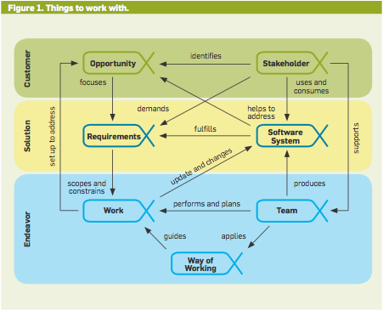
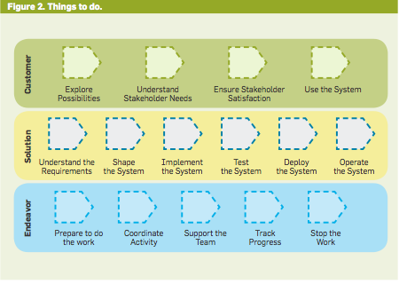
practice
this vision, SEMAT focused on two major goals: Finding a kernel of widely agreed-upon elements, and defining a solid theoretical basis.
To a large extent these two tasks are independent of each other. Finding the kernel and its elements is a prag- matic exercise requiring experienced software developers with knowledge of many of the existing methods. Defin- ing the theoretical basis is academic research and may take many years to reach a successful outcome.
^{The Power of the common Ground}
SEMAT’s first step was to identify a common ground for software engi- neering. This common ground is mani- fested as a kernel of essential elements that are universal to all software-devel- opment efforts, and a simple language for describing methods and practices. The kernel was first published in the SEMAT OMG (Object Management Group) submission.2,9 As shown in figures 1 and 2, the kernel contains a small number of “things we always work with” and “things we always do” when developing software systems. Work is also ongoing to define the “skills we always need to have,” but this will have to wait until future versions of the kernel.
More than just a conceptual model, the kernel provides:
˲ A thinking framework for teams to reason about the progress they are making and the health of their endeav- ors;
˲ Common ground for the discus- sion, improvement, comparison, and sharing of software-engineering meth- ods and practices;
˲ A framework for teams to assemble and continuously improve their way of working by the composition of sepa- rately defined, and sourced, practices;
˲ A foundation for defining practice- independent measures to assess the quality of the software produced and the methods used to produce it; and
˲ Most importantly, a way of helping teams understand where they are, what they should do next, and where they need to improve.
^{The big idea}
What is it that makes the kernel more than just a conceptual model of soft- ware engineering? What is it that is re-
ideas. What they are against is the non- lean, non-agile behavior that comes from people adopting inappropriate solutions just because they believe these solutions are fashionable—or because of peer pressure or political correctness.
SEMAT supports a process to rede- fine software engineering based on a solid theory, proven principles, and best practices that:
˲ Include a kernel of widely agreed- upon elements, extensible for specific uses;
˲ Address both technology and peo- ple issues;
˲ Are supported by industry, aca- demia, researchers, and users; and
˲ Support extension in the face of changing requirements and technol- ogy.
The SEMAT call for action received a broad base of support, including a growing list of signatories and sup- porters (http://www.semat.org). In February 2010 the SEMAT founders developed the call for action into a vi- sion statement.5 In accordance with

Slide 4
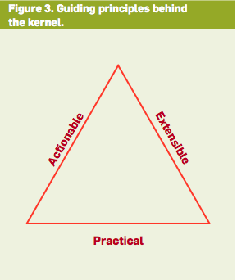
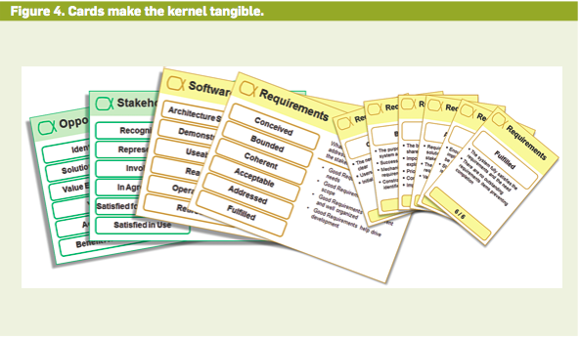
ally new here? This can be summed up in its founding principles (see Figure 3), which really bring out three unique features of the kernel: it is actionable; it is extensible; and it is practical.
The kernel is actionable. A unique feature of the kernel is the way that it handles the “things to work with.” These are captured as alphas rather than work products (such as docu- ments). An alpha is an essential ele- ment of the software-engineering endeavor—one that is relevant to an assessment of its progress and health. As shown in Figure 1, SEMAT has iden- tified seven alphas: opportunity, stake- holders, requirements, software sys- tem, work, way of working, and team.
The alphas are characterized by a simple set of states that represent their progress and health. As an example, the software system moves through the states of architecture selected: demon- strable, usable, ready, operational, and retired. Each state has a checklist that specifies the criteria needed to reach the state. These states make the ker- nel actionable and enable it to guide the behavior of software-development teams.
The kernel presents software devel- opment not as a linear process but as a network of collaborating elements that need to be balanced and maintained so teams can make effective and efficient progress, eliminate waste, and devel- op great software. The alphas in the kernel provide an overall framework for driving and progressing software- development efforts, regardless of the practices applied or the philosophy fol- lowed.
As practices are added to the kernel, alphas will be added to represent the things that either drive the progress of the kernel alphas or inhibit their prog- ress. For example, the requirements alpha will not be addressed as a whole but will move forward item by item. The progress of the individual require- ment items will either drive or inhibit the progress and health of the require- ments alpha. The requirements items could be of many different types: for example, features, user stories, or use- case slices, all of which can be repre- sented as alphas and have their states tracked. The benefit of relating these smaller items to the coarser-grained kernel elements is that it allows the tracking of the health of the endeavor as a whole. This provides a necessary balance to the lower-level tracking of the individual items, enabling teams to understand and optimize their ways of working.
The kernel is extensible. Another unique feature of the kernel is the way it can be extended to support different projects (for example, new develop- ment, legacy enhancements, in-house development, offshore development, software product lines, and so on). The kernel allows you to add practices, such as user stories, use cases, component- based development, architecture, pair- programming, daily stand-up meet- ings, self-organizing teams, and so on to build the methods you need. For ex- ample, different methods could be as- sembled for in-house and outsourced development or for the development of safety-critical embedded systems and back-office reporting systems.
Practice separation is the key idea here. While the term practice has been widely used in the industry for many years, the kernel has a specific ap- proach to the handling and sharing of practices. Practices are presented as distinct, separate, modular units, which a team can choose to use or not to use. This contrasts with traditional approaches that treat software devel- opment as a soup of indistinguishable practices and lead teams to dump the good with the bad when they move from one method to another.
The kernel is practical. Perhaps the most important feature of the kernel is the way it is used in practice. Tradition- al approaches to software-development methods tend to focus on supporting process engineers or quality engineers. The kernel, in contrast, is a hands-on, tangible thinking framework focused on supporting software professionals as they carry out their work.
For example, the kernel can be touched and used through cards (see Figure 4).7,10 The cards provide concise reminders and cues for team mem- bers as they go about their daily tasks. By providing practical checklists and prompts, as opposed to conceptual discussions, the kernel becomes some- thing the team uses on a daily basis. This is a fundamental difference from traditional approaches, which tend to overemphasize method description as opposed to method use and tend to be consulted only by people new to the team.
Cards provide concise descrip- tions that serve as reminders for team members. They can keep the kernel as

Slide 5
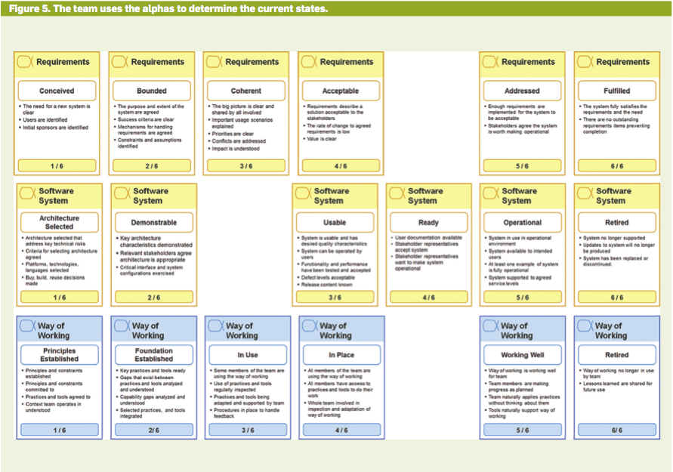
a small deck of cards in their pockets, which they can easily pull out to dis- cuss the current status of development and the work assignment and collabo- ration among team members. Teams can also discuss areas of improvement by referring to the cards. Thus, the ker- nel is not merely a heavyweight descrip- tion of what a team needs to do. Rather, it forms an essential part of what they are doing each day.
The kernel in action. The kernel has many applications in software profes- sionals’ everyday lives. They include:
˲ Running an iteration (or sprint).
˲ Running the entire development from idea to product.
˲ Scaling to large organizations and complex software-development en- deavors.
The first application, planning an iteration, is used here as an example of what a team can do with the kernel. The others are covered fully in The Es- sence of Software Engineering—Applying the SEMAT Kernel.6
The example presented here as- sumes that a company has very little
in the way of formal processes. In the past it has relied on having skilled and creative individuals on experienced teams, but the company is now grow- ing and has many new hires. These new employees, mostly fresh out of university, have good technical skills— for example, in programming lan- guages—but are less equipped in other aspects of software development, such as working with stakeholders to gain agreement on requirements.
This company has a development team that is responsible for making a mobile social-network application that lets users share and browse ideas, pho- tos, and comments. The team began with only two developers, Smith (the team leader) and Tom, both of whom are familiar with the kernel. They are later joined by two more developers, Dick and Harriet, who are new to the job and have no previous knowledge of the kernel. Success to team leader Smith means more than functionality, schedule, and quality. This team ran development iteratively. You can think of planning an iteration as follows:
1. Determine where you are: Work out the current state of the endeavor.
2. Determine where to go: Decide what to emphasize next and what the objectives of the next iteration will be.
3. Determine how to get there: Agree on the tasks the team needs to do to achieve the objectives.
^{Determine Where the team}
^{is using the Kernel}
Let’s assume that Smith and his team are six weeks into development. They have provided an early demonstration of the system to their stakeholders, who are pleased and provide valuable feedback. The system is not yet usable by end users, however. You can use the kernel to do this in a number of ways. If you are using alpha state cards, then you can do a walk-through as follows:
1. Lay out the cards for each alpha in a row on a table with the first state on the left and the final state on the right.
2. Walk through each state and ask your team if you have achieved that state.
3. If the state is achieved, move that

Slide 6
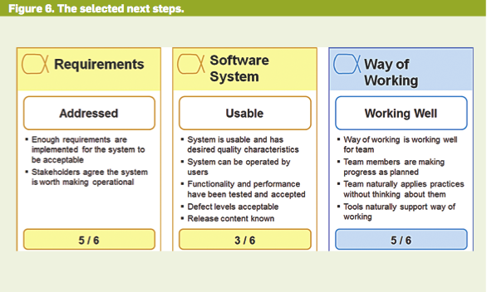
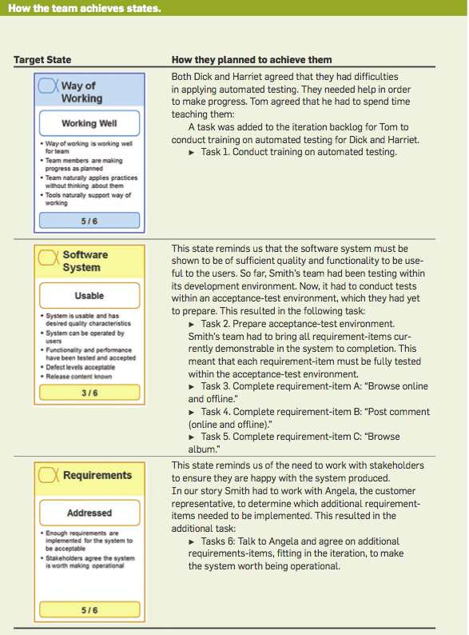
state card to the left. Continue with the next card until you get to the state that your team has not yet achieved.
4. Move this state card and the rest of the pending state cards to the right.
Figure 5 shows the states Smith’s team has achieved on the left, and those not yet achieved on the right. For simplicity, Figure 5 shows only three of the kernel alphas.
Determine where to go with the kernel. Once the team agrees on the current alpha states, the members discuss what the next desired “target” states are to guide their planning. The team agrees to use the immediate next alpha states to help establish the ob- jectives of the next iteration, as shown in Figure 6.
The name of the alpha state sup- plies a hint to understanding what needs to be achieved to reach a state. Team members can find out more by reading and understanding the alpha- state checklist. By going through the states one by one for each alpha, a team quickly becomes familiar with what is required to achieve each state. In this way the team learns about the kernel alphas at the same time as they deter- mine their current state of develop- ment and their next target states.
Determine how to get there with the kernel. Smith and his team look at the next target states and agree that they need to establish some priorities. First, they need to determine their way of working: working well; then the software system: usable; and finally re- quirements: addressed. The reason is simple; not having the way of work- ing: working well would impede their attempts to get the software system: usable. In addition, they agree on the priority for the missing requirement- items necessary to achieve the require- ments: addressed state.
Smith and his team next discuss what needs to be done to achieve these states, as shown in the accompanying table. By going through the target al- pha states, Smith is able to determine a set of objectives and tasks for the next iteration.
How the kernel helps in planning iterations. A good plan must be inclu- sive, meaning that it includes all essen- tial items and covers the whole team. It must also be concrete, so it is actionable for the team. The team must also have

Slide 7
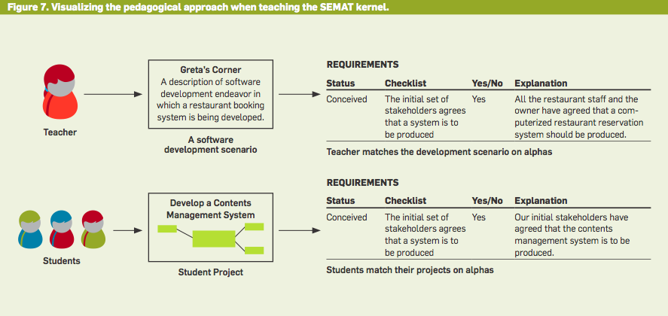
a way to monitor its progress against the plan. The kernel helps you achieve this as follows:
Inclusive. The kernel alphas serve as reminders across the different dimen- sions of software development, help- ing create a plan that addresses all di- mensions in a balanced way.
Concrete. The checklists for each al- pha state hint at what you need to do in the iteration. The same checklists help determine your progress by making clear what you have done and compar- ing this with what you intended to do.
^{the Kernel in the Real World}
Although the ideas presented here will be new to many of you, they have al- ready been successfully applied in the real world by both industry and aca- demia. In all cases they used the kernel and practices developed by Ivar Jacob- son International.1,10 Early adopters of the kernel idea include:
˲ MunichRe, the world’s leading re- insurance company, where a family of “collaboration models” has been as- sembled to cover the whole spectrum of software and application work. Four collaboration models—exploratory, standard, maintenance, and support— have been built on the same kernel from the same set of 12 practices.
˲ Fujitsu Services, where the Apt Toolkit has been built on top of an ear- ly version of the software-engineering kernel, including both agile and water- fall ways of working.1
˲ A major Japanese consumer elec- tronics company, where the software processes have been defined on top of an early version of the kernel, helping teams apply new practices and manage an offshore development vendor.
˲ KPN, where a kernel-based process was adopted by more than 300 projects across 13 programs as part of a move to iterative development. The kernel also provided the basis for a new results- focused QA process, which could be applied to all projects regardless of the method or practices used.
˲ A major U.K. government depart- ment, where a kernel-based agile toolset was introduced to enable dis- ciplined agility and the tracking of project progress and health in a prac- tice-independent fashion.
The kernel is already being used in first- and second-year software-engi- neering courses at KTH Royal Institute of Technology in Sweden. After stu- dents in the first-year courses conduct- ed their projects, they went through the SEMAT alphas and matched them to their project results, under the direc- tion of Anders Sjögren. The students had the opportunity to acquaint them- selves with and evaluate the alphas and gain insight into the project’s progress and health. In the second-year courses, run by Mira Kajko-Mattsson, the stu- dents were asked to use the SEMAT ker- nel when running their projects along with the development method they followed. As shown in Figure 7, Kajko-
Mattsson created a software-develop- ment scenario and evaluated it for each alpha, its states, and the state checklist items. The students were then asked to do the same when conducting and evaluating their projects.
The experiences of these courses provided valuable lessons. For exam- ple, the kernel assures that all the es- sential aspects of software engineering are considered in a project. By match- ing the project results against the ker- nel alphas, the students could easily identify the good and bad sides of their development methods. The kernel also prepared students for future software- engineering endeavors with minimal teaching effort. By following all the ker- nel alphas, the students could learn the total scope of the software-engineering endeavor and thereby see what would be required of them in their future as professionals.
How the kernel relates to agile and others. The kernel can be used with all the popular management and techni- cal practices, including Scrum, Kan- ban, risk-driven iterative, waterfall, use-case-driven development, accep- tance-test-driven development, con- tinuous integration, and test-driven development. It will help teams em- barking on the development of new and innovative software products and those involved in enhancing and main- taining established software products. It will help all sizes of teams from one- man bands to 1,000-strong software-

Slide 8
^{engineering programs.} For example, the kernel supports
the values of the Agile Manifesto. With its focus on checklists and results, and its inherent practice independence, it values individuals and interactions over processes and tools. With its focus on the needs of professional software- development teams, it values the way of working and fulfilling team respon- sibilities over methods.
The kernel does not in any way com- pete with existing methods, be they agile or anything else. On the contrary, the kernel is agnostic to a team’s cho- sen method. Even if a team is already using a particular method, the kernel can still help. Regardless of the meth- od used, as Robert Martin pointed out in his foreword to The Essence of Soft- ware Engineering, projects—even agile ones—can get out of kilter, and when they do, teams need to know more. This is where the real value of the ker- nel lies. It can guide a team in the ac- tions they need to take to get back on course, to extend their method, or to address a critical gap in their way of working. It focuses on the needs of the software professional and values the “use of methods” over “the description of method definitions” (as has been normal in the past).
The kernel does not just support modern best practices; it also recogniz- es that a vast amount of software is al- ready developed and needs to be main- tained. It will live for decades and will have to be maintained in an efficient way. This means the way you work with this software will have to evolve along- side the software itself. New practices will need to be introduced in a way that complements the ones already in use. The kernel provides the mecha- nisms to migrate legacy methods from monolithic waterfall approaches to more modern agile ones and beyond, in an evolutionary way. It allows you to change your legacy methods practice- by-practice, while maintaining and im- proving the teams’ ability to deliver.
How the kernel will help you. Use of the kernel has many benefits for ex- perienced or aspiring software profes- sionals, and for the teams they work in. For example, it helps you assess the progress and health of software- development endeavors, evaluate cur- rent practices, and improve your way
of working. It also helps you improve communication, move more easily be- tween teams, and adopt new ideas. It will help the industry as a whole by im- proving interoperability among teams, suppliers, and development organiza- tions.
By providing a practice-indepen- dent foundation for the definition of software methods, the kernel also has the power completely to transform the way that methods are defined and prac- tices are shared. For example, by allow- ing teams to mix and match practices from different sources to build and im- prove their way of working, the kernel addresses two of the key methodologi- cal problems facing the industry:
˲ Teams are no longer trapped by their methods; they can continuously improve their way of working by adding or removing practices when the situa- tion demands.
˲ Methodologists no longer need to waste time describing complete meth- ods; they can easily describe their new ideas in a concise and reusable way.
Finally, the kernel benefits aca- demia. The kernel provides a basis for the creation of foundation courses in software engineering that can then be complemented with additional cours- es in specific practices—either as part of the initial educational curriculum or later during the student’s professional development. Equally as important is the kernel’s ability to act as a shared reference model and enabler for fur- ther research and experimentation.
The SEmAT initiative. Dr. Dobb’s Journal, (2009). 5. Jacobson, I., meyer, B. and Soley, R. The SEmAT vision
^{statement, (2009).} 6. Jacobson, I., Pan-Wei Ng, mcmahon, P., Spence,
I. and Lidman S. The Essence of Software Engineering—Applying the SEMAT Kernel. Addison- Wesley. (Forthcoming in Jan. 2013 but available in a prepublication version on safaribooksonline.com.)
7. Jacobson, I., Pan-Wei Ng and Spence, I. Enough of process—let’s do practices. Journal of Object Technology 6, 6 (2007), 41-67.
8. Jacobson, I. and Spence, I. Why we need a theory for software engineering. Dr. Dobb’s Journal, (2009). 9. Object management group (Omg). RFP: A foundation for the Agile creation and enactment of software
^{engineering methods, (2012).} 10. Pan-Wei Ng and magee, m. Lightweight application
lifecycle management using state cards. Agile Journal (Oct. 2010)
Ivar Jacobson, the chairman of Ivar Jacobson International, is a father of components and component architecture, use cases, the Unified modeling Language, and the Rational Unified Process. He has contributed to modern business modeling and aspect-oriented software development.
Pan-Wei ng coaches large-scale systems development involving many millions of lines of code and hundreds
of people per release, helping them transition to a lean and agile way of working, not forgetting to improve their code and architecture and to test through use cases and aspects. He is the coauthor, with Ivar Jacobson, of Aspect- oriented Software Development with Use Cases.
Paul McMahon is an independent consultant focusing on coaching project managers, team leaders, and software professionals in the practical use of lean and agile techniques in constrained environments. He has been a leader in the SEmAT initiative since its inception.
Ian Spence is CTO at Ivar Jacobson International and the team leader for the development of the SEmAT kernel. He has introduced hundreds of projects to iterative and agile practices as well as led numerous successful large- scale transformation projects working with development organizations of up to 5,000 people.
Svante Lidman has extensive experience building high- performance enterprise software-development teams.
He has held positions at Hansoft AB, Ivar Jacobson International, microsoft, Rational Software, Objectory, among others. Since mid-2010 Lidman was the leading change agent in the largest lean/agile transition ever done in Scandinavia.
^{practice}
￼￼
Related articles on queue.acm.org
^{There’s no Such Thing}
^{as a Free (Software) Lunch}
Jay Michaelson http://queue.acm.org/detail.cfm?id=1005066
^{Purpose-Built Languages}
^{Mike Shapiro}
http://queue.acm.org/detail.cfm?id=1508217
^{Open Source to the Core}
^{Jordan Hubbard}
http://queue.acm.org/detail.cfm?id=1005064
^{References}
1. Azoff, m. Apt methods and Tools, Fujitsu. Ovum Technology Report. Reference Code O100032-002 (Jan. 2011).
2. Fujitsu, Ivar Jacobson International AB, model driven Solutions. Essence—kernel and language for software engineering. Initial submission, 2012, version 1.0.
3. Jacobson, I. and meyer, B. methods need theory. Dr. Dobb’s Journal,(2009).
4. Jacobson, I., meyer, B. and Soley, R. Call for action:

